Slide 1
Data bounty
Konrad Eilers
Email: eilerskonrad1@gmail.com

Slide 2
Data Bounty Summary
Summary
Historical Information
Algorithm Proposal
Benefits
Agriculture is extremely important for Madhya Pradesh to alleviate the population out of poverty
This analysis shows that the crop yields for the most important crops, soya beans and wheat, demonstrate high variability across states and years. This makes it difficult for farmers in Madhya Pradesh to plan ahead and make informed planting decisions. Research shows that this can have devastating effects on food security and thus poverty alleviation.
I propose to implement a scalable, accurate, and inexpensive prediction method to generate information on crop yield several months before harvest based of on You, L. et al. (2017)
This brings significant benefits, not just an early warning system and well-planned government help in case of crisis, but also an improvement to the effectiveness of irrigation projects as well as the efficiency of the procurement system e-Uparajan by including future price forecasts.
Source: You, L. et al. (2017) Deep Gaussian Process for Crop Yield Prediction Based on Remote Sensing Data. https://cs.stanford.edu/~ermon/papers/cropyield_AAAI17.pdf

Slide 3
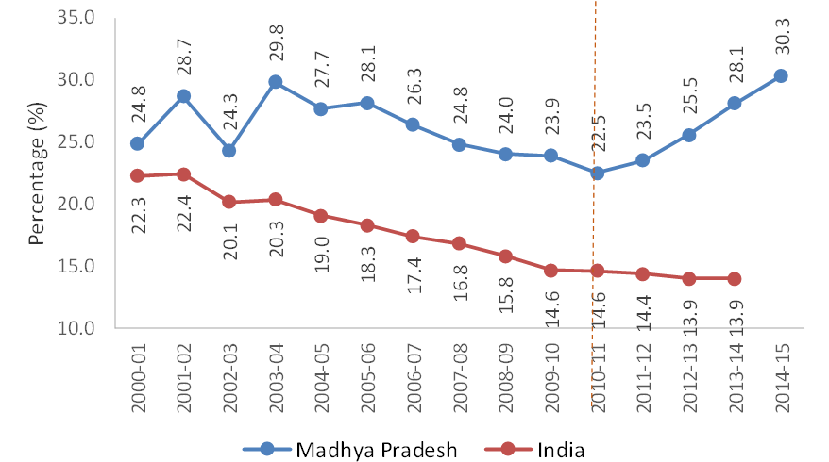
Agricultural Pattern I
Summary
Historical Information
Algorithm Proposal
Benefits
Madhya Pradesh (MP) outperforms India in Share of Agriculture in Total GDP
Around 71.3% of the population (in comparison to national average 68.8%) lives in rural areas making MP a rural economy
Agricultural growth rates play a key role in faster alleviation out of poverty
In a rural economy such as MP, agriculture is extremely important
Source: Gulati, A., Rajkhowa, P. & Sharma, P. Making Rapid Strides-Agriculture in Madhya Pradesh: Sources, Drivers, and Policy Lessons; Working Paper 339 (https://think-asia.org/handle/11540/7030). Part of Dimitra Bounty Phase 1 datasets.

Slide 4
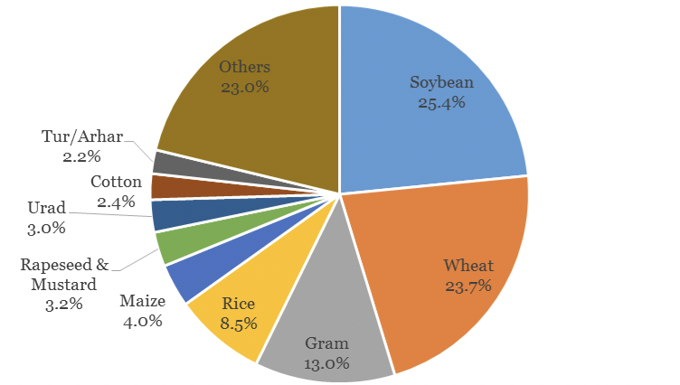
Agricultural Pattern II
Summary
Historical Information
Algorithm Proposal
Benefits
The cropping pattern (chart right) demonstrates that 62% of its gross cropped area (GCA) devoted to food grains and 32% to oilseeds
Wheat is the major crop grown during the rabi season and it is intercropped with gram while in the Kharif season, MP mostly grows oilseeds, specifically soybean
How stable are the crop yields from the most important crops?
Source: Gulati, A., Rajkhowa, P. & Sharma, P. Making Rapid Strides-Agriculture in Madhya Pradesh: Sources, Drivers, and Policy Lessons; Working Paper 339 (https://think-asia.org/handle/11540/7030). Part of Dimitra Bounty Phase 1 datasets.

Slide 5
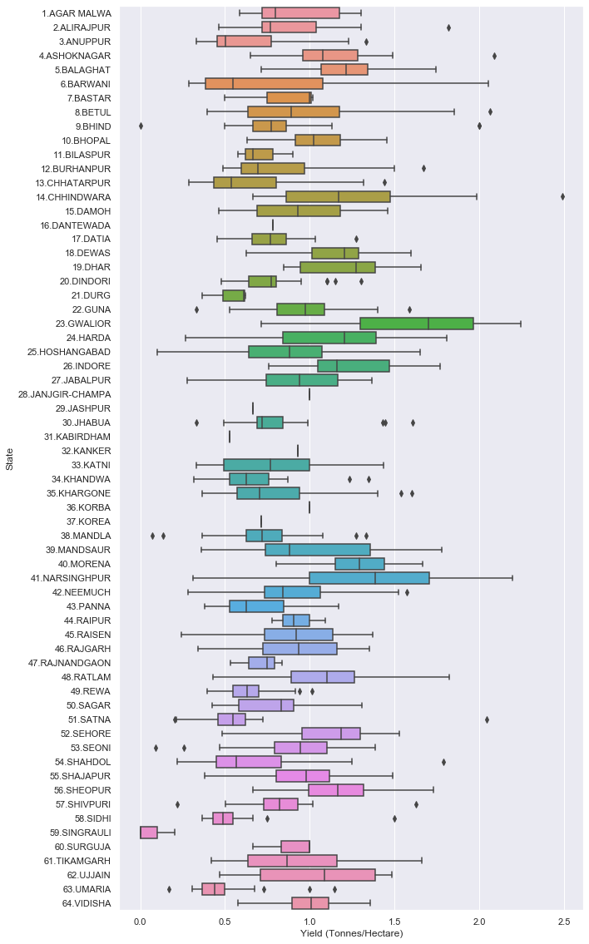
How stable is the crop Yield for Soya Beans?
Summary
Historical Information
Algorithm Proposal
Benefits
The chart on the right demonstrates the distribution of crop yields across the different states and across all years on record for soya beans
Soyabeans are only harvested in the season Kharif
The chart demonstrates two results
There is significant variability across regions. Given the different road patterns, soil patterns and weather patterns in the different states, this is expected!
There is significant variability within the region – This is surprising! Different years (same season) result in significant swings in crop yields
This makes planning difficult for farmers in MP!
Source: Part of Dimitra Bounty Phase 1 datasets. Dataset covers distribution in the years 1997-2020.

Slide 6
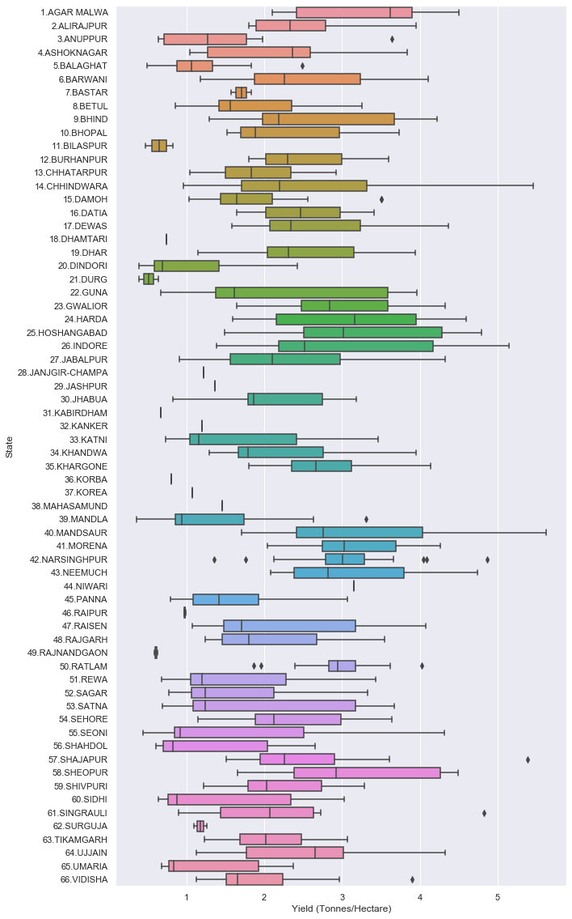
How stable is the crop Yield for Wheat?
Summary
Historical Information
Algorithm Proposal
Benefits
The chart on the right demonstrates the distribution of crop yields across the different states and across all years on record for Wheat
Wheat are only harvested in the season Rabi
The chart demonstrates two results (the same result):
There is significant variability across regions. Given the different road patterns, soil patterns and weather patterns in the different states, this is expected!
There is significant variability within the region – This is surprising! Different years (same season) result in significant swings in crop yields
This makes planning difficult for farmers in MP!
Source: Part of Dimitra Bounty Phase 1 datasets. Dataset covers distribution in the years 1997-2020.

Slide 7
Results of Exploratory analysis
Summary
Historical Information
Algorithm Proposal
Benefits
For the most important crops, soya beans and wheat, there is significant variability between states and within a state over time
This results in a farmer not being able to plan well. However, developing a crop plan is key to a successful harvest.
“A central challenge of addressing food security issues is yield estimation, namely being able to accurately predict crop yields well before harvest.” (You et al., 2017)
How to solve this issue? I am proposing a crop yield prediction algorithm to address this important problem.
Source: You, L. et al. (2017) Deep Gaussian Process for Crop Yield Prediction Based on Remote Sensing Data. https://cs.stanford.edu/~ermon/papers/cropyield_AAAI17.pdf

Slide 8
Algorithmic Approach I
Summary
Historical Information
Algorithm Proposal
Benefits
Color scale corresponds to numeric values (blue: low pred. crop yield; red: high pred. crop yield)
Using the deep learning architecture proposed by You, L. et al. (2017), I am proposing to generate low-level crop yield predictions
The proposed algorithm produces scalable, accurate, and inexpensive prediction methods to generate information on crop yield several months before harvest
Source: You, L. et al. (2017) Deep Gaussian Process for Crop Yield Prediction Based on Remote Sensing Data. https://cs.stanford.edu/~ermon/papers/cropyield_AAAI17.pdf
Imagery taken from: http://sustain.stanford.edu/crop-yield-analysis

Slide 9
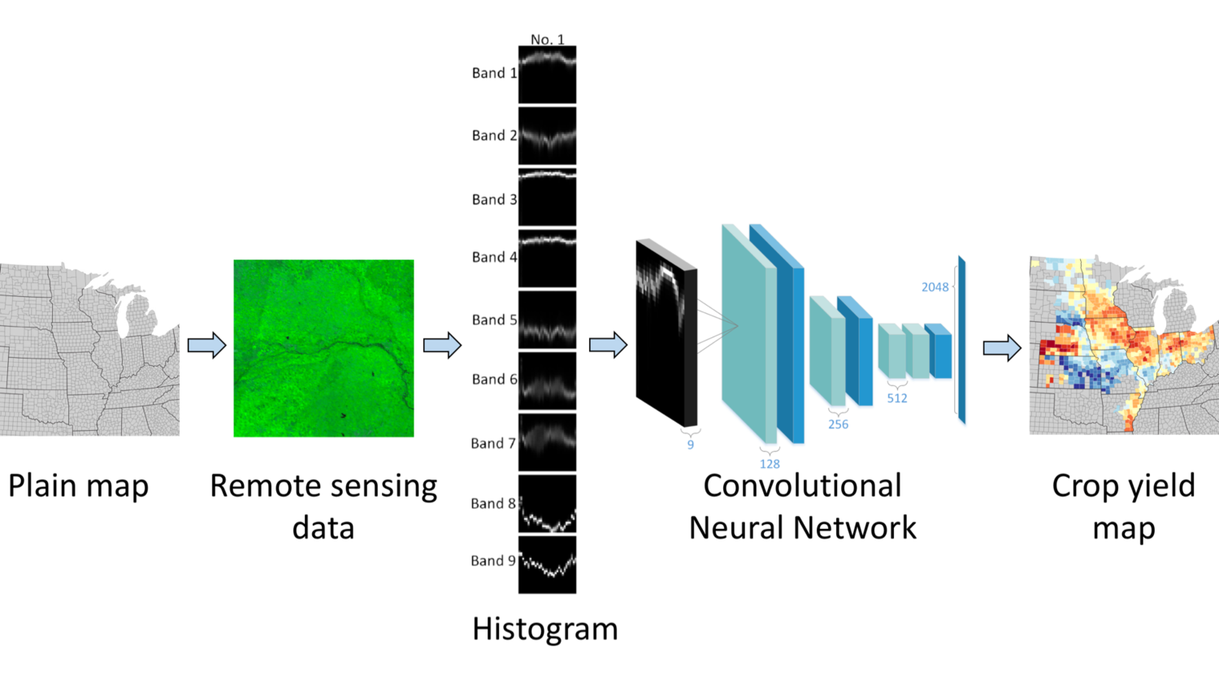
Algorithmic Approach II
Summary
Historical Information
Algorithm Proposal
Benefits
Plug-and-play architecture that can be enriched with data as part of Dimitra 1 data release
Remote sensing data can be enriched with soil data & detailed weather data to improve predictions
Architecture relies on deep learning by relying on proven concepts such as Deep Gaussian Processes and Convolutional Neural Networks.
Source: You, L. et al. (2017) Deep Gaussian Process for Crop Yield Prediction Based on Remote Sensing Data. https://cs.stanford.edu/~ermon/papers/cropyield_AAAI17.pdf
Imagery taken from: http://sustain.stanford.edu/crop-yield-analysis

Slide 10




Benefits
Summary
Historical Information
Algorithm Proposal
Benefits
Based on the forecast, the Madhya Pradesh government could implement important short term and long-term measures to alleviate people out of poverty
An early warning system (either using app / news papers / etc.) allows farmers to take action accordingly and plan responsibly.
Long-term irrigation projects have proved successful (see source, page. ii). If the forecast predicts poor crop yield in the coming months, government can increase support for irrigation via funding or short-term water support
The strong procurement system e-Uparajan that MP has put in place can take the forecasts into account. Given the forecasting algorithm, future crop yields can dynamically be taken into account into the procurement system which improves the planning horizon for all market participants.
Government and international aid can be planned and allocated effectively according to the forecasting algorithm in case of crisis
Source: Gulati, A., Rajkhowa, P. & Sharma, P. Making Rapid Strides-Agriculture in Madhya Pradesh: Sources, Drivers, and Policy Lessons; Working Paper 339 (https://think-asia.org/handle/11540/7030). Part of Dimitra Bounty Phase 1 datasets.

