Slide 1
95%
of people with ALS lose the ability to speak
Ball et al., in Beukelman, Fager & Nordness (2011)
Notes:
95% of people with ALS lose the ability to speak (Ball et al., cited in Beukelman, Fager & Nordness 2011).

Slide 2
ALEX, BY THE END OF ONE SCHOOL DAY
165 → 118
words a minute, as his voice tires
Notes:
Alex’s speaking rate fell from 165 to 118 words a minute over one school day. Dr. Suraj Tandon: “The more he speaks, the more his voice fatigues, and the less he is able to speak in the future.”

Slide 3
TODAY’S TOOLS FAIL THEM
20×
slower than talking
$20,083
for one eye-gaze device
92%
rely on unpaid caregivers
Google SpeakFaster · Ontario ADP (2025) · ALS Canada (2026)
Notes:
Eye-gaze typing runs 8–10 words a minute vs about 180 spoken (Google Research, SpeakFaster). One eye-gaze device costs $20,083 (Ontario ADP price list, 2025). 92% of people with ALS rely on unpaid caregivers (ALS Canada, 2026).

Slide 4
Mouth a word. Your voice speaks.
01
Mouth it silently
02
AirPods feel your jaw move
03
Spoken in your own voice
Notes:
Mouth a word silently. AirPods Pro 2 motion sensors pick up the jaw movement. A model trained on your own movements recognizes it, and ElevenLabs speaks it in your own cloned voice. No camera, no microphone.

Slide 5
THE COST
EYE-GAZE DEVICE
LOUVOICE, FIRST YEAR
$20,083
~$389
AirPods people already own, plus their own voice.
Ontario ADP (2025) · AirPods Pro $329 + $4.99/month
Notes:
Eye-gaze speech device: $20,083 (Ontario ADP 2025, Tobii Dynavox I-16). LouVoice first year: AirPods Pro $329 plus $4.99 a month, about $389.

Slide 6
EARLY PROOF
71%
45/45
word accuracy · 12 words
demo sentences right
“Very, very viable.”
DR. SURAJ TANDON · PALLIATIVE CARE & INTERNAL MEDICINE
Notes:
71% word accuracy on held-out quiz takes across 12 words (guessing is 8%). Demo mode chose the right sentence 45 of 45 times between two trained sentences. 754 real AirPods takes. Dr. Suraj Tandon: “Very, very viable.” ALS Canada representatives: “Absolutely fantastic … incredibly thoughtful.”

Slide 7
BIOHACKS 2026
Built this weekend with
ElevenLabs
Tiger Data
Vultr
GoDaddy Registry
Entire
Notes:
LouVoice was built this weekend with ElevenLabs, Tiger Data, Vultr, GoDaddy Registry and Entire.

Slide 8
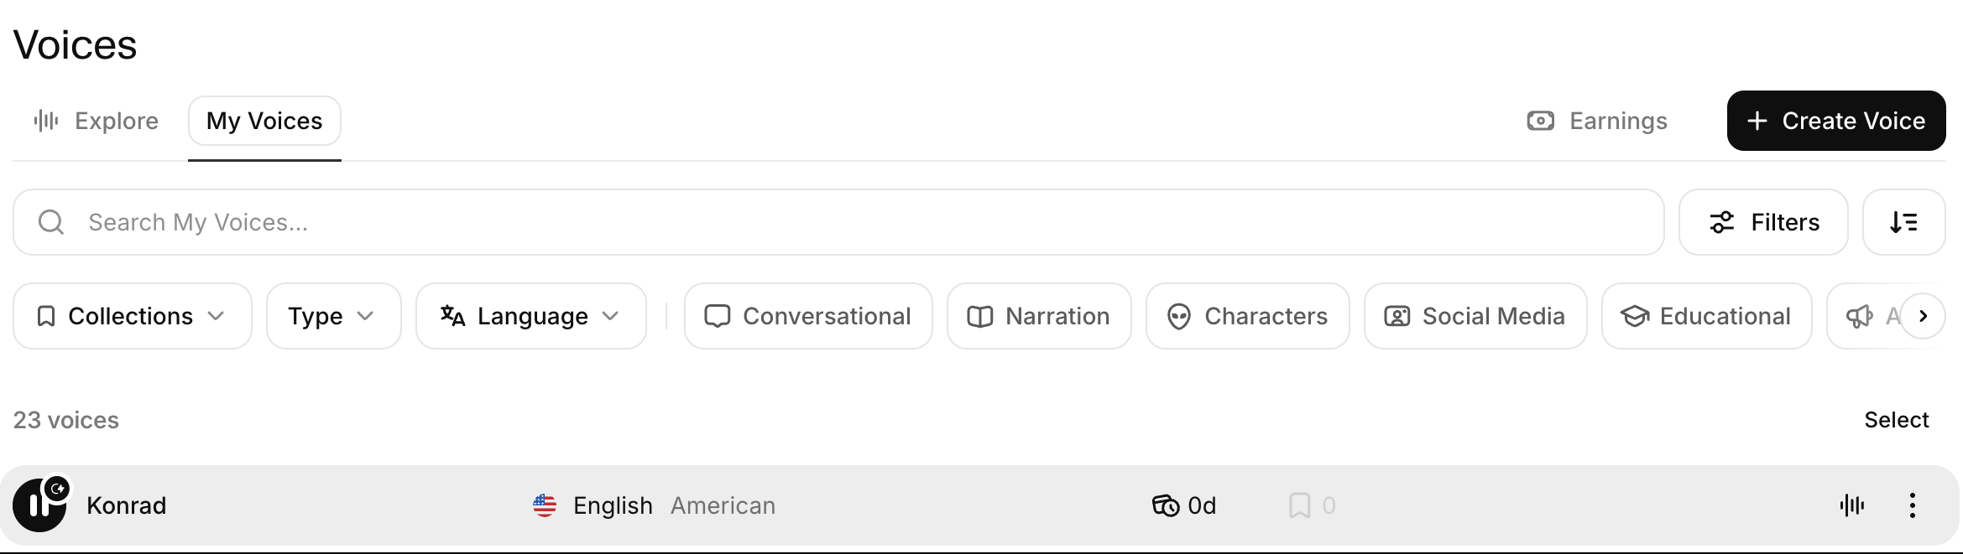
BUILT WITH ELEVENLABS
Every word, in their own voice
Notes:
ElevenLabs: a voice clone made from the user’s own recordings speaks every recognized word. Audio is cached on the Mac, so repeats play instantly, even offline. The API key lives in the macOS Keychain.

Slide 9
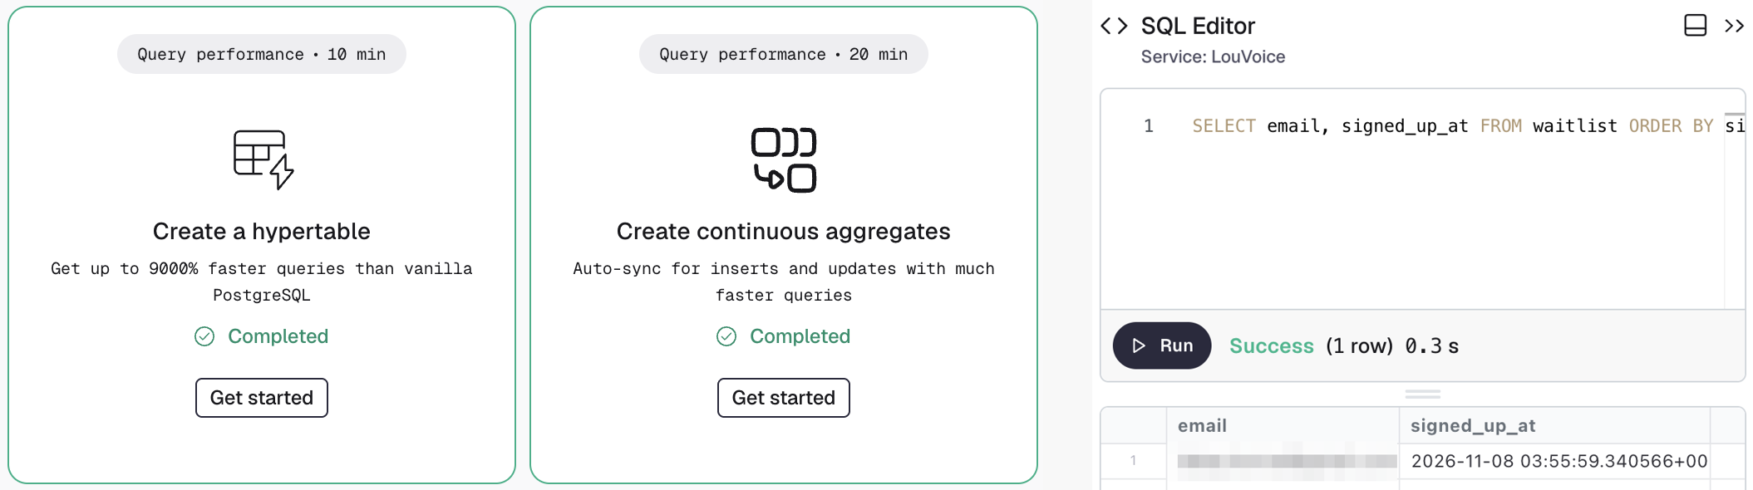
BUILT WITH TIGER DATA
Every attempt, tracked for months
Notes:
Tiger Data: every attempt goes into the word_attempts hypertable; the word_weekly continuous aggregate turns it into weekly progress for caregivers. Waitlist signups from louvoice.health are stored here too.

Slide 10
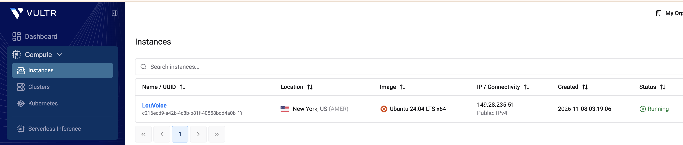
BUILT WITH VULTR
Per-user models on Vultr GPUs
01
Mouth each word 4 times
02
Vultr Cloud GPU retrains the model
03
Your model, back on the Mac
Also hosts louvoice.health
Notes:
Vultr: each user mouths every word 4 times; a Vultr Cloud GPU fine-tunes the whole network for them in PyTorch, and the tuned model comes back to the Mac so recognition runs offline. Vultr also hosts louvoice.health and its API.

Slide 11
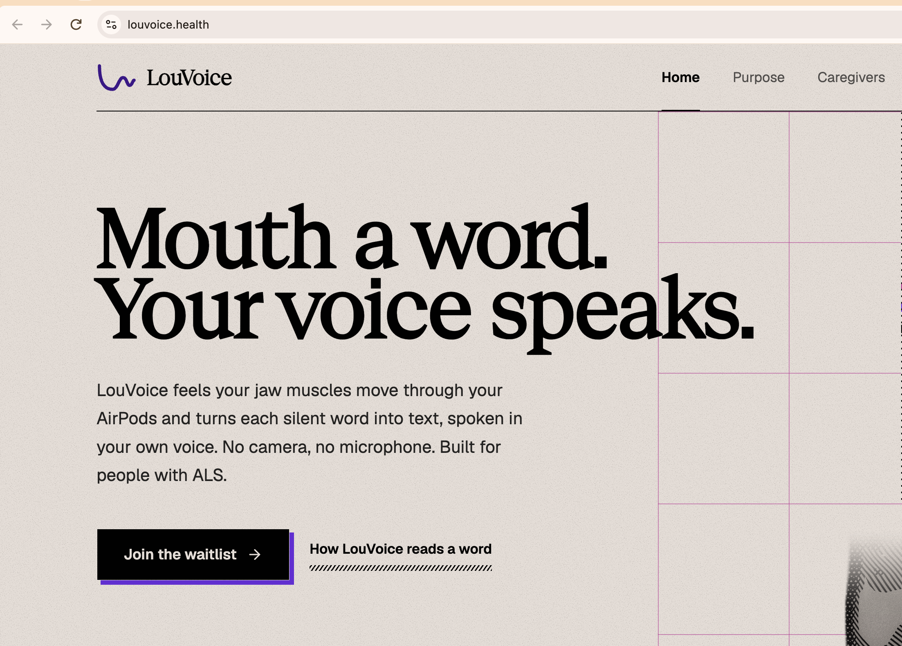
BUILT WITH GODADDY REGISTRY
A domain that says health
.health
Notes:
GoDaddy Registry: louvoice.health, through the .health offer. DNS points at our Vultr server; families and clinics join the waitlist there today.

Slide 12
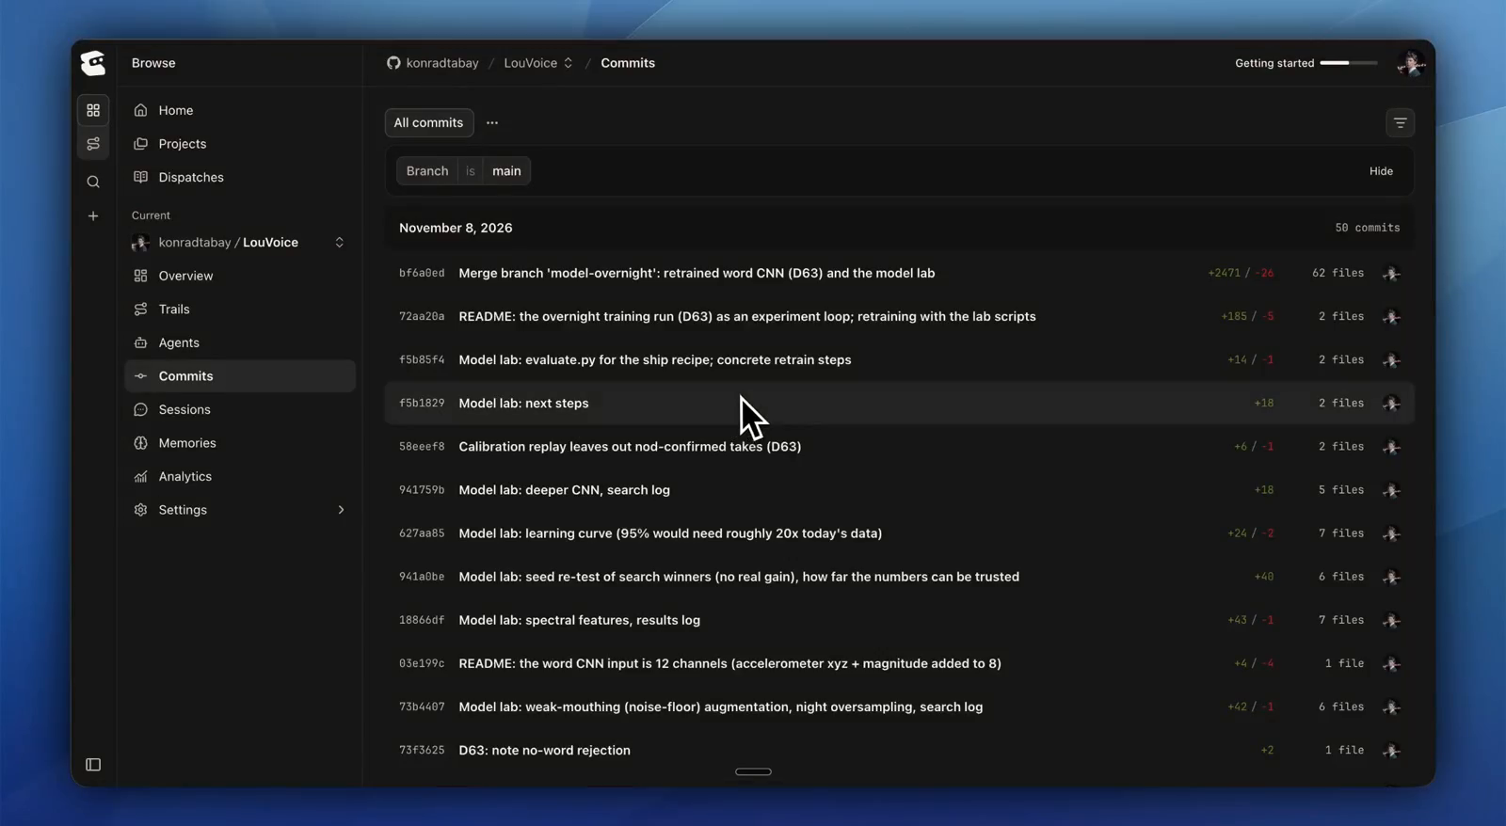
BUILT WITH ENTIRE
Every AI change, traceable
52
checkpoints this weekend
Notes:
Entire: hooks capture every Claude Code session on our repo as a checkpoint, stored as git refs next to our commits. 52 checkpoints this weekend.

Slide 13
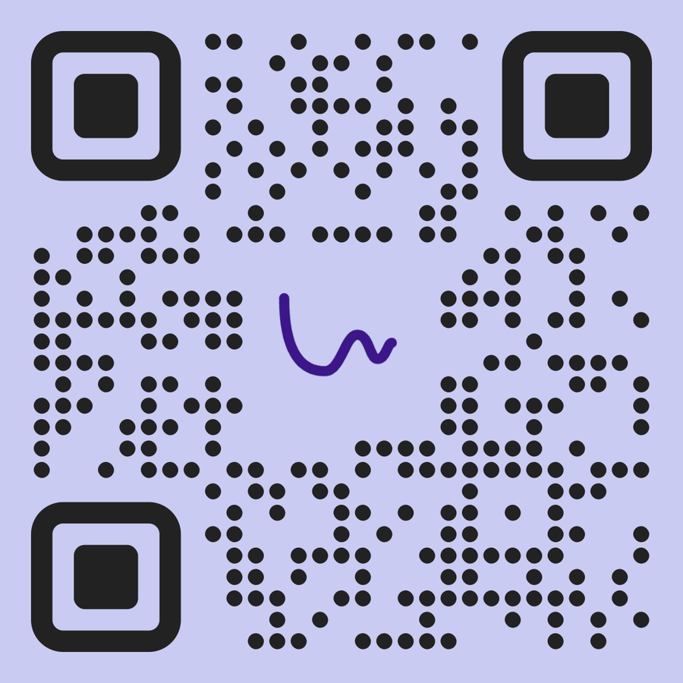
NEXT: ALS CLINICS, THEN THE ICU
Scan to join the waitlist
louvoice.health
Notes:
Next: clinical pilots in ALS clinics across Canada, then non-verbal ER and ICU patients. Scan to join the waitlist.

