Slide 1

People Counter
Service Manual

Slide 2
Why do my customer counter not work?
Is the Transmitter turned on
Is the Transmitter set up correctly
Do the Sensor on the Transmitter need to be corrected
Is the Receiver turned on
Is the Receiver set up correctly
Is the Receiver connected correctly to the POS
On the next slides you will find instructions how to test above issues. If you cannot solve above issues yourself – contact Regional manager
Are your figures not shown in Power BI – create IT ticket

Slide 3
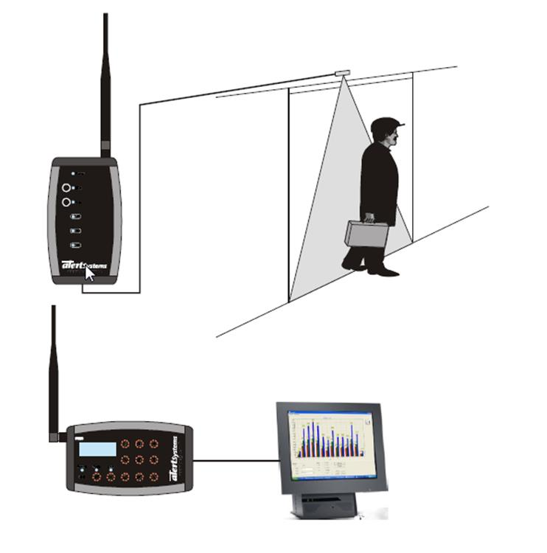
Hardware
1
The counter contains 2 pieces of hardware
  The Transmitter above the entrance
  The Receiver attached to the MPOS at the counter
2

Slide 4
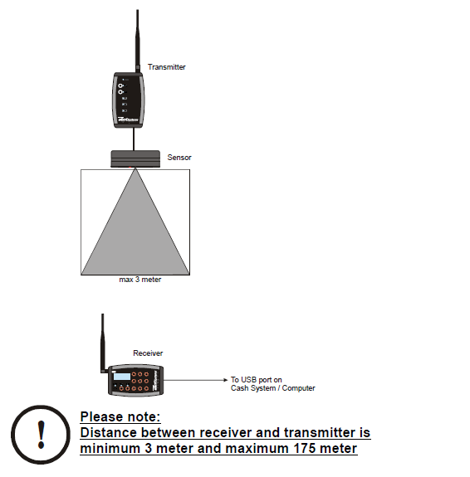
Placement in store
Entrence
Counter

Slide 5
Placement in store
The sensor on the receiver have a reach on 3 meters as shown on the picture

Slide 6
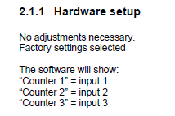
Hardware set up

Slide 7
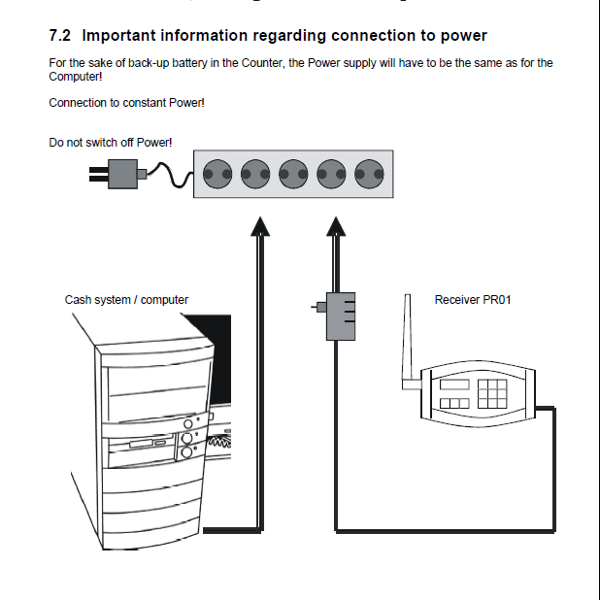
Hardware set up

Slide 8
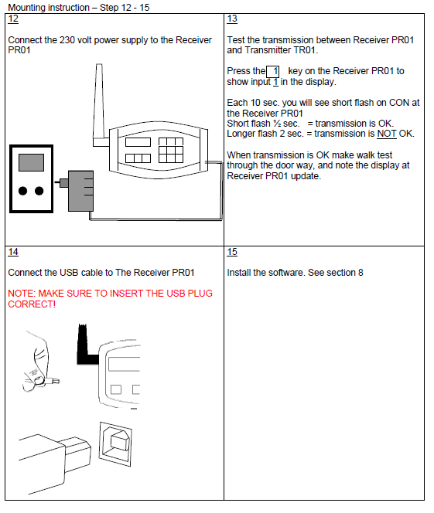
Mounting receiver to POS

Slide 9
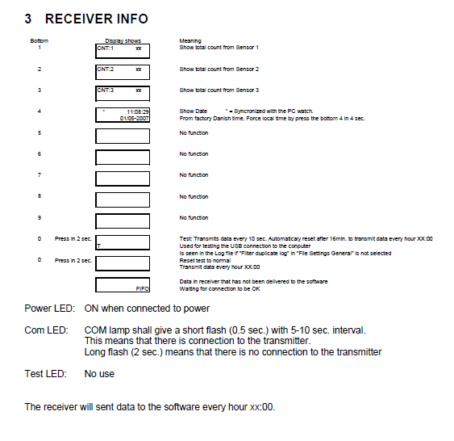
Receiver info

Slide 10
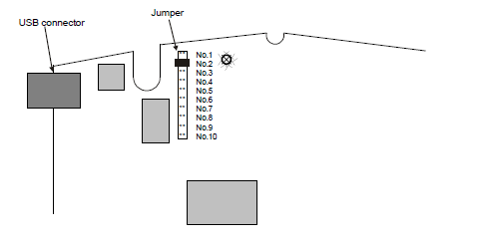
Receiver info
Make sure the jumper is on No. 2

Slide 11
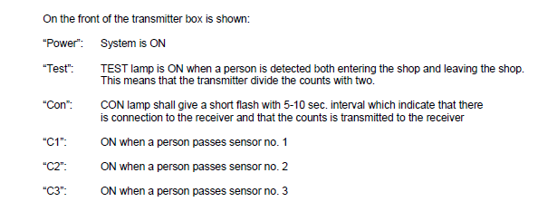
Transmitter info

Slide 12
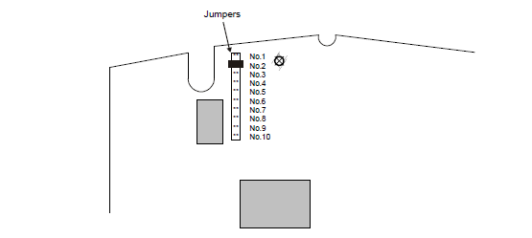
Transmitter info
Make sure the jumper is on No. 2

Slide 13
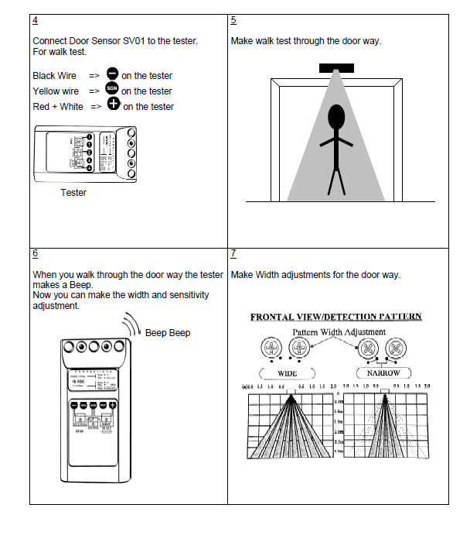
How to adjust and test the sensor

Slide 14
Large Entrance
If you entrance is wider then 3 meters. You need 2 sensors.
Make sure you have the right amount of sensors.

