Slide 1
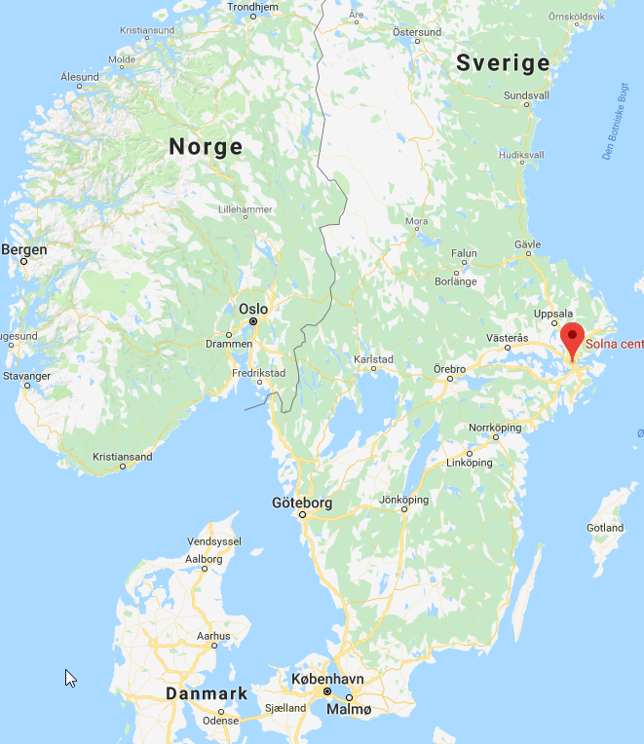

Farsta, Stockholm

Slide 2

IMPORTANT DATES
 | Original date | New date
Handover from Center to Handcrafts team | 11-03-2019
Product arrival date | ?
Handover to Retail | 04-04-2019
Opening date | 11-04-2019
Grand Opening Period | Until midsummer
2

Slide 3
CONTACT SHEET
 | Name | Phone | Skype | Mail
Project coordinator | Magdalena Turek | +48 42 236 15 90 |  | mt@changepoland.com
Local HQ | Katja Remme | 0045 2048 9975 | cos.katja.andersen | kre@change.com
HR | Helena Freudenthal | 0046 705883240 |  | hry@change.com
Sales Trainer | Erica Fridlund | 0046 70 031 77 56 |  | ef@change.com
Store Manager
Handcrafts team
Center Warehouse
Marketing
Ragn-sells | Josef Haddad | +46 709274893 |  | josef.haddad@ragnsells.com
3

Slide 4
PREPERATION
Staff
Recruit store manager | Helena
Recruit staff | Helena
Create store in Samesystem | Helena
Create employees in Samesystem | Helena
Change Academy login | Helena
POS login | Erica
GDPR walktroght + signing | Helena
Onboard Store Manager | Erica
Onboard staff | Erica
Create Budget | Erica
Create work scedule for store, prep and first weeks | Erica
Marketing
Marketing plan for opening period | Katja
Order Marketing materials for opening period | Katja
Marketing plan after opening | Erica ongoing
On Sight
Handover from Handcrafts team | Katja? and Erica
Check all orders has been shipped from warehouse | Project coordinator
Check all orders are recived in store | Erica
VM the store and make it ready for opening | Erica
Setup IT + TV | Erica
Inform vendors
Sami | Erica
Stimm | Erica
Svensk Handel | Erica
Payday | Erica
Electricity | Erica
Renovation | Erica
Loomis | Erica
Internet | Samir
Phone | Samir
Money handling
Buy safe | Erica
Buy Exchange Money (2000,-) | Erica
Order bags and paper for bank | Erica
4

Slide 5
PURCHASE
Purchase, Cleaning
Vacuumcleaner and bags | Erica Media Markt
Swab for the floor plus proper cleaning products for the woodenfloors | Erica Rusta /Clas O
Windowcleaner | Erica Rusta /Clas O
Windowwiper | Erica Rusta Clas O
Dusters | Erica Rusta /Clas O
Purchase, bathroom & Kitchen
Soap | Erica Rusta
Towels | Erica Ikea
Kithsentovels | Erica Ikea
Knifes, forkes, spoons | Erica Ikea
Coffemachine Water heater | Erica Rusta
Plates | Erica Ikea
Glasses | Erica Ikea
Cups | Erica Ikea
Garbage bags big | Erica Clas O
Toilet paper | Erica Rusta
Toilet cleaner | Erica Rusta
Dish washing | Erica Rusta
Purchase, office equipment
Tape | Erica Clas O
Stapler | Erica ClasO
A4 paper for printer and store | Erica Clas O
Calendar | Erica Clas O
Scissors | Erica Clas O
Carpenterknife | Erica Clas O
Pens | Erica Change Warehouse
Calculator Post-it Rubberbands First adi kit Fire extingusher | Erica Clas O
Dymo Price machine – ordered Clas O Tags to price machine- Ordered Clas O Fästpistol Fästen till pistol Kvittensblock | Erica
Purchase furniture
Backroom | Erica Ikea tis 13e
Relax area in store Ordered delivery 13th nov | Erica MIO tis 13e
5

Slide 6
Int HQ loose ends
Need final confirmation on Handover date
Can we split the deliveries in 2 as normal? Still need to final confirm the date
Check up on Internet and phone
Relaxing area – should we buy furniture locally?
Frontpage not filled out
6

