Slide 1

Power BI
Manual

Slide 2
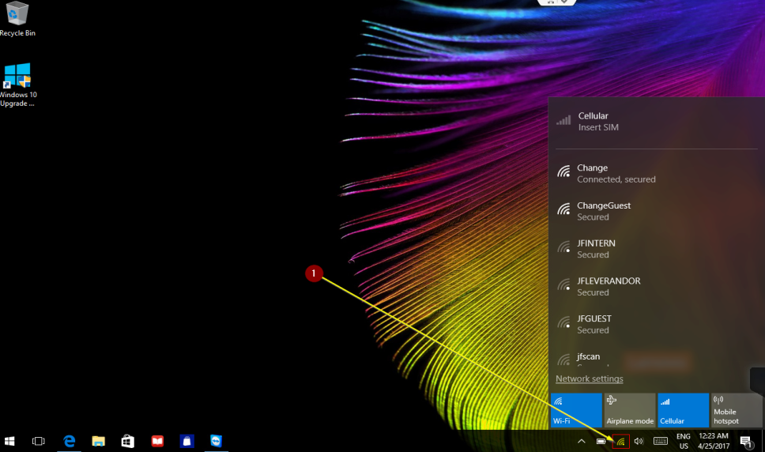
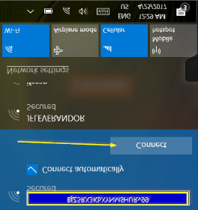
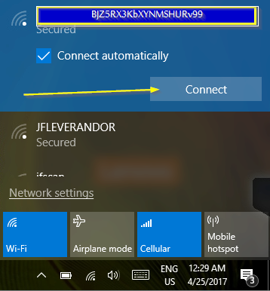
Start up the system
Press WiFi icon below right corner
Choose WiFi BJZ5RX3KbXYNMSHURv99
Tick off Connect automatically
Press Connect
Type in the Password
  AlL4Ch@nge
1
2
Now the Wi-Fi is established on the tablet (shows Connected).
3

