Slide 1

Team 2
Panagiotis Georgakis
Konstantina Paraskevi Katsanou
Giorgos Tzafilkos
Nikitas Voukelatos

Slide 2

Getting the Data Right
Identifying the variables of interest
Column corrections
Concatenation
Bad formats and typing
Normal operating conditions filtering
Isolating the inputs and outputs

Slide 3
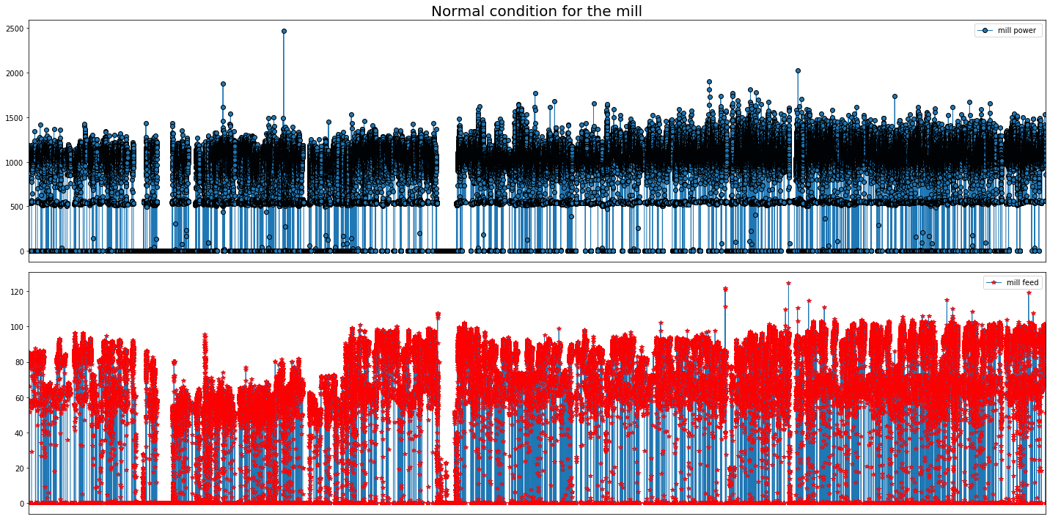
Defining normal operating conditions
Variables used: Mill operation Total feed Mill motor power
Raw Data - mill power, mill feed

Slide 4
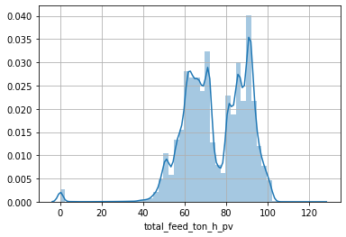
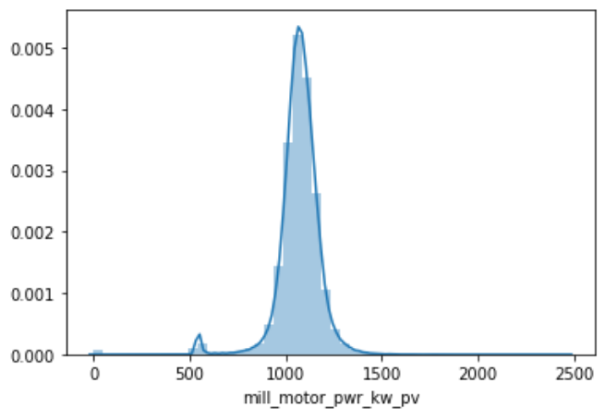
Distribution Plots
Applying the first filters

Slide 5
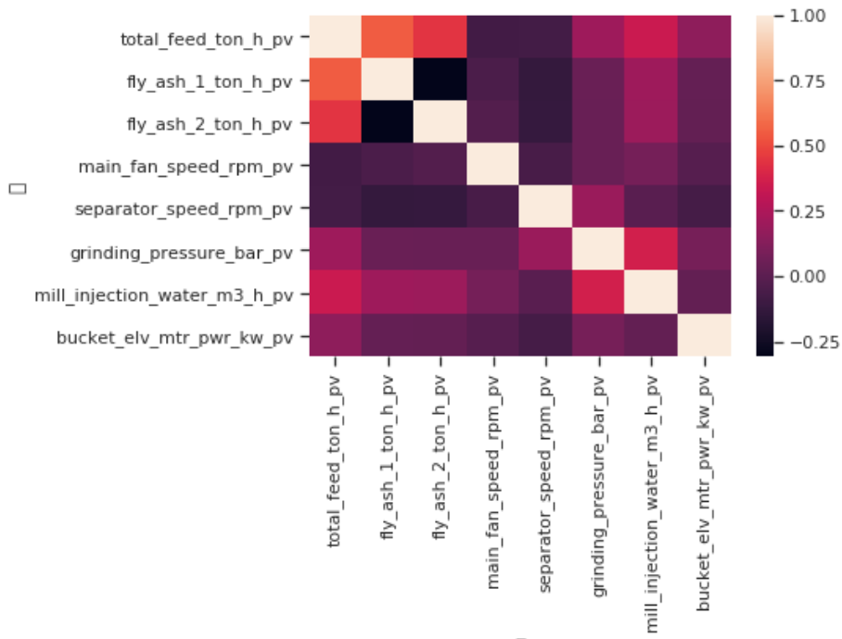
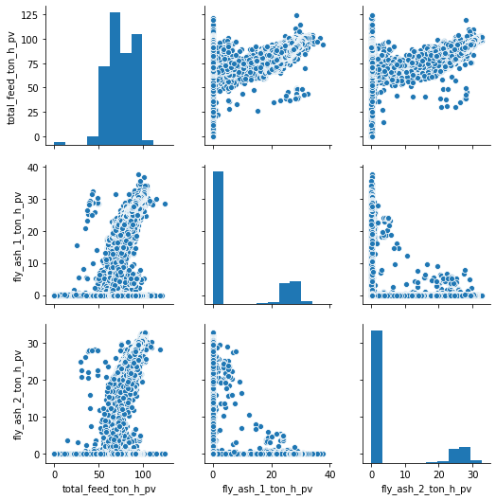
Correlations

Slide 6
Separate the data
Data set
80% DATA SET
20% DATA SET
Train set
Test Set
ADDITIONAL CLEANING
NO FURTHER CLEANING

Slide 7
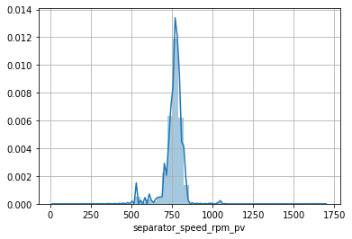
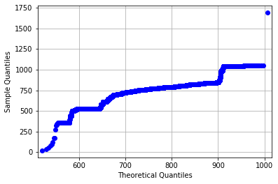
Creating new filters into our train set
Use of QQplots and distribution plots to determine outliers.

Slide 8
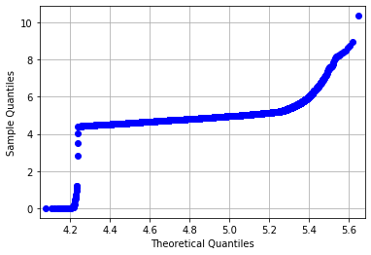
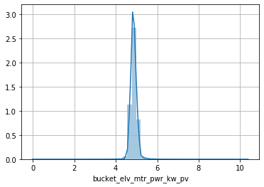
Creating new filters into our train set
Sometimes only distribution plots were not helpful.

Slide 9
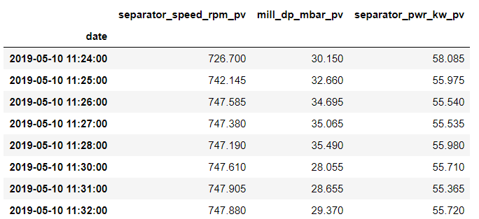
Handling Time
Setting the date as datetime for practical reasons.
Setting frequency as 1’.
Using interpolation to fill the missing values in our dataset.

Slide 10
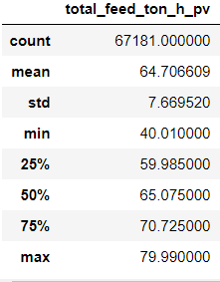
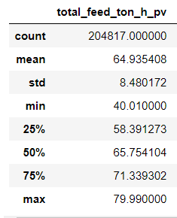
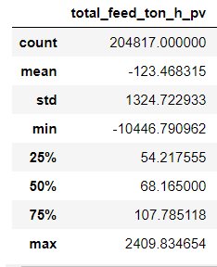
Why linear interpolation?

Slide 11
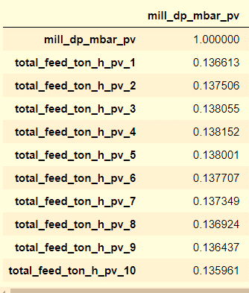

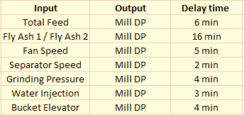
Delay Times
Block 1
Block 2

Slide 12
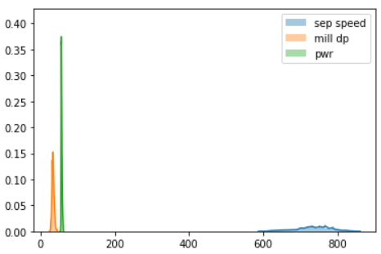
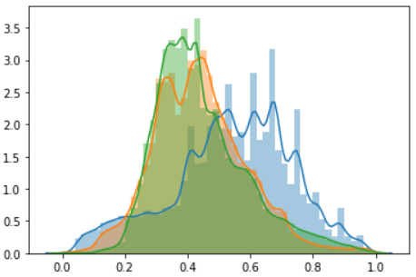
Scaling
Scaling was implemented using the MinMax scaling method

Slide 13
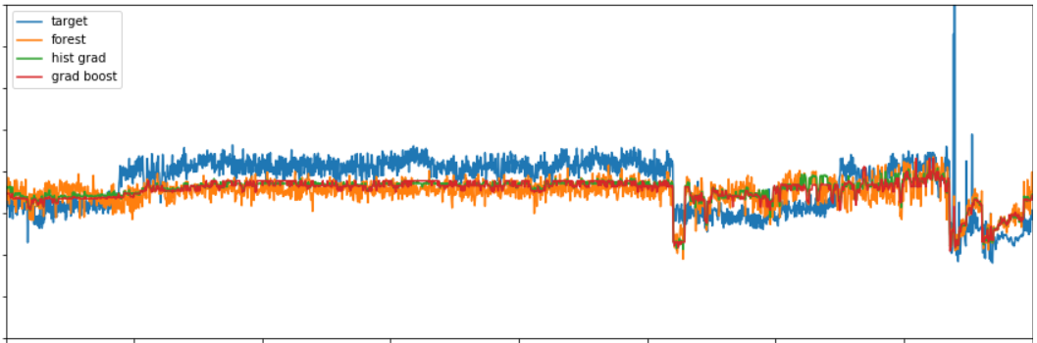
Separator Motor Power (KW)
Model | Mean Absolute Error (MAE) | Mean Squared Error (MSE) | R^2 Score
Gradient Boosting | 1.017 | 1.890 | 0.176
Histogram-Based Gradient Boosting | 1.035 | 1.902 | 0.165
Random Forest | 1.095 | 1.968 | 0.105

Slide 14
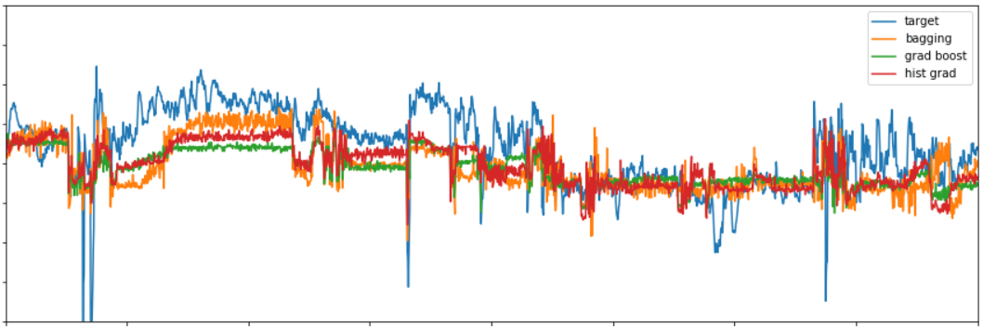
Mill Differential Pressure (mbar)
Model | Mean Absolute Error (MAE) | Mean Squared Error (MSE) | R^2 Score
Histogram-Based Gradient Boosting | 1.744 | 2.236 | 0.128
Gradient Boosting | 1.840 | 2.320 | 0.061
Bagging | 1.836 | 2.355 | 0.033

Slide 15
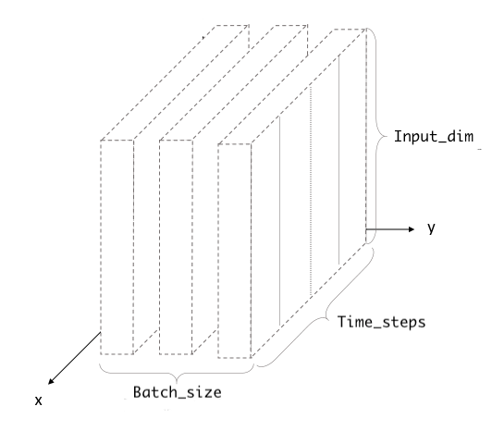

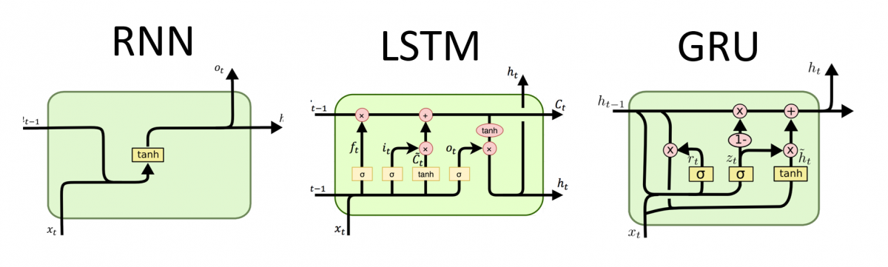
Deep Learning Models - LSTM, GRU with GPU

Slide 16
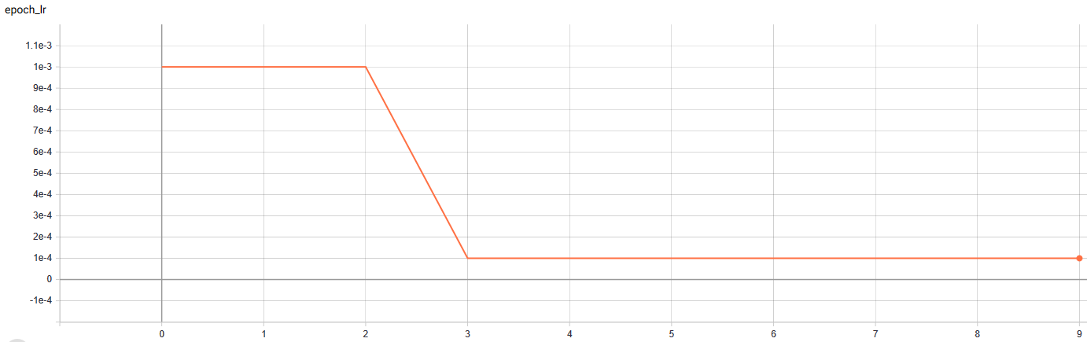
TensorBoard graphs

Slide 17
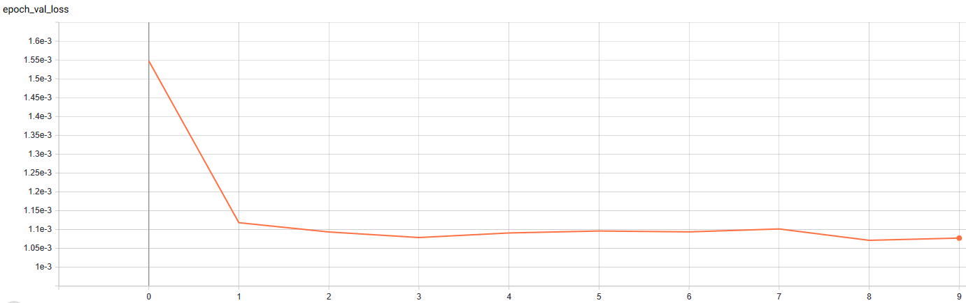
TensorBoard graphs

Slide 18
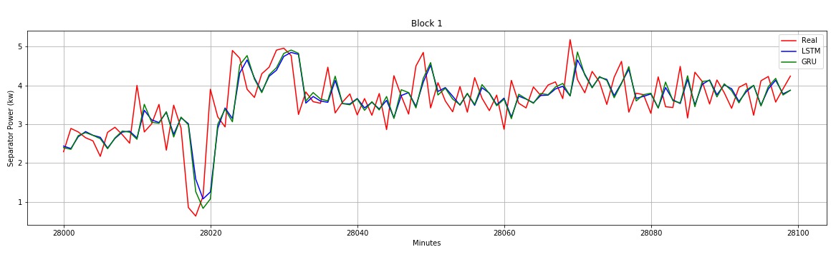
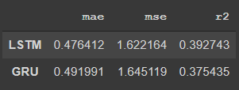
Block 1 model evaluation
Training time(CPU): 56 min Training time(GPU): 3 min

Slide 19
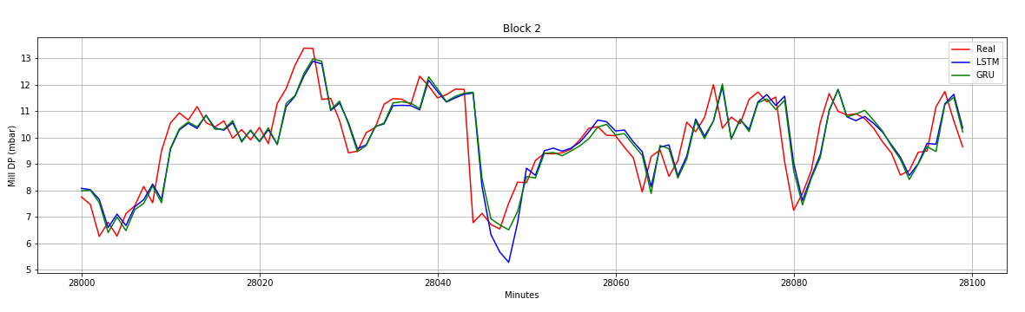
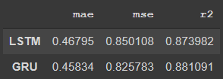
Block 2 model evaluation
Training time(CPU): 2.5 hr
Training time(GPU): 21 min

Slide 20
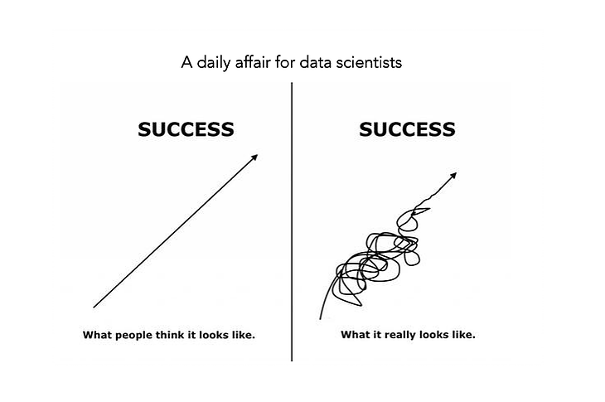
Thank you for your time!

