Slide 1






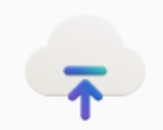

Standard agent setup
Azure AI Hub
Azure AI Agent999
Azure AI Project
Add your own Knowledge source(s)
Azure Key Vault
Azure AI Search
Azure AI Services
Azure Storage
Add your own Actions
Notes:
The bicep templates mentioned in the slide are available at https://github.com/Azure/azure-quickstart-templates/tree/master/quickstarts/microsoft.azure-ai-agent-service

