Slide 1

NovaRetail Group

Slide 2

Business Context

Slide 3
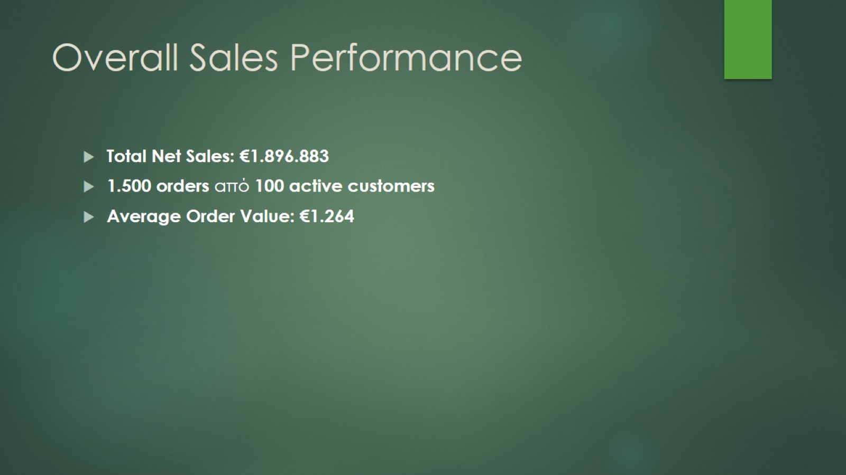
Overall Sales Performance

Slide 4
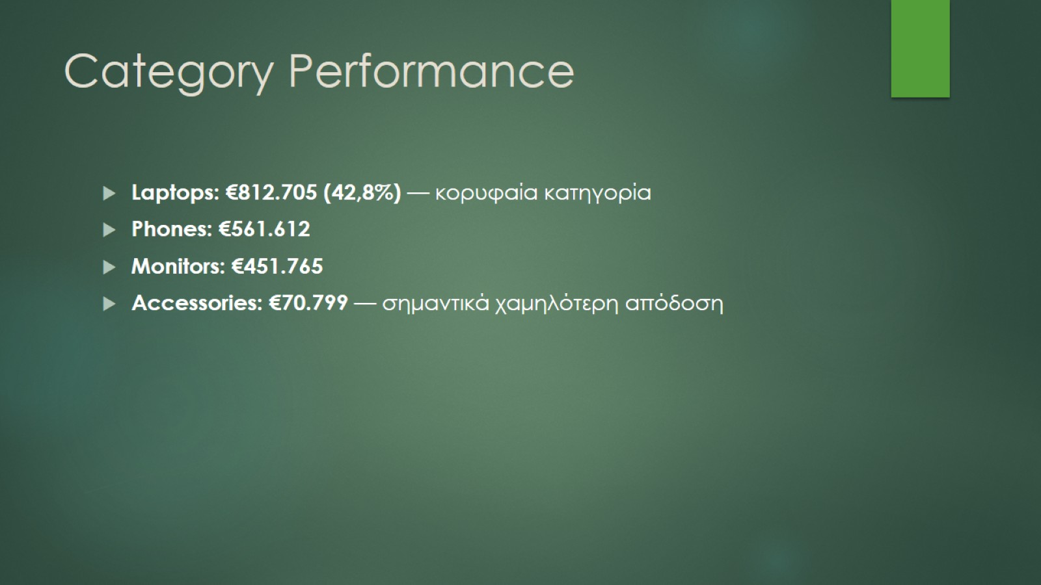
Category Performance

Slide 5
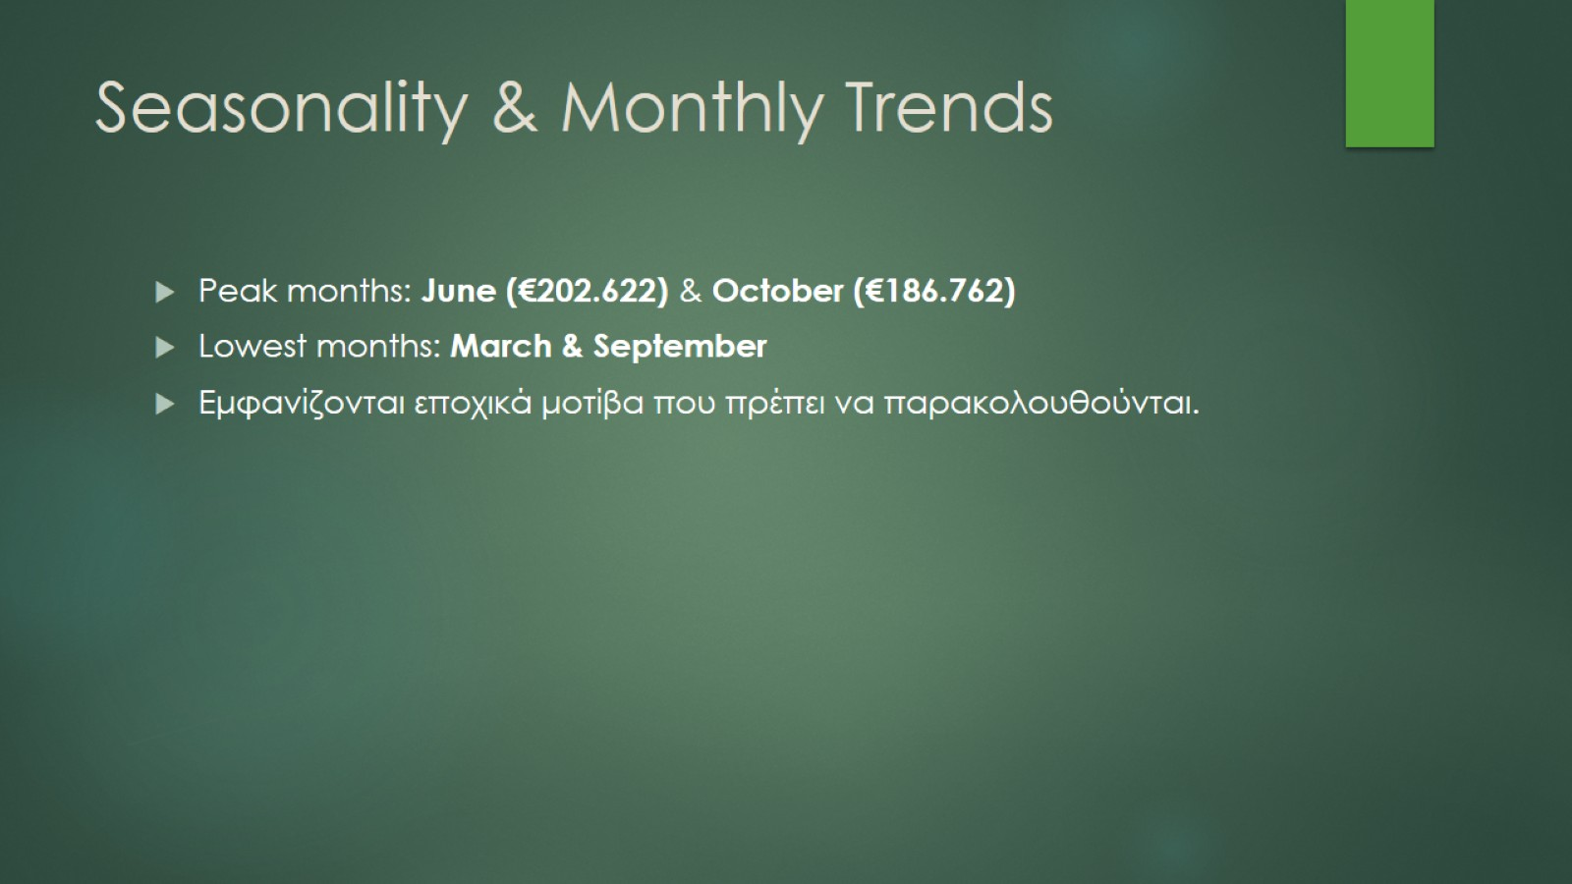
Seasonality & Monthly Trends

Slide 6
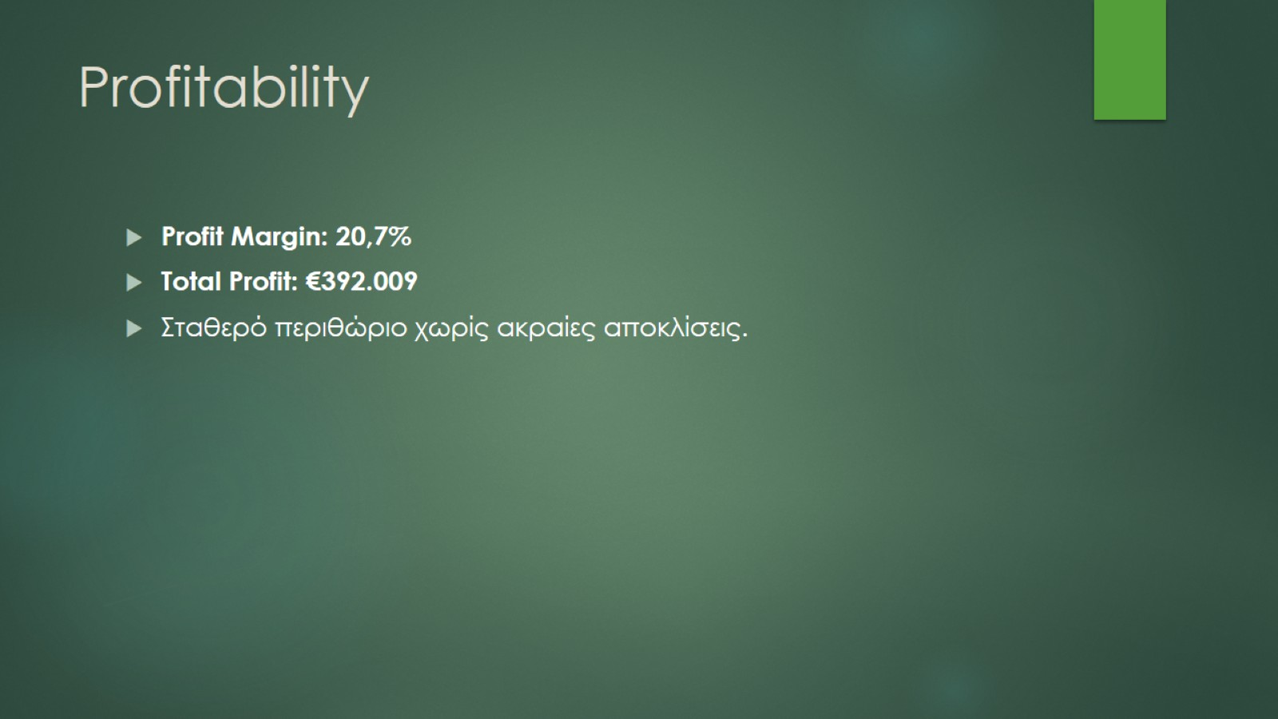
Profitability

Slide 7
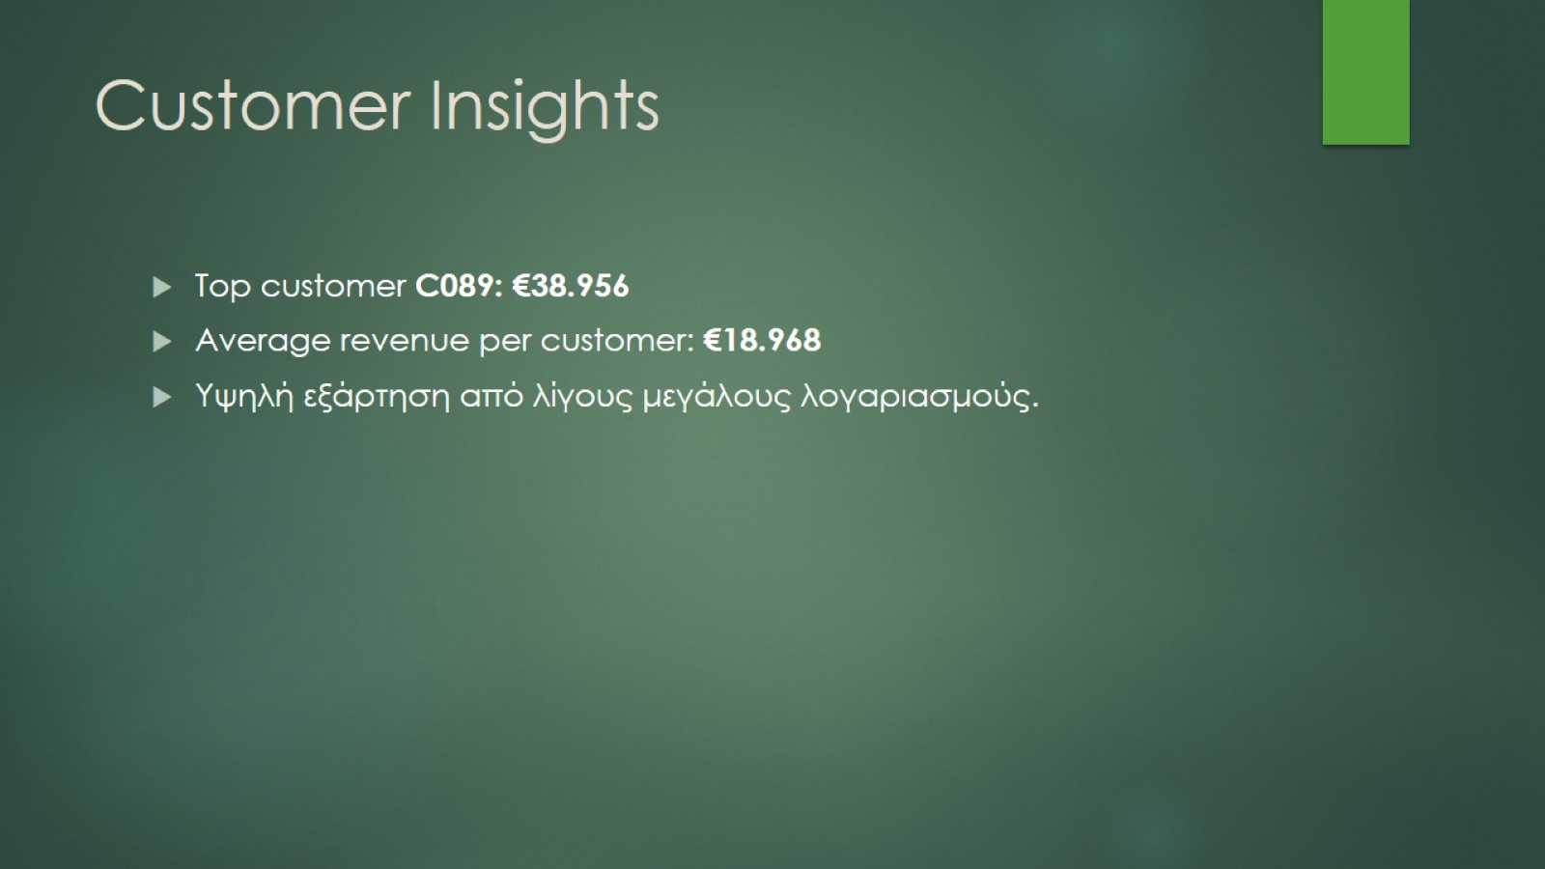
Customer Insights

Slide 8
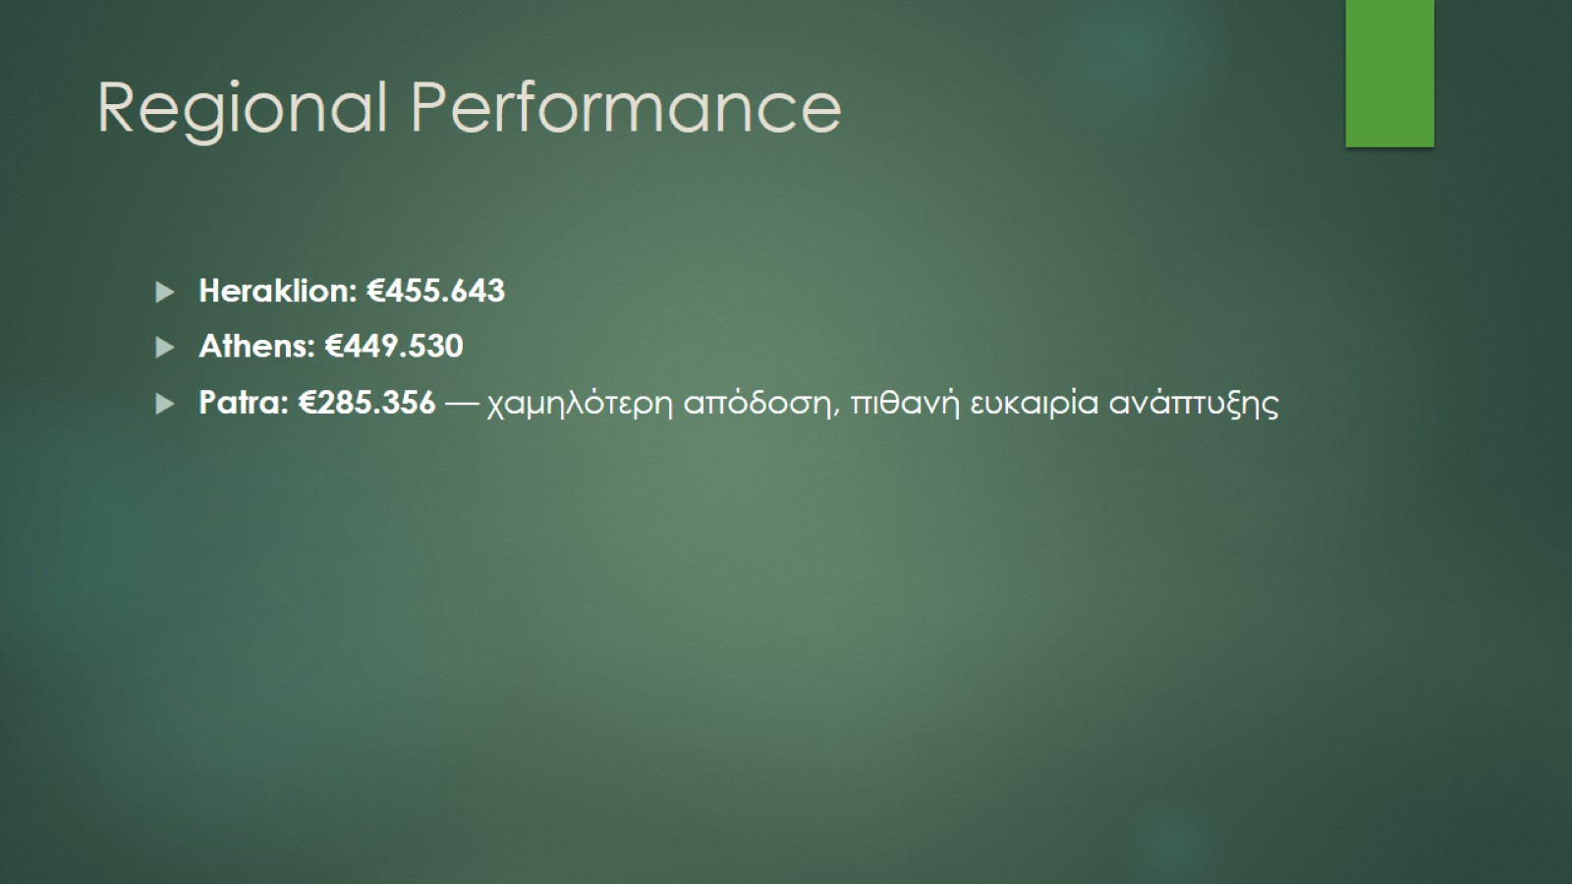
Regional Performance

Slide 9
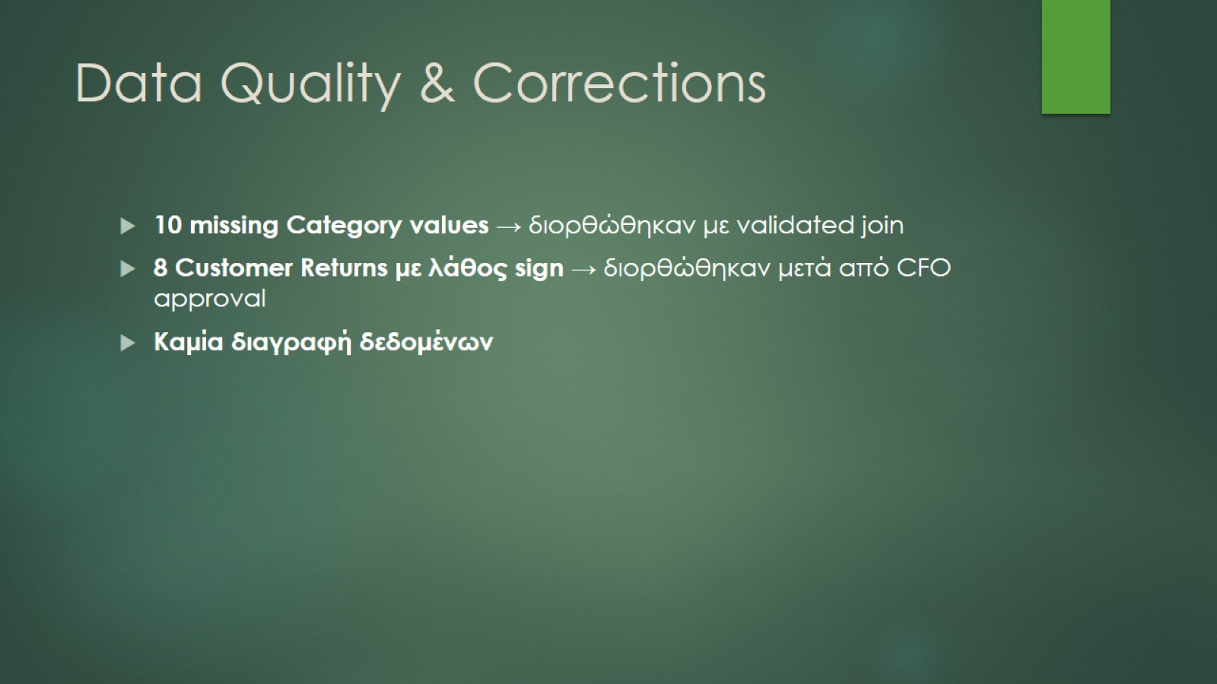
Data Quality & Corrections

Slide 10
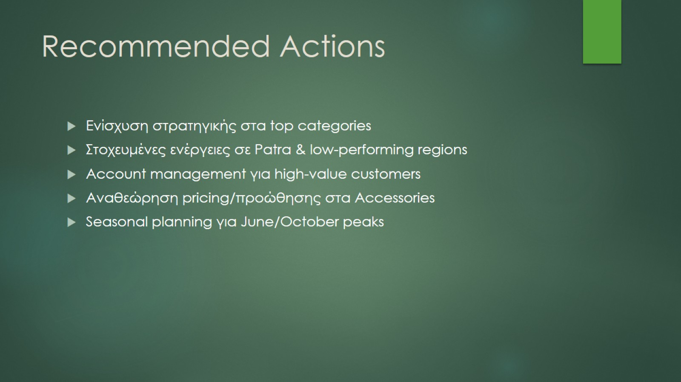
Recommended Actions

