Slide 1
CS50 Final Project
“FilterMe”
Konstantinos Kostis

Slide 2
Presentation Outline
Who am i?
Project Description
Code Architecture
Modules Responsibilities (in a nutshell)
Demo time!
Future Steps & Enhancements
Links / Resources
Thank you!

Slide 3
Who am i?
Hello CS50!!!
My name is Konstantinos Kostis and i live in Athens, Greece! Very pleased to meet you!
My Github profile: https://github.com/konstantinoskostis

Slide 4
Project Description
FilterMe is a client-side image filtering tool presented as a web page!
It is built using good old HTML/CSS/JS. It is actually very much JS heavy :-)
Supports:
Reading & Rendering of JPEG and PNG images
Applying filters (Copy/Duplicate, Grayscale, Reflect, Sepia)
Through this web page, i actually created a small JS image processing framework with a set of classes and a well layered architecture.

Slide 5
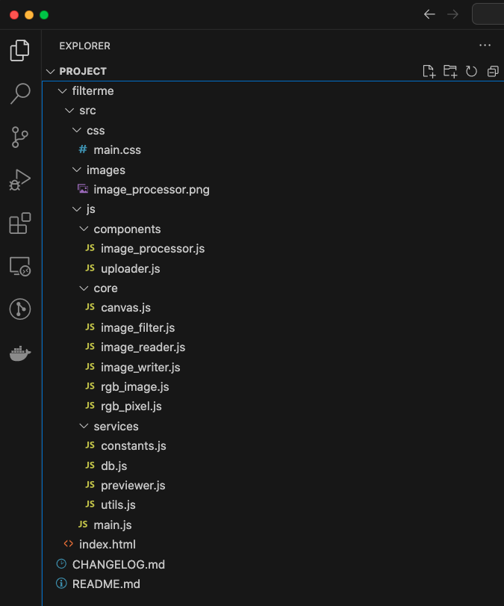
Code Architecture
“A picture is worth a thousand words”

Slide 6
Modules Responsibilities
The core package, contains plain JS classes for representing a pixel, a 2D image of pixels, reading an image from base64 encoding, writing a 2D image to base64 and applying filters to 2D images. This module actually, is the mini image processing framework backbone!
The services package, contains plain JS classes for interfacing with the sessionStorage, creating base64 encoding given an image file and creating Image (<img>) elements from base64.
The components package, contains plain JS classes that bind HTML button elements to actual actions. This is done by using all needed classes from the core and services packages.
The main.js simply initializes the two classes found in the components package.
The index.html is the web page linking the main.css, main.js, jquery.js (only used for document.ready()) and bootstrap.js/bootstrap.css (used for file-selection, buttons and select-options)

Slide 7
Demo Time!!!

Slide 8
Future Steps & Enhancements
Support more & advanced filter operations + combination of filters
Allow user to download the produced/processed image (with a good file name :-) )
Handle multiple images
Make use of browser SQLite infrastructure to persist images and their metadata along with log of the sequence of operations on an image.
Address Error Handling regarding core classes
Write documentation and generate API Docs
Revisit internal & external API
Introduce code formatting tools & enforce proper code style by using style guides

Slide 9
Links / Resources
MDN: https://developer.mozilla.org/en-US/
Bootstrap: https://getbootstrap.com/docs/5.3/getting-started/introduction/
jQuery: https://jquery.com/
Icon: https://www.flaticon.com/free-icons/library
CS50: https://pll.harvard.edu/course/cs50-introduction-computer-science

Slide 10
Thank you!

