Slide 1
The Battle of Neighborhoods

Slide 2
1. Introduction/Business Problem
Let's say a person got a job offer from a great company with great career prospects in other city or other borough of his/her current city.
I think a person would love to shift to a location which is exactly or almost similar to his/her last location
He/she loves the great amenities and other types of venues that exist in his/her current neighbourhood like school, gym, swimming pool, Amusement park, restaurants, coffee-shops, spencer etc.
So I’ll find out what are borough-neighbourhoods are very similar to give current location.

Slide 3
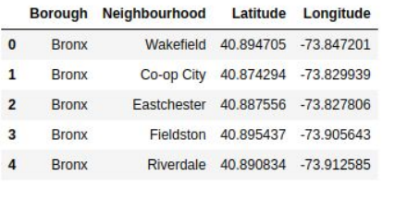
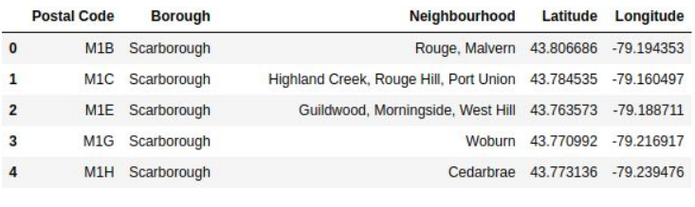
2. Data
New York Data
Toronto Data

Slide 4
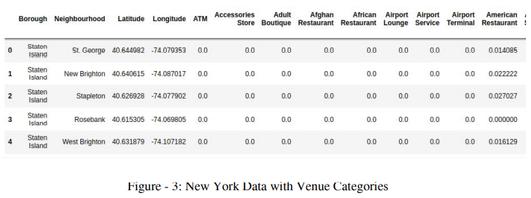
3. Getting Venues Using Foursquare API

Slide 5
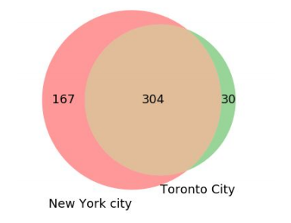
4. Analysis – Common Venue Categories
There are some common venue categories in both data. Figure 4 is showing that there are total 304 common venue categories in both cities. So we’ll take only these common categories of data. Other than common categories of the data we’ll be dropped.

Slide 6
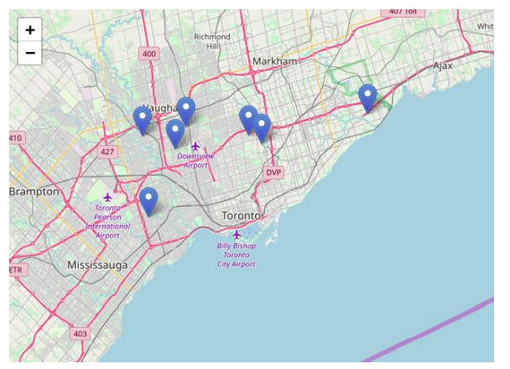
4. Analysis - Top 7 similar borough in Toronto City
Top 7 similar borough in Toronto City Let’s say current location is Bronx, Riverdale, New York. We’ll get the index, latitude and longitude of this location form the New York city data. We can get the all common venue categories data of corresponding index and then we’ll multiply with Toronto City data. This will give how much each borough is similar to current location. We’ll sort these values and get the top 7 boroughs. Then we’ll visualize it using the folium.

Slide 7
5. Conclusion
Cosine similarity is used here to find how similarity between two boroughs. This model can be implemented within a city also. This will help to find a suitable place for people. This will give most similar borough and neighbourhood

