Slide 1





Advancing IVF (In Vitro Fertilisation)
Success through Genomic Embryo
Development Analysis

Slide 2


Portrait of Our End User
Elizabeth: 40 years old,
4 failed IVF transfers.
"I see fantastic science news
every day, but I can't just get
a baby...”
Millions of women are
like Elizabeth.

Slide 3

Problem
Even top IVF clinics require 2–3 embryo transfers to achieve a live birth, resulting in significant time delay and emotional burden. Objective biomarkers for embryo implantation potential are needed.

Slide 4
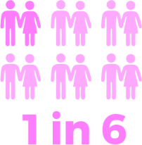
Infertility
(1 in 6 couples)
IN VITRO FERTILISATION (IVF) is a common solution (10% of newborns), but it IS SUBOPTIMAL: low (40%) success rate

Slide 5
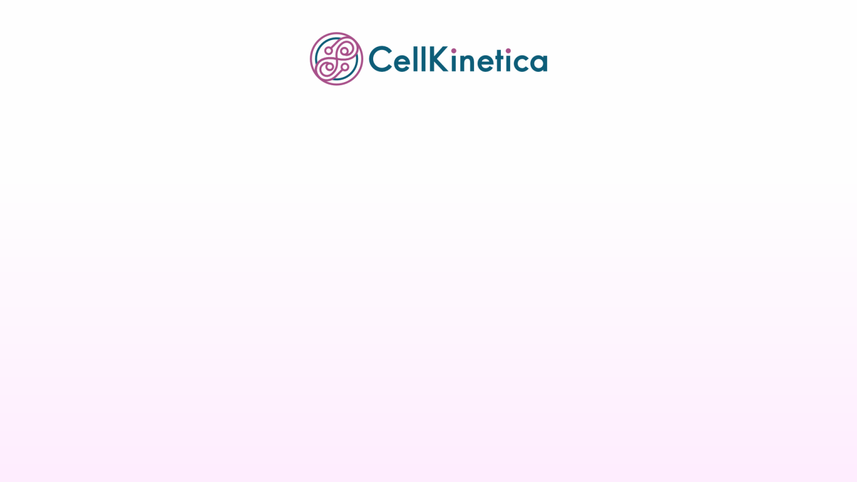



Opportunity is open
Better embryo
biomarkers
Fewer
transfers
Faster
pregnancy

Slide 6

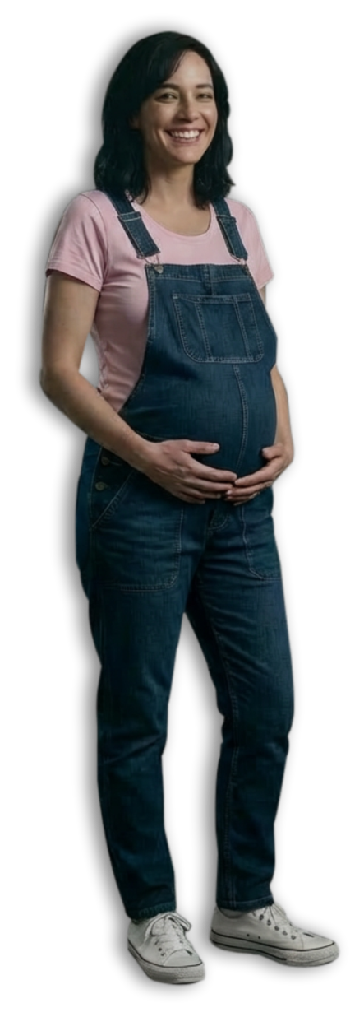
We help women
get pregnant
faster
by advancing IVF success rate

Slide 7

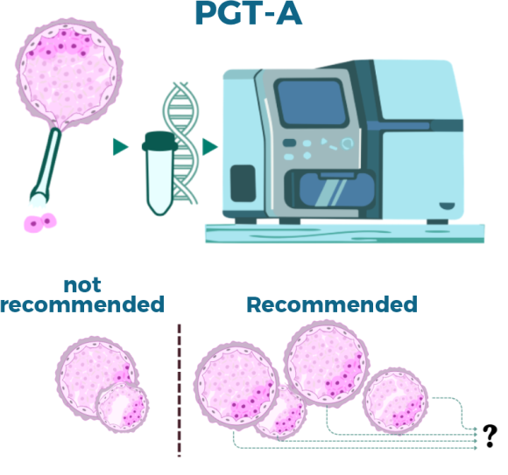
Solution
PGT-A (Preimplantation Genetic Testing for Aneuploidy) — the global standard — classifies embryos as "recommended" or "not recommended" for transfer based on chromosome count alone.
CellKinetica enhances this decision: using existing PGT-A data, we provide high-resolution genomic screening platform to help embryologists prioritize embryos with high implantation potential.

Slide 8


Development potential -
based ranking of
recommended embryos
by implantation potential.

Slide 9


With
CellKinetica
44%
Of women with IVT failures
Would be preented

Slide 10

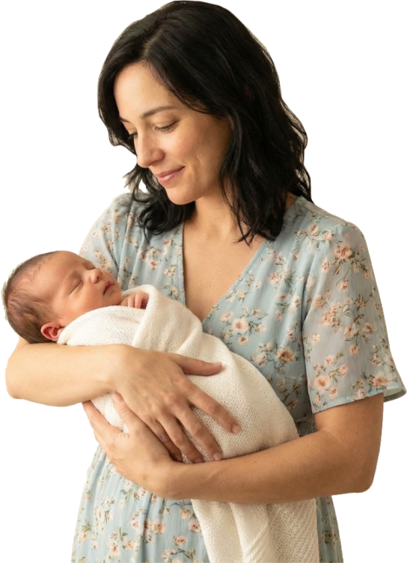
Validation on
539
real world
live-births:
44% (45 out of 102)
of women with IVF
failures would have
conceived at least
one cycle faster.

Slide 11

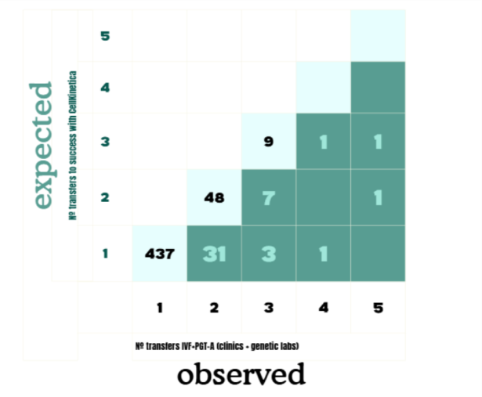
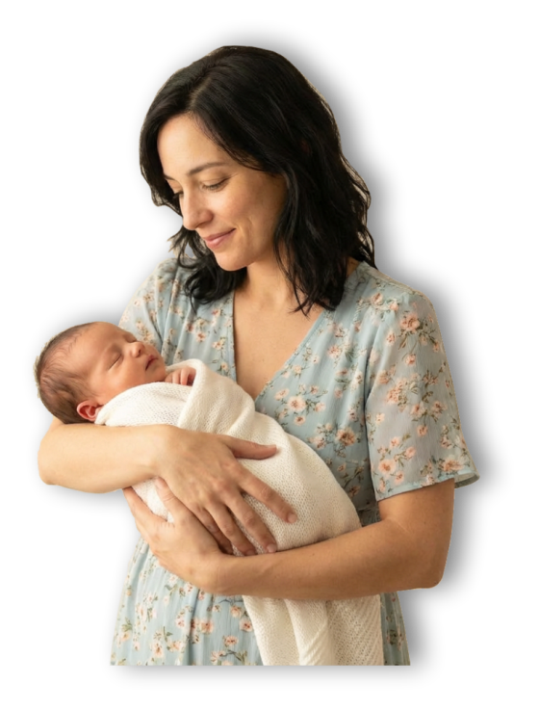
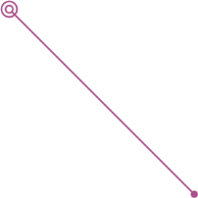
Elizabeth and her
child might have
met 3 transfers
earlier
If CellKinetica had guided embryo
selection, these 31 women would
have achieved pregnancy after the
first transfer instead of the second.

Slide 12



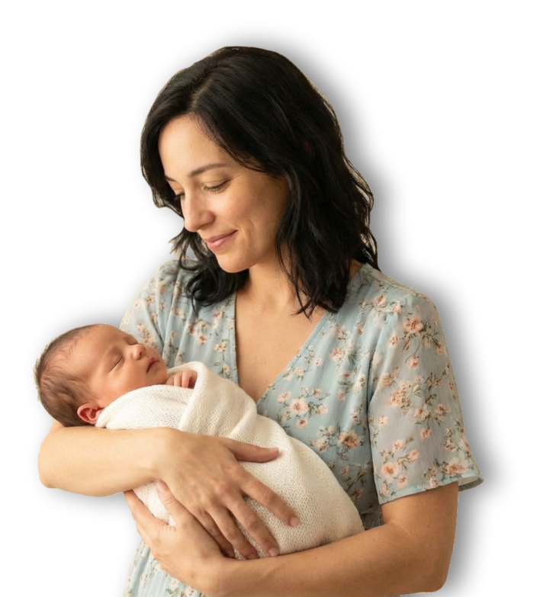
Trained on 30,000
embryo genomes
Validated on 539
live-birth pregnancies

Slide 13

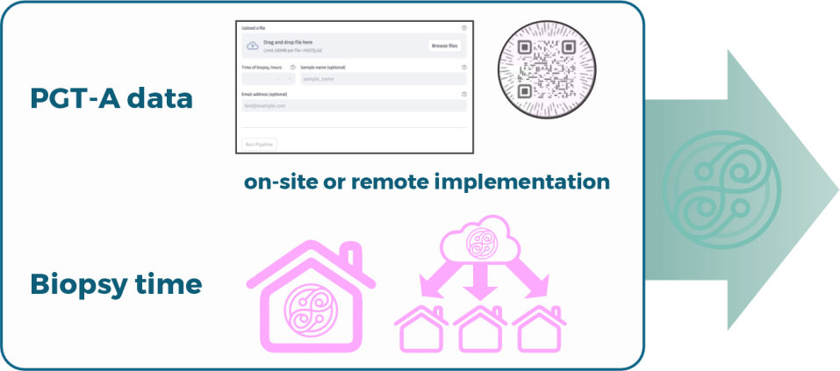
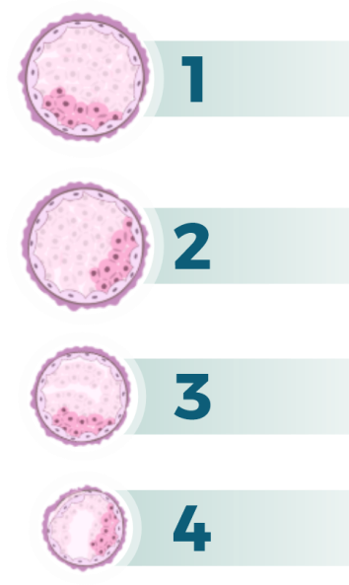
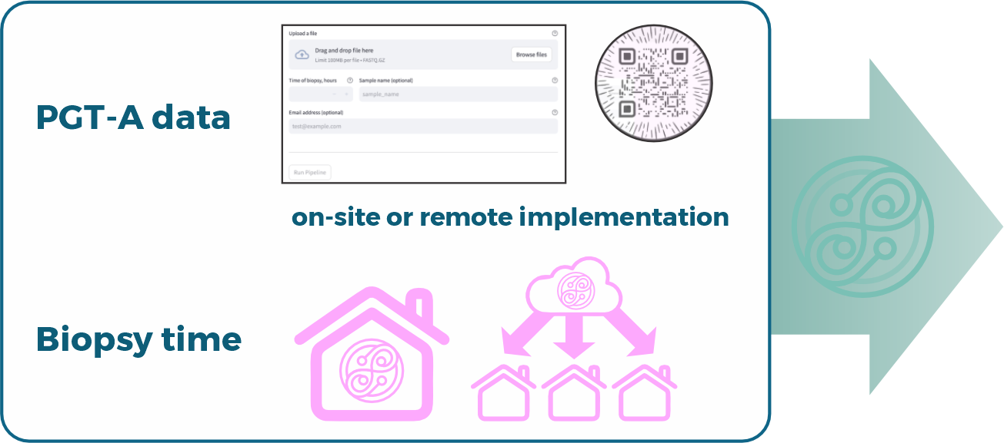
A fast, robust, and fully functional prototype is ready for deployment. By inputting PGT-A data and time of biopsy, users receive recommended embryo transfer ranking in under 10 minutes.
Genomic Screening Platform to Support Embryologist Decisions
Prototype is live

Slide 14

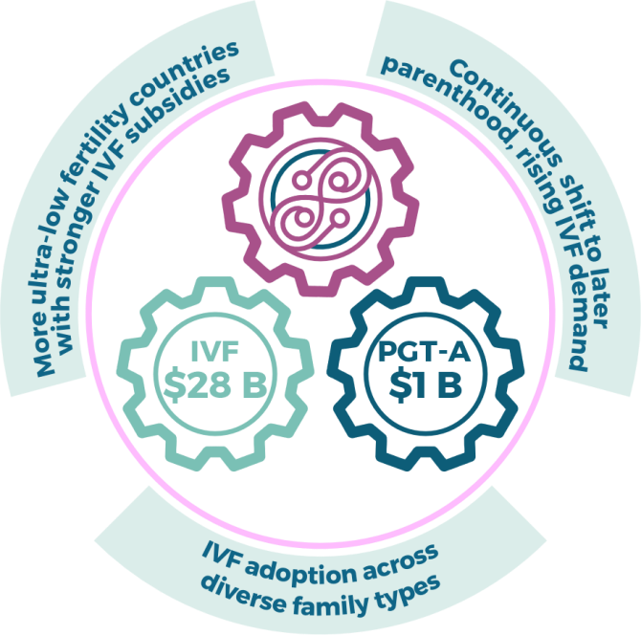
Market
Large, expanding market - further accelerated by our entry:
CellKinetica unlocks greater clinical value in both PGT-A and IVF, synergistically boosting their global adoption and success rates.
Grand View Research

Slide 15
Market access:
CellKinetica price ~ $500/test per embryo
(10% of PGT-A; low range of prices).
TAM $500M (now) - $2500M (in several years): 1M global PGT-A users, growing towards 5 M IVF users.
SAM $150M (target in first 36 months):
300K PGT-A users in high-demand European (South/East) countries.
SOM $75M (target in first 18 months):
150K users (50%) in leading labs of Spain, Greece, Italy, Poland.

Slide 16
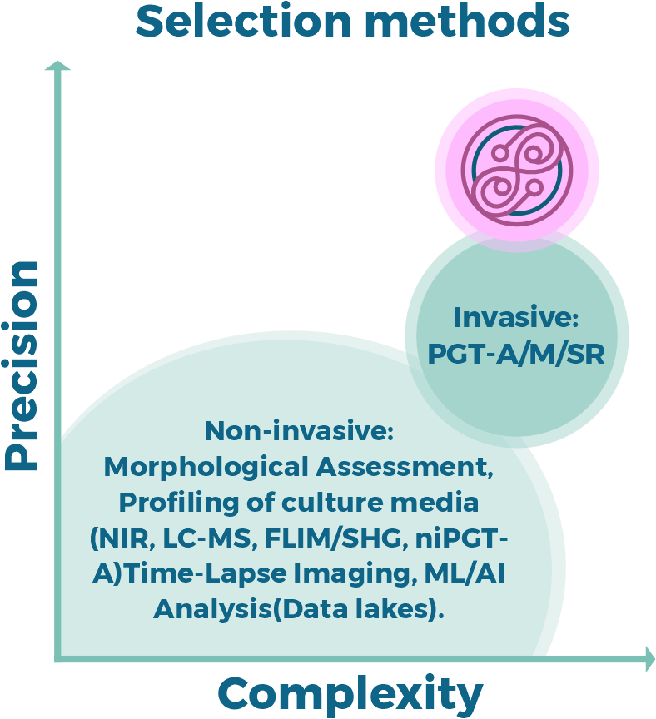
Competition
CellKinetica delivers higher precision without added complexity easy to implement, interpret, extend, and scalepowered by maximal info value from complete cellular dynamics during early embryogenesis

Slide 17
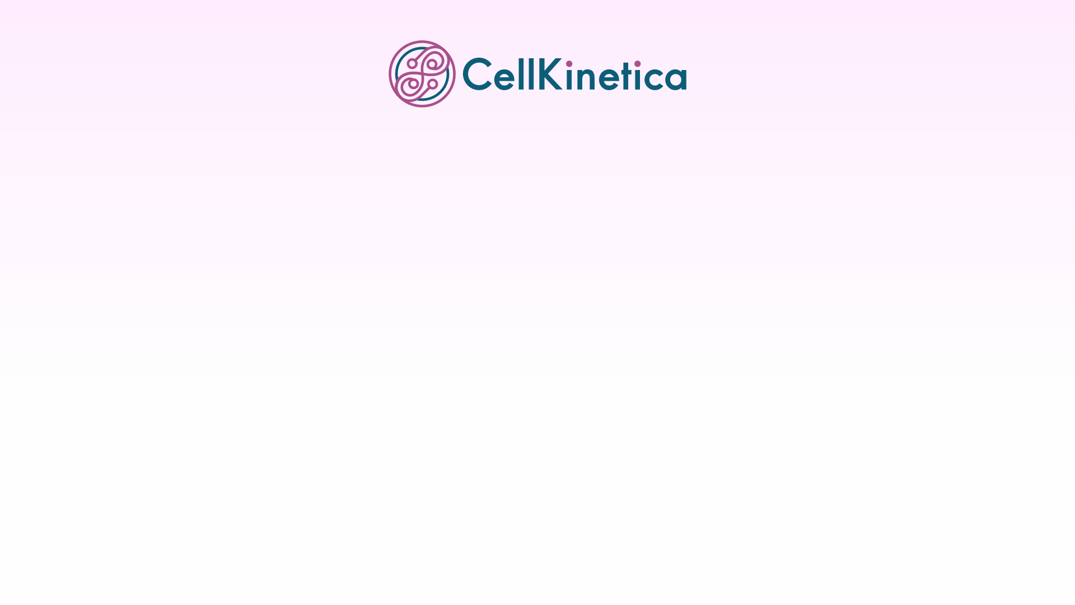

Competitor
Strengths
Weaknesses
Opportunities
Threats
Low info value
(first 16 cells time point)
High implementation
Embryoscope+ AI
Market leader
Larger datasets
New interpretations
Superior alternatives
New critical data
Established brand
PGT-A based der
Low info value
(biopsy time point)
Clinically debated
MitoScore/MitoSure
Dynamic extensions
Add-ons
Superior alternatives
New critical data
Numerous
Easy integration
Minimal info value
Noisy metrics
Clinically unproven
Other non‑invasive
New tools emerging
Superior alternatives
Highest info value
(all cellular divisions
are traced)
Validated pilot
Easy integration
Multi-country
Scaling Is Needed
PGT-A synergy
M/SR extension
Entrance to market
Competing breakthroughs
CellKinetica

Slide 18
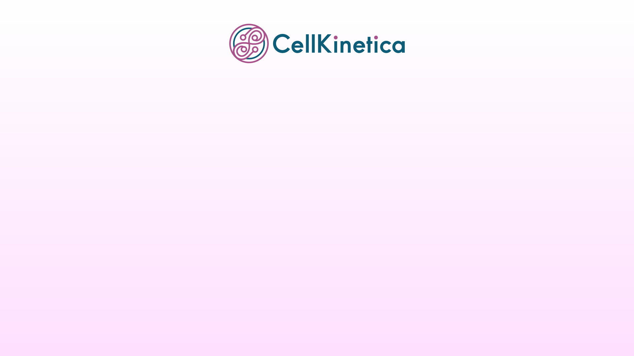
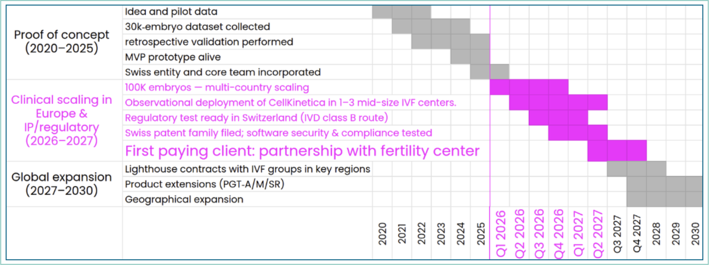
Product roadmap
Strategic goal: Position CellKinetica as the globally adopted screening platform alongside PGT-ANext major milestone: Secure the first paying client by mid-2027.

Slide 19


Execution Roadmap:
Go-to-Market, Legal, IP
& Regulatory
Secured clinical partnerships
& defensible IP → Position
CellKinetica as the leading
embryo ranking solution in
Europe and globally.

Slide 20


Go-to-Market Strategy: Mid-size EU South/East (Spain, Greece, Poland) → Full Europe → Global (USA, Japan, South Korea, +)
Traction: Advanced discussions & Letters of Intent (Greece, Estonia, Canada)
Legal Foundation (SeedUp): Swiss Société Anonyme (SA) (Q1 2026) • Clean cap table (1y cliff/3y vesting)
IP Strategy (Reuteler): Trade secret • Database → Broad patent filing (Q2 2026)
Risk Mitigation & Freedom To Operate (FTO): Distinct algorithms • No blocking patents → Strong FTO
Regulatory Roadmap (Veranex): In Vitro Diagnostics (IVD) Class B • "Research-use only" (RUO) revenue stream

Slide 21

Financial model
B2B Go-to-Market Itinital
Phase:
Mid-Sized European Fertility Centers
Sustainable Unit Economics:
$10.5M LTV per Clinic, Break-Even
at Month 23

Slide 22

Financial model
Model Inputs
(Europe mid-size IVF clinics):
Clinic Volume 7000 users/year
Test Pricing 500 $/test
Customer Acquisition Cost 30'000 $/clinic
Customer Lifetime 36 month
Acquisition Cadence 2 month
Cost of clinic maintenance 3'000 $/month
Pre-Revenue Burn: $1.25M over 18 months
Fixed costs: base salaries 40k$/month
variable costs: server, IP/regulatory/legal fees, travels
https://cellkineticafinmod.shinyapps.io/CellKineticaFinMod/

Slide 23
Financial model
(for 36 months):
Number of Active Clinics 9
Monthly Revenue 2.6 M$
Annual Recurring Revenue 31.5 M$
LifeTime Value, LTV 10.5 M$
LTV/CAC, x 350
Break-even (months) 23
https://cellkineticafinmod.shinyapps.io/CellKineticaFinMod/

Slide 24

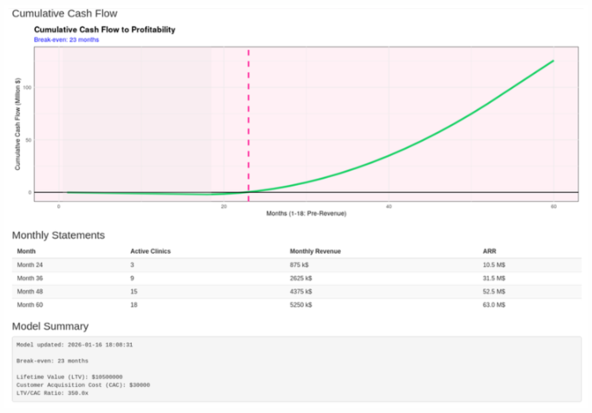

Slide 25
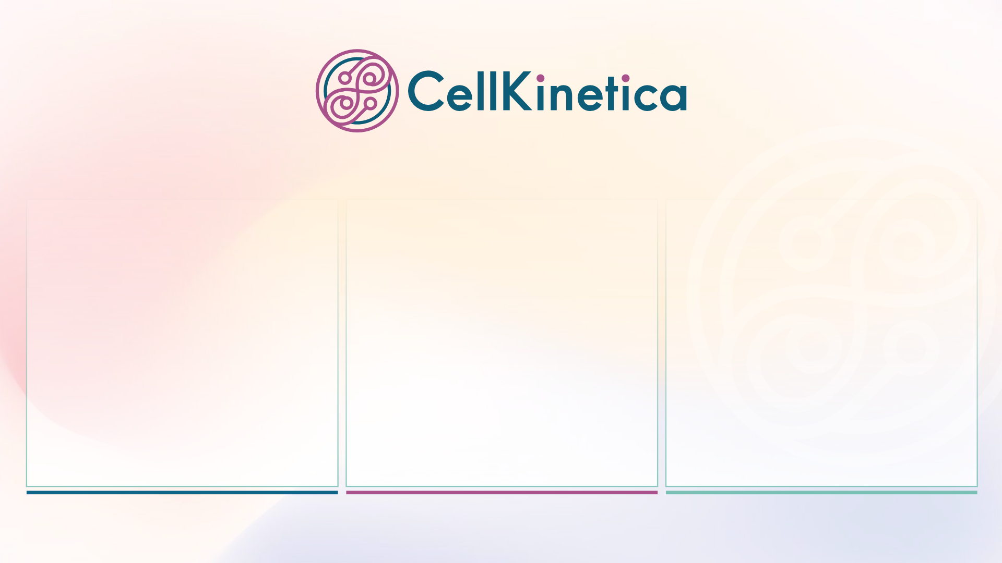




Team
Geneticist /
performance
driver
Bioinformatician
Developmental
biologist /
data engineer

Slide 26

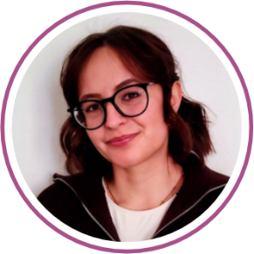


Team
Konstantin Popadin
PhD, CEO (Switzerland)
Geneticist at Lomonosov MSU,
Harvard, EPFL.
Successfully managed teams of
50+ researchers.
Valeriia Timonina
Bioinformatician (Switzerland)
PhD - student, EPFL
Human genomics data scientist.
Eugenii Tretiakov
PhD, CTO (Austria)
Developmental Biologist & Bio/Data
/DevOps Engineer.
8+ years building HPC clusters
& pipelines.

Slide 27
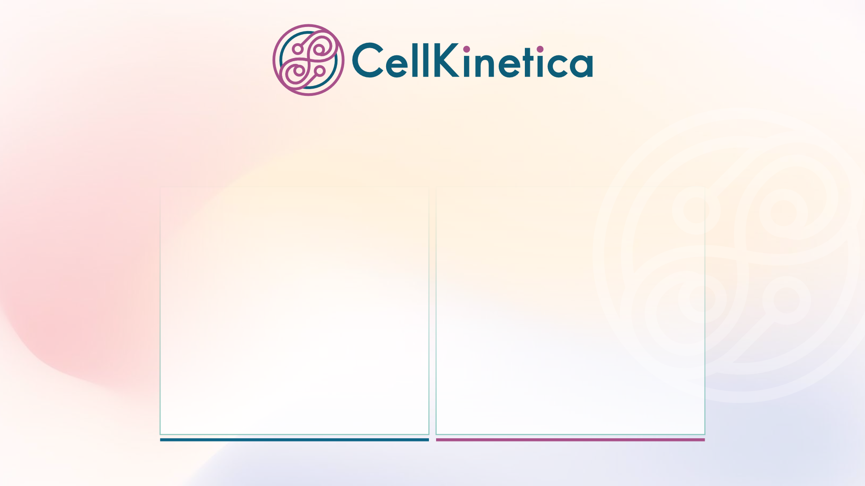
Team
Dr Ximena Bonilla
(Switzerland)
MD PhD, Medical geneticist, Clinical-Scientific Bridge Builder.
Anthony Payot
(Switzerland)
Financial and operational
professional..

Slide 28

Team
Dr Periklis Makrythanasis
(Greece)
Expert in medical genomics,
diagnostics, and family planning.
Dr Ilya Volodyaev
(Israel)
Leading IVF embryologist. .
Dr Ilya Mazunin
(Russia)
Molecular biologist, IVF specialist
and genome engineer.
Prof Andres Salumets (Estonia)
Founder of Celvia - growing
research-driven reproductive
medicine company.
Prof Konstantin Khrapko
(USA)
Leading scientist in deleterious
mutational dynamics during
human embryogenesis..
Mark Khrapko
(USA)
Strategic advisor.

