Slide 1
06. Script

Slide 2
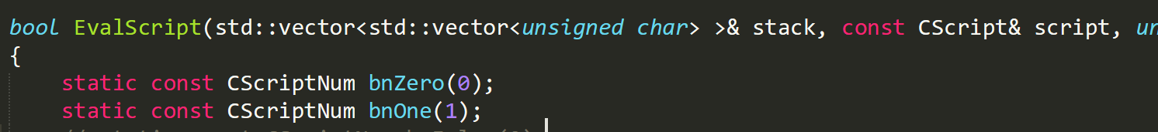
Script
Bitcoin Program Input is called script
Works with a stack
https://en.bitcoin.it/wiki/Script
Script processing function in src/script/interpreter.cpp

Slide 3
Script Operation
Read an opcode, do something below:
Read following data to the stack
Pop something from the stack and calculate
Push something to the stack

Slide 4
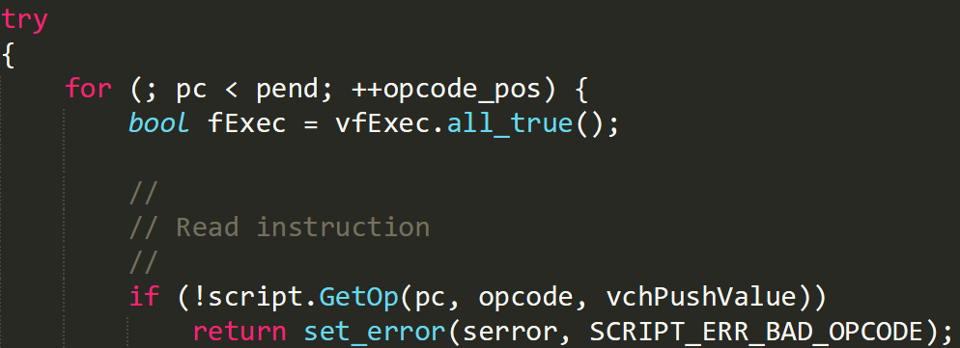
Read an opcode
Read an opcode, proceed iterator to x more byte
x depends on the opcode
Process until end
Get opcode and move pc

Slide 5
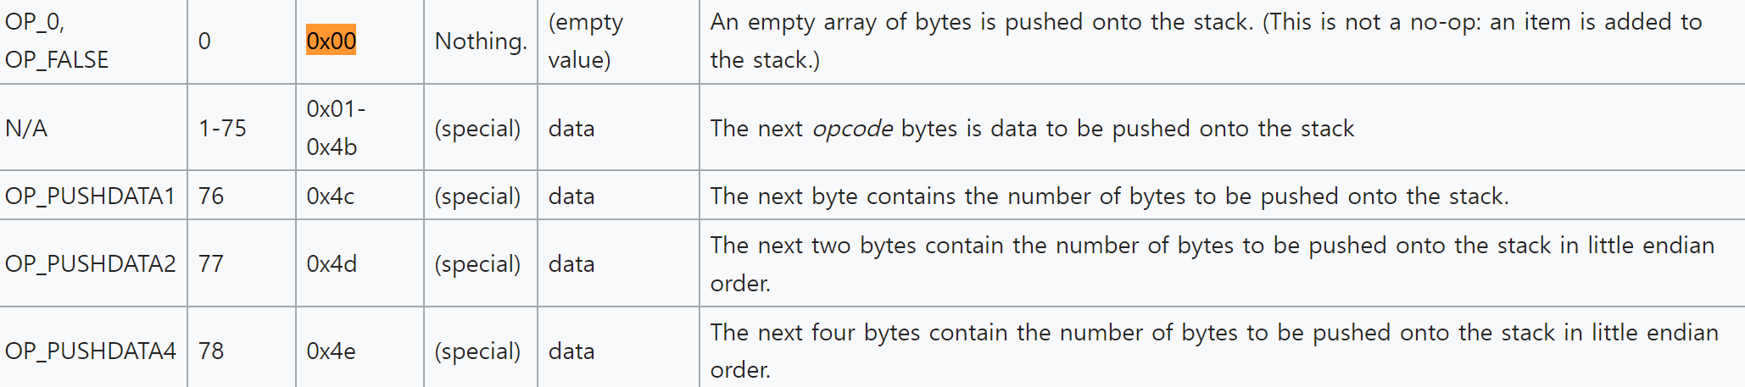
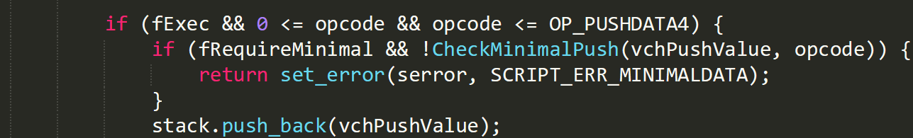
Read following data to the stack
0~PUSHDATA4 opcodes make move to the stack

Slide 6
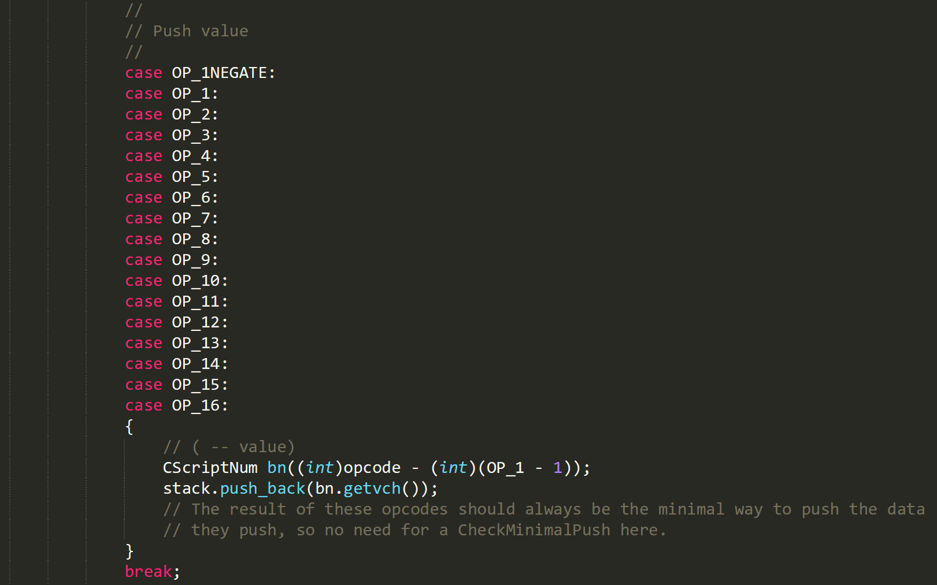
Add some static number to the stack

Slide 7
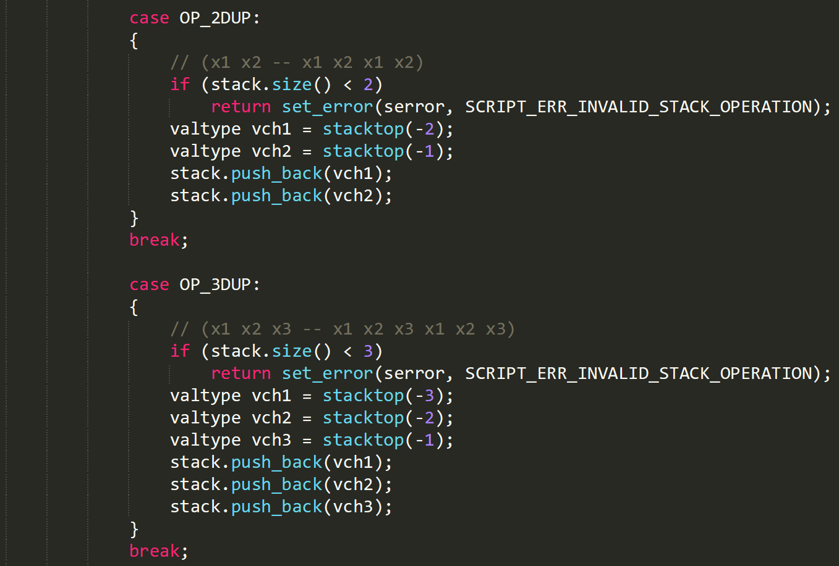
Duplicate the top of the stack

Slide 8
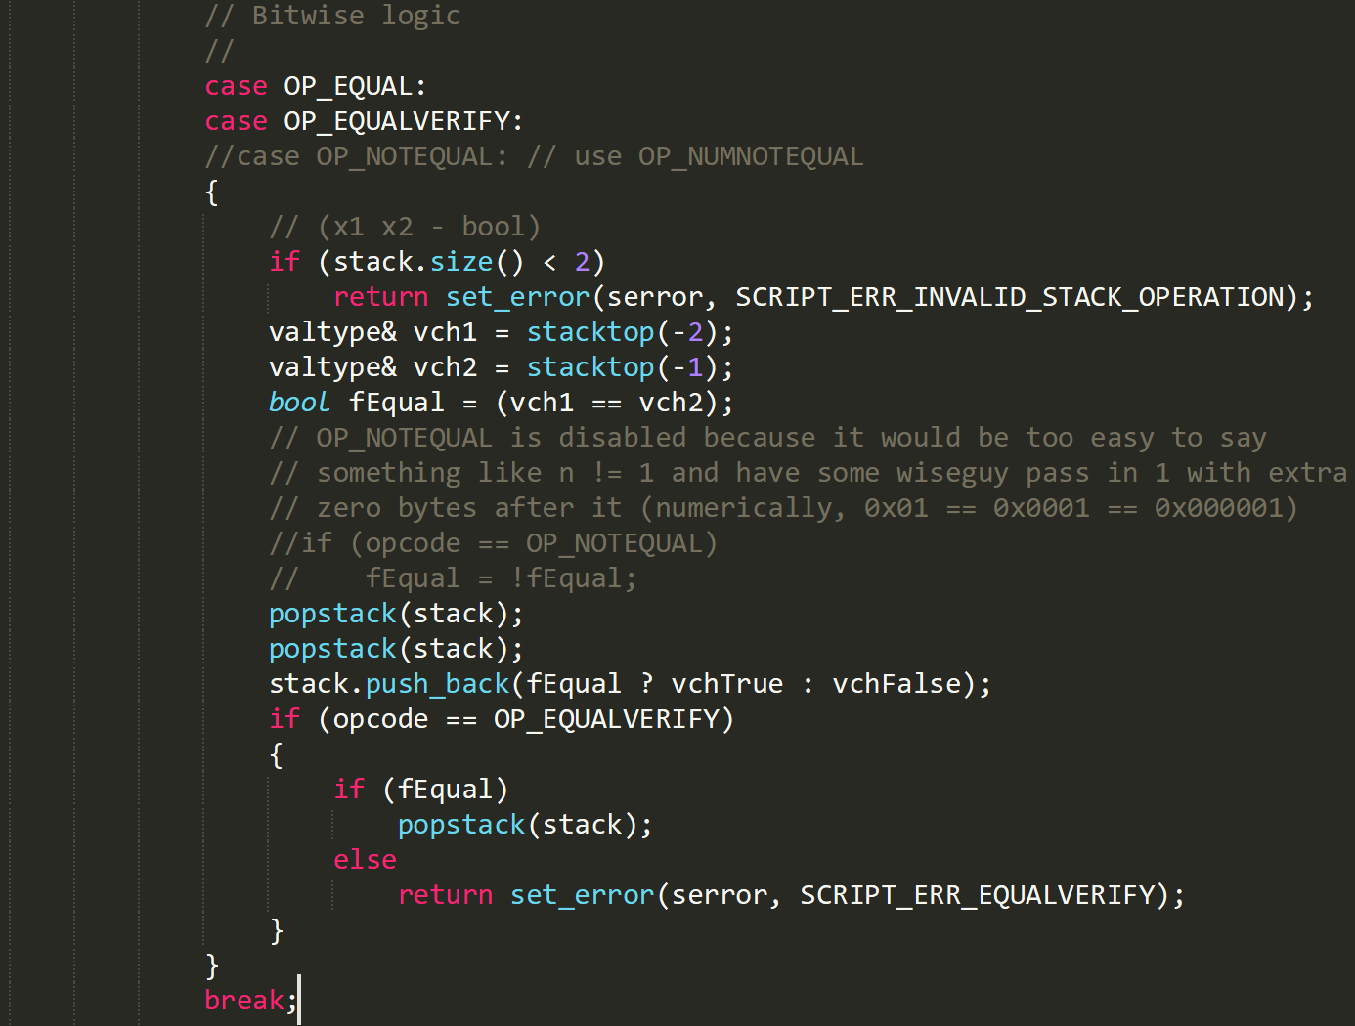
Match two data on the top of stack

Slide 9
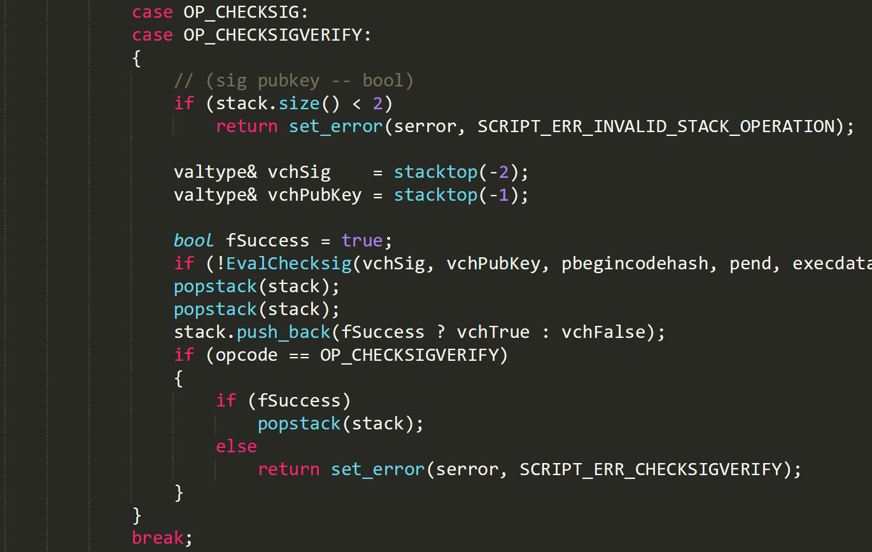
Check Signature
Notes:
EvalChecksig
➔ EvalChecksigPreTapscript
➔ GenericTransactionSignatureChecker<T>::CheckECDSASignature

