Slide 1

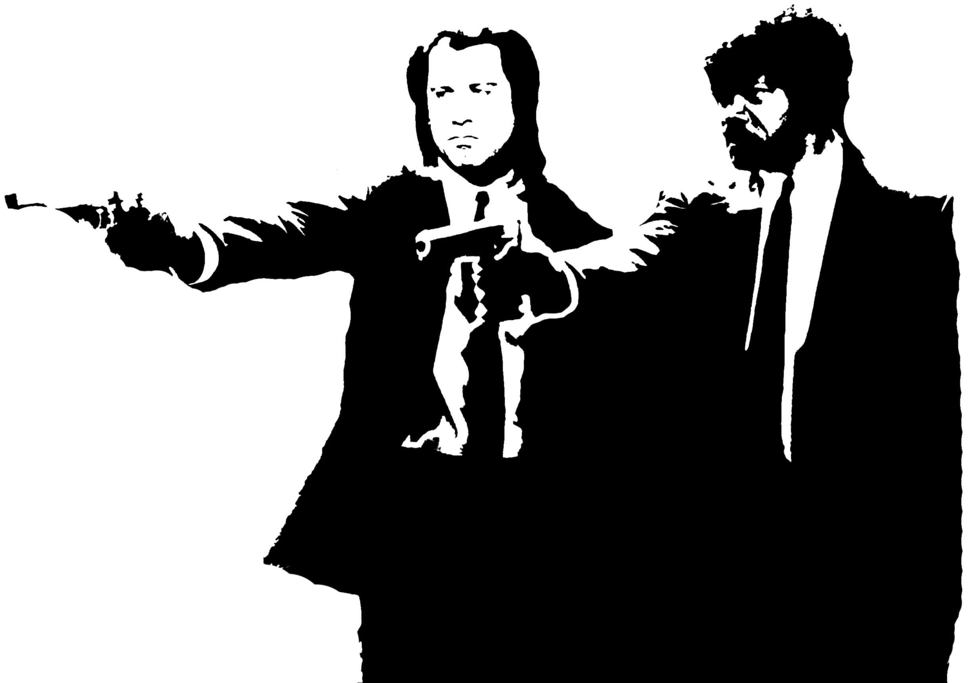
English, Techmaker,
Do You Speak It?
Progress Through Innovations
Conference, March 30th, 2017
Applied Maths and Computer Science Faculty
Konstantin Gorbunov, PMM-61
E-mail: konstunn@ngs.ru

Slide 2
Plan
Personal reason
Historical reason
(«We are not makers of history. We are made my history.» - Martin Luther King, Jr.)
Language of techmakers
Motivation to learn
Tips for learning

Slide 3
Personal reason
Automation and Computer Engineering
Applied Math and Computer Science

Slide 4
Martin Luther King, Jr.

Slide 5
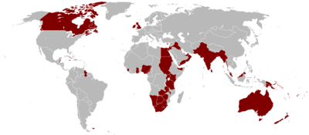
Historical reason
British Empire

Slide 6

World Language
1.5 billion speakers
And 400 million Russian speakers

Slide 7
English Use Cases Worldwide
Diplomacy
Sport
Science
Technology
Education
Internet
Mass Media
Tourism

Slide 8
Language of Software Developers
Documentation
Issue tracking
Interfaces (API, GUI, CLI)
Programming languages
Forums, mailing lists

Slide 9
StackExchange.com
One great place
Q&A forum
Community
Forums from statistics to cooking.
(screenshot)

Slide 10
Mass Media. Literacy.
More languages
More info
More opinions
More points of view
Objective information

Slide 11
Motivation
Extract knowledge
Understand deeper
Exceed limits
Learn English

Slide 12
Tips
Watch (Pulp Fiction)
Listen
Read
Speak
Surf the Web (stack exchange)
Profit

Slide 13
English, Techmaker,
Do You Speak It?
Progress Through Innovations
Conference, March 30th, 2017
Applied Maths and Computer Science Faculty
Konstantin Gorbunov, PMM-61
E-mail: konstunn@ngs.ru

