Slide 1
Angular Introduction
What is Angular?
Two flavors of Angular
Important files in Angular project

Slide 2
What is Angular?
An application framework to build single page applications
Contrast to React which is a library to build UX
An application framework provides
Necessary components to build an entire application
Caching, state management, routing etc.
A library however does not provide all of this.
You have to rely on other libraries to achieve all of this
Redux to manage application state

Slide 3
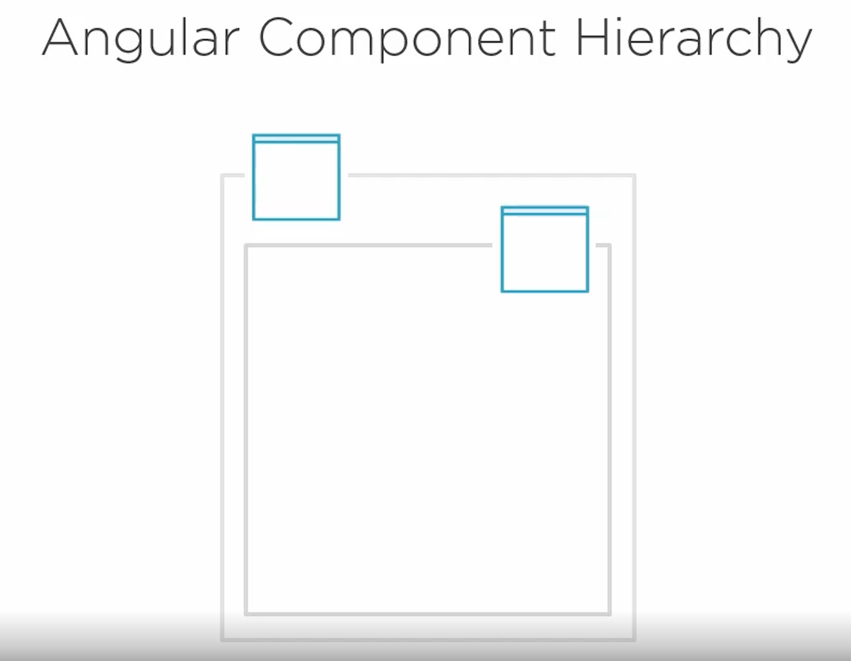

Slide 4
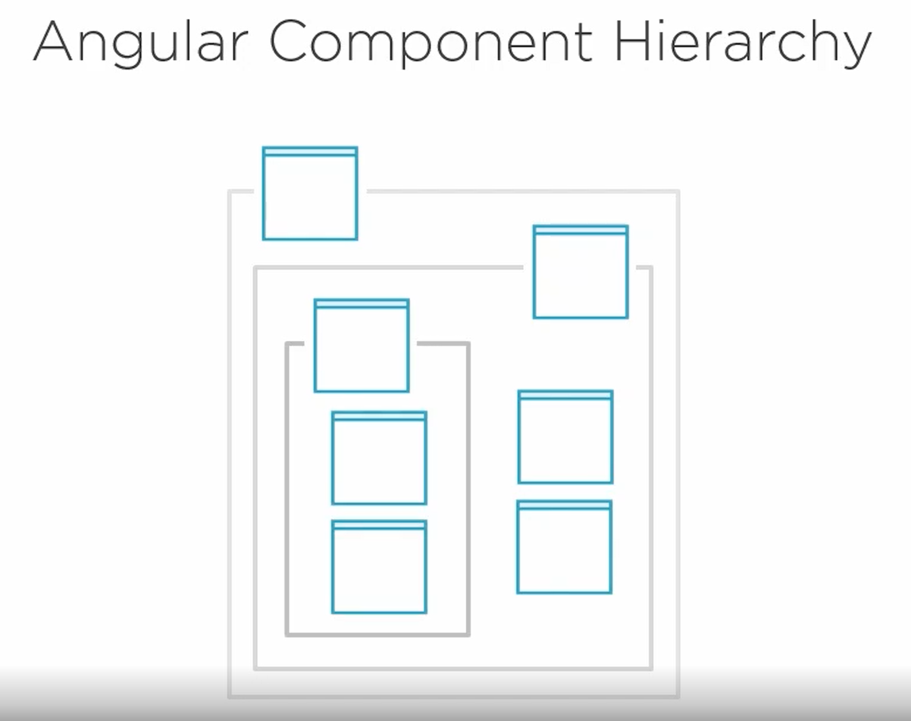

Slide 5
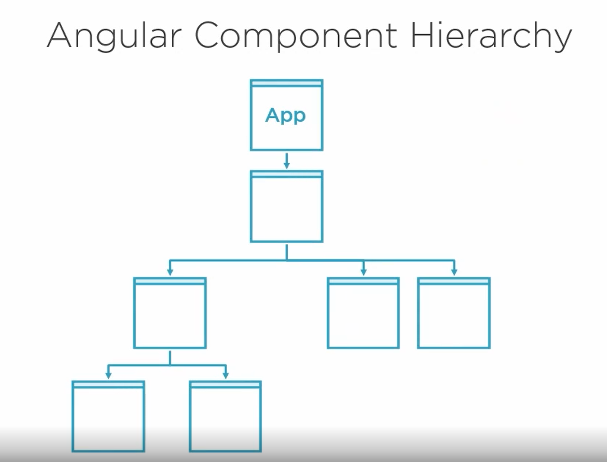

Slide 6
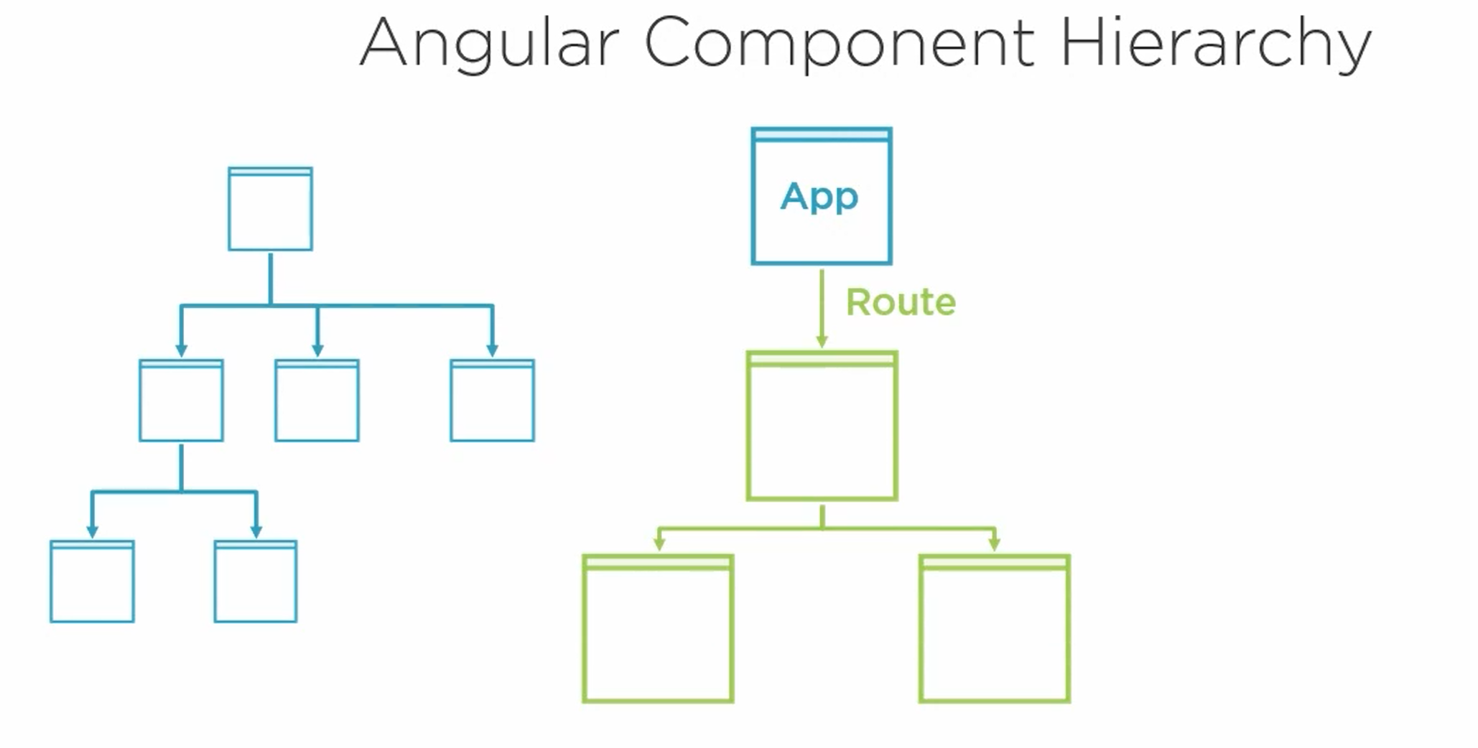

Slide 7
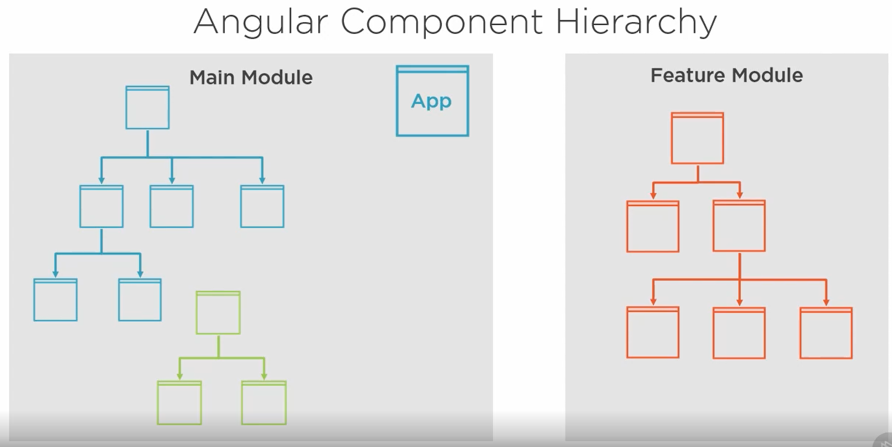

Slide 8
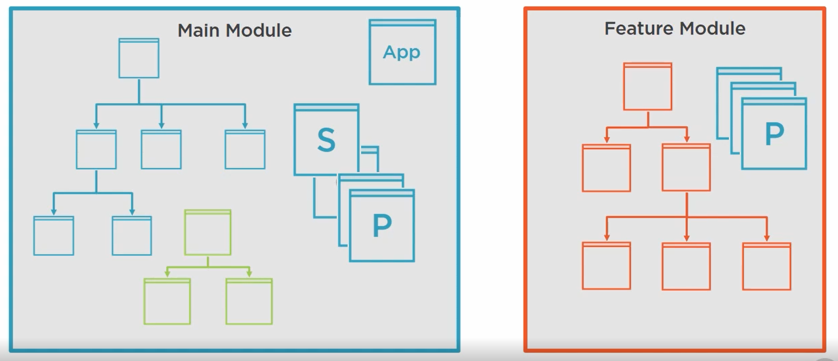
Notes:
Components, directives and pipes have to be registered in the module and they are only available in the module they are registered with. However services are available across modules since they are registered as providers in root module.

Slide 9
AngularJS vs Angular
All angular code below version 2 is called AngularJS
All angular code above version 2 is called Angular or Angular 2 or Angular 2+.
AngularJS has to be coded in vanilla Javascript
Angular has to be coded in Typescript

Slide 10
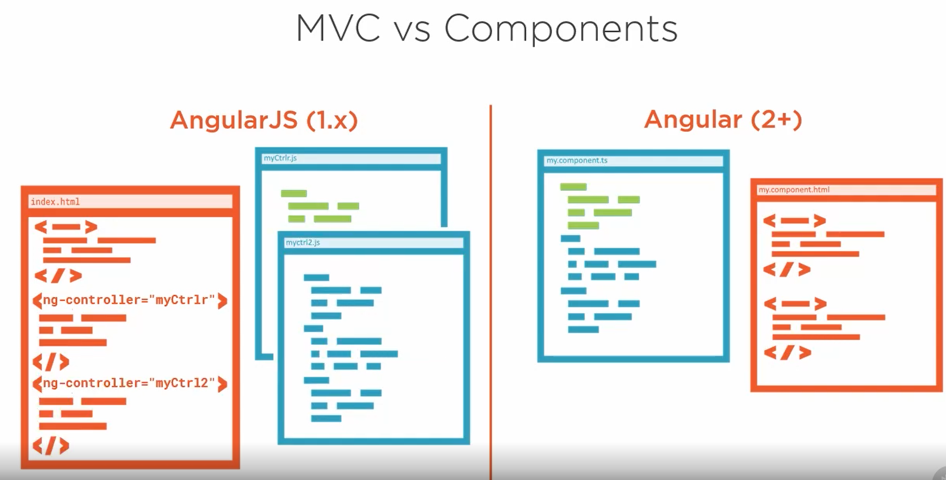
Notes:
In AngularJS you have an HTML template which identifies or maps to controller. Controller has your model or scope which holds data and behavior (functions).
In AngularJS HTML Template is in control. That is HTML template decides which controller to be loaded and executed.
However in Angular it is the component which is in charge. Component has a lifecycle and is responsible for rendering the HTML after all necessary logic has been executed.

Slide 11
Demo | Angular CLI
Create a new project using Angular CLI
ng new ng-fundamentals
Run the code ng serve or npm start

Slide 12
Important File/Folders
e2e – Integration tests source code is kept in this folder.
node_modules – All node modules are installed in this folder.
src – This is where all source code and unit tests code is placed.
angular.json -- workspace-wide and project-specific configuration defaults for build and development tools provided by the Angular CLI.
As developers you will mostly be modifying following sections of this file:
assets
styles
scripts
karma.conf.js – Configuration file for test runner Karma.
Notes:
http://karma-runner.github.io/4.0/config/configuration-file.html

Slide 13
Important Files/Folders
package-lock.json -- Package-lock is a large list of each dependency listed in your package.json, the specific version that should be installed, the location of the module (URI), a hash that verifies the integrity of the module, the list of packages it requires, and a list of dependencies.
package.json – list of dependencies and dev time dependencies. You will sometimes modify the scripts section to add more commands as we will see in future.
favicon.ico – This file represents the icon which will be displayed in favorites folder when you add your application as favorite.

Slide 14
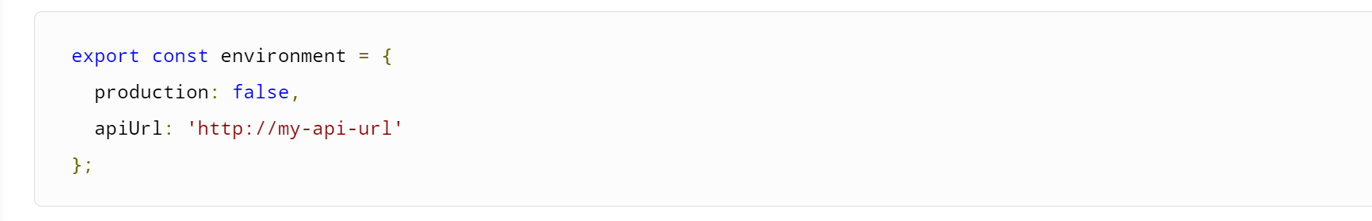
Important Files/Folders
environment.ts – The base file which contains default environment settings. To use this file in components this file needs to be imported in components.
The “build” command uses this as build target when no environment is specified.
You can add further properties on the environment object like below:

Slide 15
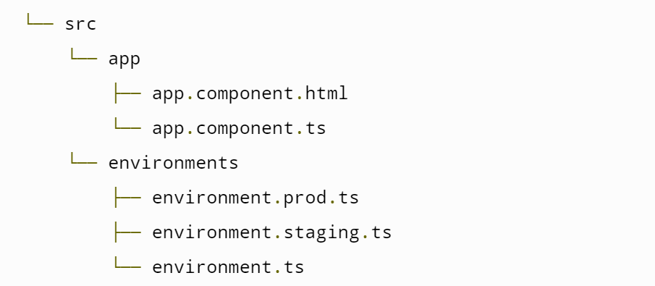
Important Files/Folders
You can add environment specific configuration files and then during the build replace environment.ts with environment specific file.

Slide 16
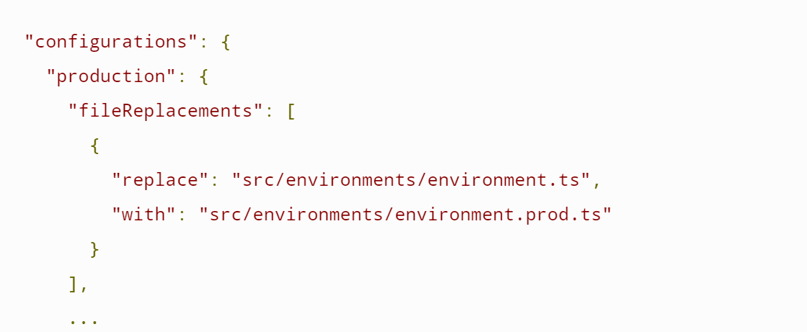
Important Files/Folders
This is how you configure the replacements:

Slide 17
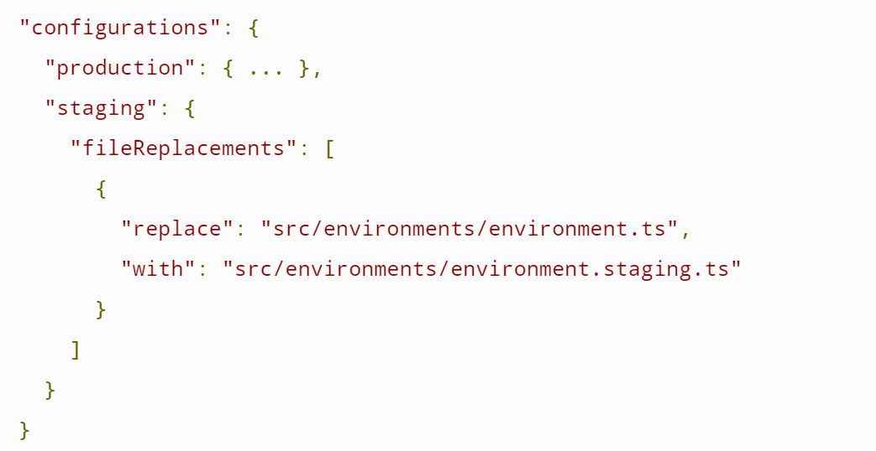
Important Files/Folders
Another replacement example:

Slide 18
Important Files/Folders
Command to use particular environment config:

Slide 19
Important Files/Folders
index.html – This is the file that is loaded in the browser first. The file has reference to root component of the application which is then processed by Angular to render the application.
main.ts – This is the code that gets executed first. It loads the AppModule which in turn loads all other modules, components, providers etc.
styles.css – Global css style file. Styles specified here will be available across the application.
.gitignore – Specifies file and folders which should not be recursed while pushing code to remote repo.
Notes:
https://dev.to/casperns/how-angular-trigger-indexhtml-and-start-working-1l46

