Slide 1
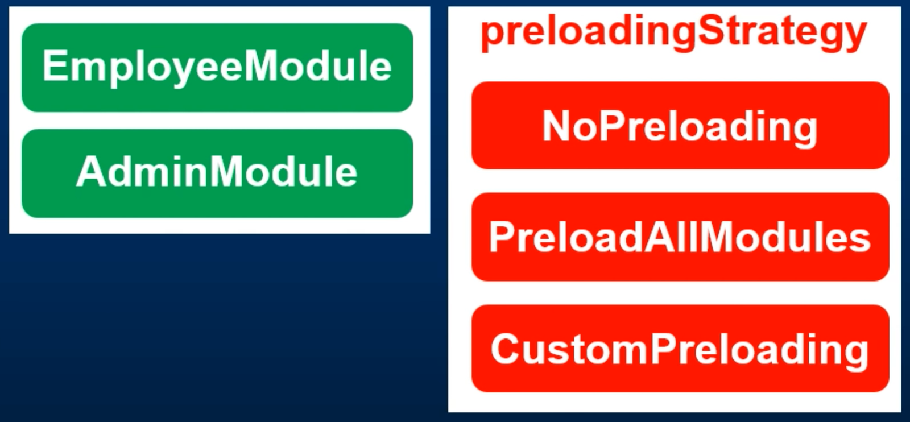
Custom Preloading Strategy

Slide 2
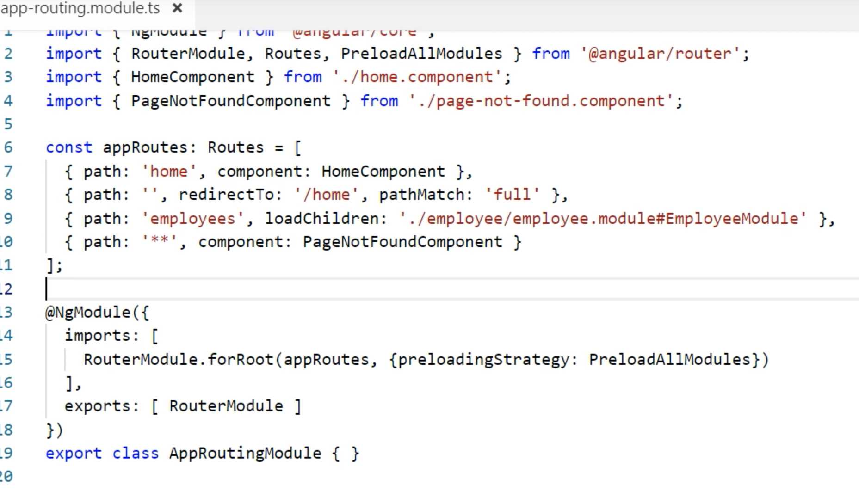
Custom Preloading Strategy

Slide 3
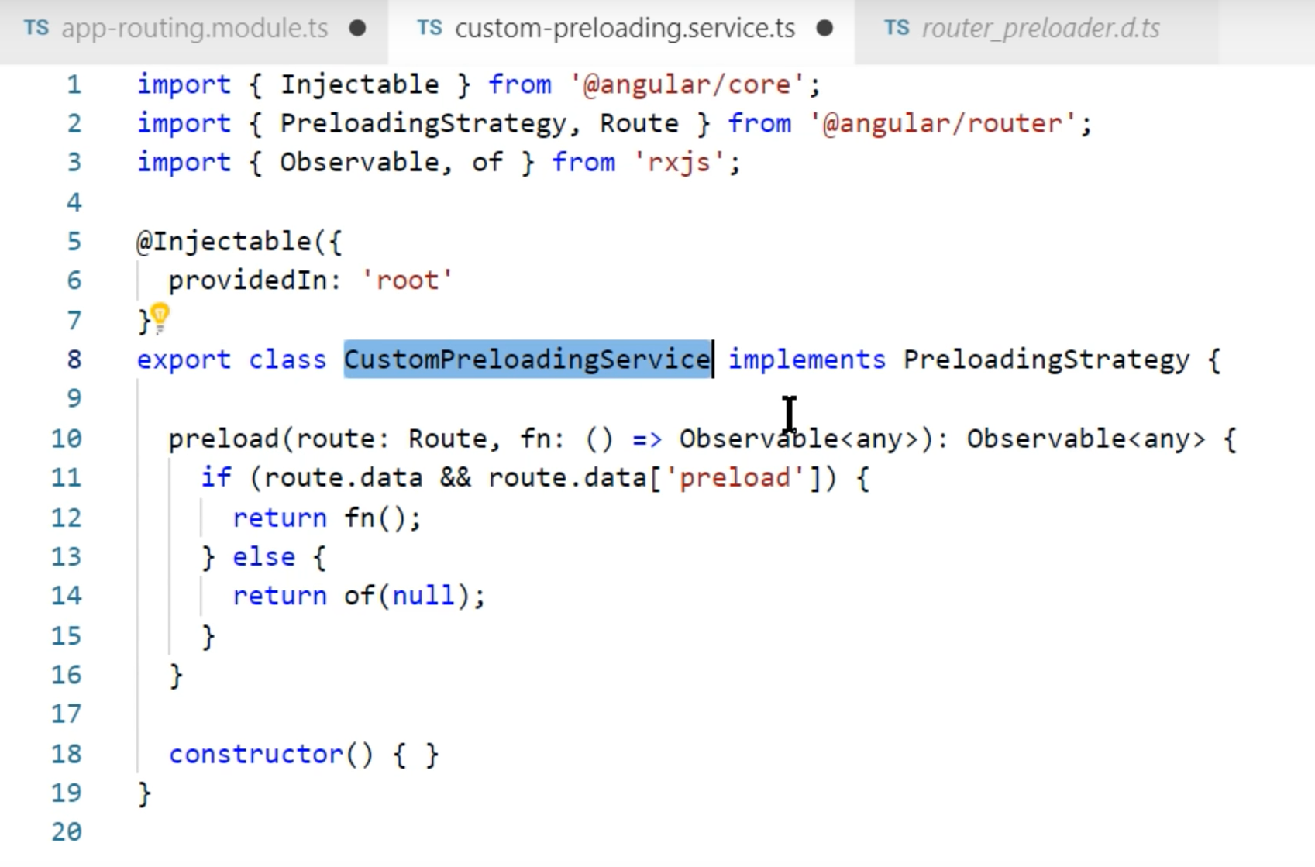
How to do custom preloading?
Create a service; call CustomPreloadingService.

Slide 4
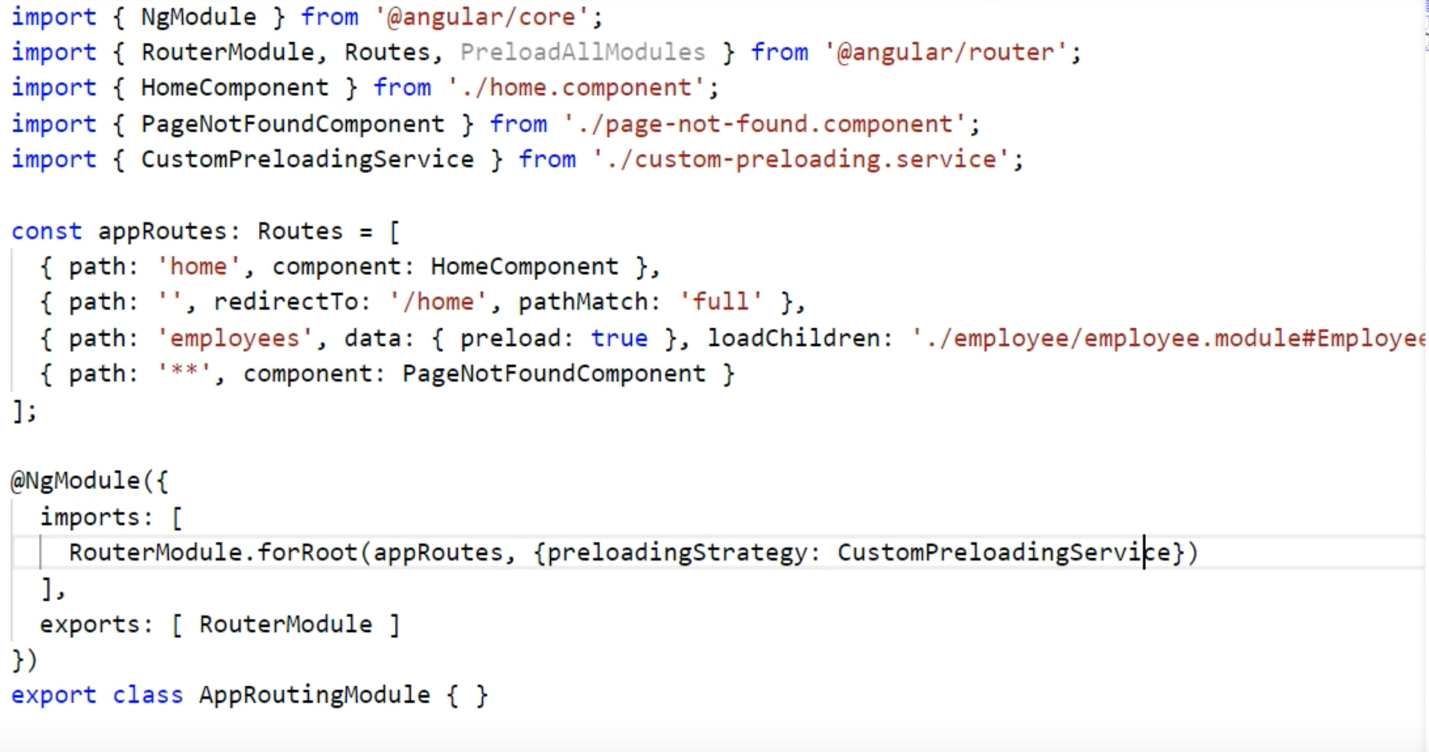
How to do custom preloading?

