Slide 1
Performance Optimization
Angular is a performant framework
But apps become slow as they grow
So its important to know how to develop performant apps

Slide 2
Performance Optimization
Improving change detection
OnPush Change detection
Use pipes instead of methods in templates
Using trackBy in ngFor
Detach change detection: For heavy computations
Improving page load
Cache static content using Angular PWA
Cache Http calls using Angular PWA
Optimize bundling and preloading
Server side rendering with Angular Universal

Slide 3
Improving change detection | OnPush change detection
Default change detection behavior for components is to re-render every time an asynchronous event has happened in the app such as click, XMLHttpRequest, setTimout.
This can become a problem because this will cause many unnecessary renderings of the templates, that may not have been changed.
OnPush change detection fixes this by only re-rendering a template if either:
One of its input properties has gotten a new reference
An event from the component or one of its children eg. click on a button in the component
Explicit run of change detection

Slide 4
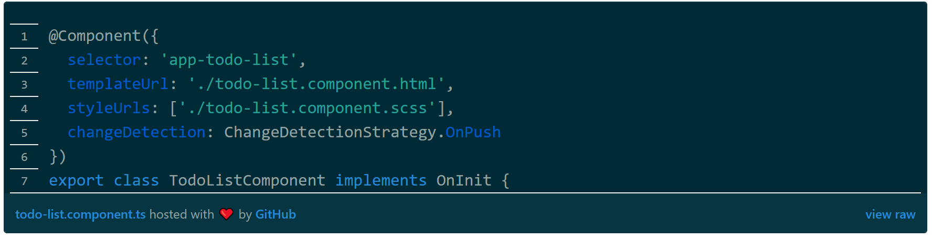
Improving change detection | OnPush change detection
To apply this strategy you just need to set the change-detection strategy in the component’s decorator:
Notes:
https://blog.angular-university.io/how-does-angular-2-change-detection-really-work/

Slide 5
Using pipes instead of methods in templates
Methods in a template will get triggered every time a component gets re-rendered.
Even with onPush change detection, that will mean that it gets triggered every time there is interaction with the component or any children of the component (click, type).
If the methods are doing heavy computations, this will make the app slow as it scales as it keeps recomputing every time there is interaction with the component.

Slide 6
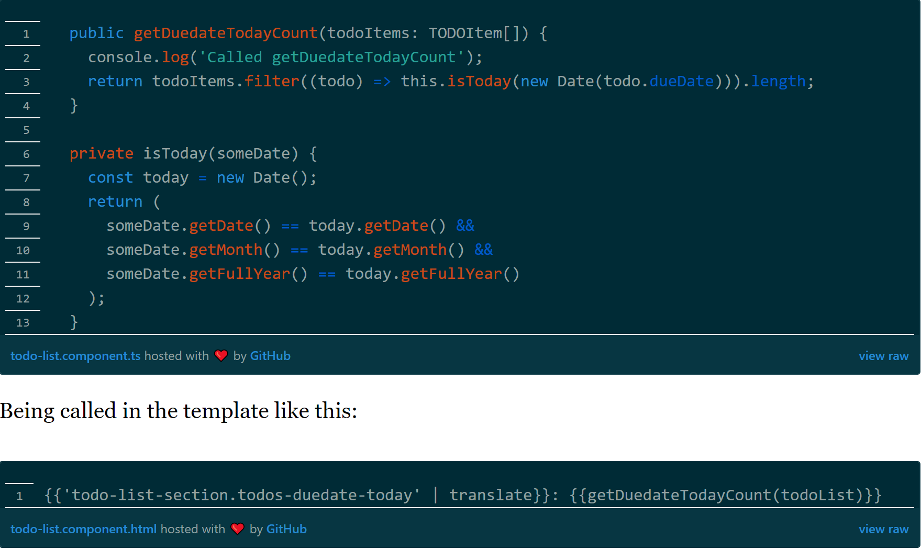
Using pipes instead of methods in templates
What you can do instead is use a pipe to make sure, that you are only recomputing when the input to the pipe changes.

Slide 7
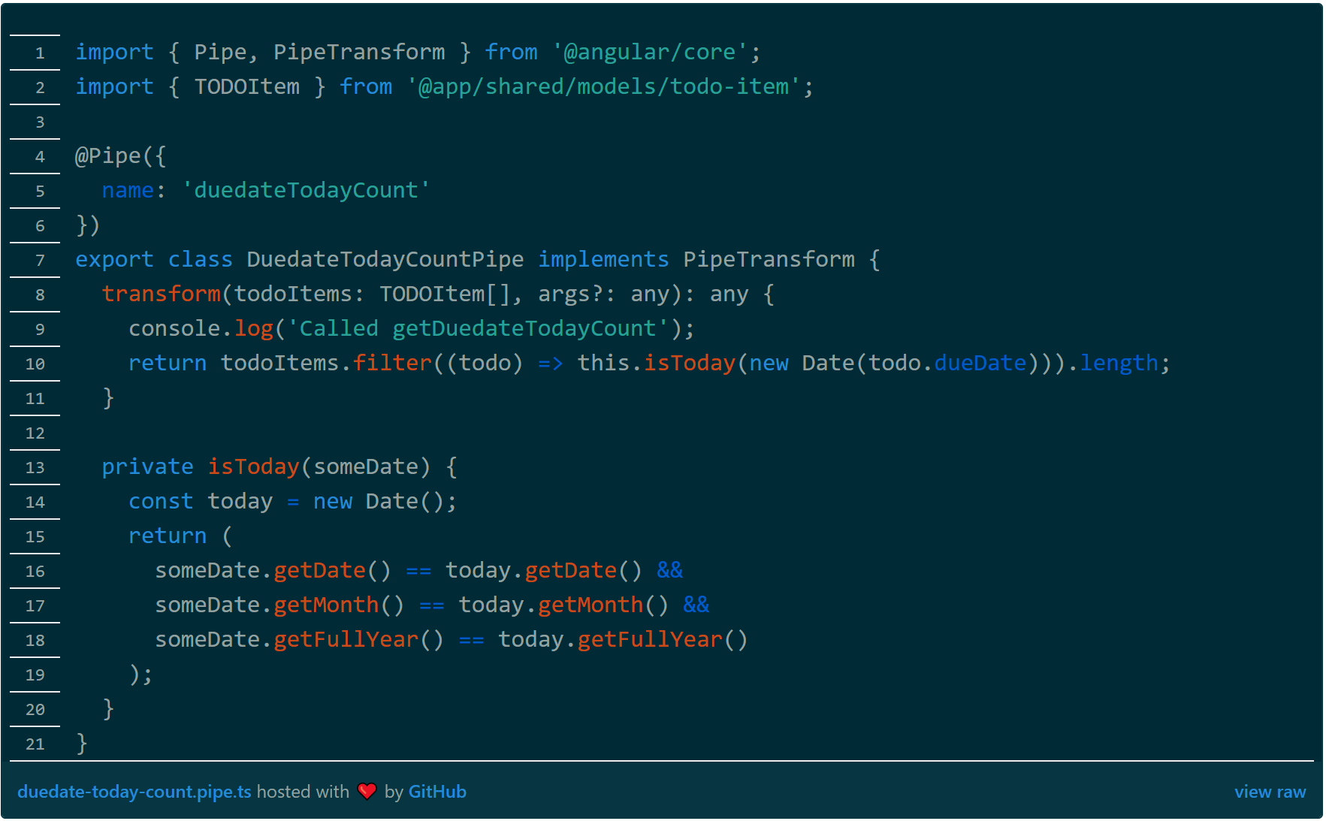
Using pipes instead of methods in templates

Slide 8
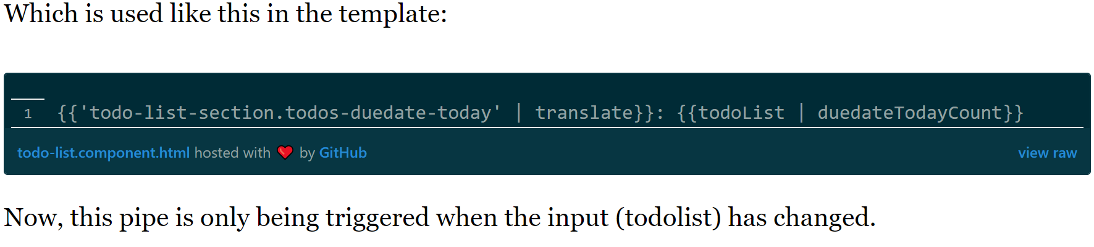
Using pipes instead of methods in templates

Slide 9
Using tractBy in ngFor
When using ngFor and updating the list, Angular will by default remove the whole list from the DOM and create it again
Because it has no way, by default, to know which item has been added or removed from the list
The trackBy function is solving this by allowing you to provide Angular with a function used for evaluating, which item has been updated or removed from the ngFor list, and then only rerender that

Slide 10
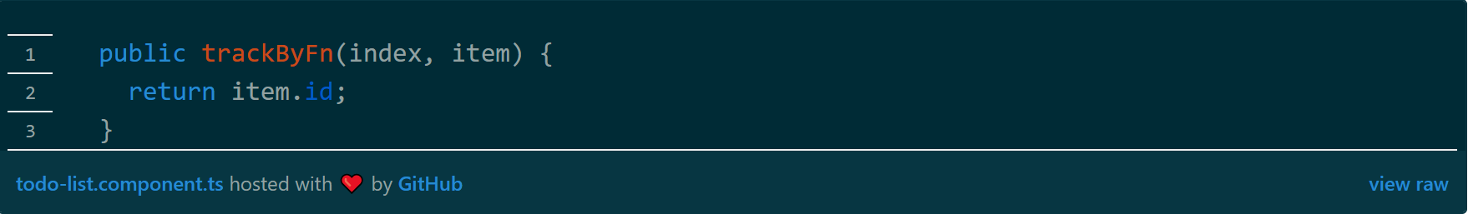
Using trackBy in ngFor

Slide 11
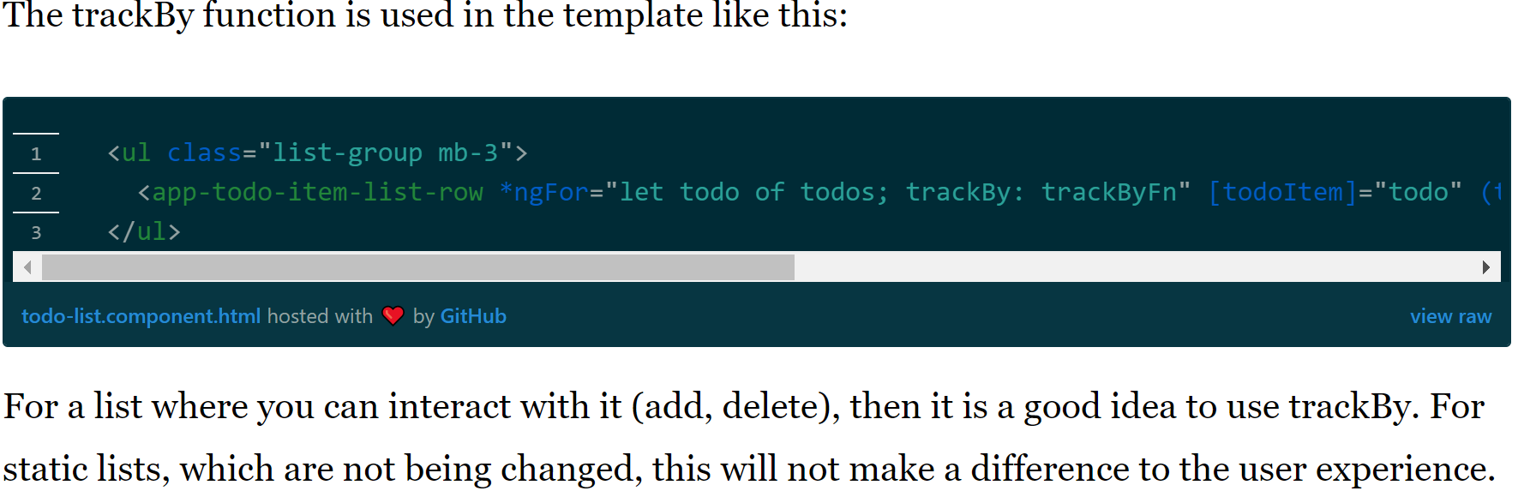
Using trackBy in ngFor

Slide 12
Detach change detection | For heavy computations
In extreme cases, you would want to only trigger change detection manually for some components.
That is if a component is instantiated 100’s of times on the same page and re-rendering every one of them is expensive you can turn off automatic change detection completely for the component and only trigger changes manually in the places it is necessary.

Slide 13
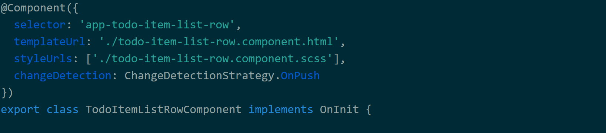
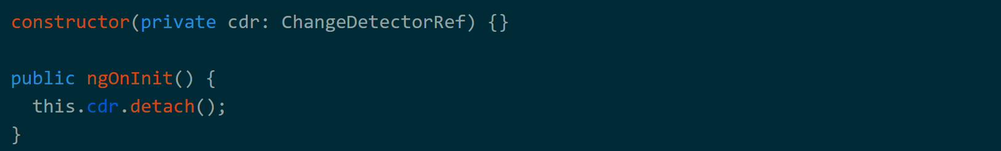
Detach change detection | For heavy computations

Slide 14
Improving Page Load
Use CSS Sprites for small images – to request less
Cache HTTP calls using Angular PWA
Lazy load routes
Optimizing bundling and preloading

Slide 15
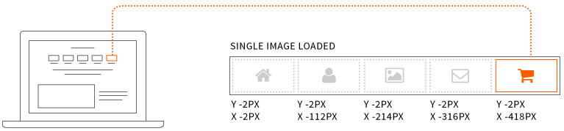
CSS Sprites
A CSS Sprite performance optimization technique
It combines multiple images into a single image called a sprite sheet or tile set
Sprites reduce network congestion by reducing the number of downloads needed to render a web page

Slide 16
How CSS Sprites Work
A web developer merges several images into a single sprite sheet placing them in a grid like pattern
When a particular image is needed, the CSS references the sprite sheet, offsets it by the index of the desired sprite then defines the size of sprite in pixels

Slide 17
How to create a CSS Sprite Sheet
There are many tools to automate building the sprite sheet.
Sprite sheet can also be generated in any image editing program

Slide 18
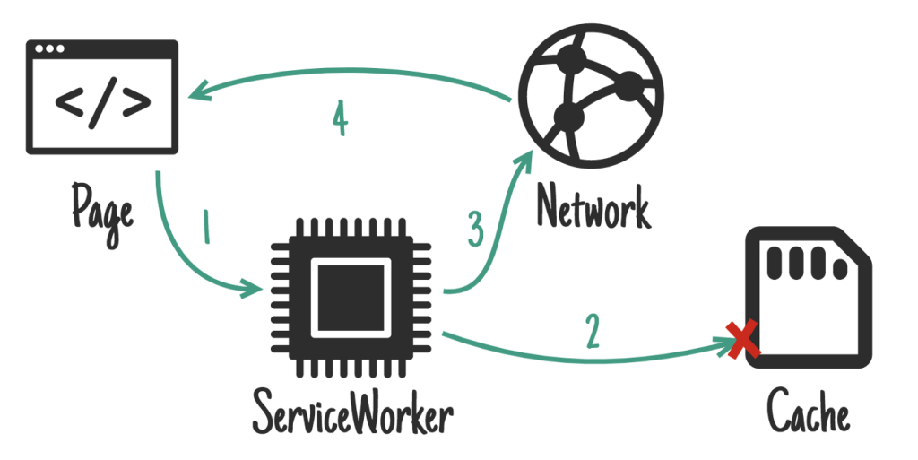
Cache Http Calls Using Angular PWA
In PWA a concept called ServiceWorker helps us to configure caching
ServiceWorker hooks into XHR requests
Keeps application free of caching logic

Slide 19
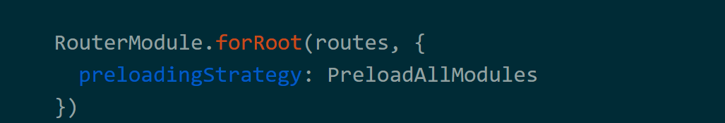
Optimizing bundling and preloading
To optimize page load even further you can choose to preload the feature modules, so navigation is instant when you want to render lazily loaded module:

Slide 20
Overall Steps
OnPush Change Detection
Lazy loading modules
Improve page load with Angular PWA
trackBy for ngFor
Pure pipes instead of methods (including async)
Cache HTTP requests better
Detach/manual change detection
Angular Universal

