Slide 1
Angular Development - Artifacts
Component
Directives
Pipes
Services
Modules
Form – But it is a component.
Custom Validator – But it is a directive.
Resolver – But it is a service.

Slide 2
Angular Development - Artifacts
Route Guard – But it’s a service or a simple function.
Your entire application is an interaction of these artifacts.

Slide 3
Angular Development - Artifacts
Component - Components are the most basic UI building block of an Angular app. An Angular app contains a tree of Angular components.
Angular components are a subset of directives, always associated with a template. Unlike other directives, only one component can be instantiated per an element in a template.
Directive – Is a TypeScript class. You can define your own directives to attach custom behavior to elements in the DOM.
Pipe – Is a Directive that helps you do data formatting tasks in an elegant manner.

Slide 4
Angular Development - Artifacts
Services – Is a TypeScript class. Are used to wrap complex piece of code and to talk to server using HttpClient and RxJS. Services must be injected into components or other services, directives before the service methods can be called.
Module – Just a wrapper or container for other Angular artifacts. All Angular artifacts of a module are loaded when the module is loaded. Modules are eagerly loaded by default and can be lazily loaded. Two types of modules are possible in Angular one is Core Module and other is Feature Module. Core Module is responsible to bootstrap the application and feature modules provide app specific features.

Slide 5
Angular Development - Artifacts
Form – An application has multiple forms. Forms are implemented as Components in Angular.
Custom Validator – Validates one or more fields and implemented as a Directive.
Resolvers – Is called by Angular automatically when user hits a route and calls the “resolve” method on the service to prevent a route from being activated by the user.
Route Guard – Is called by Angular automatically when user hits a route to prevent user from activating the route. One example is Auth Guard which makes sure user is authenticated.

Slide 6
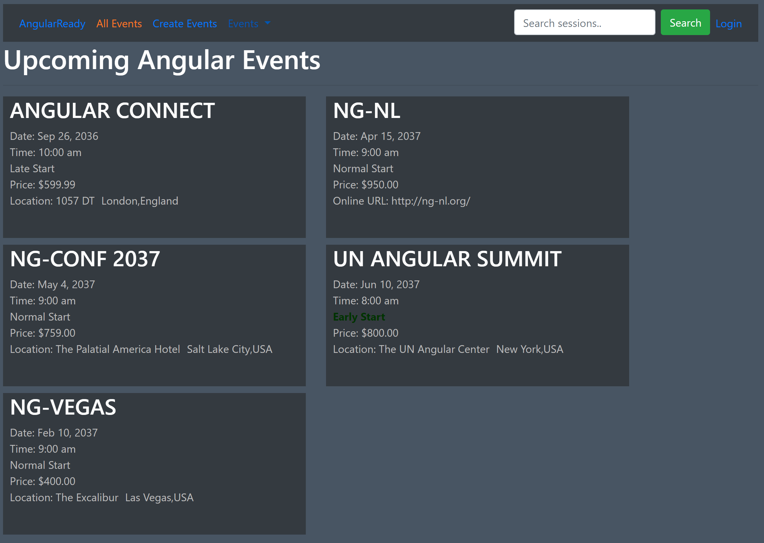
Angular Development – Let’s Begin

