Slide 1
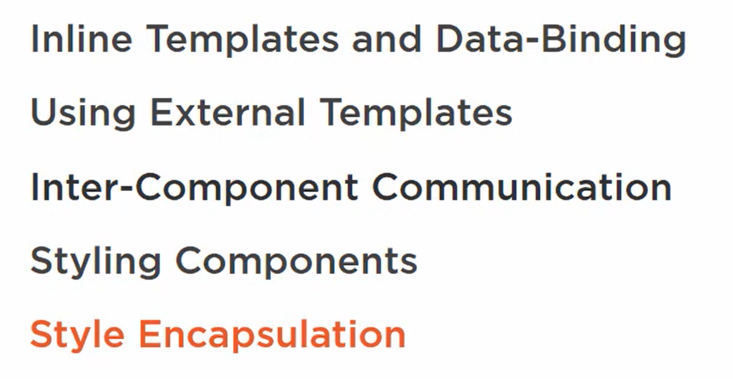
Creating and Communicating Between Components

Slide 2
Create a Component

