Slide 1
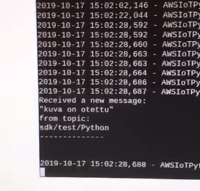
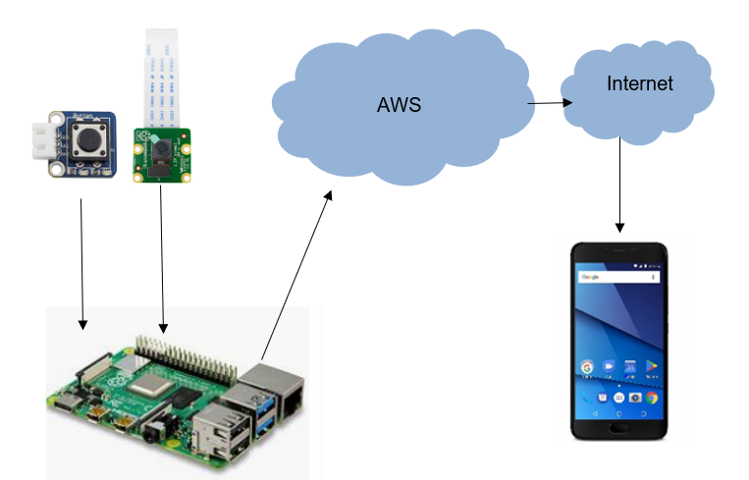
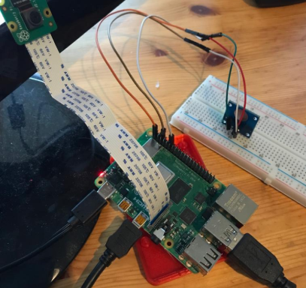
Access control with Raspberry pi camera
Kontu, Prokkola, Salmela-Siniketo TVT18KMO
Information Technology, Software Development
Introduction
Raspberry pi sends the image to the AWS server in cloud, whereof supervisor can view the picture on his own Android phone.
FIGURE 1. System diagram of the product
Objectives
The aim of this project was to make an access control system, using Raspberry pi camera, AWS web service and Android phone. When someone wants to step in, he presses the button, and Raspberry pi camera take a photo.
Methods
Raspberry pi programs were developed with Python. Raspberry detects when a button is pressed and sends a message and an image to the cloud. Android phone can open images in the cloud.
FIGURE 2. Connecting camera and button to Raspberry
Results
This project went rather closely according to the original plan. AWS was a new thing and initially difficult to use. Schedule reasons, we had to leave out some previously planned things from the program.
FIGURE 3. Aenean hendrerit
FIGURE 3. A new message has been sent
Conclusions
Had there been more time, we would have added a point to the program where the phone user can either accept or reject the access request. To this end, we would have used green and red LEDs at the project stage.
References
https://aws.amazon.com/
https://www.raspberrypi.org/
Project
ECTS credits: 3
2019, Autumn
Instructor: Pertti Heikkilä

