Slide 1
Estimating Action Potential Thresholds From Neuronal Time-Series

Slide 2
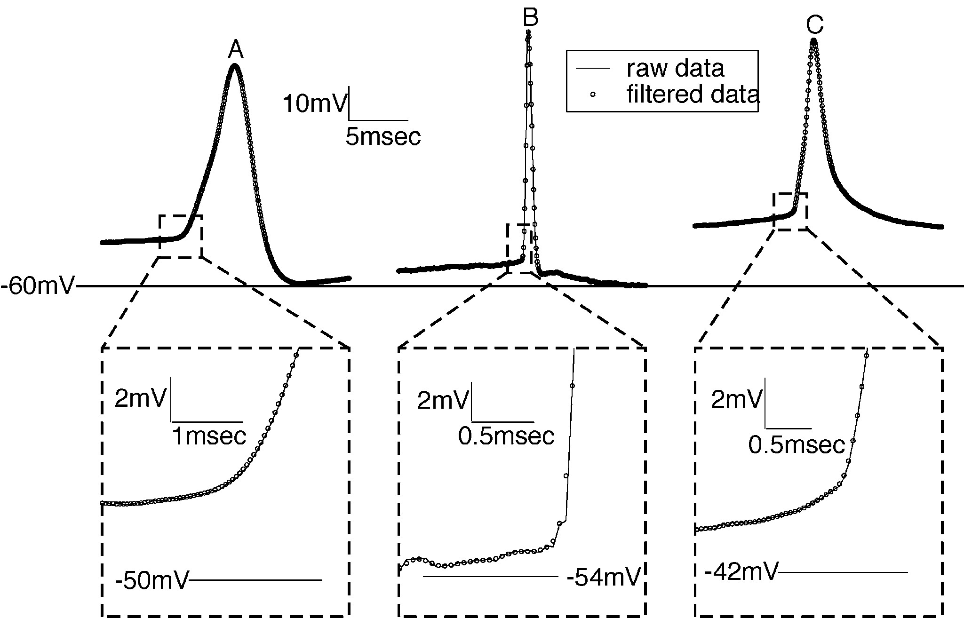

Slide 3
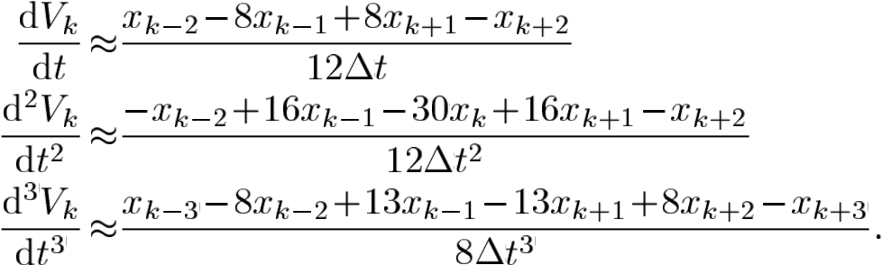
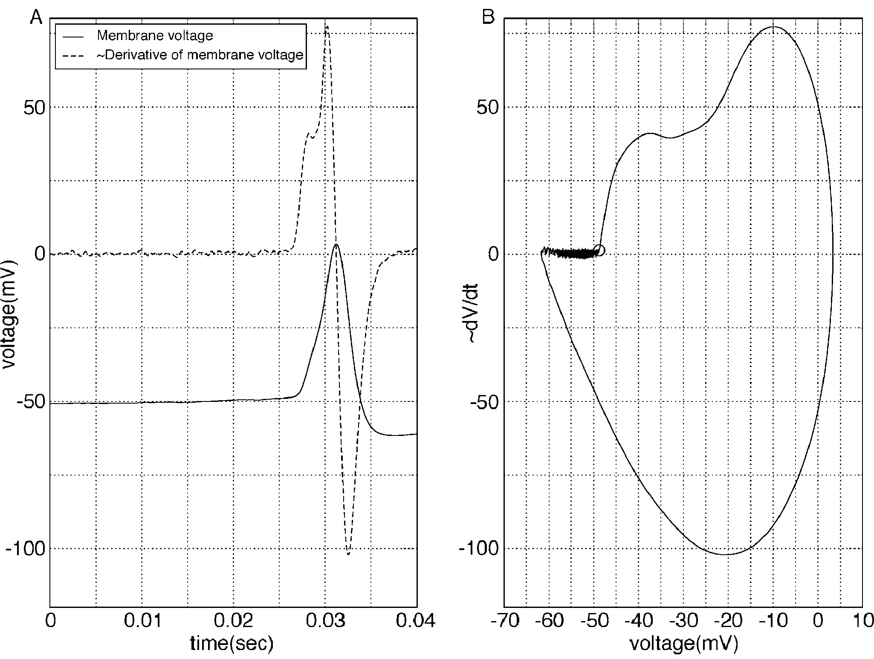
Derivative estimates

Slide 4
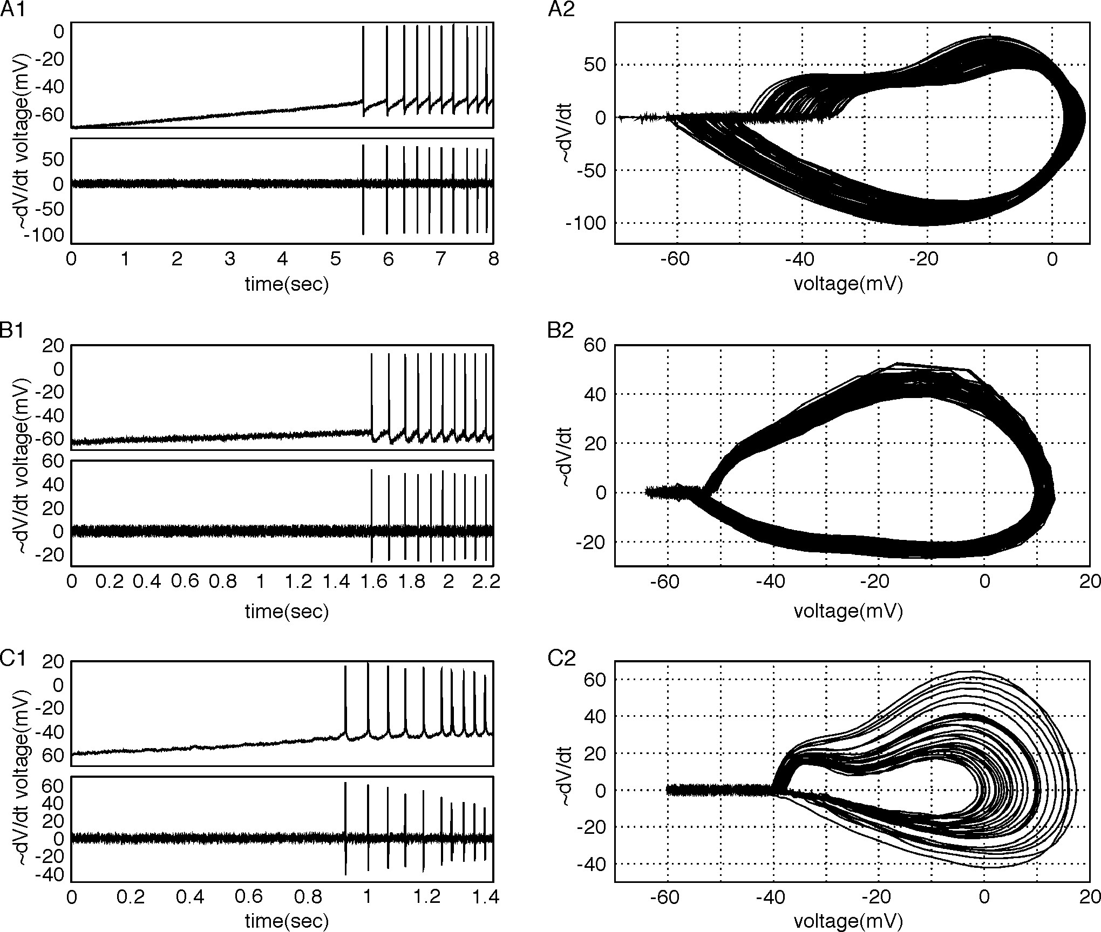

Slide 5
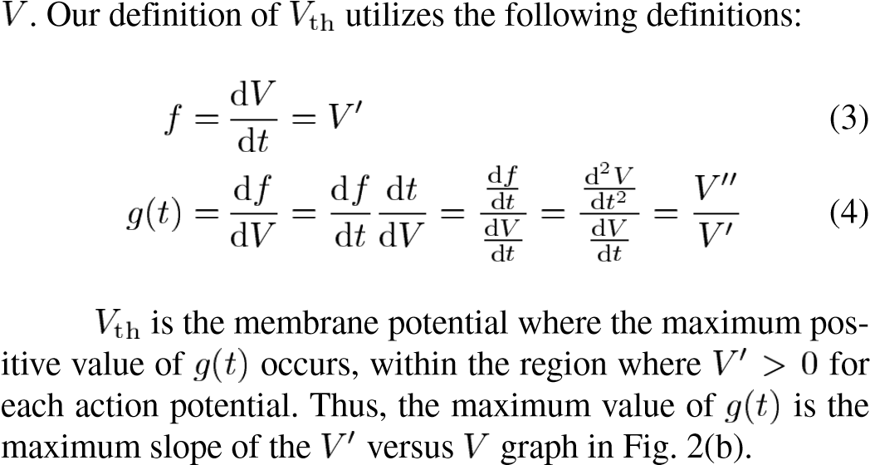
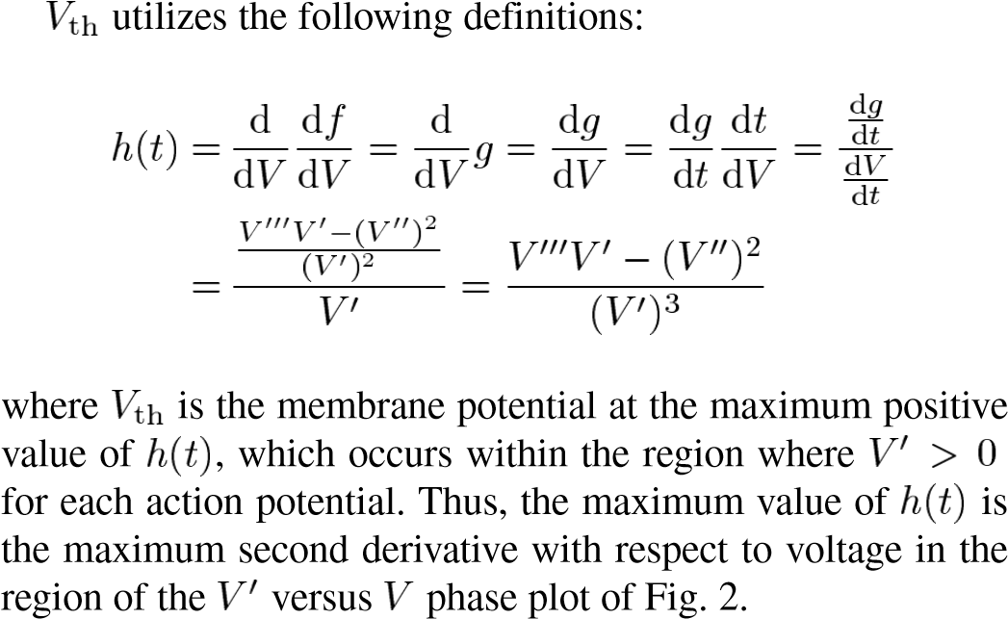

Slide 6
Algorythm AP Th
Transfer the data into Py-Enviroment
Do some cleaning-filtering
Detrent the V-trace – remove the baseline, but keep the information about the baseline in separate variable (Vbase_mem)
Check if the trace has Ap at all, if NO – abort execution
Split the trace into separate AP:
Define the minimal distance between separate AP and make the typical processing window (pre-spike, and post-spike)
Find 1st, 2d, and 3d derivatives and then a g(t)-function
Find the nearest point in V(t) where (g(t)>0)_{dV/dt>0}→max

Slide 7
Additionally:
Also need to calculate into the general statistics alongside with Th:
Am,
Slope,
Decay,
Baseline,
AP power (area under dV/dt vs V(t)),
time of AP Am,
time of AP Th,
Area under dV/dt >0,
Area ander dV/dt <0,
max(dV/dt >0),
max(dV/dt <0)

