Slide 1

aa

Slide 2
MOBILE DEVICE PROGRAMMING
TEAM2 PROJECT

Slide 3

AGENDA
CORNER
SAMRETH
SILVANA
SOKCHEA
APP PERSISTENT
YEALTH
APP SETTING
YOGA AND HEALTH
USER STATISTIC
MDP PROJECT - TEAM 2 - 2022

Slide 4
YEALTH
TEAM
AGENDA
1. Team & Role
2. Project Overview : 2.1. The Product 2.2. Persona 2.3. Usability
3. App Architecture : 3.1. Layout 3.2. Design Pattern 3.3. Dependency
4. App Demo
5. Project Repository
6. Project Conclusion
MDP PROJECT - TEAM 2 - 2022
YOGA AND HEALTH
APP PERSISTENT
APP FLOW
APP RESOURCES
ONBOARDING
APP SETTING
USER SETTING
MEDIA RESOURCES
CALCULATOR
USER STATISTIC
ARTICLE SCREEN
CONTENTS PLAYER
USER DATA

Slide 5
YEALTH
AGENDA
TEAM
KONURALP
SAMRETH
SILVANA
SOKCHEA
APP PERSISTENT
APP FLOW
APP RESOURCES
ONBOARDING
APP SETTING
USER SETTING
MEDIA RESOURCES
CALCULATOR
USER STATISTIC
ARTICLE SCREEN
CONTENTS PLAYER
USER DATA
MDP PROJECT - TEAM 2 - 2022
YOGA AND HEALTH

Slide 6
USABILITY
PRODUCT
A yoga mobile application with convenience/smooth UI and light weight storage which allows users to practice yoga easily and provides them additional wellness functionalities for tracking their health and reaching wellness related articles.
PERSONA
Our users are people who enjoy doing yoga at their flexible times and prefer light, simple mobile application with enough functionalities instead of heavy application with complex UI.
MDP PROJECT - TEAM 2 - 2022

Slide 7
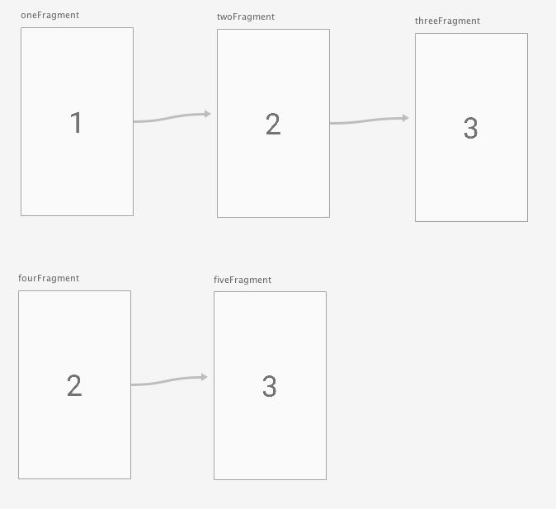
ARCHITECTURE
USABILITY
MDP PROJECT - TEAM 2 - 2022
NAVIGATION COMPONENTS
All Screens Navigations
Our Main App Flow

Slide 8
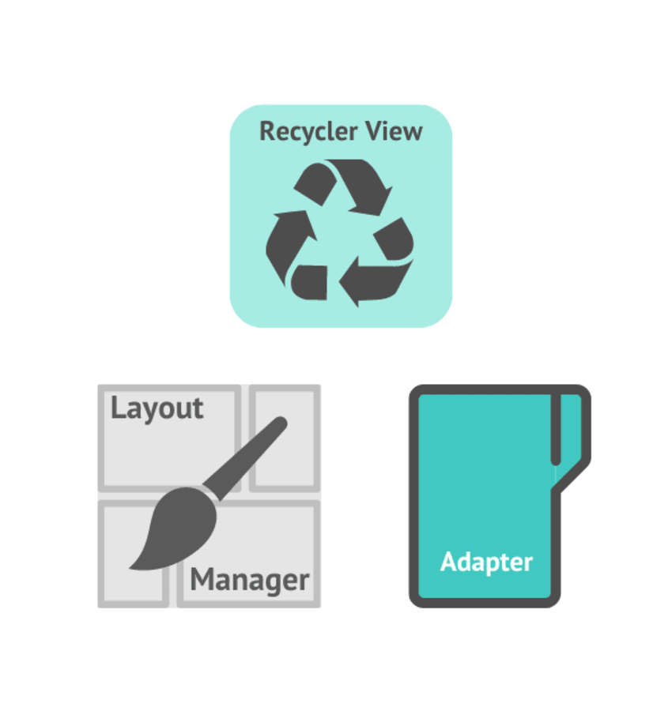
USABILITY
ARCHITECTURE
NAVIGATION COMPONENTS
All Screens Navigations
Our Main App Flow
MDP PROJECT - TEAM 2 - 2022
RECYCLEVIEW
Articles View
User Statistics View

Slide 9
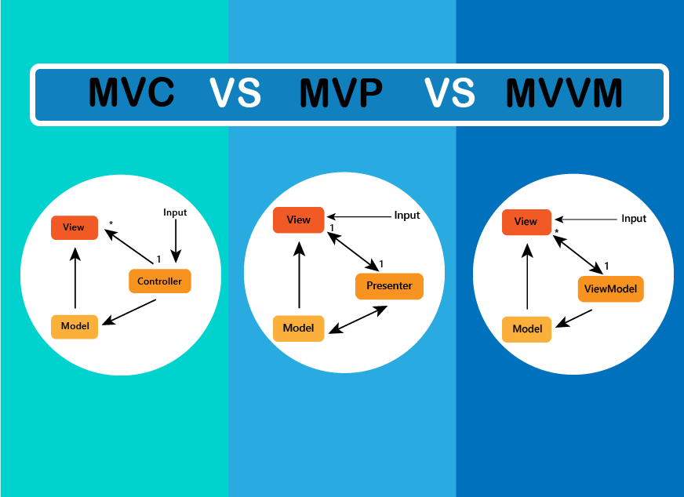
NAVIGATION COMPONENTS
All Screens Navigations
Our Main App Flow
DESIGN PATTERN
ARCHITECTURE
RECYCLEVIEW
Articles View
User Statistics View
MDP PROJECT - TEAM 2 - 2022

Slide 10
DEPENDENCY
ARCHITECTURE
DESIGN PATTERN
MVC
Simple UI/Process: Saving User Profile ,Displaying Articles
MVVM
App Database
Saving App State
Media Player
Contents Fetching
MDP PROJECT - TEAM 2 - 2022
RECYCLEVIEW
Articles View
User Statistics View

Slide 11
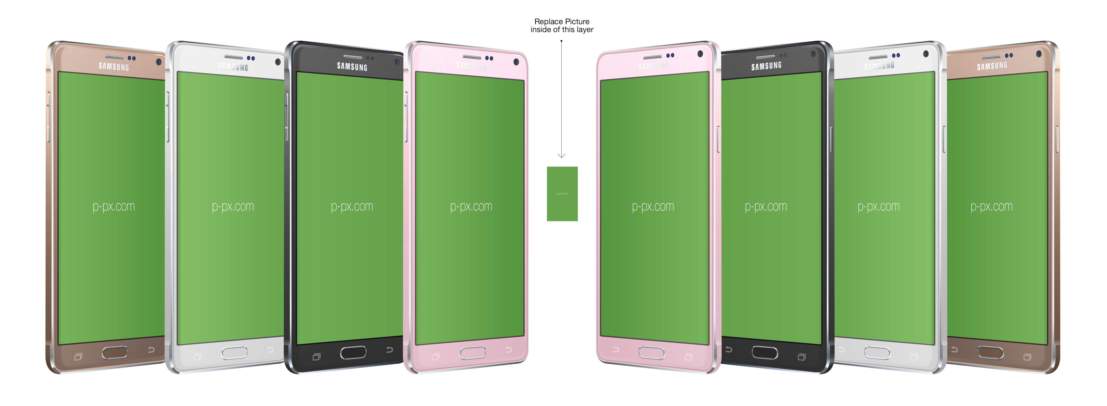
DESIGN PATTERN
APP DEMO
DEPENDENCY
ANDROID
View Model
Navigation Components
Room Database
Coroutines
Material IO
Kotlin
MDP PROJECT - TEAM 2 - 2022

Slide 12

REPOSITORY
DEPENDENCY
APP DEMO
MDP PROJECT - TEAM 2 - 2022

Slide 13
APP DEMO
PROJECT CONCLUSION
REPOSITORY
GitHub:
https://github.com/team2-mdp/yoga-app
team2-mdp
MDP PROJECT - TEAM 2 - 2022

Slide 14
REPOSITORY
PROJECT CONCLUSION
Our Yealth app is built successfully and powered by many layers of android components and frameworks. We engineered it with layers of abstractions and design patterns.
Likewise, life is found in layers. Each layer is consciousness in different disguises and conform to different law/protocol. Balance and success life occur when we are able to freely access and control these layers.
MDP PROJECT - TEAM 2 - 2022

Slide 15

PROJECT CONCLUSION
THANK YOU FOR YOUR TIME !!!
MDP PROJECT - TEAM 2 - 2022

