Slide 1
Migration Overview (draft)
new-trading-app
trading-app
postgresql / Service
DBMS Configuration
db.yaml
App start-up script
TODO
psql
Job (Pod)
DB init scripts (database creation, table creation)
init.yaml
Volume Mount
ConfigMap
DB endpoints / SQL
init scripts
SQL files

Slide 2
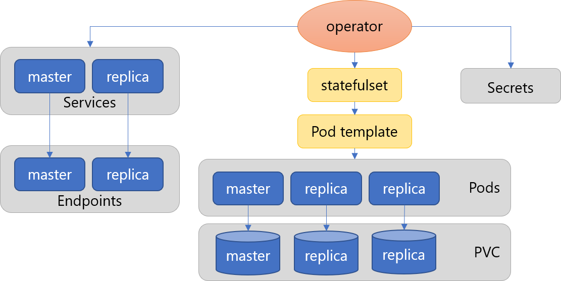
Results (2):DiVA DOA (Database Operator Adaption) MVP
Nov.-Dec., 2021
DOA: Code and configuration analysis for automatic migration to Kubernetes Postgres Operator Kubernetes Operator Automatically manages resources (Pod, RS, Service, PV, ...)
Postgres Operator by Zalando Maintains Postgres HA clusters
✓ Implemented MVP including
Configuration and script analysis
Kubernetes Manifests generation
Containerization of this tool itself
To be published on DiVA repository
DiVA-DOA: Overall Architecture
postgres .yaml
init-pod .yaml
diva-doa
DiVA Tools
Analyzer/ Generator
generate
secrets .yaml
cm- scripts .yaml
cm- sqls .yaml
Target app
HA cluster managed by Postgres Operator
DBMS config
SQL files
Codes, Start-up scripts
Documents
= implemented
Notes:
MVP demo を作ったとする

