Slide 1


FundRaiser

Slide 2



Presentation Outline
Team Members Introduction
FundRaiser Web Application
Technology Stack Overview
Architecture Overview
Database Overview
Team Organization
Scenario Demonstration

Slide 3
Team Members Introduction
Vidakis Konstantinos
Vrachoritis Vasilios
Mitsakos Ioannis
Pantelakis Michalis

Slide 4


FundRaiser Web Application
Crowdfunding Platform
Create a Project and get funding for it!
Invest in a Project that you like and get a reward!

Slide 5
Technology Stack Overview
.NET Core Framework
Entity Framework Core
Microsoft SQL Server Management Studio
xUnit
HTML and CSS (Bootstrap)
Microsoft Azure
GitHub

Slide 6
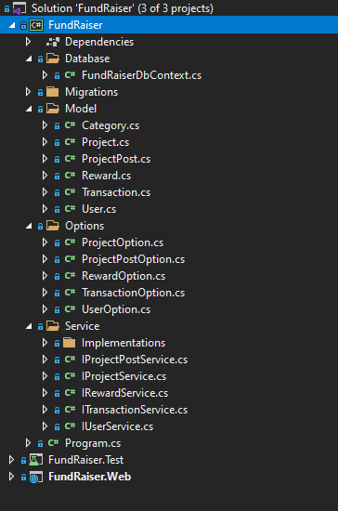
Architecture Overview
Project Structure:
Core : Database, Models, Services (Interfaces & Implementation)
Test : xUnit tests for Services implemented on Core
Web: ViewModels, Controllers, Views

Slide 7
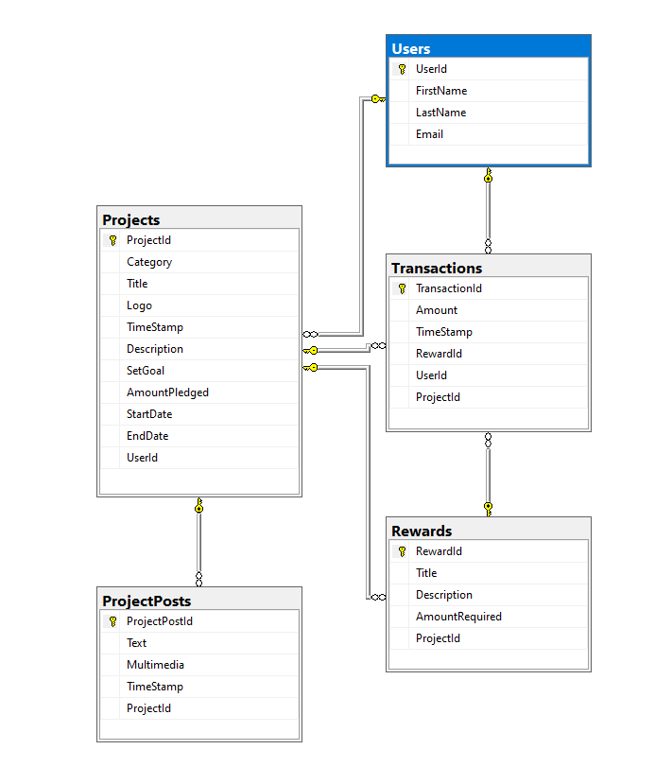
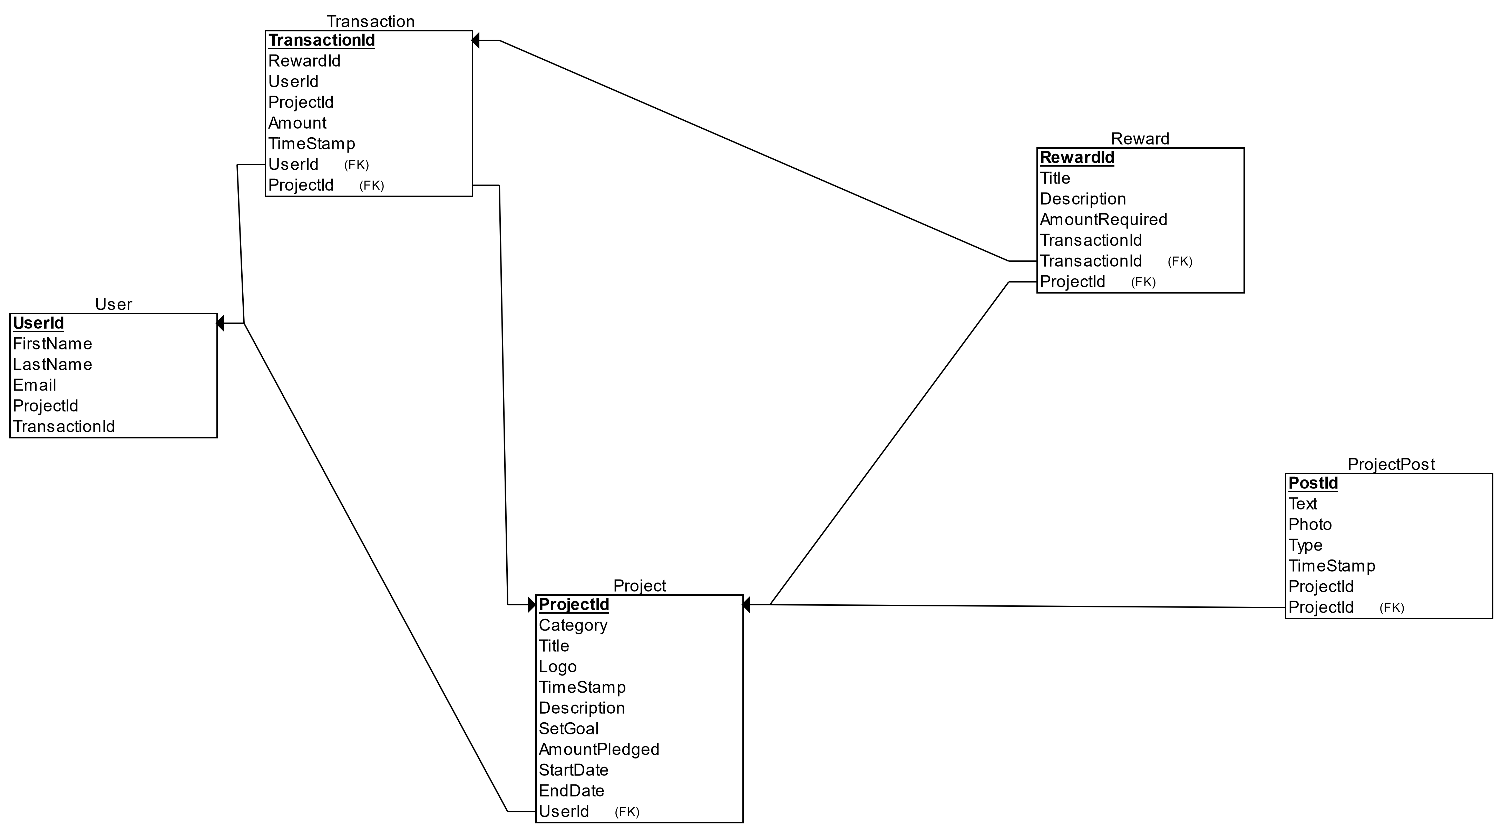

Database Overview

Slide 8

Team Organization
Microsoft Teams for Communicating & Coding Sessions
GitHub for tracking changes & collaborative work
Azure for having a common database

Slide 9
Project Requirements
Create a Project with reward packages
Fund a project by selecting a reward package
View list of available projects and project details
Used EF Core, DI and Coding conventions
Worked with GitHub and deployed Application on Azure
Wrote Unit Tests and experimented with REST API for third party integrations

Slide 10
Scenario Demonstration

Slide 11
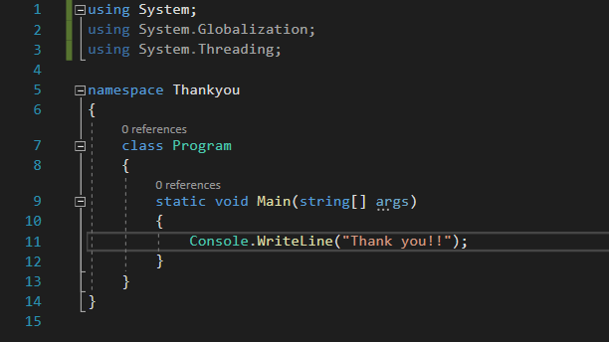
THE ENDING

