Slide 1

Konza Technopolis Partners Forum, Tree Planting and Investor Conference.

Slide 2
Introduction
The Konza Technopolis Development Authority (KoTDA) is the implementing agency for Konza Technopolis, a Government of Kenya Vision 2030 project aimed at developing a sustainable smart city and an innovation ecosystem, contributing to Kenyaʼs knowledge-based economy.
Konza offers attractive investment opportunities for investors that will contribute towards the attainment Kenya’s ambition to be a middle-income country with a high standard of living for its people by 2030. KoTDA recognises the critical role that investors and stakeholders play in actualising the Konza Technopolis.
The Authority is set to host a stakeholder engagement forum starting with a breakfast session, tree planting and Investor Conference to showcase the project progress, value propositions and investment opportunities at Konza Technopolis. The conference also provides a great opportunity to address all investor queries, and offers a platform for developers, financiers, and commercial investors to interact and network.

Slide 3
Investment Opportunities
The Conference will primarily seek to showcase the value propositions and investment cases to potential investors and developers both local and international, on the areas of investment in Konza. The investment opportunities are:
Smart Manufacturing | Medical & Pharmaceutical services Pharmaceutical services
Light Industry & Logistics | Education & training institutions
R&D Centres | Hotels & Convention Centres
Media & information services | Entertainment
Smart Agriculture | Business enterprises
Property development | Recreation and Sports facilities
ICT & IT Enabled services
Product development & innovation

Slide 4
Why Attend?
The Konza Technopolis Investors Conference offers you the opportunity to:
Get an update of the Konza Technopolis project progress, the opportunities therein, incentives and investment procedures
Meet and interact with Konza investors/developers for business opportunities
Exhibit your products
Create new linkages

Slide 5
Exhibition Opportunity
The Authority presents a Sponsorship package of Kes 50,000 with the following benefits:
An exhibition space.
A social media video to be uploaded on the Authority’s social media platforms.
Half page in KoTDA’s External Newsletter.
Branding of site and sponsor mention throughout the event.
Bank Account Details:
KCB Bank
Kipande house branch
A/c no. 1141631520
Account Name: Konza Technopolis Development Authority
NB: Kindly reach out to Ms. Brenda Kaaria, Communications Officer, at bkaaria@konza.go.ke to discuss further on your participation. In the event that you may require a tailor-made package to better suit your purpose, we shall be happy to consider.

Slide 6
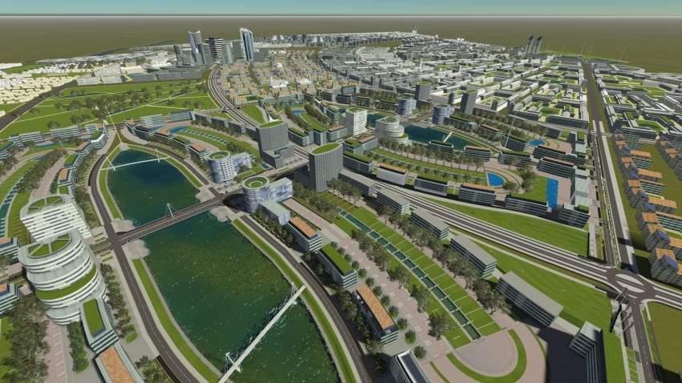

THANK YOU!

