Slide 1
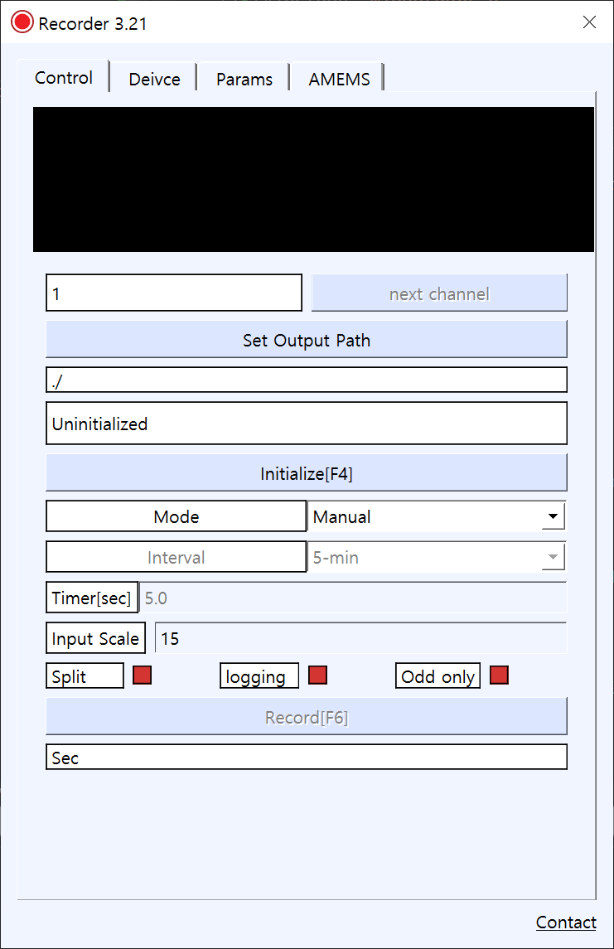
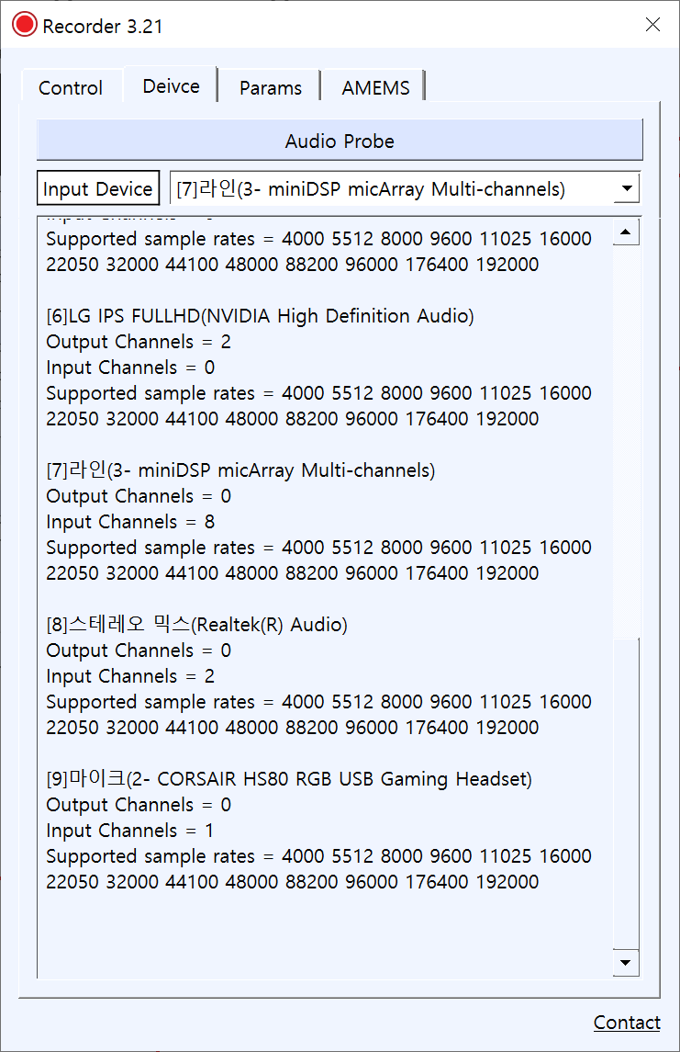
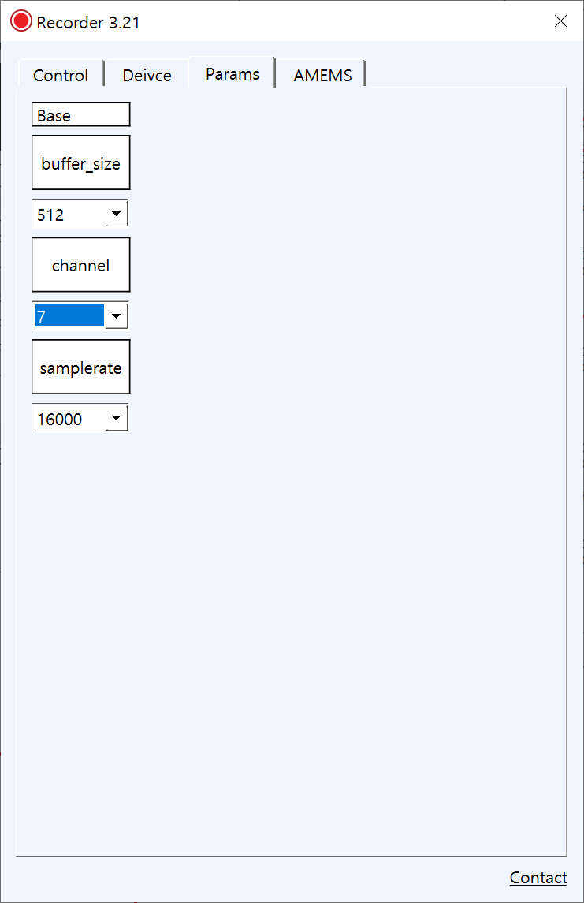
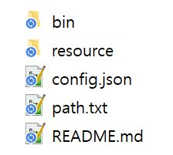
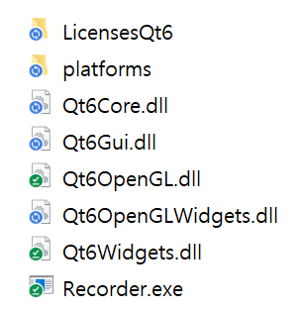
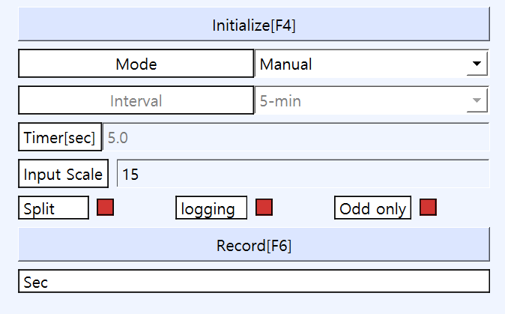
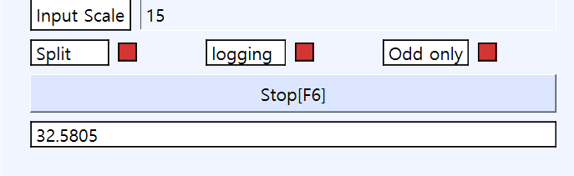
Recorder 3.21
https://drive.google.com/file/d/1Y4RpUYlp_b_RwfSBZGkKZ2jWyXNnGY2B/view?usp=sharing
1. Select Input Device
Audio Probe :
Search Connected audio devices
2. Set parameters
<< Select Input device
Input channel : 7
List of connected devices
Samplerate : 16kHz
3. Initialize and record
Initialize and Record
4. Stop

Slide 2
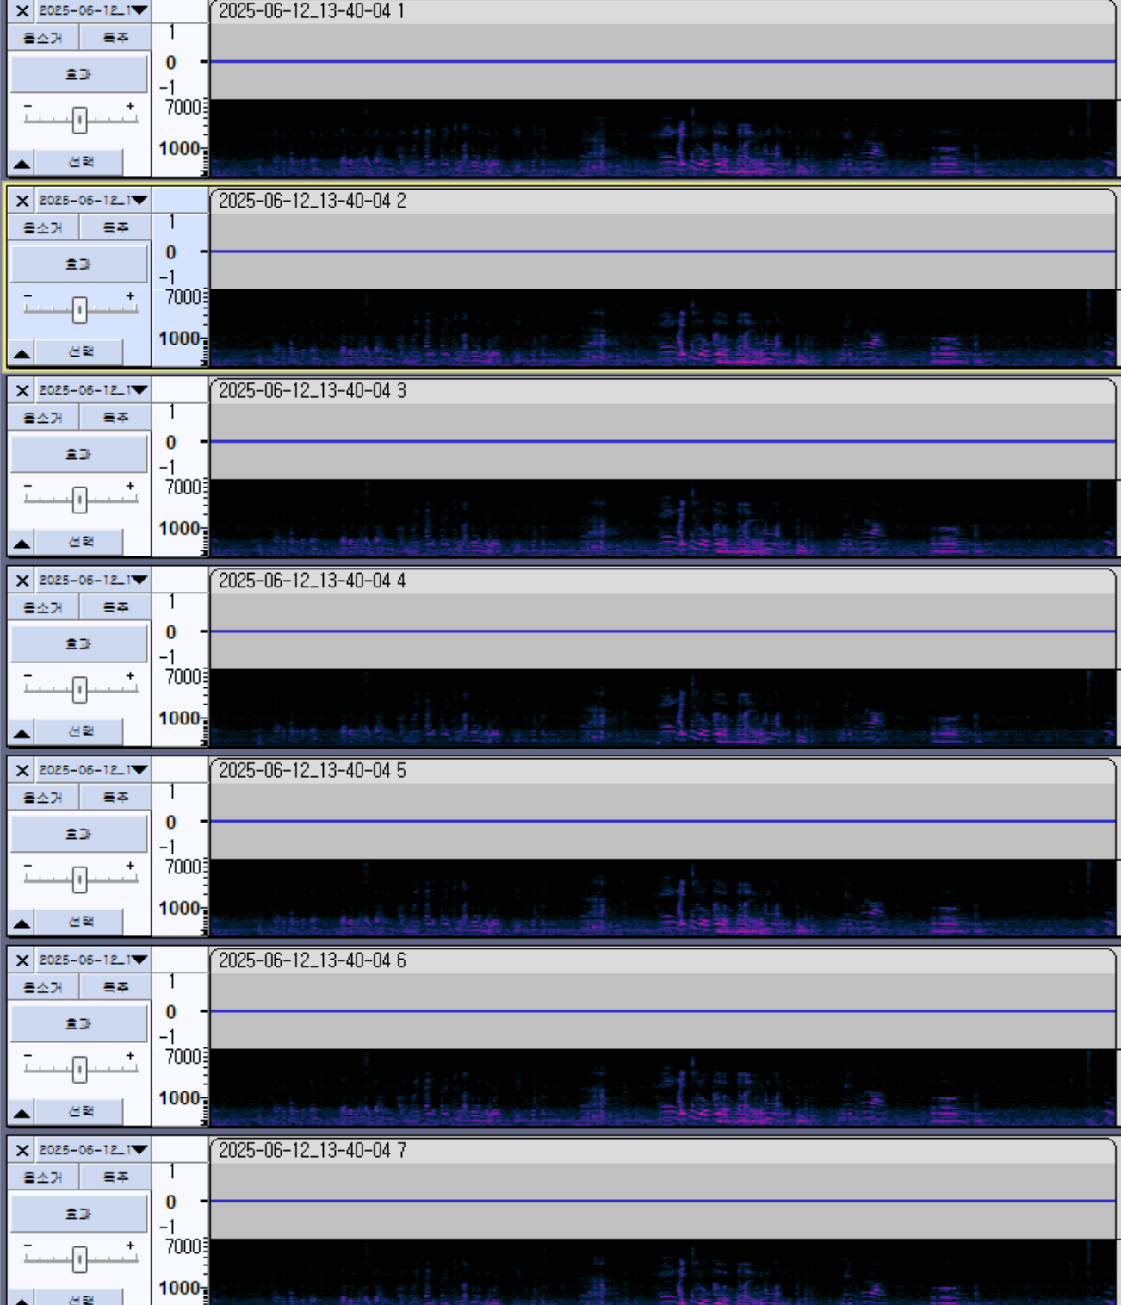
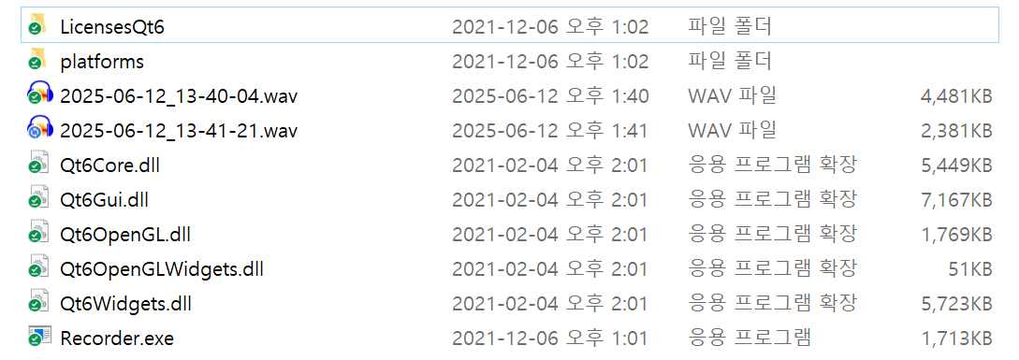
Audacity : Multi-channel audio tool
https://www.audacityteam.org/
Check all multi- channels
NOTE :
If the input microphone sensitivity is too high, it may appear as if nothing was recorded.
-> Increase input scale
Recorded audio

