Slide 1












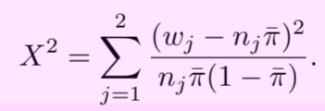








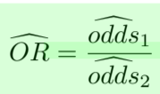




Distribution
PMF
Likelihood
(likelihood function)
Confidence interval
H₀ Testing
Wald
Binomial
LRT
Wilson ( n < 40)
See page 18 for n = 40
(Score statistic)
(Y₁ and Y₂ are independent)

Slide 2
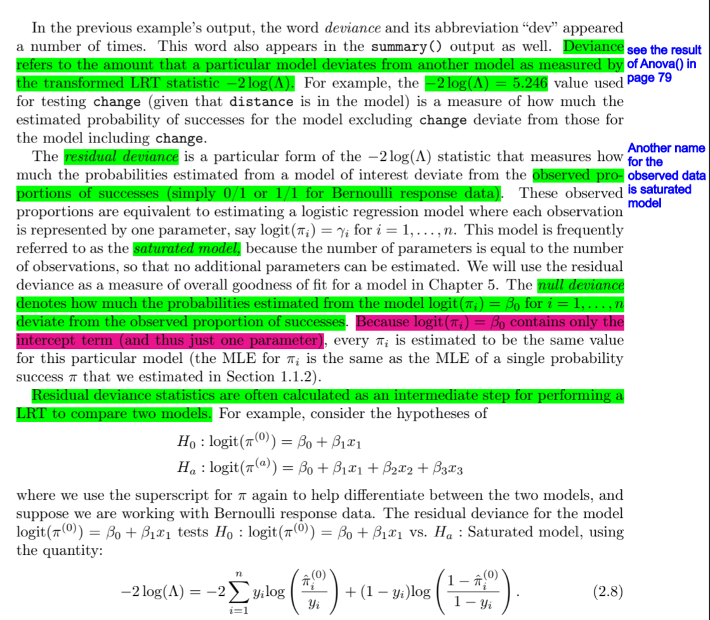

Slide 3




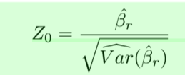








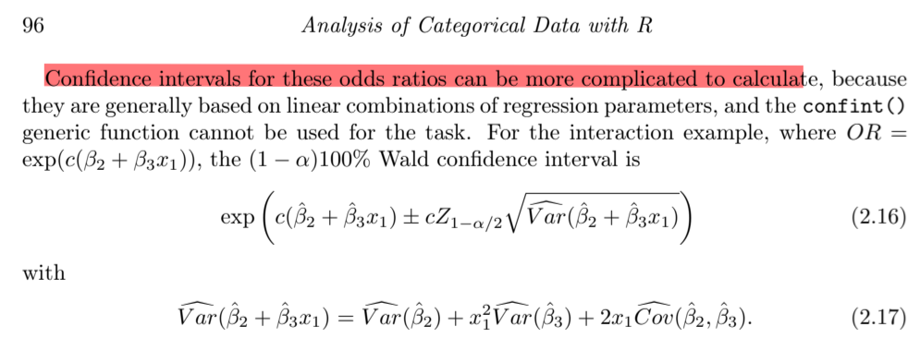



Target
Pi & logit & Odd ratio
Confidence interval
H₀ Testing
Use -2log(lamba)
Binomial

Slide 4











Distribution
PMF
parameters
How to find joint
Multinomial
Given contingency table, find joint PMF
One
Multinomial
Product
Multinomial
(I multinomial distribution)
Given marginal count and conditional probability, find joint PMF

Slide 5








Target
Pi & logit & Odd ratio
Confidence interval
H₀ Testing
See page 170
Nominal response

Slide 6
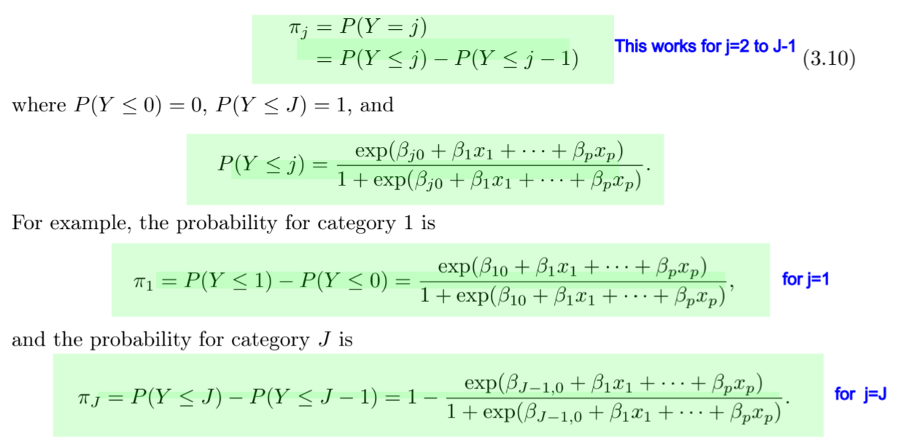


Target
Pi & logit & Odd ratio
Confidence interval
H₀ Testing
Ordinal response

Slide 7



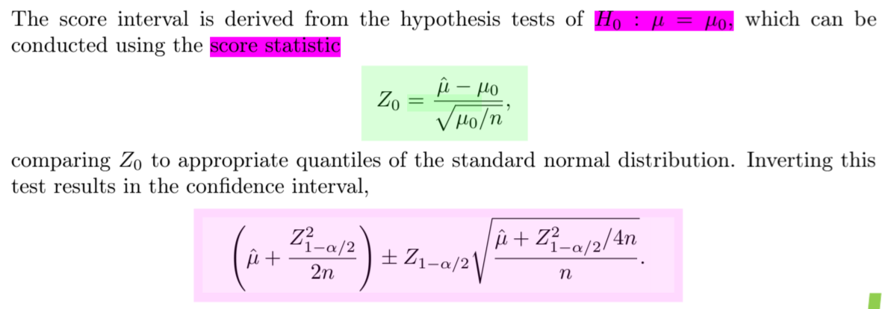



Target
PMF
Parameter
Poisson distribution

