Slide 1









Slide 2










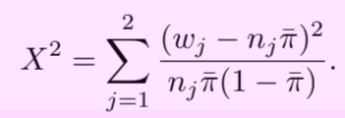








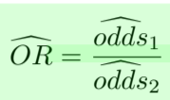




Distribution
PMF
Likelihood
(likelihood function)
Confidence interval
H₀ Testing
Wald
Binomial
LRT
Wilson ( n < 40)
See page 18 for n = 40
(Score statistic)
(Y₁ and Y₂ are independent)

