Slide 1
Filter visible points
Test task for Obstacle detection (research engineer)
József Köő

Slide 2
General assumptions
.ply file contains points in camera frustum
Camera is placed in origin
Principal axis is Z axis
Based on that, extrinsic parameters for camera model are not needed to be considered
Main task is to remove occluded points from world coordinate

Slide 3
Intrinsic parameters
Z
P1
P2
Projection plane
These parameters define a function how the real point is projected into 2D image screen.
In our cases light from each point reaches camera with a linear path.
Therefore function can’t cause further occlusions. Only the relative distance between projected points can be changed by Intrinsic parameters
X
P1
P2
Projection plane with K1 parameters
P1
P2
Projection plane with K2 parameters

Slide 4
General solution
Z
P1
P2
Projection plane
Distance from origin does not change the projection of point
(1,1,1) will be projected the same way as (2,2,2)
Divide the view into small regions which are defined by the angles of Z axis and point coordinate. As it would be in polar coordinate system.
Points has no volume -> Each region shall contain only one point as result. In each region the closest point shall be selected as visible, others can be removed since occluded.
X
P2 point occludes P1 in the same region

Slide 5
Computation optimization
Exact angle values are not needed, so trigonometric functions are not needed.
For pinhole model, absolute distance can be substituted with Z value, since distance is only needed for comparing 2 points with each other.
Program do not need to store those regions which contain no points. A dynamic structure used and only new regions added.
Points define the regions with a predefined resolution.

Slide 6

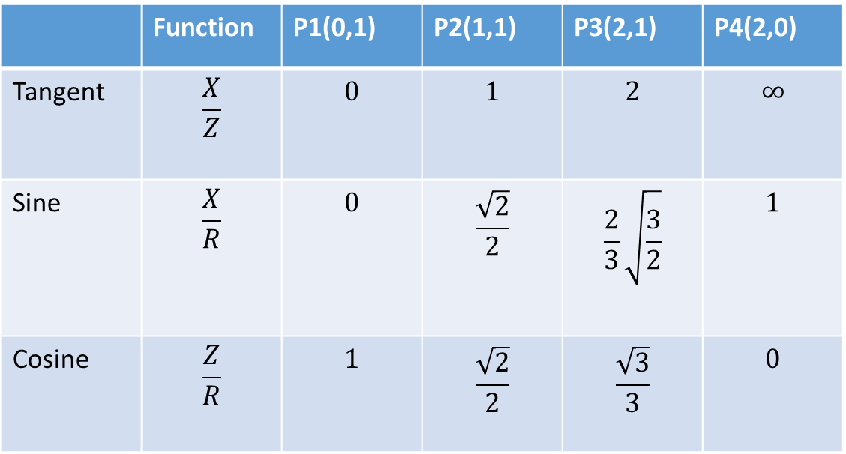
Region definition functions
 | Function | P1(0,1) | P2(1,1) | P3(2,1) | P4(2,0)
Tangent | $$\frac{X}{Z}$$ | $$0$$ | $$1$$ | $$2$$ | $$∞$$
Sine | $$\frac{X}{R}$$ | $$0$$ | $$\frac{\sqrt{2}}{2}$$ | $$\frac{2}{3}\sqrt{\frac{3}{2}}$$ | $$1$$
Cosine | $$\frac{Z}{R}$$ | $$1$$ | $$\frac{\sqrt{2}}{2}$$ | $$\frac{\sqrt{3}}{3}$$ | $$0$$
Z
P1
P2
P3
P4
X
$$R −distance from origo$$

Slide 7
Tangent – x/z
Z
P1
P2
P3
For pinhole camera model it could be a good estimation
If the view angle is 90° all the values can be mapped into a region [-1,1] region.
For to wide view angle it is not suitable. Resolution will be too high on side regions
P4
X
-1
0
1
2
P1
P2
P3
P4
->...->
Unit projection plane

Slide 8
Sine – x/R
Z
P1
P2
P3
For fisheye camera it is a good estimation
180° view angle is mapped to a region [-1,1]
Points in middle has higher resolution. If this is the region of interest, it is advantageous.
P4
X
-0,5
0
0,5
1
P1
P2
P4
P3
Unit projection plane

Slide 9
Cosine – z/R
Z
P1
P2
P3
180° view angle is mapped to a region [0,1,0]. Separation of sides is necessary. Need to consider X or Y coordinate’s sign.
Points in the edge has higher resolution. If this is the region of interest, it is advantageous.
P4
X
0,5
1
0,5
0
P1
P2
P4
P3
Unit projection plane

Slide 10
Implementation
I used Tangent method for pinhole camera models
It does not requires to calculate distance for every point
The used cameras view angles were not wider than 90°
I used Sine method for mei camera models
It separates sides with sign during calculation
I assumed region of interest is the middle, so loss on edges are permitted

Slide 11
Future plans
Investigate „k-d array” structure instead of „map”. It could boost search in regions.
investigate parallel computation possibilities.

