Slide 1
MASTER'S THESIS DEFENSE
Enhancing Stability in Direct Training
of Spiking Neural Networks
Membrane Potential Initialization & Threshold-Robust Surrogate Gradients
Hyunho Kook (국 현 호)
Advisor: Prof. Eunhyeok Park
Committee: Prof. Jungseul Ok · Prof. Jae-Joon Kim
Department of Computer Science and Engineering · POSTECH · May 2026

Slide 2
MOTIVATION
Why Spiking Neural Networks?
DNNs are powerful but expensive
THIS THESIS
Training and serving large models routinely consumes megawatt-scale power; even edge inference is hard under tight energy budgets.
Two instabilities,
two principled fixes.
SNNs: an event-driven alternative
Information flows as discrete spikes over time. Paired with neuromorphic hardware, computation skips inactive neurons — orders of magnitude lower energy.
① Temporal Covariate Shift
in the membrane potential — invisible to existing remedies.
But direct training is unstable
② Gradient pathology
when the firing threshold becomes a learnable parameter — never explicitly characterized before.
Recent direct-training methods narrowed the accuracy gap, yet two persistent instabilities still hold SNNs back.
Defense — Hyunho Kook
2 / 21

Slide 3
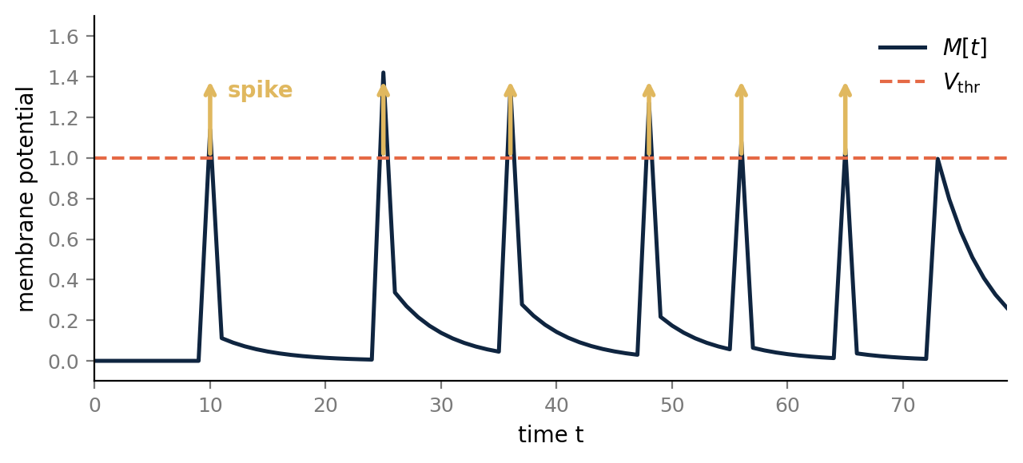
BACKGROUND · 1/2
Spiking Neurons in 60 Seconds
Three discrete-time updates, plus one trick to get gradients through them
Leaky Integrate-and-Fire neuron
Integrate
M[t] = (1−1/τ)·U[t−1] + (1/τ)·I_in[t]
Fire
S[t] = H( M[t] − V_thr ) ∈ {0, 1}
Reset
U[t] = M[t] − V_thr · S[t] (soft reset)
Two learnable parameters: τ (leakage) · V_thr (threshold).
M[t] integrates inputs, fires at V_thr, resets — repeat.
Heaviside H is not differentiable
Surrogate gradient: backward pass uses smooth f'(x) ≈ H'(x).
Everything in this thesis turns on M[t] and V_thr · TCS at M[t] · pathology at V_thr
Defense — Hyunho Kook
3 / 21

Slide 4
BACKGROUND · 2/2
Surrogate Gradient — Training Through the Spike
Spikes are non-differentiable; smooth surrogates re-open backprop
The problem
The fix: surrogate gradient (SG)
Forward: S = H( M − V_thr ) ∈ {0, 1}
Forward unchanged. In backward, replace δ with smooth f'( x ):
Backward: ∂S / ∂M = δ( M − V_thr )
∂S / ∂M ≈ f'( x ), | x | < γ/2
Heaviside has zero gradient almost everywhere, with a delta spike exactly at threshold — gradient information cannot flow.
f' is peak-normalized (max = 1), supported on a window of width γ around 0. Forward stays binary; gradient flows.
Common shapes · same window, different curve
Two natural choices for x
x = M − V_thr → AS-SG (Absolute scale) x = M / V_thr − 1 → RS-SG (Relative scale) Same SG curve, two ways to plug in V_thr → analyzed in Part II.
▸ Rectangular ▸ Triangular ▸ Arctan ▸ Sigmoid Shape matters less than scale — TrSG works across all four. γ controls the active window WIDTH; height is set by the chain rule.
Defense — Hyunho Kook
4 / 21

Slide 5
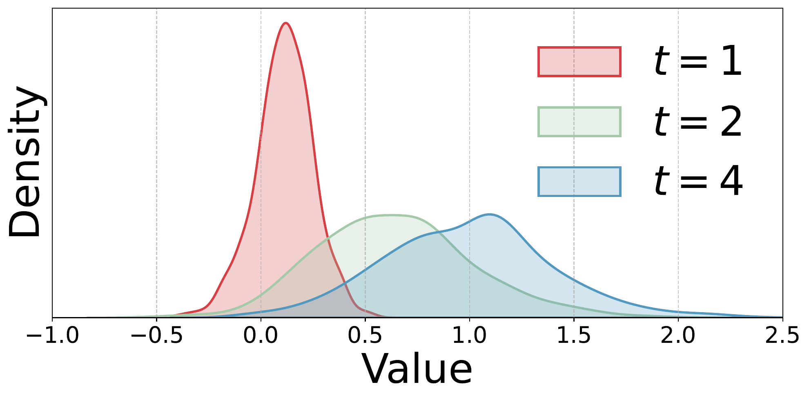
SETUP · 1/2
Diagnosis ①: TCS Lives in the Membrane Potential
What everyone notices
Activation distributions drift across timesteps. Batch-norm statistics estimated at one timestep no longer fit at another — accuracy drops.
What existing fixes do
TEBN, TAB add per-timestep BN parameters. More compute, more parameters — and they don't reach the cause.
M[t] under tdBN — distribution clearly drifts as t grows
Our claim
TCS originates one level deeper — in M[t] itself.
Defense — Hyunho Kook
5 / 21

Slide 6
SETUP · 2/2
Diagnosis ②: Trainable V_thr Breaks the Gradient
PLIF, LTMD, DIET-SNN all let V_thr learn — but the surrogate gradient is scale-sensitive
V_thr ≪ 1 (small threshold)
V_thr ≫ 1 (large threshold)
▸ AS-SG floods — fixed window covers almost the entire distribution
▸ RS-SG explodes — the 1/V_thr factor blows the magnitude up
▸ Real example: at V_thr = 0.1, RS-SG diverges to NaN within 100 epochs
▸ AS-SG starves — fixed window covers a tiny tail of the distribution
▸ RS-SG vanishes — the same 1/V_thr factor shrinks the magnitude
▸ Real example: at V_thr = 2.0, AS-SG hits 0% active neurons by epoch 100
These are not corner cases.
Trainable V_thr in practice drifts well below 1 in early layers and above 2 in deep ones — exactly the regimes where AS-SG and RS-SG both fail. We'll quantify in Part II.
Defense — Hyunho Kook
6 / 21

Slide 7
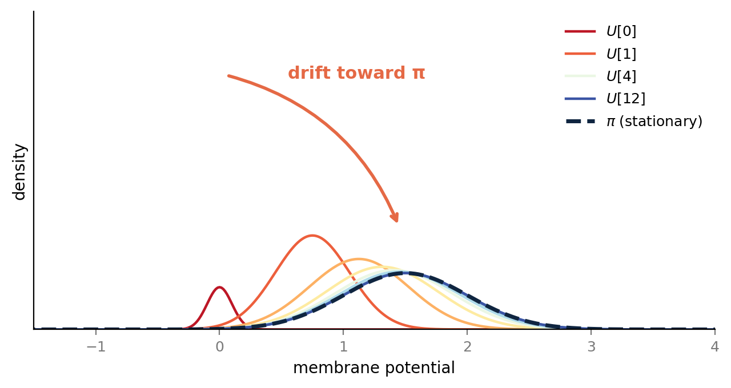
PART I · MP-INIT
Why Does the Membrane Potential Drift?
Because it's a Markov chain pulled toward a unique distribution
The recurrence is a Markov chain
U[t+1] = f( U[t], I_in[t+1] ) — Markov by construction; i.i.d. inputs ⇒ time-homogeneous
Theorem (Doeblin minorization)
Under (i.i.d. inputs) + (bounded U[t]), the chain has a unique stationary π. Moreover, ‖ Pⁿ(x, ·) − π(·) ‖_TV ≤ C · (1 − ε)ⁿ
Implications
Distribution of U[t] for t = 0, 1, 2, 3, 4, 5, 8, 12
▸ Initial state ≠ π ⇒ drift is inevitable
▸ Standard U[0] = 0 is far from π
▸ Don't fix BN — fix the initial state
Starting from U[0]=0 (sharp red), the distribution exponentially approaches the stationary π (dashed navy).
Defense — Hyunho Kook
7 / 21

Slide 8
PART I · MP-INIT
MP-Init — Initialize at the Stationary Mean
U[T] is the closest sample to π → use a running mean of E[U[T]]
Lemma — best constant is the mean
Algorithm (training-only)
argmin_c E[ (π − c)² ] = E[π]
init μ_l ← 0 for each layer l
for each batch:
U_l[0] ← μ_l
run T LIF steps as usual
m ← mean( U_l[T] of active neurons )
μ_l ← β · μ_l + (1 − β) · m
Practical estimator
U[T] is the closest sample to π. Maintain a per-layer running mean μ ← β · μ + (1 − β) · mean( U[T] ) over training, β = 0.9. At every batch, set U[0] = μ.
Inference: μ frozen → standard LIF dynamics
Zero changes to BN, no per-timestep parameters, full neuromorphic-hardware compatibility.
Defense — Hyunho Kook
8 / 21

Slide 9
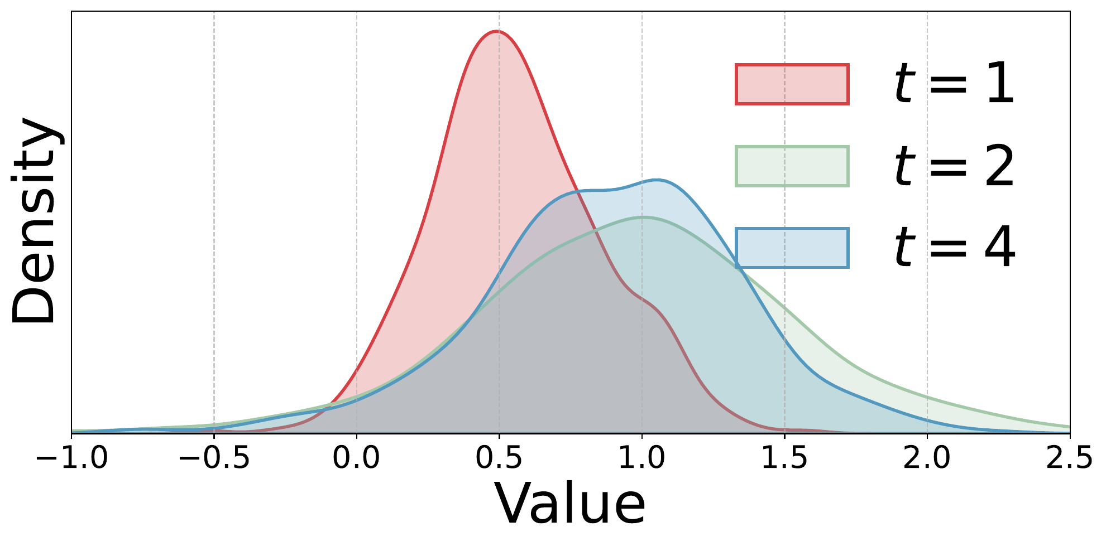
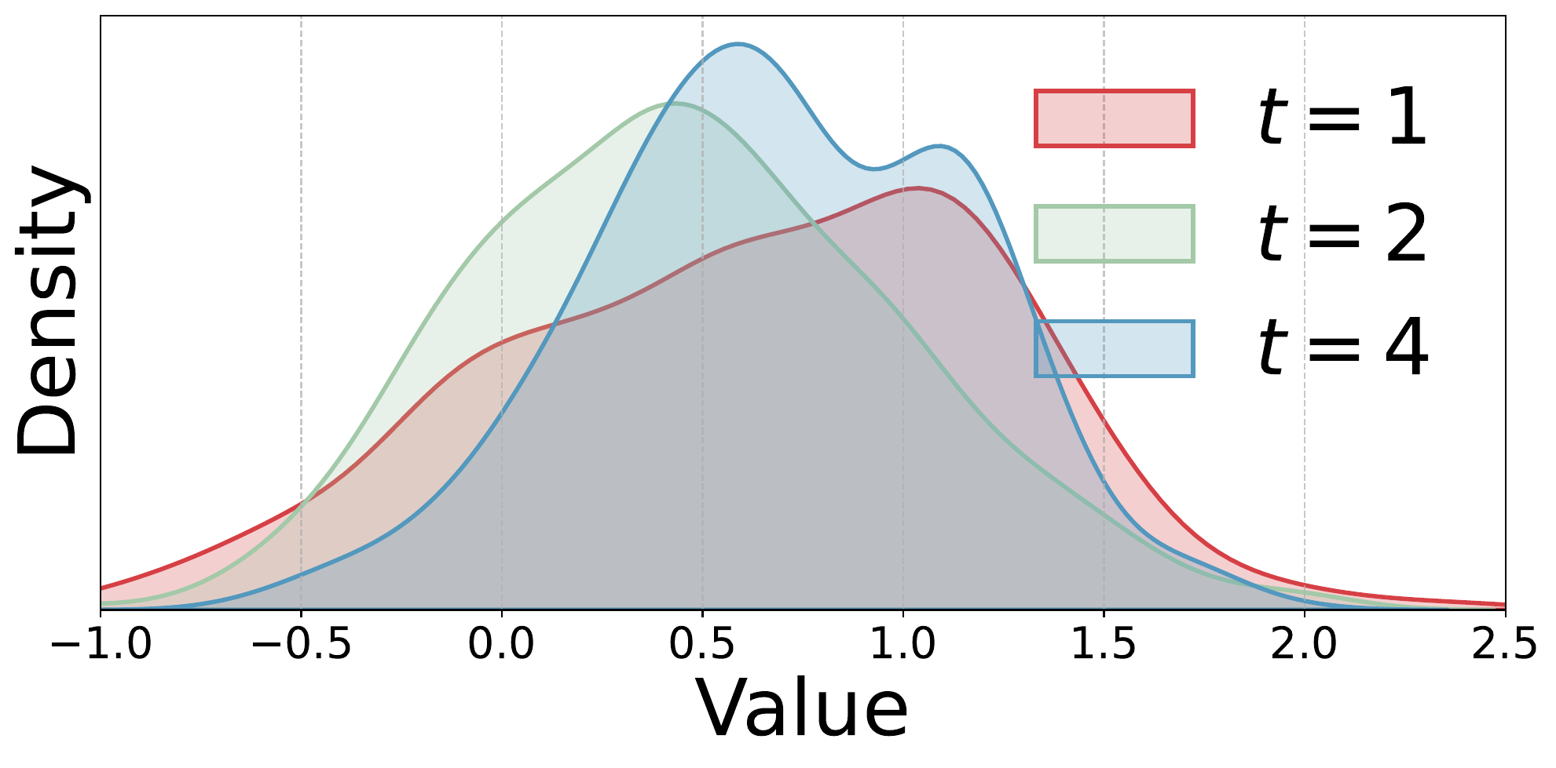
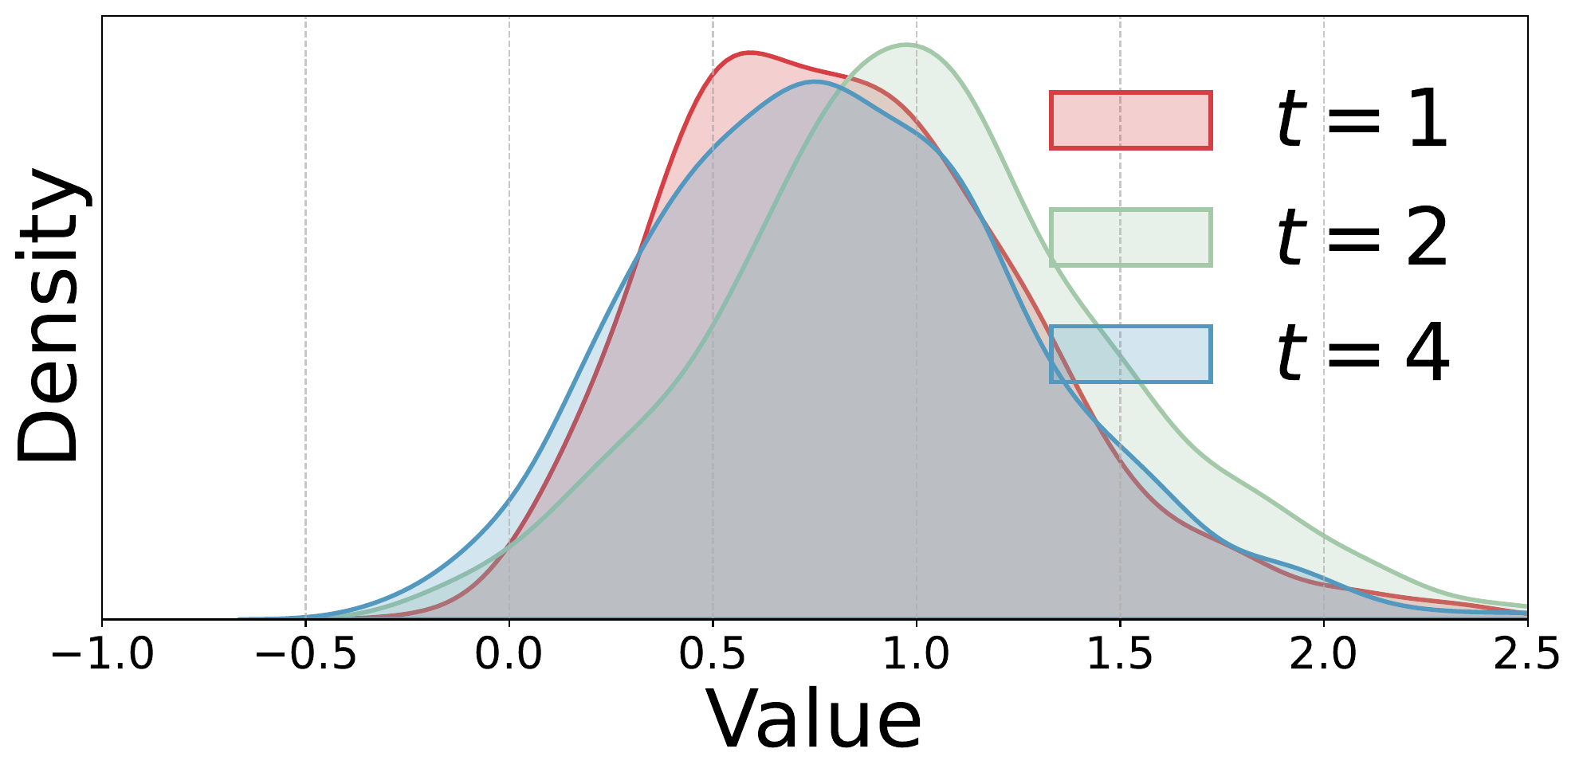
PART I · MP-INIT
MP-Init Works — in Both Distribution and Metric
Membrane potential distributions across timesteps (ResNet-19 / CIFAR-100)
tdBN
TEBN
TAB
MP-Init (ours)
Consistent accuracy gain on every baseline
Setting | Baseline | + MP-Init
CIFAR-100 · T=2 · tdBN | 72.35 | 74.01
CIFAR-100 · T=4 · tdBN | 75.55 | 76.09
CIFAR-100 · T=4 · TEBN | 75.96 | 76.45
CIFAR-100 · T=4 · TAB | 76.25 | 77.24
DVS-CIFAR10 · T=10 · tdBN | 76.60 | 77.37
+1.66 %pt at T = 2
Biggest gain in the most latency-critical regime — exactly where SNN energy efficiency matters.
Defense — Hyunho Kook
9 / 21

Slide 10
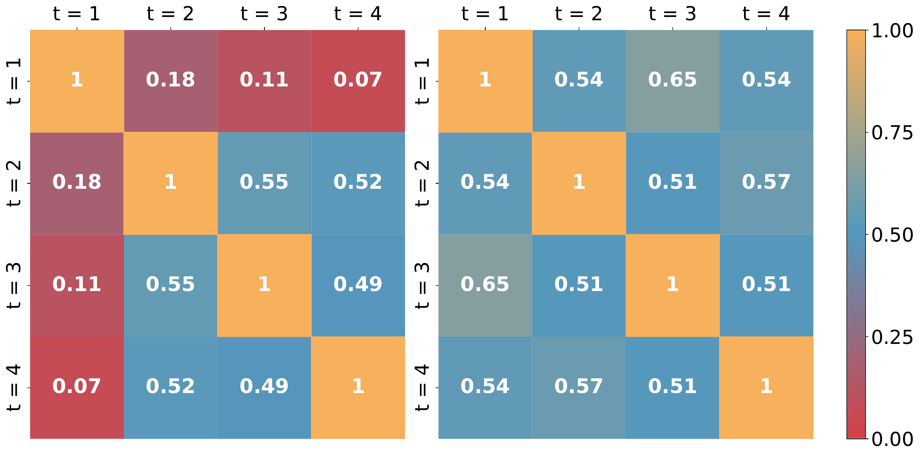
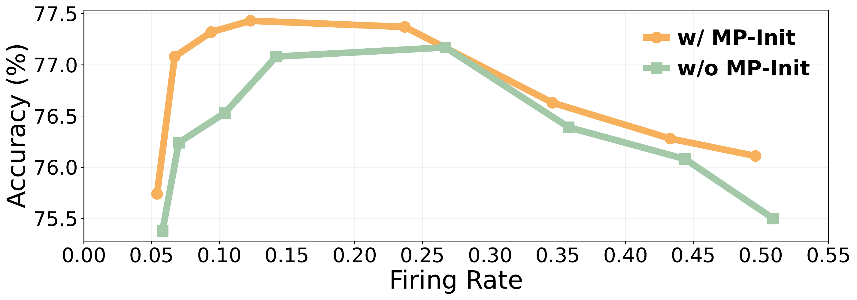
PART I · MP-INIT
Why MP-Init Works — A Closer Look
Aligning distributions aligns gradients — and improves the firing-rate frontier
Gradient cosine similarity across timesteps
Accuracy vs. firing rate (Pareto frontier)
ResNet-19 · CIFAR-100 · 4 timesteps
ResNet-19 · CIFAR-100 with sparsity regularizer
▸ Without MP-Init: gradients at t=1 conflict with later steps (cos 0.07–0.18)
▸ With MP-Init: temporal ensemble realigned (cos ≈ 0.5)
▸ Stable optimization — not just stable inference
▸ MP-Init dominates baseline at every firing rate
▸ Even at 6% firing rate, beats all baseline settings
▸ Gains come from spiking BETTER, not spiking MORE
Higher accuracy from more stable training — efficiency-preserving improvements, not accuracy-via-spend.
Defense — Hyunho Kook
10 / 21

Slide 11
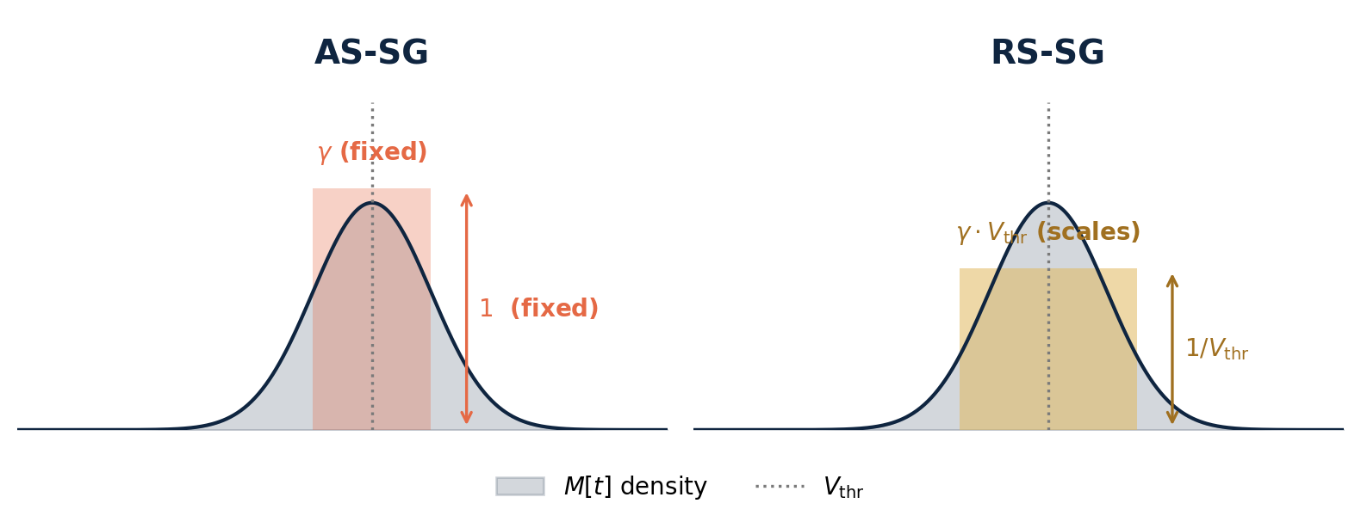
PART II · TRSG
Two Surrogate-Gradient Families
AS-SG and RS-SG — look similar, behave very differently when V_thr is trainable
∂S/∂M ≈ f'(x) · rectangular f' = 1 on | x | < γ/2 (peak-normalized) · γ = active window width
AS-SG · Absolute-Scale
Gradient-window vs membrane distribution
x = M[t] − V_thr
Window of FIXED width γ, centered at V_thr
RS-SG · Relative-Scale
x = M[t] / V_thr − 1
Window SCALES with V_thr — but magnitude / V_thr
Same when V_thr is fixed. Once V_thr trains, AS-SG and RS-SG break in opposite ways.
Defense — Hyunho Kook
11 / 21

Slide 12
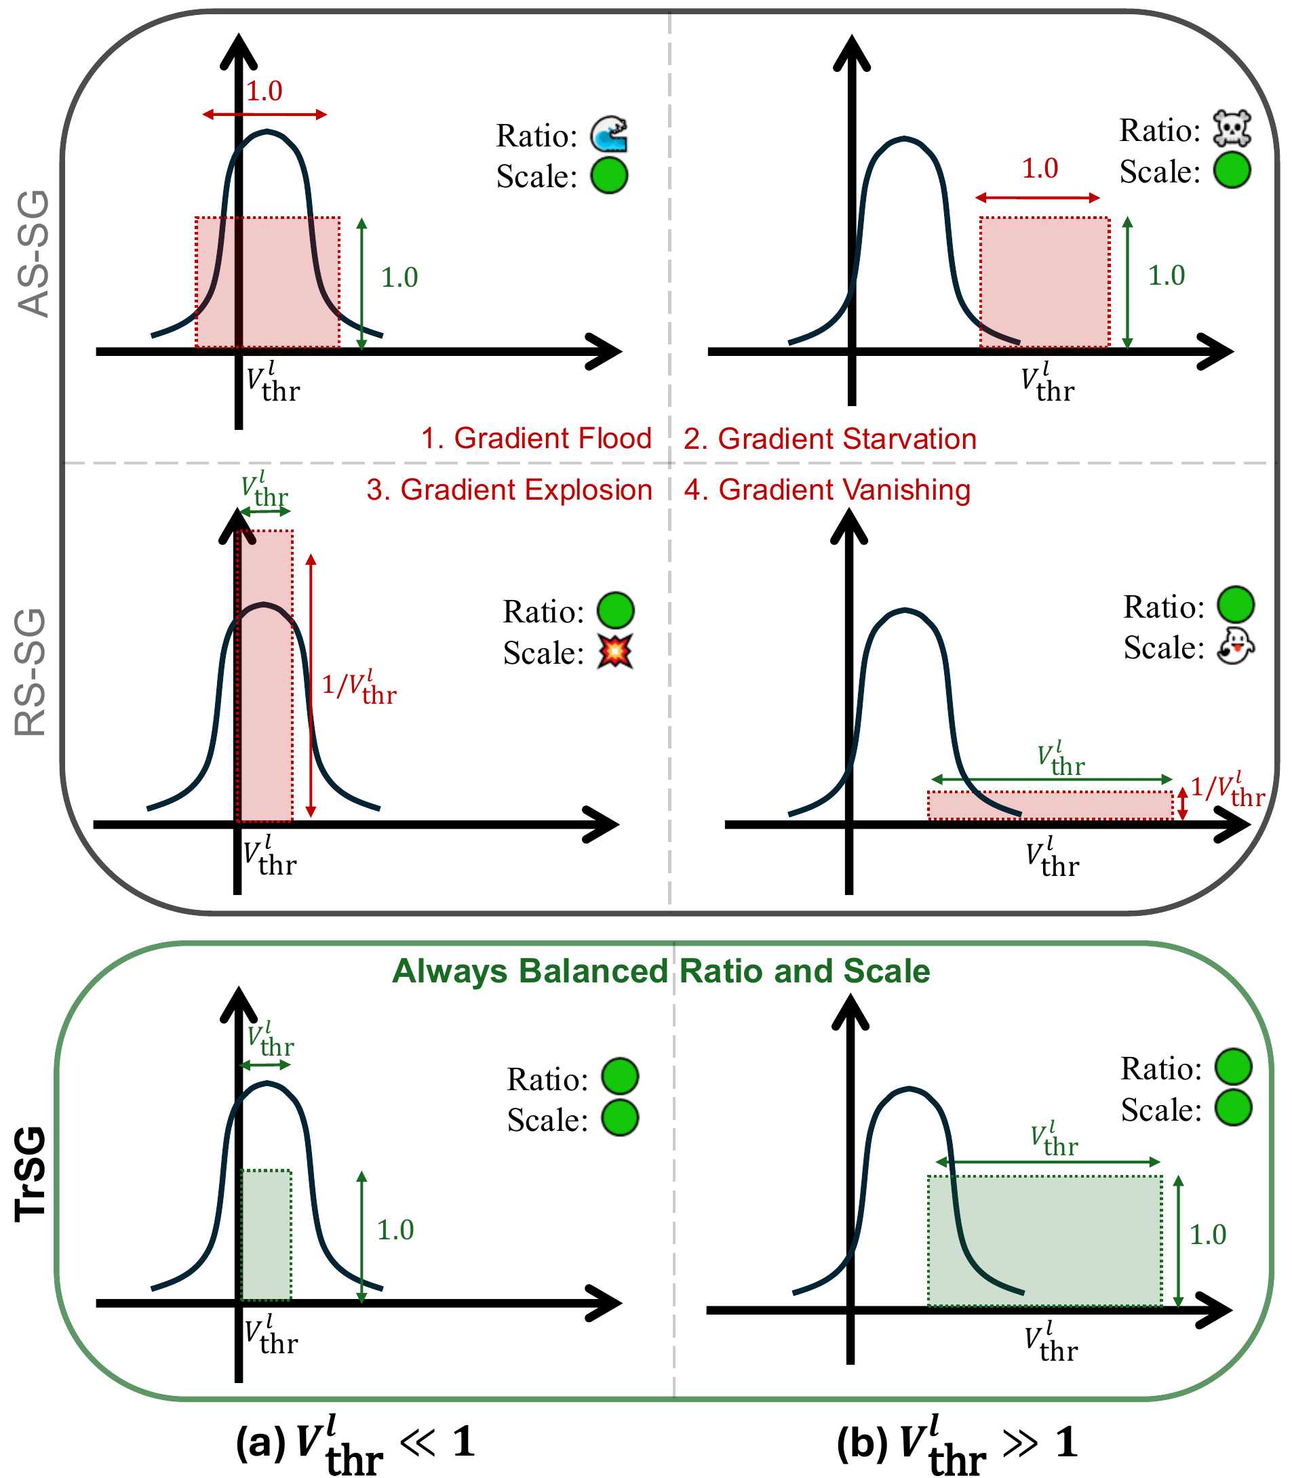
PART II · TRSG
Four Failure Modes — and One Fix
Both window width AND gradient magnitude must scale correctly with V_thr
Each colored box = active gradient region. width = window · height = magnitude
✗ Flood
✗ Starvation
✗ Explosion
✗ Vanishing
✓ Balanced
AS-SG · V_thr ≪ 1
AS-SG · V_thr ≫ 1
RS-SG · V_thr ≪ 1
RS-SG · V_thr ≫ 1
TrSG · all regimes
Defense — Hyunho Kook
12 / 21

Slide 13
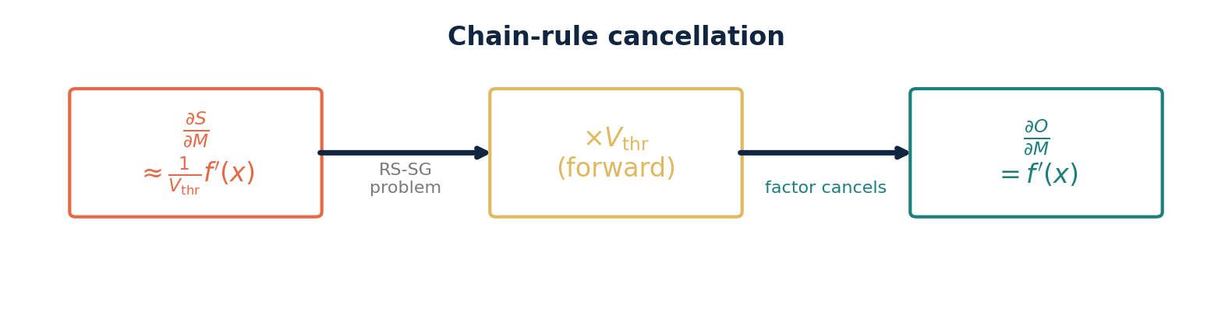
PART II · TRSG
TrSG — One-Line Fix
Multiply the threshold on the forward path; chain rule cancels the bad factor
The recipe
1
Relative-scale window
2
Multiply on forward
3
Chain rule cancels
x = M / V_thr − 1
O[t] = V_thr · S[t]
∂O/∂M = f'(x)
Window adapts with V_thr · gradient magnitude is threshold-invariant.
Defense — Hyunho Kook
13 / 21

Slide 14
PART II · TRSG
Inference Stays Binary
TrSG is a training-only trick — neuromorphic hardware never sees it
Training
Forward: O[t] = V_thr · S[t] (real-valued — gradient flows cleanly through V_thr)
At deployment, absorb V_thr into the next layer's weights
W'_{l→l+1} = V_thr^l · W_{l→l+1} (one-time rescaling per layer)
Forward at test time: O[t] = S[t] ∈ {0, 1} (standard LIF — back to binary spikes)
Standard LIF operators at inference. Hardware compatibility preserved.
Defense — Hyunho Kook
14 / 21

Slide 15
PART II · TRSG
Why TrSG Works — A Stable Gradient
Three stability metrics tell the same story across extreme V_thr
AbsStr
RatioAG
GradCV
mean |gradient|
% neurons with active gradient
std / mean of |gradient|
low → vanishing, high → exploding
low → starvation, high → flooding
high → unstable, hard-to-tune updates
Stress-test metrics at epoch 100 — CIFAR-100, ResNet-19, τ=2.0 frozen
V_thr = 0.1 (small threshold)
V_thr = 2.0 (large threshold)
SG | AbsStr | RatioAG | GradCV
AS-SG | 0.0145 | 90.20% | 1.22
RS-SG | NaN | 0.00% | NaN
TrSG | 0.0153 | 21.45% | 0.87
SG | AbsStr | RatioAG | GradCV
AS-SG | 0.0000 | 0.00% | 0.000
RS-SG | 0.0021 | 0.10% | 2.25
TrSG | 0.0323 | 6.90% | 0.73
TrSG keeps all three metrics in the healthy range — at every threshold.
Defense — Hyunho Kook
15 / 21

Slide 16
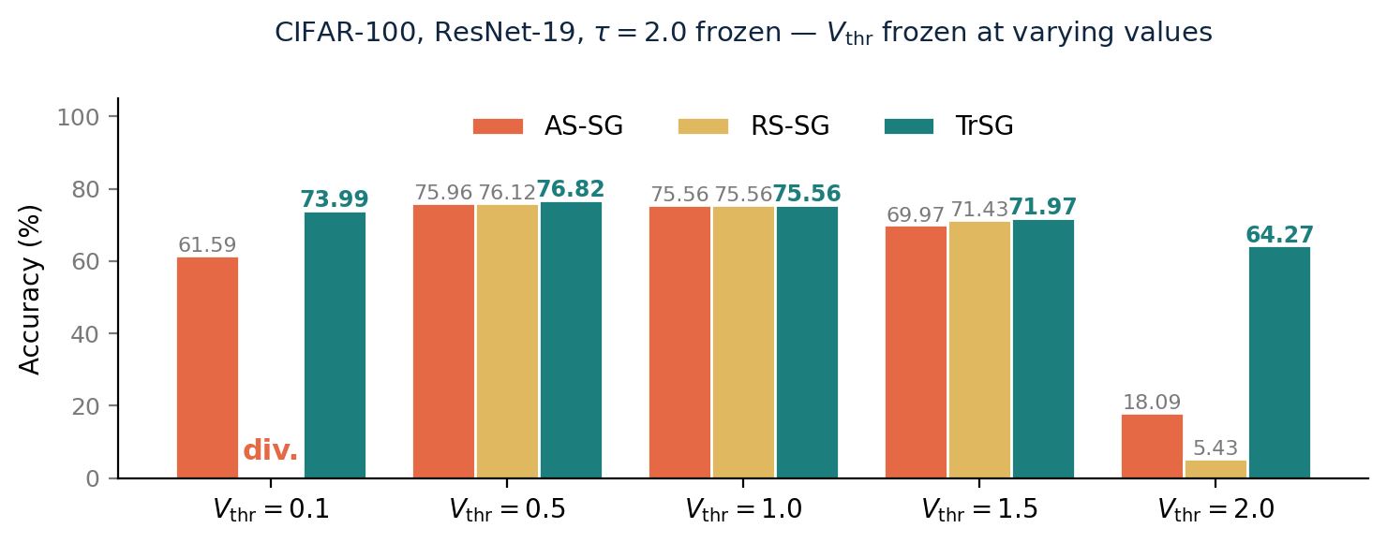
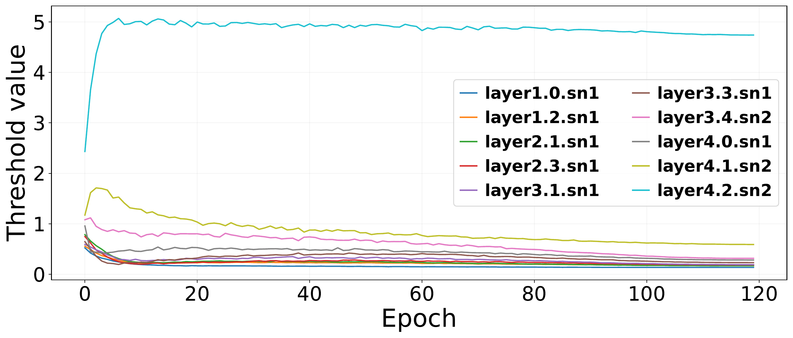
PART II · TRSG
TrSG Robust Across All V_thr
Direct accuracy evidence + real trainings actually visit the extreme regimes
Accuracy with V_thr frozen at varying values
Trainable V_thr trajectories — ImageNet
CIFAR-100, ResNet-19, τ=2.0 frozen
ResNet-34 on ImageNet · 120 epochs
▸ Frozen V_thr accuracy: TrSG wins at every threshold; AS-SG/RS-SG fail outside V_thr ≈ 1
▸ Real trainings drift V_thr ≪ 1 in early layers and ≫ 1 in deep layers — exactly the failure regimes
Threshold-robustness is a practical necessity, not a theoretical edge case.
Defense — Hyunho Kook
16 / 21

Slide 17
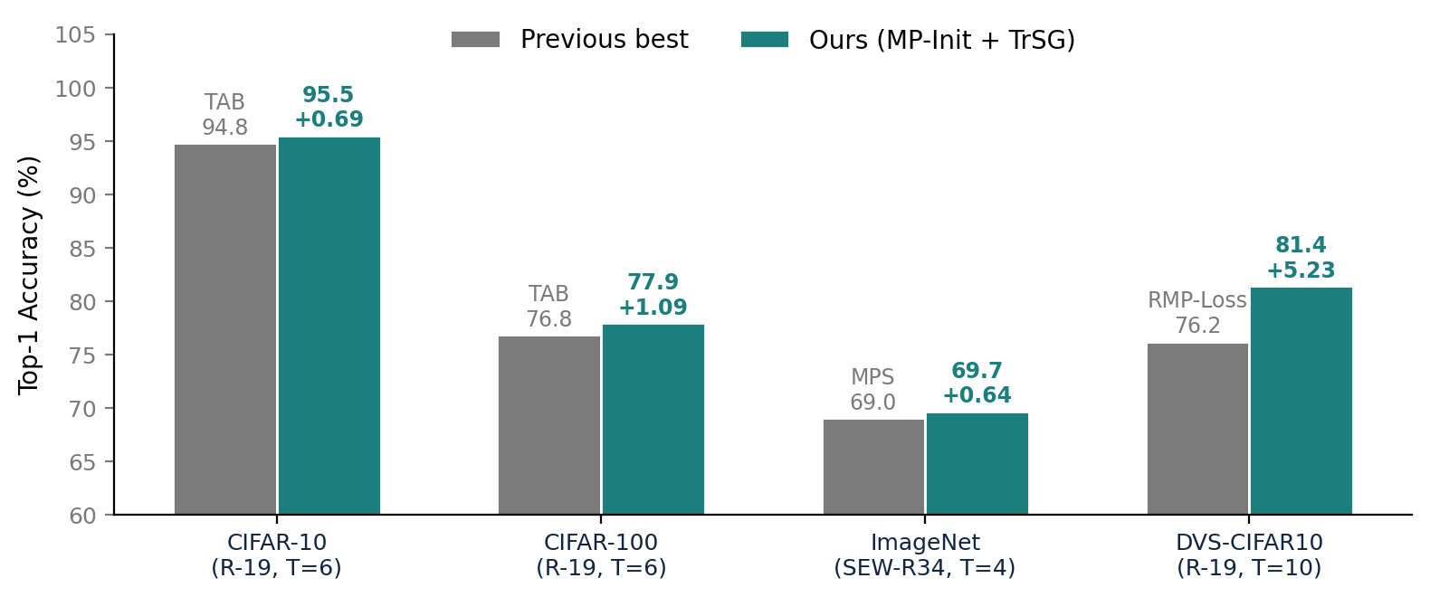
EXPERIMENTS · 1/3
Main Results — SOTA Across the Board
Standard LIF neurons · no AutoAugment / Cutout · three trials
+1.09
%pt
CIFAR-100 · beats TAB
+0.64
%pt
ImageNet · beats MPS
+5.23
%pt
DVS-CIFAR10 · beats RMP-Loss
Biggest gain on the most challenging (event-based) dataset — DVS-CIFAR10 +5.23 %pt
Defense — Hyunho Kook
17 / 21

Slide 18
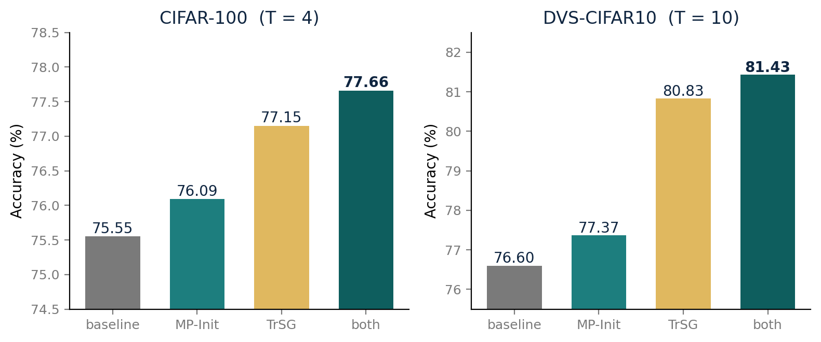
EXPERIMENTS · 2/3
Ablation — Independent and Complementary
Each method helps alone; gains stack additively (largest combined effect on event-based data)
Takeaway
MP-Init alone
+0.5 ~ 0.8
TrSG alone
+1.6 ~ 4.2
Both
+2.1 ~ 4.8
The two fixes are orthogonal — diagnoses aim at different components, not the same problem twice.
Defense — Hyunho Kook
18 / 21

Slide 19
EXPERIMENTS · 3/3
Beyond Classification
Transformer SNNs · object detection · energy preserved
Transformer SNN (QKFormer, ImageNet, T=4)
Object detection (COCO-2017, EMS-ResNet10, T=3)
Baseline 78.80 → + ours 79.90 (+1.10 %pt) AS-SG 77.09 → RS-SG 78.70 → TrSG 79.90 Drop-in SG swap on a state-of-the-art Transformer SNN.
mAP@0.5 0.291 → 0.305 (+0.014) mAP@0.5:0.95 0.138 → 0.147 (+0.009) First evidence the principles transfer beyond classification.
Energy under matched configuration (CIFAR-100)
All four surrogate shapes
Baseline 1.57 mJ · 75.58 % + MP-Init + TrSG 1.67 mJ · 77.68 % +2.10 %pt at +6 % energy → orders of magnitude better than spike-rate-multiplying baselines (cf. Pareto frontier on slide 9).
Rectangular · Triangular · Arctan · Sigmoid TrSG remains the best across initial V_thr, initial τ, and surrogate shape — never tied for second.
No architectural changes, no extra losses, no per-timestep parameters — just drop in.
Defense — Hyunho Kook
19 / 21

Slide 20
CONCLUSION
What This Talk Was About
Two long-standing instabilities of direct SNN training, traced and fixed.
Both fixes are minimal, principled, and preserve standard inference.
MP-Init
TrSG
Validated
TCS originates in the membrane potential — fix the initial state. Per-layer running mean of U[T]. Zero overhead, standard LIF inference.
Threshold-induced gradient pathology — fix it with one forward-path multiplication. Window adapts, magnitude is invariant. Standard LIF after training.
SOTA on CIFAR-10/100, ImageNet, DVS-CIFAR10. Generalizes to Transformer SNNs (QKFormer +1.10) and detection (COCO +0.014 mAP). All without architectural changes.
Defense — Hyunho Kook
20 / 21

Slide 21
CONCLUSION
Two instabilities, two principled fixes,
one cohesive story.
LIMITATIONS
▸ Per-layer constant approximates π only at the mean — richer parameterizations are open. ▸ Hardware with fixed neuron parameters needs quantization-aware adaptation. ▸ i.i.d. assumption empirically supported, but tighter bounds welcome.
FUTURE WORK
▸ Hardware-aware adaptation: Loihi, Akida, TrueNorth ▸ Beyond LIF: adaptive LIF, Izhikevich, foundation-scale SNNs
Thank you. Questions?
21 / 21

Slide 22
BACKUP MATERIAL
Appendix
Q&A reference: hardware, datasets, prior work
A1
Can SNNs run on real chips?
A5
From DVS events to SNN input
A2
Where SNN efficiency comes from
A6
How were SNNs trained before?
A3
Energy: SNN chip vs DNN platforms
A7
Prior work on TCS & threshold learning
A4
What is an event-based dataset?

Slide 23
APPENDIX · A1
Can SNNs Actually Run on Chips?
Production-grade neuromorphic silicon already exists.
Yes — and at scale.
Chip | Year | Process | Capacity | Headline metric
IBM TrueNorth | 2014 | 65 nm | 1 M neur. 256 M syn. | 70 mW · 26 pJ/event
Intel Loihi | 2018 | 14 nm | 130 K neur. 130 M syn. | 23.6 pJ / op
Intel Loihi 2 | 2021 | Intel 4 | 1 M neur. graded spikes | improved · multi-bit
SpiNNaker 2 | 2024 | 22 nm | 152 K neur. 152 M syn. / chip | ARM-based · digital
Tianjic | 2019 | 28 nm | 40 K neur. SNN+ANN hybrid | Tsinghua · hybrid arch.
Speck (SynSense) | 2022 | 65 nm | 328 K neur. DVS on-chip | < 10 mW · always-on
BrainScaleS-2 | 2022 | 65 nm | 512 analog neur. | 1000× biological speed
Several research and commercial chips natively run spiking models. Our methods (MP-Init, TrSG) are training-time techniques that produce the same LIF model these chips already accept — so the trained network ports directly without architectural changes.
Key takeaway
Hardware is here. The bottleneck is training quality at low T.
Appendix — Hyunho Kook
Refs: Merolla 2014 · Davies 2018 · Mayr 2019 · Pei 2019 · SynSense 2022 · BrainScaleS team 2022.
A1 / A7

Slide 24
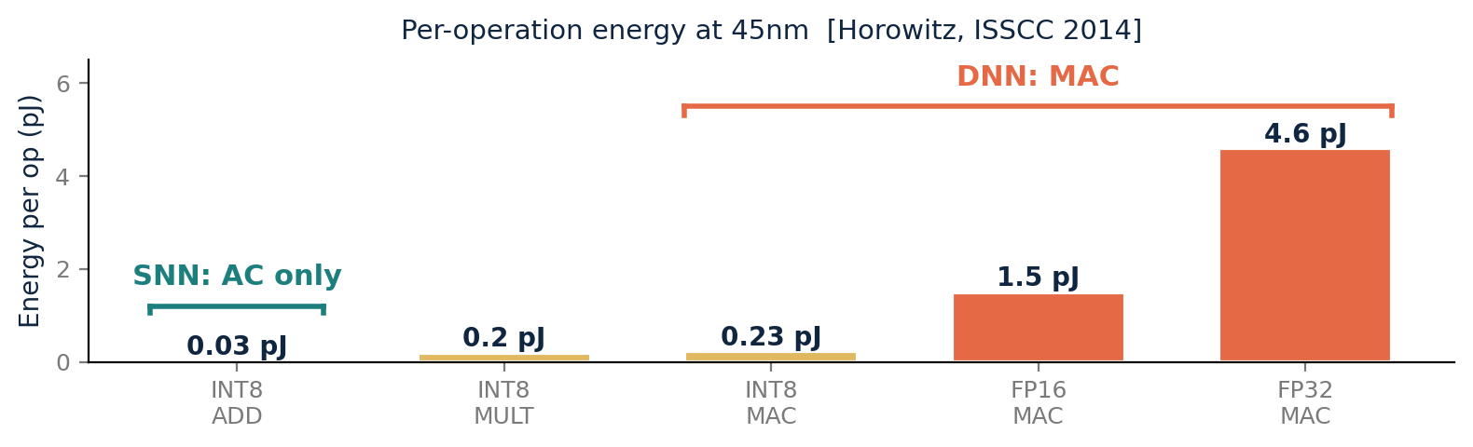
APPENDIX · A2
Where SNN Efficiency Comes From
Three structural advantages — none requires a new training scheme.
① Event-driven
② Multiplication-free
③ Co-located memory
No spike → no compute. Inactive neurons skip MAC and memory access entirely.
Spike ∈ {0, 1} → W·spike degenerates to W or 0. Each synapse becomes an Accumulate (AC), not a MAC.
Neuromorphic cores keep synaptic weights in local SRAM, on-chip mesh routing — no DRAM trip.
Typical activity: 5–20 % per timestep
INT8 AC ≈ 8× cheaper than INT8 MAC (45 nm)
DRAM 64-bit ≈ 1300 pJ vs SRAM ≈ 5 pJ
Bottom line
Efficiency is structural — comes from sparsity + binary spikes + co-located memory. MP-Init / TrSG protect (1) by stabilizing low-T training.
Appendix — Hyunho Kook
A2 / A7

Slide 25
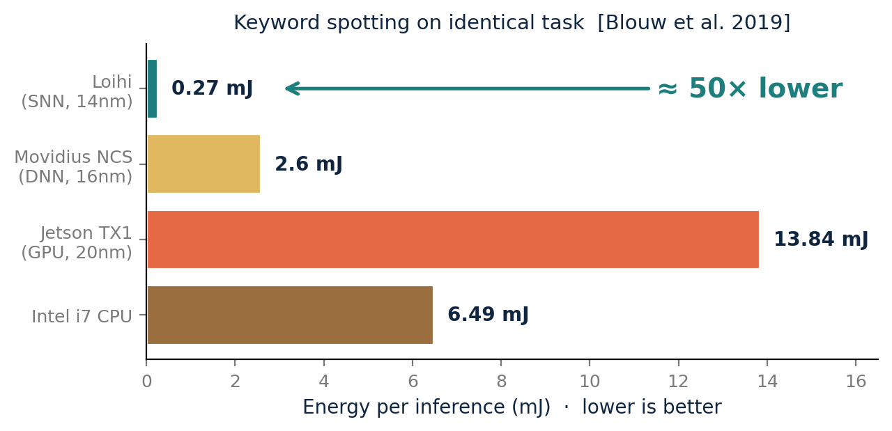
APPENDIX · A3
Energy: SNN Chip vs DNN Platforms
Same task, four hardware platforms — what does the gap actually look like?
How big is the gap?
Sparse / event tasks
~50–100× vs embedded GPU (keyword spot, gesture, sparse coding)
Static images (CIFAR / ImageNet)
~2–5× vs GPU at iso-accuracy (per published SNN/CNN comparisons)
Why so task-dependent?
Energy ∝ T × spike-rate × neurons. Low-T + high-sparsity → big gap.
Same Aloha keyword-spotting task on each platform.
Why this matters for our work
MP-Init enables T = 2 SOTA → directly multiplies energy savings.
Sources: Blouw et al. 2019 (keyword-spotting benchmark) · Davies et al. 2021 (LASSO 48× vs CPU) · Horowitz ISSCC 2014 (per-op energy).
Appendix — Hyunho Kook
A3 / A7

Slide 26
APPENDIX · A4
What Is an Event-Based Dataset?
Output of asynchronous DVS cameras — sparse, fast, high dynamic range.
DVS: Dynamic Vision Sensor
Dataset | Description | Size
DVS-CIFAR10 | CIFAR-10 on monitor + saccading DVS | 10 K
N-MNIST | MNIST shown to event camera | 70 K
N-Caltech101 | Caltech101 in event form | 9.1 K
DVS-Gesture (IBM) | 11 hand gestures, 29 subjects | 1.3 K clips
SHD | Spiking Heidelberg Digits (audio events) | 10 K
Gen1 / 1Mpx | Prophesee automotive (object detect.) | 39 h / 14 h
ASL-DVS | American Sign Language (event) | 100 K
Each pixel asynchronously emits an event when its log-intensity changes by a threshold. Output: a stream of (x, y, t, polarity) tuples.
μs
>120 dB
Sparse
No blur
temporal resolution
dynamic range
only changes emit
no exposure window
In this thesis
DVS-CIFAR10 (event-based image classification, T = 10).
Highlighted: dataset used in this thesis.
Appendix — Hyunho Kook
A4 / A7

Slide 27
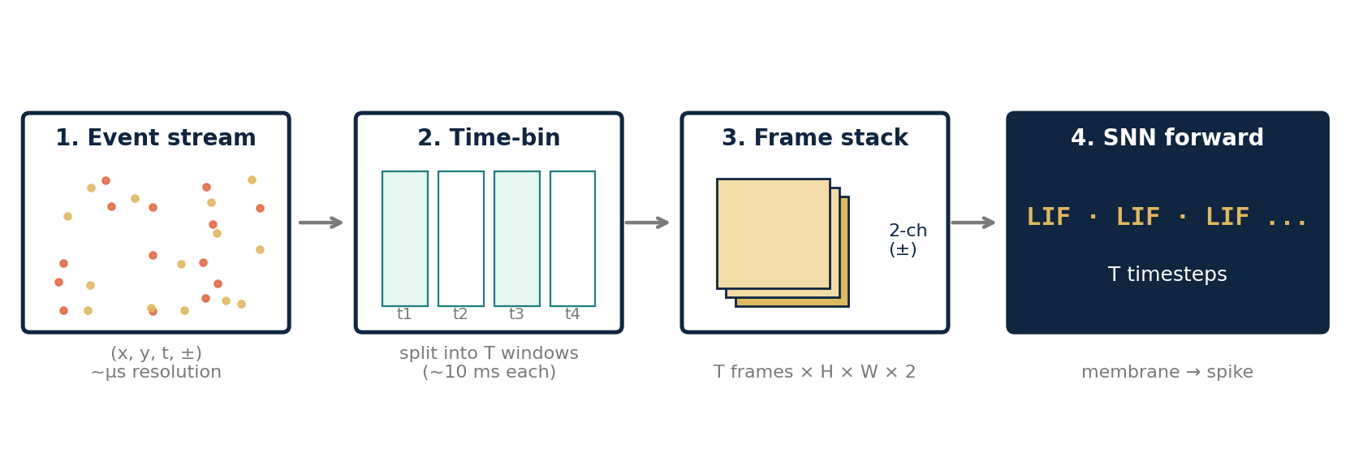
APPENDIX · A5
From DVS Events to SNN Input
Asynchronous events become T frames that the LIF stack consumes.
Why this matters for MP-Init
The first frame after binning has no history → the membrane starts at zero, far from π. That's exactly the gap MP-Init closes.
Appendix — Hyunho Kook
A5 / A7

Slide 28
APPENDIX · A6
How Were SNNs Trained Before?
From biological learning rules to modern surrogate-gradient BPTT.
1998
2015
2018
today
STDP
ANN→SNN conversion
Surrogate gradient
Direct + learnable
Spike-Timing-Dependent Plasticity
Train ANN → convert weights
Surrogate gradient (STBP / BPTT)
Learnable LIF parameters
Biological Hebbian rule. Unsupervised, local; works on small nets only.
Pretrained ReLU CNN → spike rates. Early methods: T = 100–2000. Modern (QCFS '23, Hao '23): T ≤ 8. Still cannot consume native event data.
Replace Heaviside backward with a smooth function. Few timesteps; works on event data; modern dominant.
Train V_thr, τ end-to-end → adaptive neurons. This thesis: stabilize that training pathway.
Bi & Poo 1998 Diehl & Cook 2015
Cao 2015 · Rueckauer 2017 Bu 2023 (QCFS) · Hao 2023
Bohte 2002 · Wu 2018 Neftci 2019
Fang 2021 · Wang 2022 Rathi 2023 · ours
Appendix — Hyunho Kook
A6 / A7

Slide 29
APPENDIX · A7
Where Prior Work Falls Short
TCS methods miss the membrane potential; threshold-learning methods don't diagnose the gradient.
TCS / Normalization in SNNs
Trainable LIF parameters (V_thr, τ)
Method | What it does | What it misses
BNTT '21 | BN on synaptic input current | U[t] drift not corrected
tdBN '20 | Threshold-dependent BN on activations | Pre-spike BN; U[t] persists
TEBN '22 | Timestep-specific affine on outputs | Membrane drift untouched
TAB '24 | Temporal-adaptive output normalization | Membrane TCS persists
Method | What's learned | What it misses
PLIF '21 | Leakage τ only | V_thr fixed
LTMD '22 | V_thr + τ (heavy clipping) | Hides instability
DIET-SNN '23 | V_thr + τ (gradient clip) | Doesn't classify failure
Ours (TrSG) | V_thr + τ, scale-invariant | —
Our take (MP-Init)
Fix the cause, not symptom — align M[t] with stationary π directly.
Our take (TrSG)
Diagnose first (4 failure modes), then cancel the 1/V_thr factor by construction.
Appendix — Hyunho Kook
A7 / A7

