Slide 1

DEPARTMENT OF COMPUTER SCIENCE AND ENGINEERING
SKILL ENHANCEMENT PROJECT
HEALTHCARE+:HOSPITAL APPOINTMENT SYSTEM
PROJECT STUDENT
Sanjana V, 43110811
Subiksha R,43110897
Sri Saranya S T S,43110889

Slide 2
AGENDA
Abstract
Existing system
Proposed system
Advantages
Disadvantages
Hardware requirements
Software requirements
Modules
Module description
Sample output(screenshot)
Conclusion

Slide 3
Abstract
The Hospital Appointment Booking System is a web-based platform that allows users to select their city and view a filtered list of available hospitals. The system provides an easy and efficient way for users to book appointments with doctors based on their location, availability, and specialization. It reduces manual work, saves time, and enhances healthcare accessibility.

Slide 4
Existing System
In the existing system, hospital appointment booking is often done manually or through individual hospital websites.
Users have to visit multiple websites or physically visit hospitals to check doctor availability, which is time-consuming.
Data management and appointment tracking are also inefficient, leading to patient inconvenience.

Slide 5
Proposed System
The proposed system automates hospital appointment booking through a centralized platform.
Users can select their city, filter hospitals, view available doctors, and book appointments instantly.
The system provides real-time updates, confirmation messages, and efficient hospital-patient communication.

Slide 6
Advantages
1. User-friendly and time-saving.
2. Centralized platform for hospital data.
3. Real-time appointment booking and tracking.
4. Reduces manual work and human errors.
5. Enhances healthcare accessibility for all users.

Slide 7
Disadvantages
1. Requires internet connectivity.
2. Limited functionality if server downtime occurs.
3. Initial setup and maintenance costs for hospitals.

Slide 8
Hardware Requirements
• Processor: Intel i3 or higher
• RAM: 4GB minimum
• Hard Disk: 100GB
• Monitor: 15” LED
• Keyboard and Mouse
• Internet Connection

Slide 9
Software Requirements
• Operating System: Windows
• Frontend: HTML, CSS, JavaScript, React
• Backend: Node.js
• Database: MongoDB
• IDE: VS Code
• Browser: Chrome or Edge

Slide 10
Modules
1. User Module
2. Hospital Module
3. Appointment Module
4. Admin Module

Slide 11
Module Description
• User Module: Allows users to register, log in, and book appointments.
• Hospital Module: Displays hospitals filtered by selected city.
• Appointment Module: Handles appointment booking, rescheduling, and cancellation.
• Admin Module: Manages hospital data, doctors, and user appointments.

Slide 12
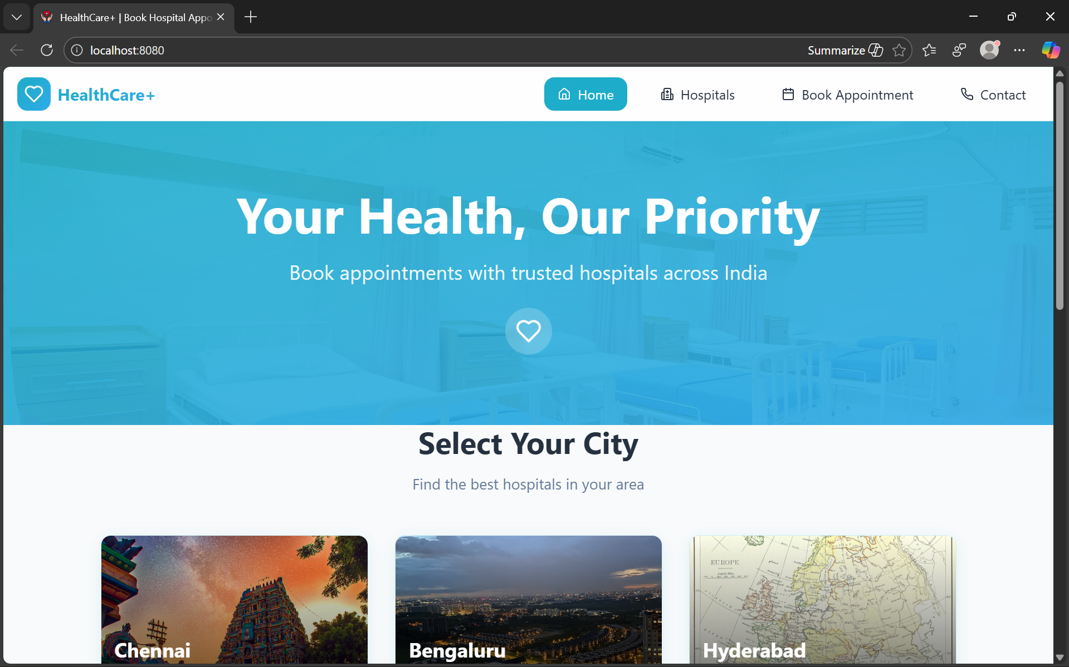
Output (Screenshot)
Screenshots of the web interface showing:
1. City selection page.

Slide 13
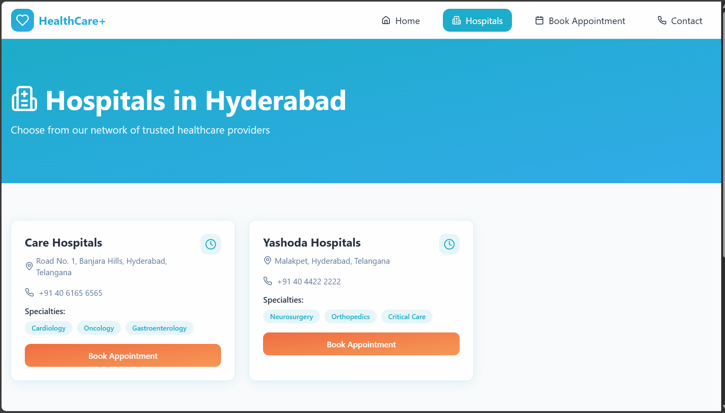
Output (Screenshot)
2. Filtered hospital list.

Slide 14
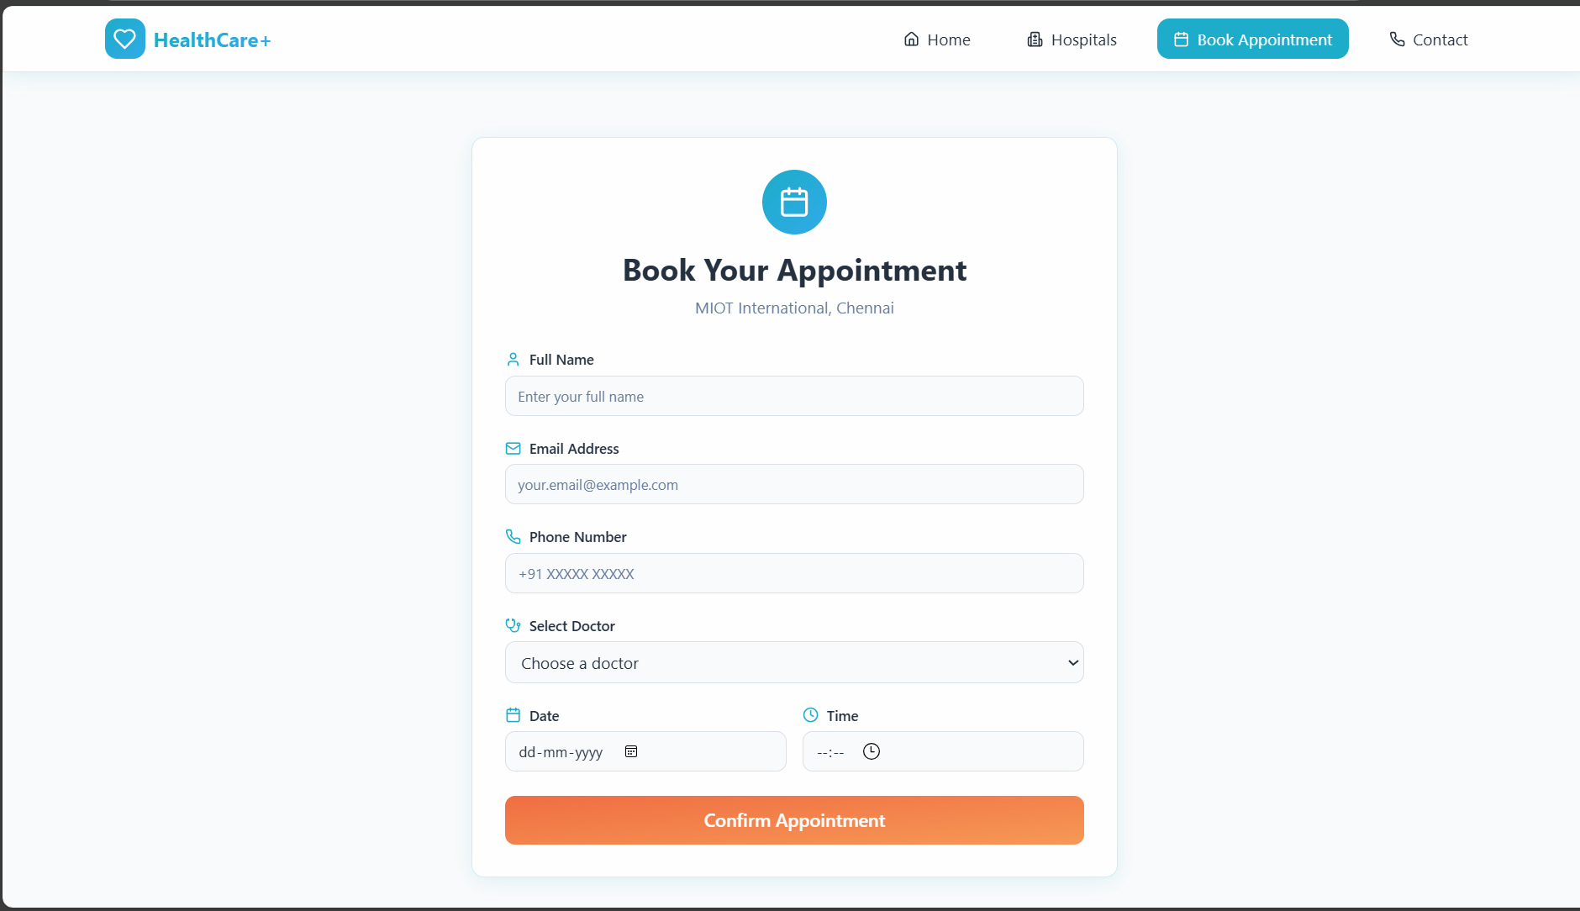
Output (Screenshot)
3. Appointment booking form.

Slide 15
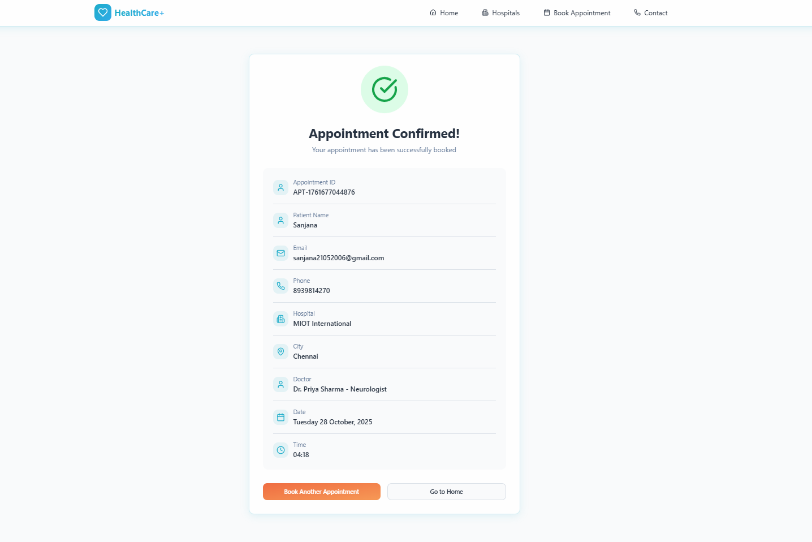
Output (Screenshot)
4. Appointment confirmation message.

Slide 16
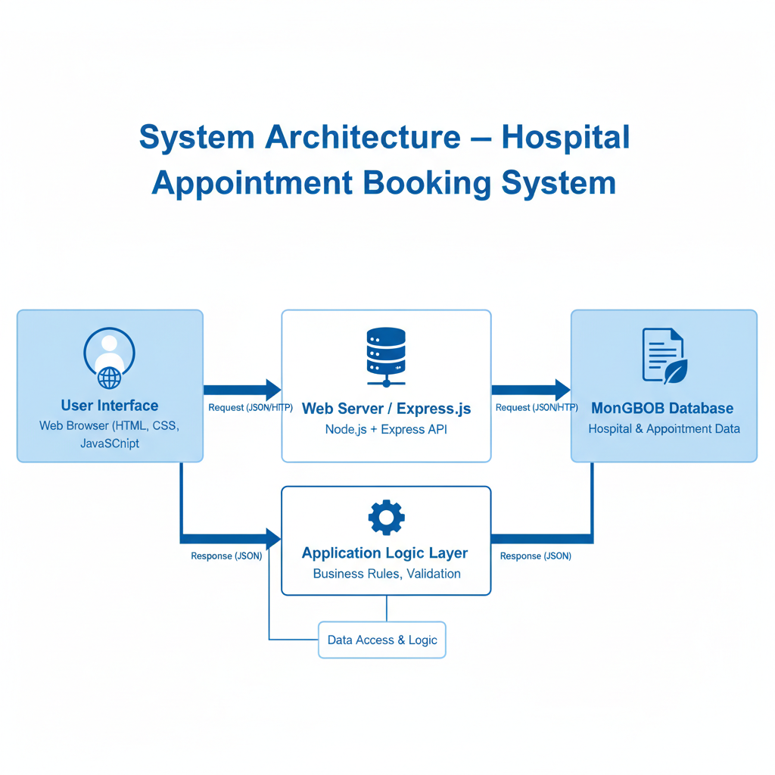
SYSTEM ARCHITECTURE

Slide 17
Conclusion
The Hospital Appointment Booking System provides an efficient, automated solution for managing patient appointments. By allowing city-based filtering and real-time scheduling, it simplifies hospital management, improves patient satisfaction, and supports a smarter healthcare system.

