Slide 1
TW-Scripts
A Comprehensive Resource for
Scripting in TiddlyWiki 5
Mohammad Rahmani
May 20th, 2021
https://github.com/kookma

Slide 2
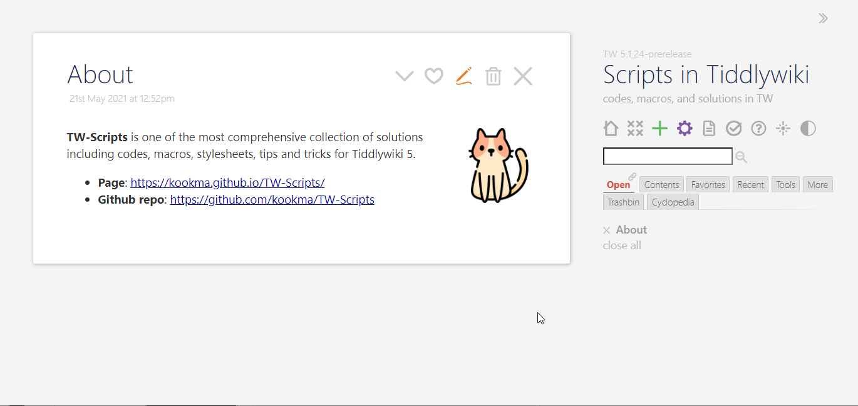
What is TW-Scripts?

Slide 3
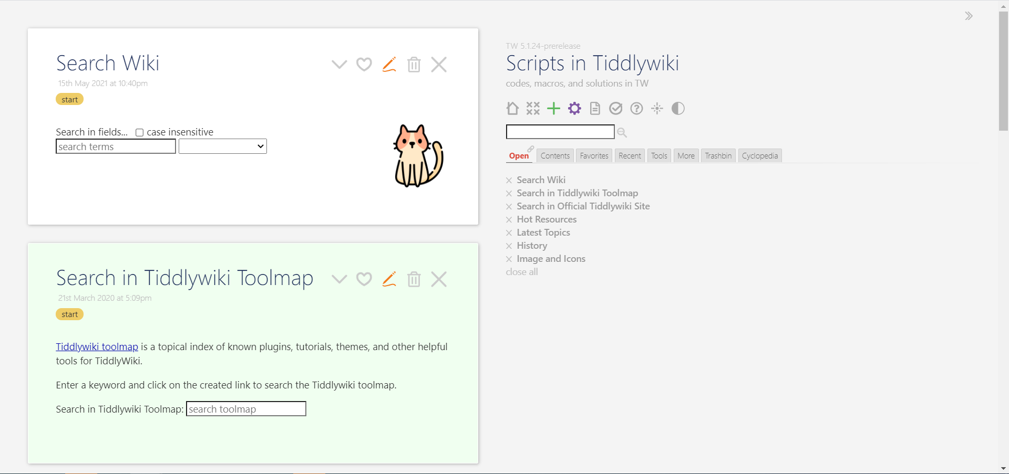
The Landing Page

Slide 4
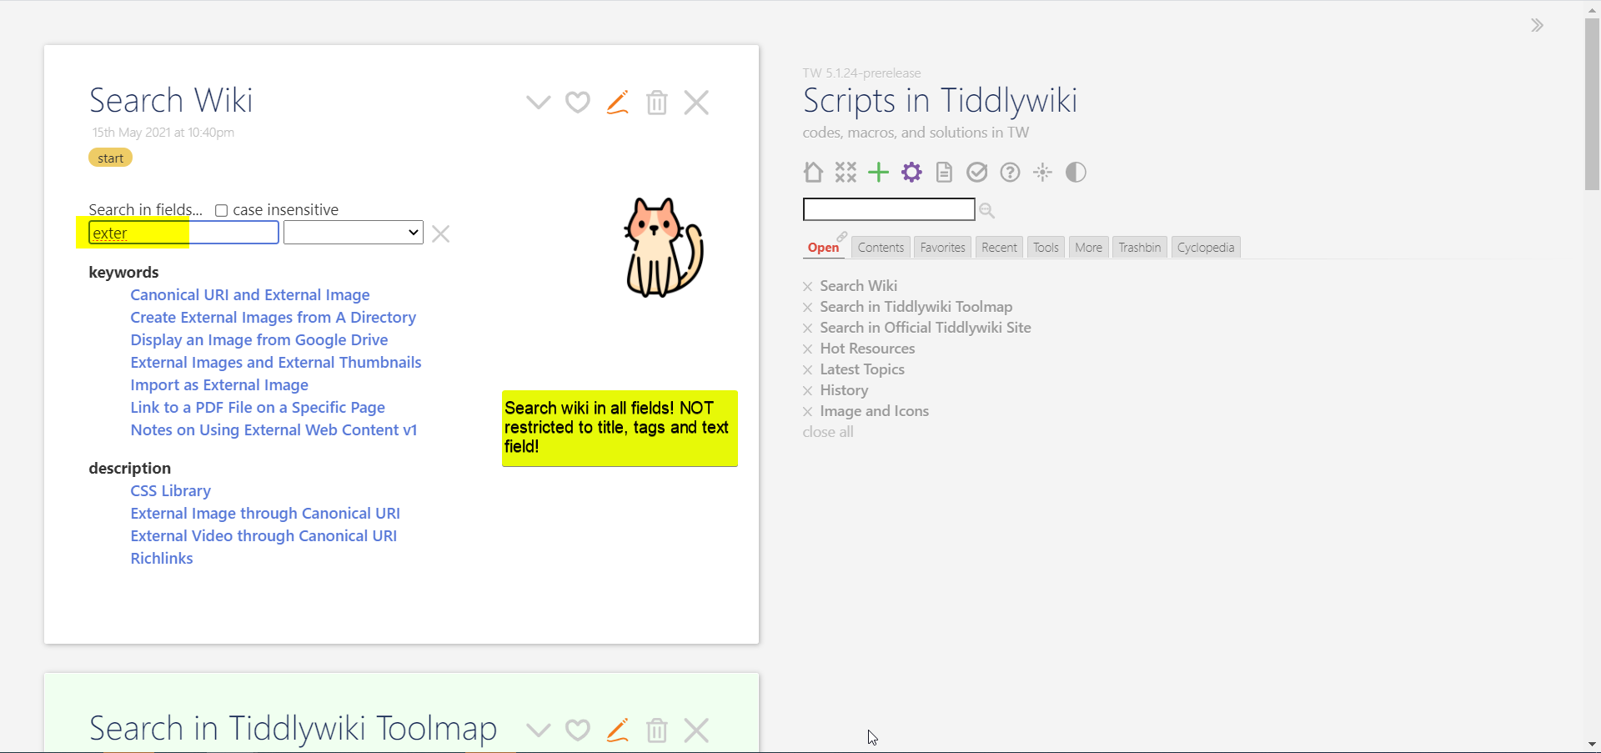
Search in TW-Scripts

Slide 5
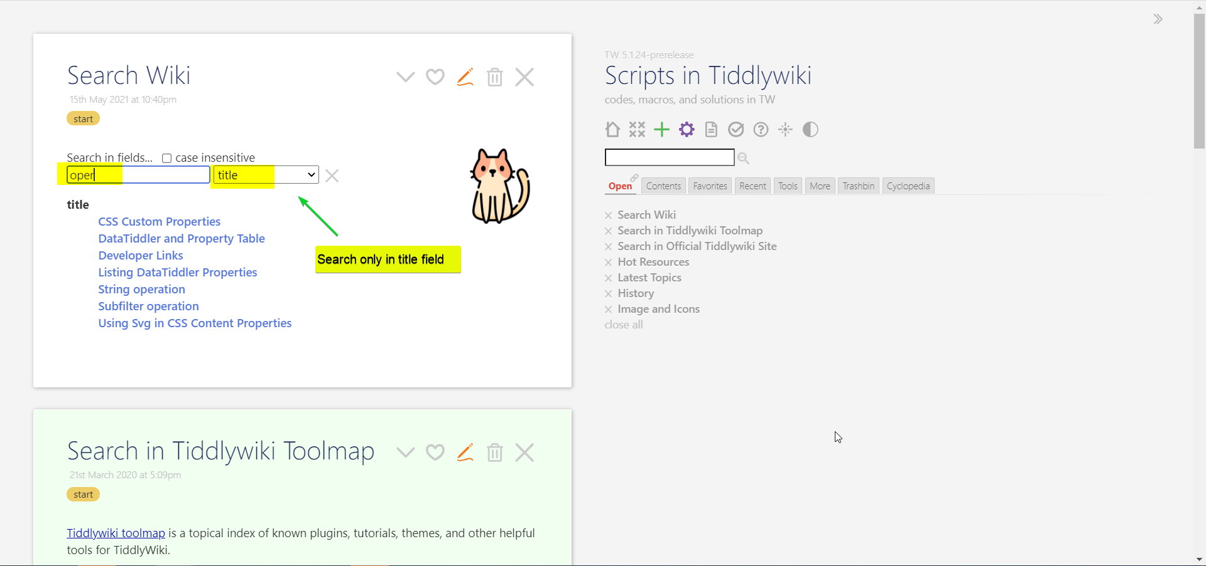
Search in TW-Scripts Using Specific Field

Slide 6
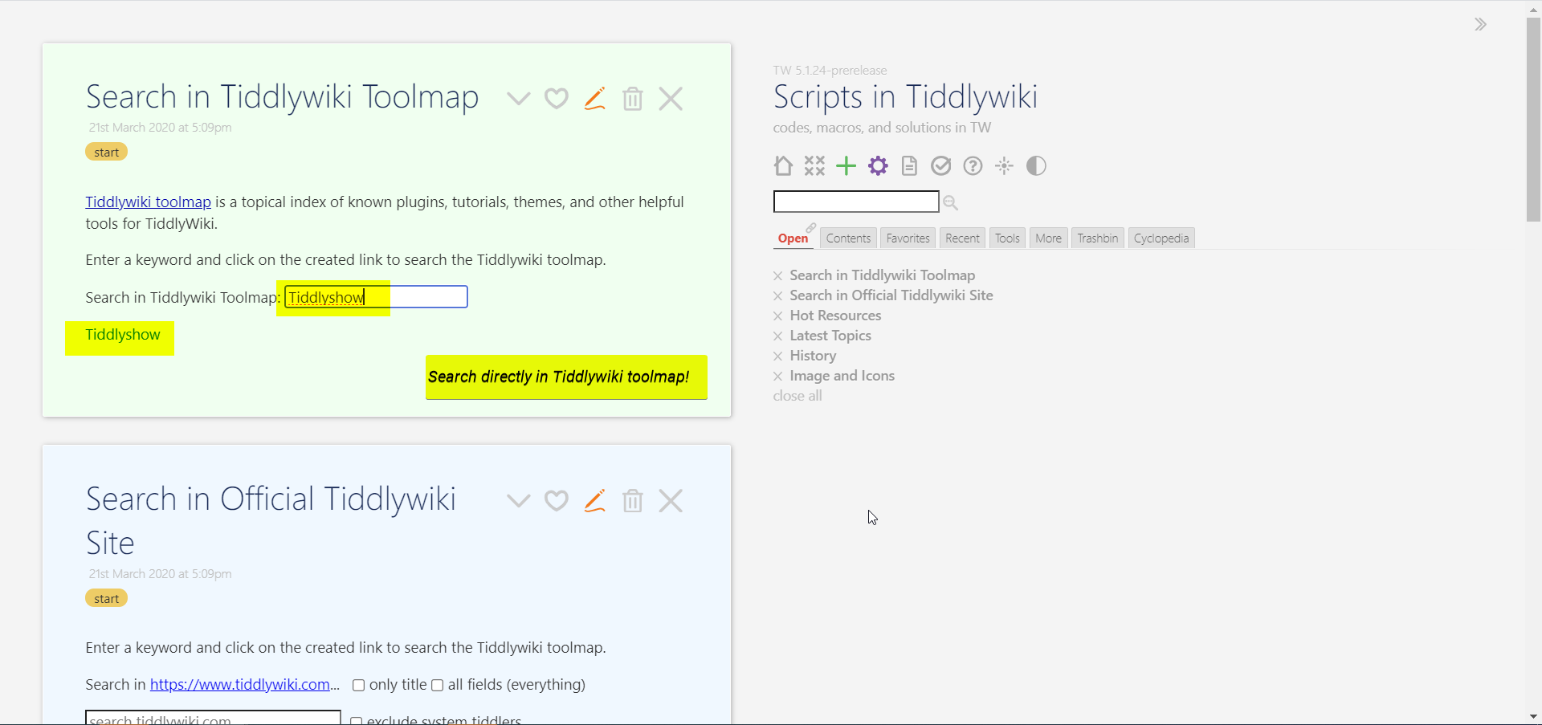
Search in TiddlyWiki Toolmap

Slide 7
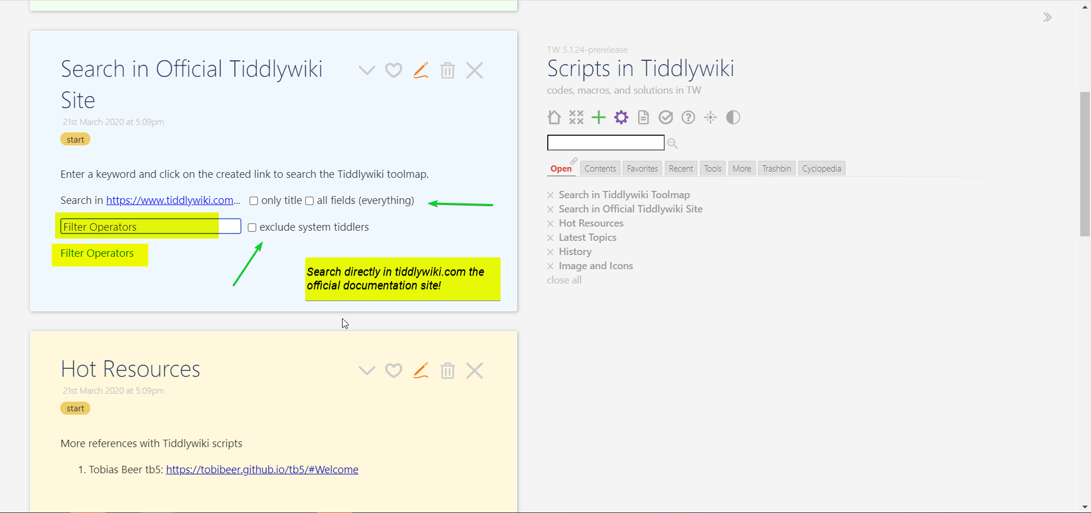
Search Official TiddlyWiki Page

Slide 8
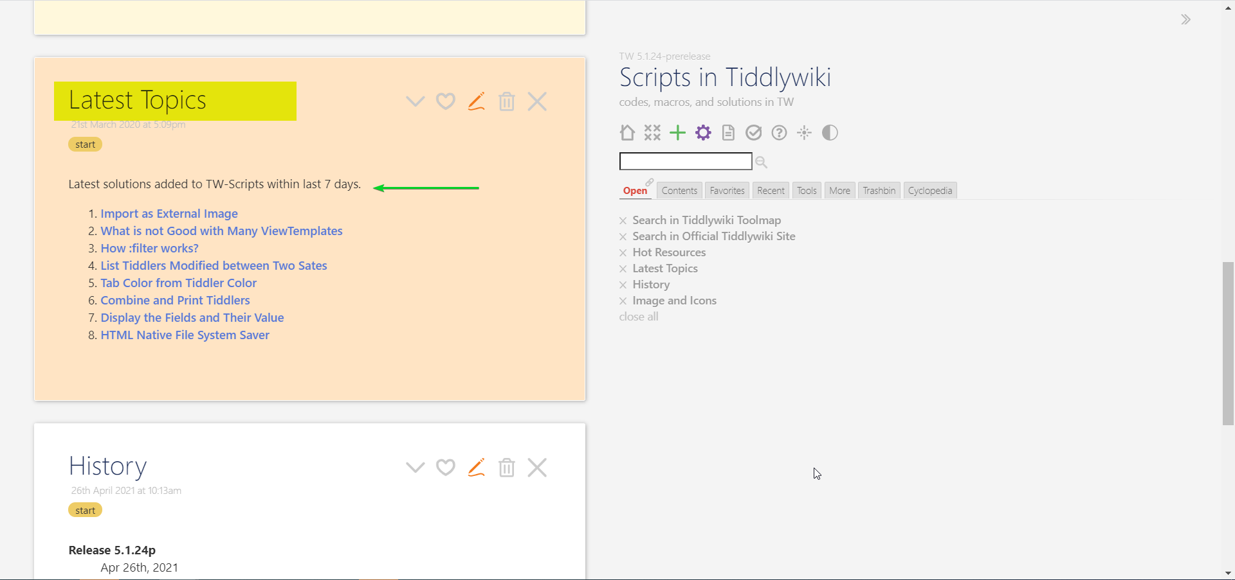
Latest Topics in TW-Scripts

Slide 9
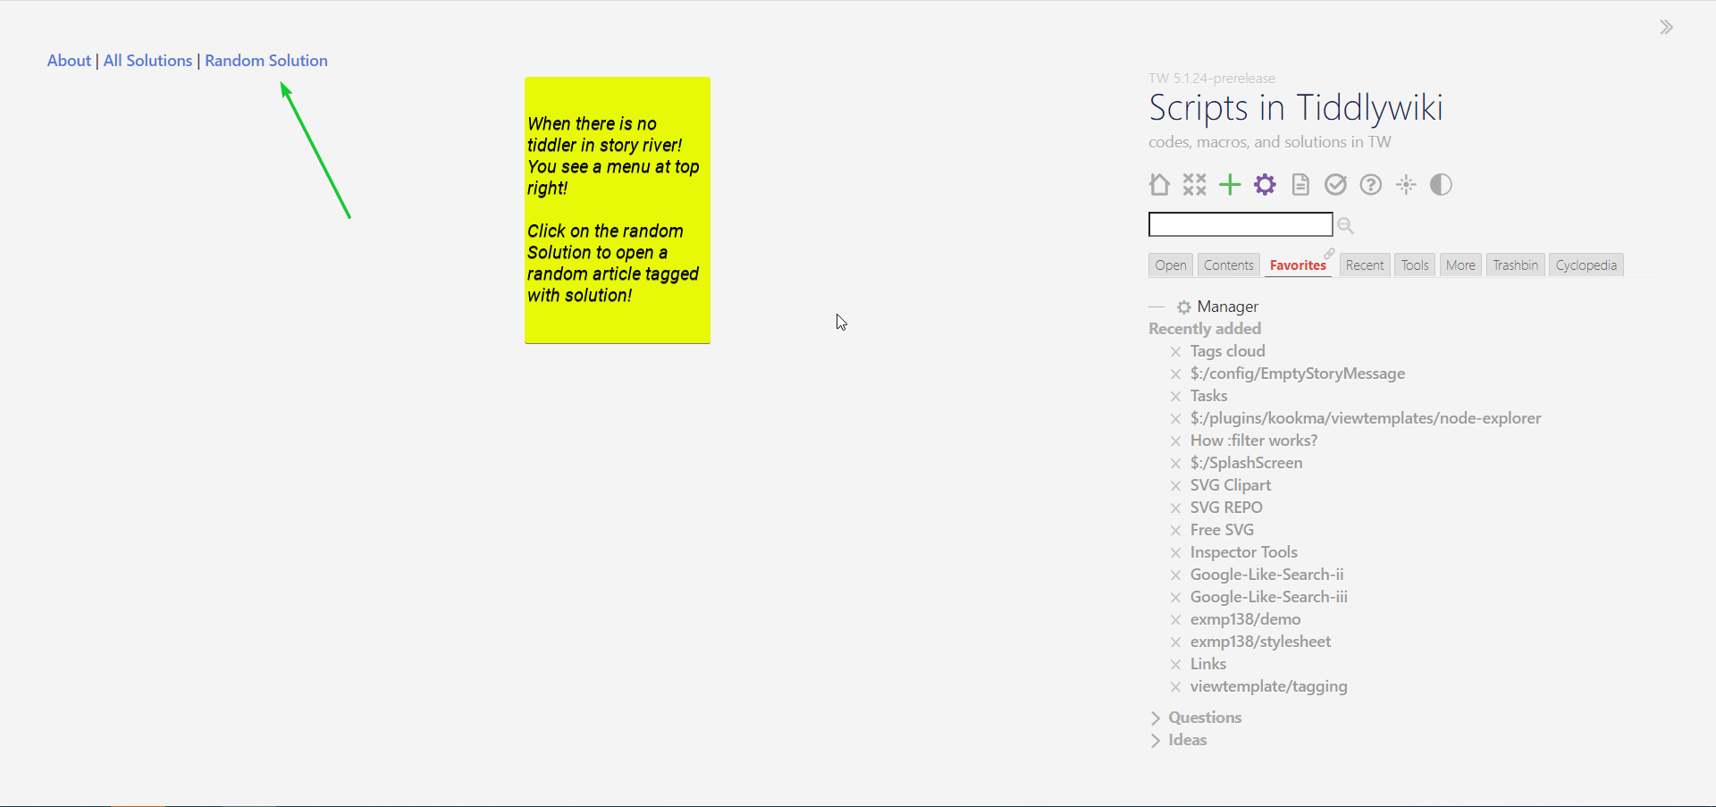
Enjoy Reading Using the Random Article . . .

Slide 10
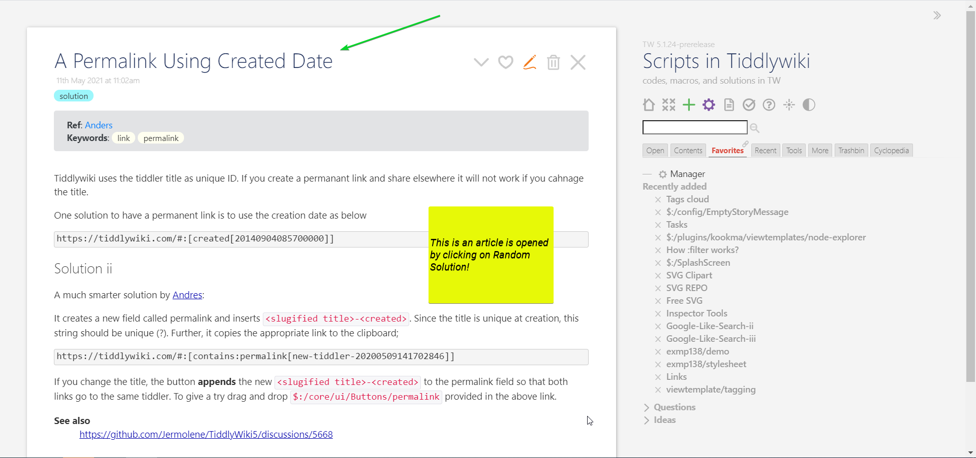
Enjoy Reading Using the Random Article

Slide 11
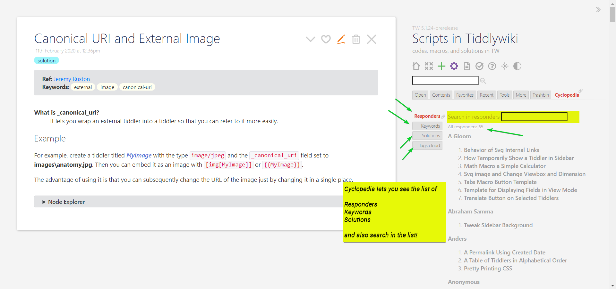
Look in Keywords, Responders, and Solutions

Slide 12
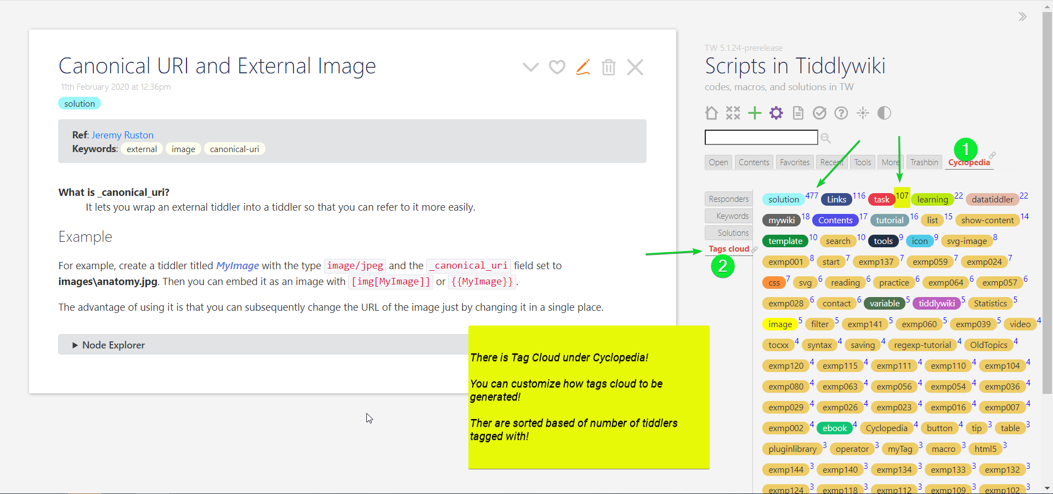
The Tags Cloud with Frequency They Used

Slide 13
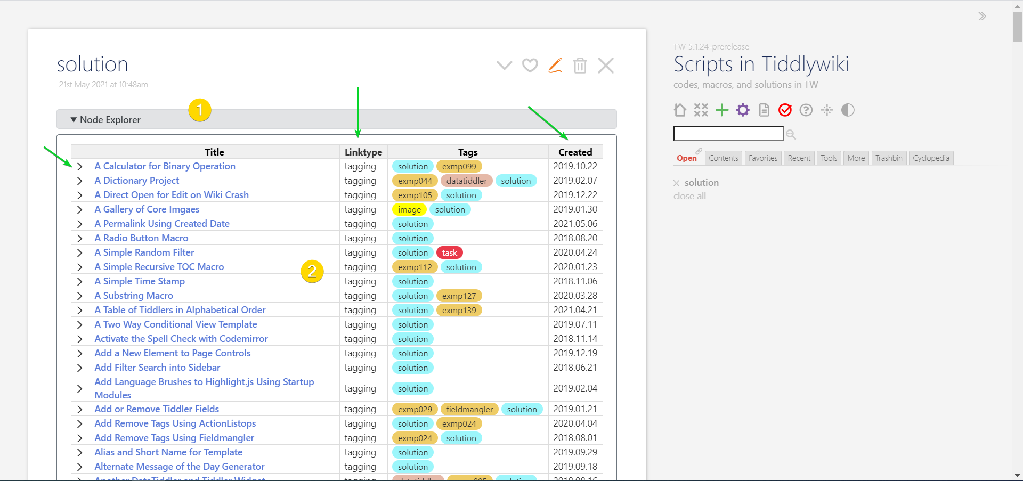
Node Explorer on Tiddlers Contain Node
A node is a link, backlink, or tagged tiddler!

Slide 14
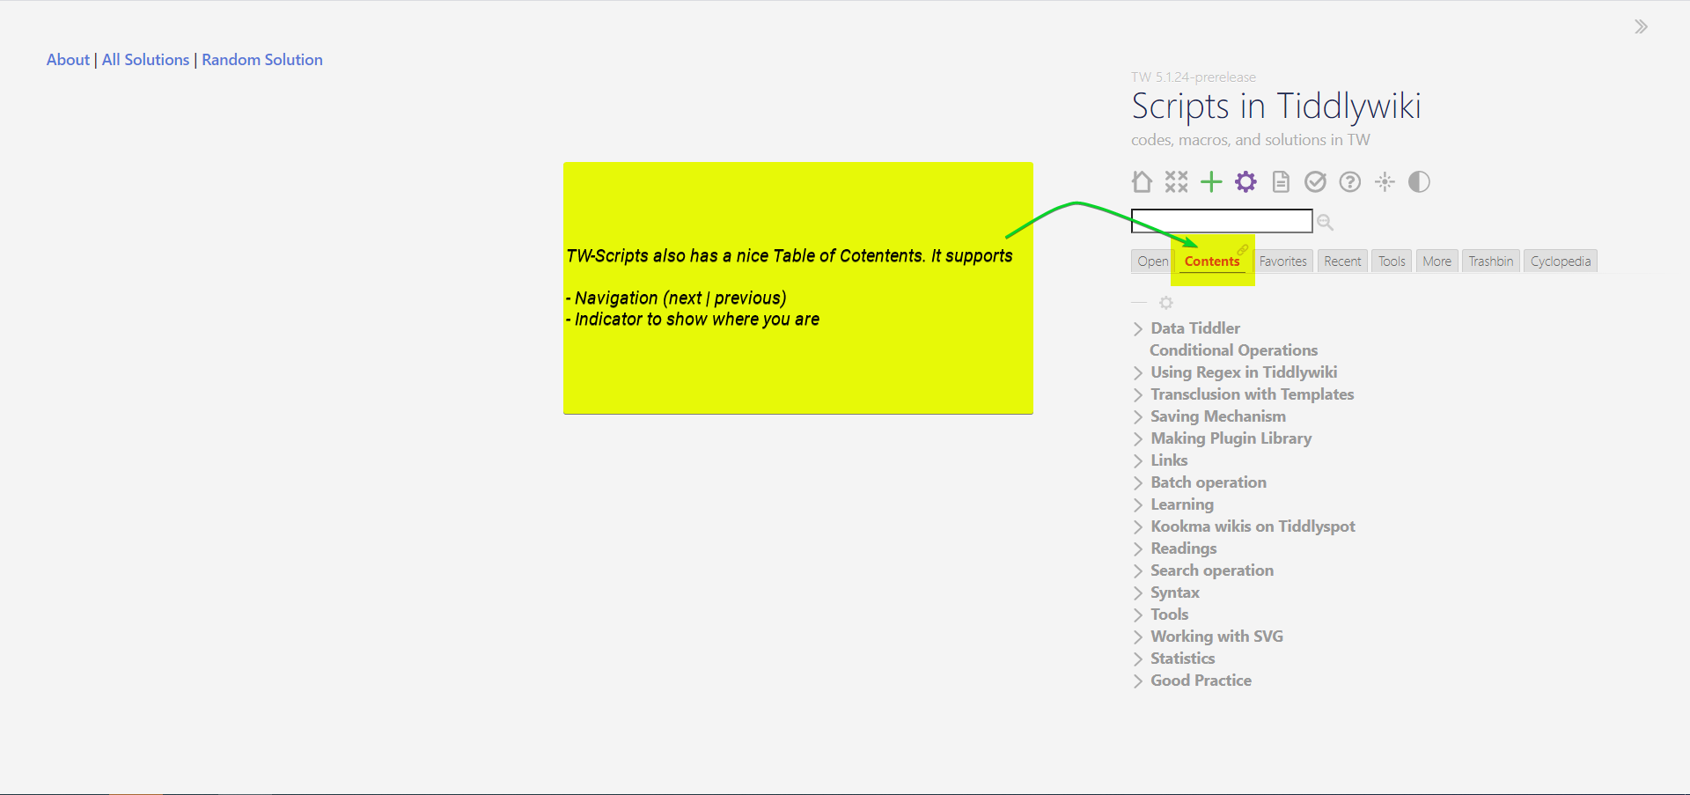
Enjoy Linear Reading Using the Contents Tab

Slide 15
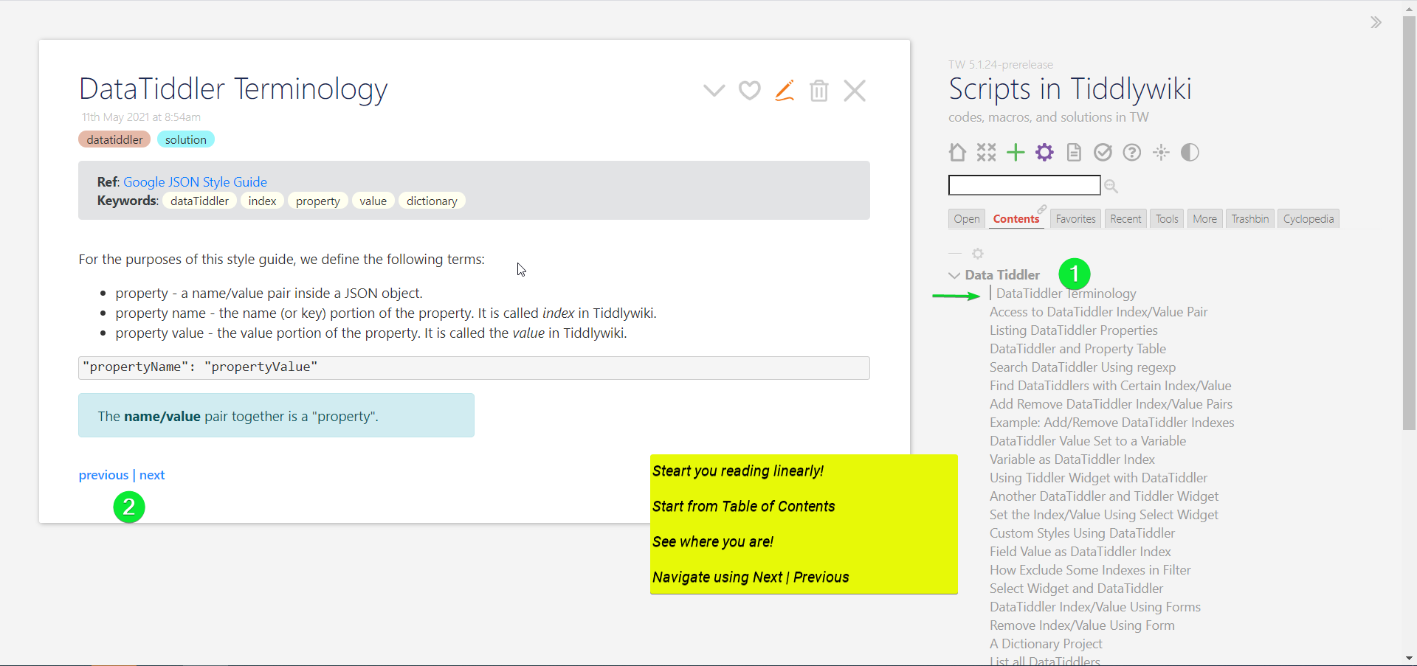
Step through Contents, and the Location Flag

Slide 16
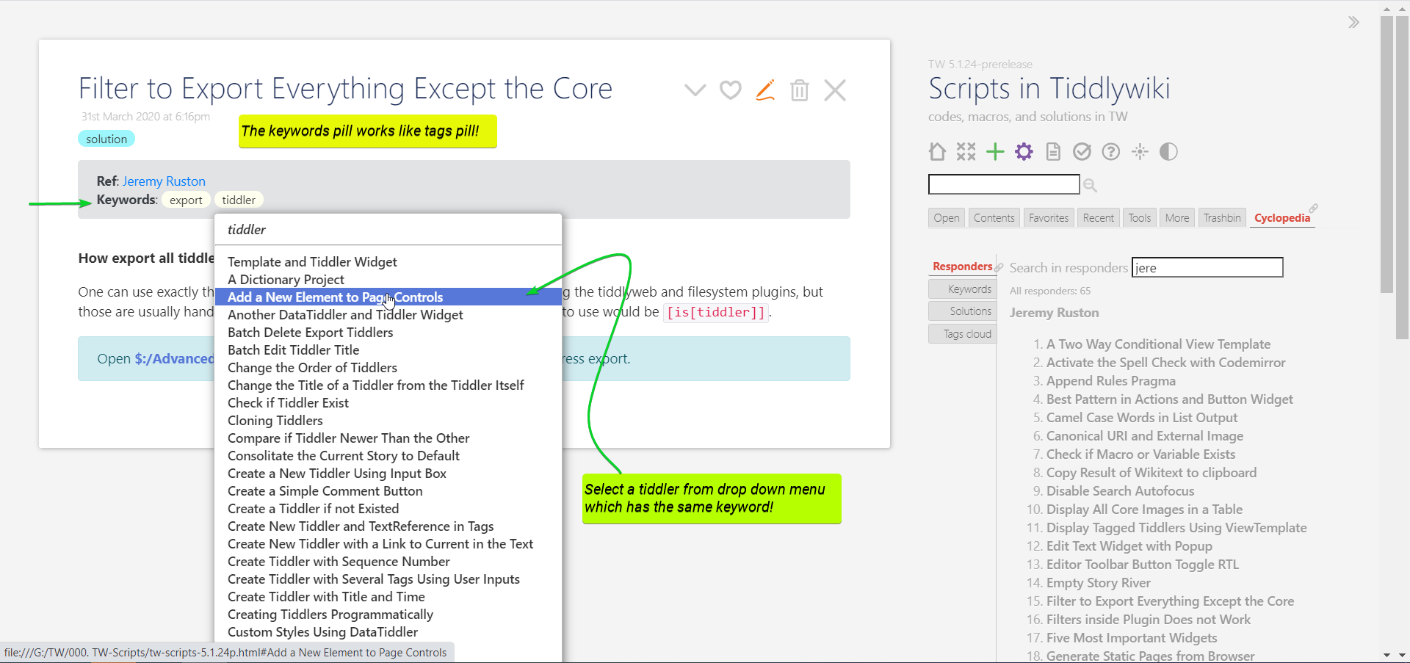
Solution Ribbon Lets Find Relevant Materials

Slide 17
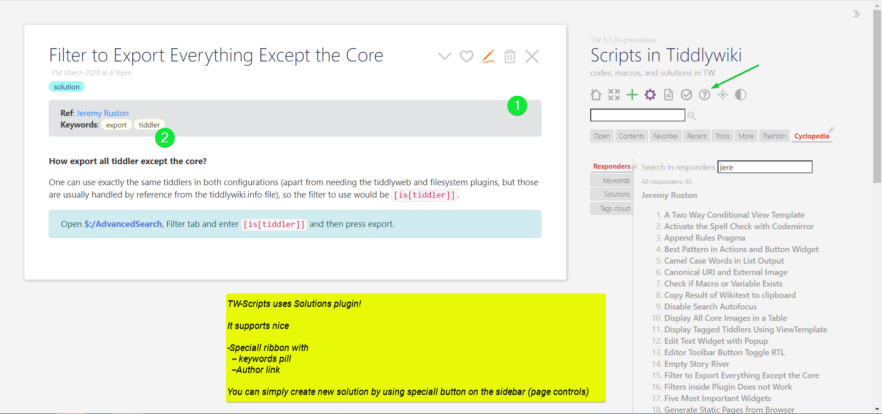
Create New Solutions

Slide 18
Stay Tuned!
Page: https://kookma.github.io/TW-Scripts/
Repo: https://github.com/kookma/TW-Scripts

