Slide 1







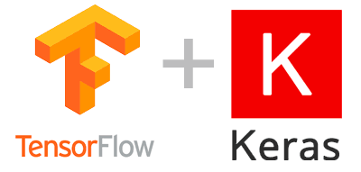
Frontend
Crawling
DataBase
Backend
User
Machine Learing

