Slide 1
Project: File Attribute Listing
Summary: Expose RESTful APIs to get file attributes from filesystem
Author: Anuj Kumar
Date: Jul-2020

Slide 2
High Level Design
Client
(Browser/Command line)
GET
Middleware
(RESTful Java)
File System

Slide 3
Hexagonal architecture (for organizing codebase)
APPLICATION
DOMAIN
PORT
ADAPTER

Slide 4
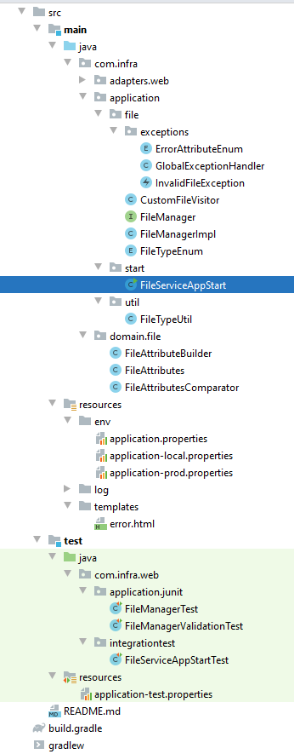
Codebase structure snapshot

