Slide 1
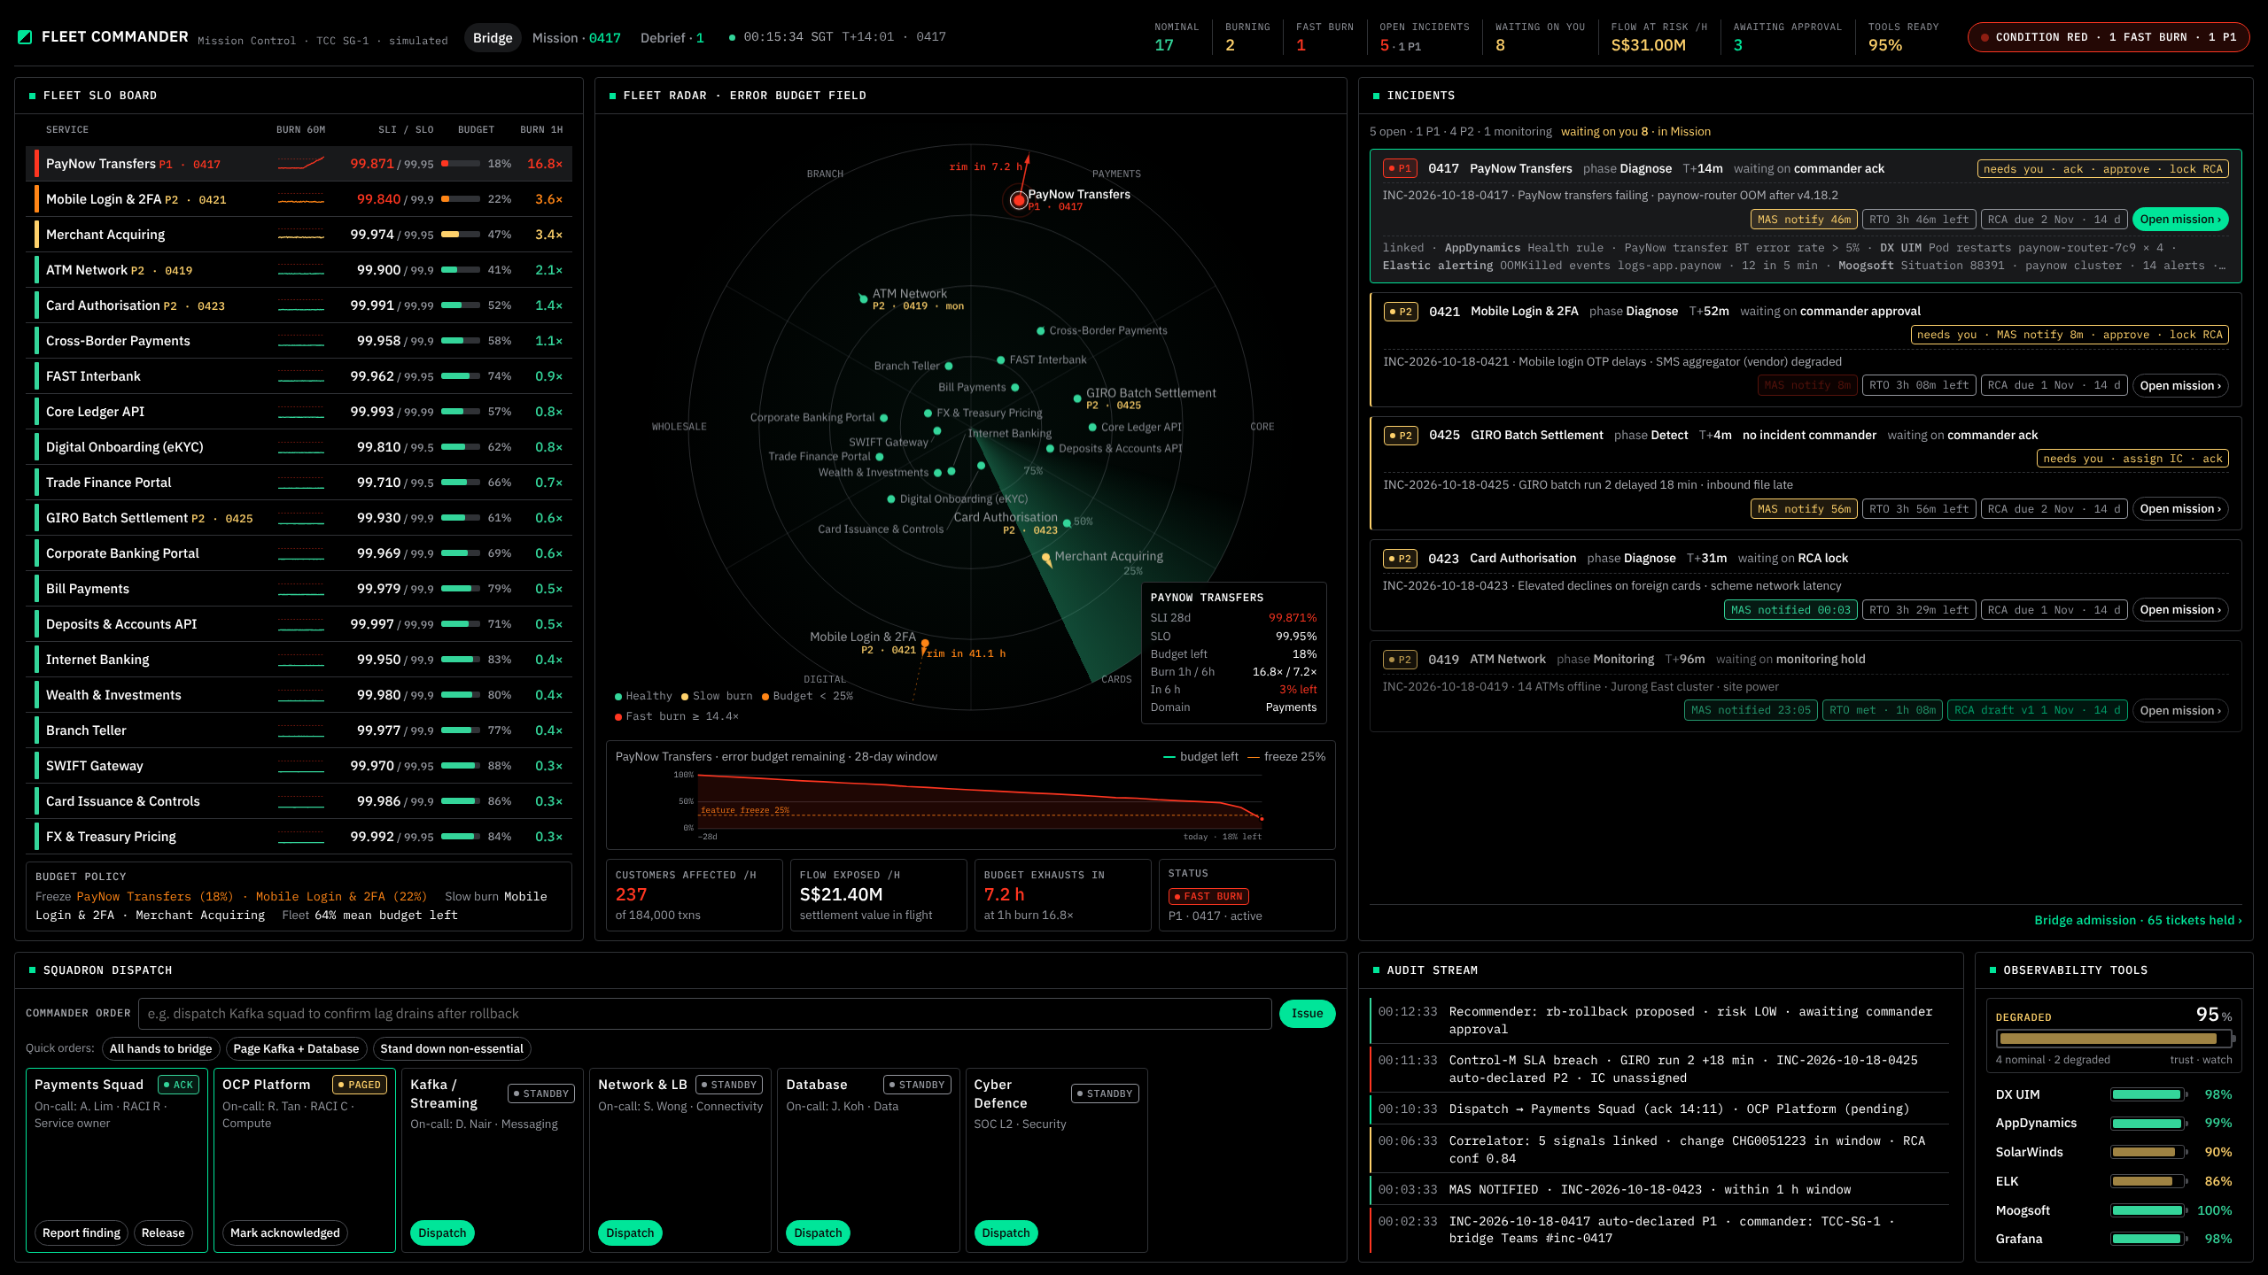
One cockpit where the Technology Command Center commands the fleet of business services by error budget, not by ticket queue
NORTH STAR · 1 OF 2
Every service on one screen
Twenty business services ranked by how fast each is burning its error budget, with the regulator's view of impact beside it.
Impact decides who reaches the bridge
Tickets are admitted by business impact; the noise is held below the line where the commander can still see it.
The regulator's three clocks run live
Notify within 1 hour, recover within 4, report within 14 days — counting down beside every incident, from detection to debrief.
BRIDGE seconds
MISSION minutes
DEBRIEF days
Three layers, one record: every command, approval and attestation is written once and kept for seven years.
The Bridge — fleet SLO board, error-budget radar, ranked incidents with bridge admission, squadron dispatch, audit stream
Notes:
North Star, part one. The point to land: today the TCC works a ticket queue; the North Star is a cockpit that ranks the whole fleet of business services by how fast each one is burning its error budget, admits incidents to the bridge by impact rather than by arrival, and keeps the MAS clocks running beside every incident. What you see on the right is the working prototype of the Bridge, twenty services, simulated telemetry.

Slide 2
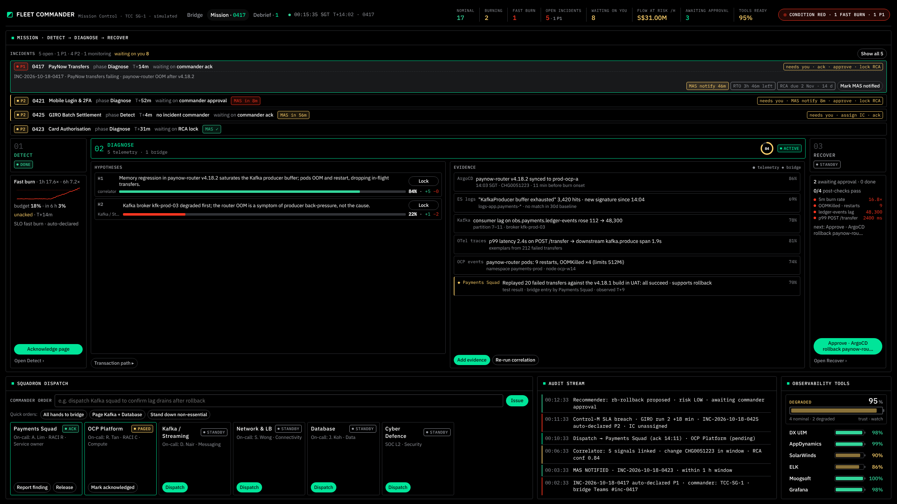
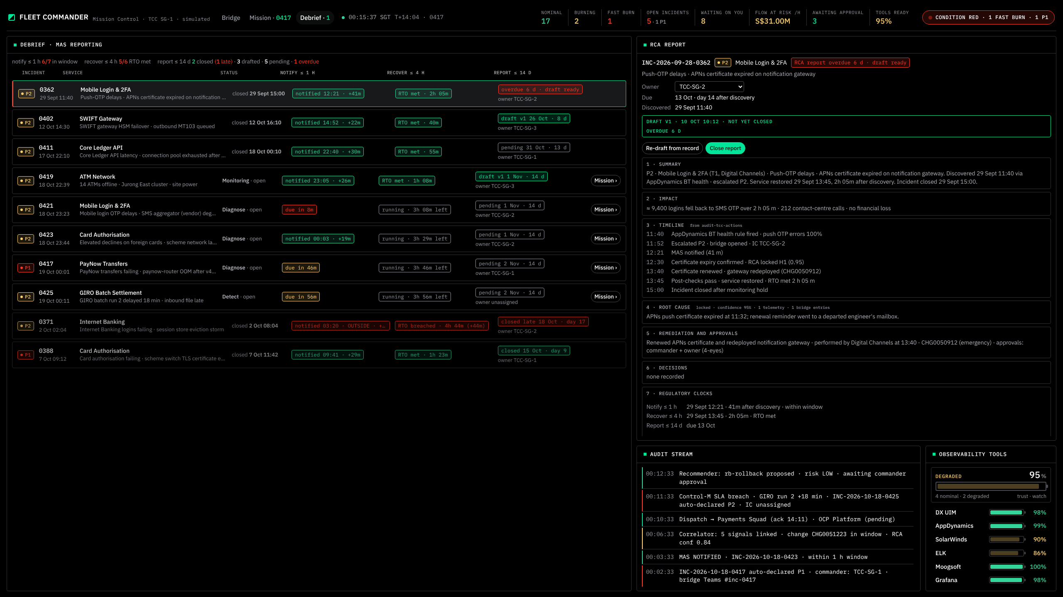
Three layers, three clocks: the Bridge watches in seconds, a Mission runs in minutes, the Debrief settles in days
NORTH STAR · 2 OF 2
01 BRIDGE · SECONDS
02 MISSION · MINUTES
03 DEBRIEF · DAYS
Fleet awareness
One incident, commanded
Obligations settled
Fleet Commander — the TCC shift lead
Incident Commander with the SME squads
Incident Commander with Risk & Compliance
“Where do I spend my attention right now?”
“What is broken, why, and what do we do — safely?”
“Did we meet our obligations — and can we prove it?”
Fleet SLO board — twenty services ranked by burn
Error-budget radar with six-hour projections
Incidents admitted by impact; squadrons dispatched
Detect → Diagnose → Recover, one phase in focus
Evidence and hypotheses to a locked root cause
Signed runbooks · four-eyes · every step audited
Notify ≤ 1 h · recover ≤ 4 h · report ≤ 14 d
RCA report assembled from the record, not retyped
Closed when settled; proof kept for seven years
Ticket queue → error-budget priority
Bridge call from memory → commanded mission with an audit trail
Report written after the fact → report assembled from the record
Notes:
North Star, part two. Three layers because they run on three clocks and have three different people in the seat. The Bridge is awareness in seconds for the shift lead. A Mission is one incident worked in minutes by an incident commander with the squads, and it is where every action lives — nothing is executed from the Bridge. The Debrief is where the three MAS obligations are settled in days and where the RCA report is assembled from the record we already wrote. The grey strips are the behavioural shift we are buying.

Slide 3
We are at the start: the tools exist and the cockpit is a working prototype, but fleet SLOs and the command plane do not yet exist
HOW WE GET THERE · WHERE WE ARE NOW
Three steps from here, each ending in a demo to this forum and a stop / continue gate.
3 · ASSURE
2028
YOU ARE HERE
2 · COMMAND
H2 2027
Debrief live: MAS clocks, RCA from the record, seven-year audit stream. All tiers on the Bridge.
1 · INSTRUMENT
H1 2027
Mission live: correlation, evidence, locked RCA. Pre-approved runbooks run through EDA under four-eyes.
0 · TODAY
Q4 2026
SLIs and error budgets for Tier-1 services. Burn-rate alerting pages. The Bridge live in the TCC.
Tools in production. Cockpit prototype on simulated data. Incidents worked from the ticket queue.
In place today
Not yet
ELK, Grafana, AppDynamics, DX UIM, SolarWinds and Moogsoft in production — the sensors and the correlator
Event-driven Ansible proven end to end; alert-as-code schema and RACI routing designed; Backstage IDP in use
Fleet Commander prototype: three pages, twenty services, admission gate, MAS clocks — a decision on what to build, not a sketch
No fleet-wide SLOs or error budgets; no SLI store, so burn rate is not computed anywhere
Incident handling is ticket-driven — ServiceNow first, business impact second; no signed runbook catalogue or automation governance
No incident-record contract between ServiceNow and a cockpit; the prototype runs on simulated telemetry, not production feeds
Notes:
Where we are: honestly, at step zero. The tools and the automation plumbing exist and the prototype has settled what we want to build, but there are no fleet SLOs, no SLI store, and incidents are still worked from the queue. The path is three steps — instrument, command, assure — and the next slide is what the platform team needs to walk it.

Slide 4




To build it, the platform team needs a dedicated squad, protected time and three decisions from this table
WHAT THE PLATFORM TEAM NEEDS
People — a squad of six for 24 months
Time — ring-fenced from BAU
Six full-time: an SRE product lead, two SLI/SLO engineers (Elastic transforms, OpenTelemetry), a front-end engineer (React, Canvas), an automation engineer (EDA, Ansible, ArgoCD) and a data and platform engineer (Elasticsearch, Kafka)
Part-time: a Risk & Compliance liaison, a ServiceNow engineer, and a UX designer for the first two quarters
The six are off the on-call rota and BAU queues for the first four quarters
A TCC commander seconded one day a week as product owner
Quarterly demo to this forum with a stop / continue gate at each one
Budget — sized in the Q4 2026 business case
Decisions — three we need now
Elasticsearch capacity for the SLI store and the seven-year audit stream (hot 30 d → cold)
OpenShift / ECK capacity for the SLI aggregation service
Vendor API enablement (AppDynamics, Moogsoft, DX UIM, SolarWinds), TCC wall display, SLO training
Every Tier-1 service has a named owner and an agreed SLO by the end of Q1 2027
Pre-approved runbooks in a signed catalogue may execute under four-eyes without a per-run CAB; freeze windows still hard-block
ServiceNow remains the incident record of truth, with a published contract to the cockpit (INC, CHG, PRB, IC assignment)
Notes:
The ask is deliberately specific. Six people for two years, kept off BAU for the first four quarters so the foundations get built rather than squeezed between incidents; a commander in the product-owner seat so we build what the TCC will actually use; the budget lines we will size in the business case this quarter; and three decisions that only this table can make — SLO ownership, the automation policy, and ServiceNow as the record of truth.

Slide 5
The solution is a command plane on top of the tools we already run: nothing is replaced, and every action takes the same governed path
ARCHITECTURE AND SOLUTION
SENSE
DX UIM
infrastructure
AppDynamics
applications
SolarWinds
network
ELK
logs
OpenTelemetry
traces · metrics
MAS TRM CONTROLS
Approval recorded with reason, RCA confidence and change reference
Second approver is the service owner; break-glass actions retro-approved
Notify ≤ 1 h · recover ≤ 4 h · report ≤ 14 d, timed from discovery
Evidence, hypotheses, outcomes and attestations append-only
Every step in the audit stream, retained seven years
STREAM & STORE
Kafka
event and telemetry streams
Elasticsearch on OpenShift (ECK)
the platform we already run
SLI store
metrics-otel.slo-* transforms
Audit stream
audit-tcc-actions · write-once · 30 d hot → 7 y cold
DECIDE
SLI engine · burn-rate rules
Elastic alerting and Grafana — new rules on existing tools
Correlator
Moogsoft situations + correlator over Elasticsearch
Incident record
ServiceNow INC · CHG · PRB, published contract
COMMAND
Fleet Commander — Bridge · Mission · Debrief
React + Canvas · WebSocket feed from the SLI aggregation API · SSO, one role per page
ACT
Signed runbook catalogue
Bitbucket, reviewed and signed
Event-Driven Ansible
rulebooks — already proven
Ansible · ArgoCD · OpenShift
execution targets
Gates
four-eyes · change freeze · dry-run · blast radius · post-check
in production today
to be built or configured by the squad
Notes:
Architecture. Read it top to bottom: the sensors we already own feed Kafka and Elasticsearch; two new stores sit on that cluster — the SLI store that makes burn rate computable, and a write-once audit stream. Above them, burn-rate rules, the correlator and ServiceNow as the record. The cockpit is the new command plane, and the action plane runs through the event-driven Ansible we have already proven, from a signed catalogue, through the gates on the right. The governance rail is not a slide decoration: every item on it is a control the cockpit enforces and records.

Slide 6
Tier-1 services are on the Bridge within a year; the full command-and-assurance loop is live by the end of 2028
THE NEXT TWO YEARS · Q4 2026 → Q4 2028
2026
2027
2028
now
Q4
Q1
Q2
Q3
Q4
Q1
Q2
Q3
Q4
Foundations
Squad staffed · first 5 SLOs
SLI store · aggregation API
Burn-rate paging live
SLI store scale-out for Tier-2
Bridge
SLO board, read-only, in TCC
Bridge GA · 20 Tier-1
Hardening: dispatch, admission tuning
Wall display, fleet-wide
Mission
Correlator · RCA lock
Recover via EDA, four-eyes
Manual records · break-glass
Per-IC view · agent intents
Debrief
MAS clocks · RCA from record
7-year audit · risk sign-off
Preventive actions tracked in ServiceNow PRB
Governance
Three decisions (this forum)
Signed runbook standard
Automation policy approved by CAB
MAS TRM attestation
Annual control review
Services on the Bridge
5
20 · Tier-1
40
Tier-1 + Tier-2
All tiers
Bridge GA · the year-one go-live
First automated remediation
First RCA report from the record
Steady state
Notes:
Two years, nine quarters. Year one is about getting Tier-1 onto the Bridge: SLOs and the SLI store first, a read-only board in the TCC by Q1, Bridge general availability for the twenty Tier-1 services by Q2 — that is the year-one go-live. The second half of 2027 is the Mission: diagnose first, then controlled remediation once CAB has approved the automation policy. 2028 is assurance: the Debrief with MAS clocks and the report from the record, the seven-year audit stream and risk sign-off, then the rest of the fleet. Each green bar is a demo to this forum and a stop / continue gate.

