Slide 1

网络系统程序员技能树
by AC

Slide 2
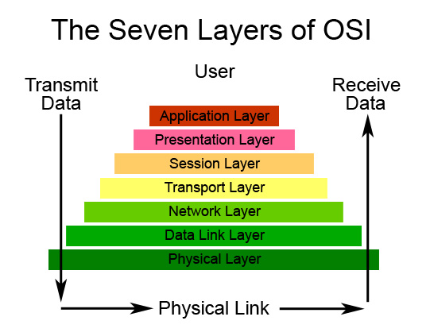

Slide 3
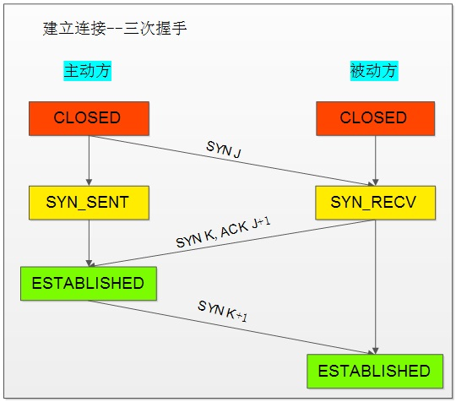

Slide 4
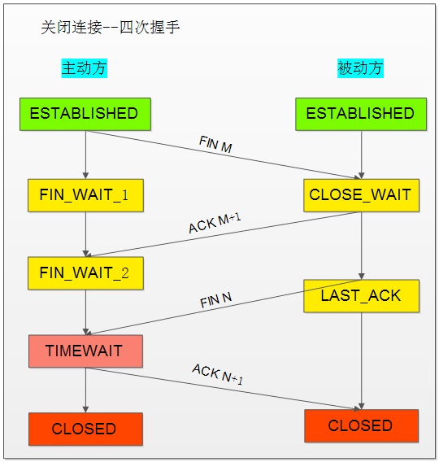

Slide 5
Topic
C1k select poll
C10k epoll kqueue iocp
c100k
C1000k(C1M) 用户态协议栈

Slide 6
Topic
Cpu
Memory
disk
net

Slide 7
Topic
L1 cache 1ns
Branch mispredict 5ns
L2 cache 7ns
Mutex lock/unlock 100ns
Main memory 100ns

Slide 8
Topic
Compress 1K bytes 10,000ns
Send 1K bytes over 1 Gbps 10,000ns
Read 1 MB sequentially 250,000 ns
Round trip within same dc 100ns

Slide 9
Topic
Disk seek 10,000,000 ns
Read 1 MB sequentially from network 10,000,000 ns
Read 1 MB sequentially from disk 30,000,000ns
Round trip within same dc 100ns

Slide 10
Topic
SMP
NUMA
Multi Core
SIMD
MIMD

Slide 11
Topic
Register
Cache
Memory
Close to cpu

Slide 12
Topic
Register
Cache
Memory
Close to cpu

Slide 13
Topic
Cpu binding
Parallel
Concurrence

Slide 14
Topic
Cache Line cache aligned
Memory Pool memory aligned
Allocator lockless jemalloc tcmalloc hoard ptmalloc2
Fragmentation Internal External
Leak
context switch

Slide 15
Topic
SATA SCSI SAS FC SSD
Array IP-SAN NAS FC-SAN Cloud
Sequence Random
IOPS Throughput Latency
RAID 0 1 01 10 5 6
Flash Cache
InfiniBand

Slide 16
Topic
Memory is new disk
Seq write/ read
Batch io

Slide 17
Topic
1 Gbps 10Gbps 100Gbps 1TGps
TSO GSO UFO LRO GRO RSS
RPS/RFS
Interface binding

Slide 18
Topic
C Java
Go python
Erlang/otp

Slide 19
Topic
Select Poll
Epoll
Kqueue
Iocp

Slide 20
Topic
Signle Process or Multi Process or mthread
Master / Worker nginx apache
Leader / Flower memcached
threadpool nginx
Reactor / proactor
SO_REUSEPORT google
fastsocket sina

Slide 21
Topic
Parallel
Concurrence
Distribution

Slide 22
Topic
Blocking Nonblocking
Sync Async

Slide 23
Topic
Locking or lockless
pthread_Mutex
Pthread_Spin
Pthread_Condition
Semaphore
Distributed Lock
Atomic Memory Barrier

Slide 24
Topic
Shared memory
Message Queue
Eventfd
Signal
Socketpair
Unixsocket

Slide 25
Topic
Zero copy
Readv / WriteV
sendfile
Mmap
Cache
AsyncIO

Slide 26
Topic
Timer
Lane
Flexibility Service
Measurable
Modularization
Data struct
Queueing

Slide 27
Topic
Tcp
Udp > T
Unixsocket > U
Infiniband Max

Slide 28
Topic
Latency
Throughput
Tcp congestion control lost-based delay-based
Data Compress
Zlib LZO snappy lz4 quicklz

Slide 29
Topic
Cache aligned
False shared
branch prediction likely unlikely
Instruction-level parallelism
Cache associativity

Slide 30
Topic
Mysql mariadb postgresql
Select update insert delete
Myisam innodb xtradb tukudb
Master / Slave cluster partition sharding
Mongodb
Memcached redis
Full cache
no db

Slide 31
Topic
Kernel tuning
Tcp parameters tuning

Slide 32
Topic
Clang llvm
gcc internal
Freebsd > linux > windows x

Slide 33
Topic
measure
Tuning optimizing
Data is The King
Dark Room

Slide 34
Topic
Tcpcopy loadrunner iometer
Valgrind
Gdb
Gprof perfevent gperftools oprofile
Systemtap dtrace utrace strace ltrace
Dstat sar iostat vmstat tcpdump wireshark

Slide 35
Topic
Jeff Dean google
Ulrich Drepper glibc
Linus Torvalds kernel
Igor Sysoev nginx

Slide 36
Topic
nginx
memcached
haproxy
kernel
glibc
lua

Slide 37
?

