Slide 1

Cloud ninjas got charms with Juju!!

Slide 2

Before i start!!

Slide 3

Bad news!!

Slide 4

And the Good news!!

Slide 5

So lets begin!!
Ninjas == DevOps
New masters of web with automated weapons!!

Slide 6
What is DevOps?
Rate of agile development and deployment requires deeper interaction between teams
A melding of development, deployment, and QA principles, methods, and practices
Fills the gap between developers and system administrators

Slide 7
What drives DevOps?
Speed of the deployment
Continuous Integration, Automated Testing, etc.
Fast change vs. Stability

Slide 8
What does DevOps “deliver”?
Fast repeatable server setup, consistent environment
Abstract ops tasks to empower devs
Smaller deployments empower ops
Repeatable processes that let you scale out quickly

Slide 9
You've got the tools already
Hardware
Virtualization
Platform (OS)
Configuration Management
… need to tie that together into something whole.

Slide 10

Manages Services, not Machines

Slide 11

Before going there!!
How about a used case!!
Everybody loves Wordpress!!

Slide 12
Traditional Way!!
Install LAMP stack
Manually configure the database
Create upload directory
and test if all works.

Slide 13
Configuration management system
Install a Tool.
Test if its installed propely
Learn a new language
Test again if the configuration promise/recipes are correct and works

Slide 14
Juju way!!
Download wordpress and its deps charms from charms repository
Deploy it

Slide 15

So!!!
How about taking Juju ride!!

Slide 16
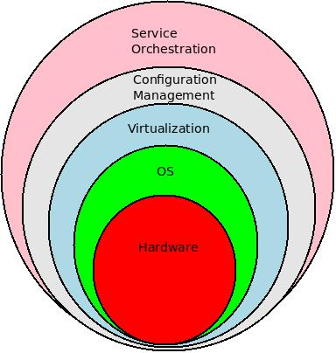
Elevate to Juju

Slide 17
What is Juju?
juju aims to be a service deployment and orchestration tool.
It enables the same kind of collaboration and ease of use which is seen around package management to happen on a higher level, around services.

Slide 18
What is Juju
With juju, different authors are able to create services independently, and make those services communicate through a simple configuration protocol.
In simplest term Juju is going to be APT for cloud

Slide 19
Compontents of Juju!!
Juju
Charms

Slide 20
Juju
Written in
Python
Uses
Apache Zookeeper, cloud-init

Slide 21
Charms
Reusable, codified best-practice.
Distilled deployment expertise.
Communication via interfaces.

Slide 22
Charms
Doesn't require foreknowledge of who will use them or how..
Independent
One can write charm in any language
python, ruby, bash ......

Slide 23
Inside Charms
Relations
Services

Slide 24
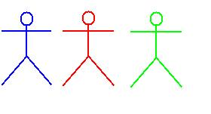
Relating services

Slide 25
Relations
A high-level interface describing the interactions between services
Services have `provides` and `requires` interfaces
Juju models the relationship between services, not machines

Slide 26
Services
Services change during their lifetime:
Number of instances?
Which machines they run on?
What services they depend on?
And how those services are implemented?

Slide 27
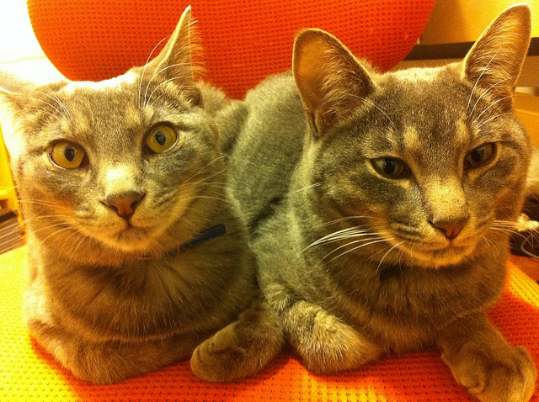
So .....

Slide 28
Lets bring back Wordpress.
juju bootstrap
juju deploy --repository charms local:mysql
juju deploy --repository charms local:wordpress
juju add-relation wordpress mysql
juju expose wordpress
juju status

Slide 29

Yes, wordpress for you!!
Was that difficult?

Slide 30
What about scaling?
Simple add any number of Wordpress units
juju-add unit wordpress
Even more
juju-add unit wordpress –n=5
Alternatively you can use Vernish chram or if load balancer needed try HAProxy charm

Slide 31
But hold on!!
If you are testing Ubuntu 11.10
sudo apt-get install juju
Older versions
sudo add-apt-repository ppa:juju/pkgs
sudo apt-get update
sudo apt-get install juju

Slide 32
Editing the config file!!
The config file is at:
~/.juju/environments.yaml
Juju currently supported
AWS, Openstack, LXC, Eucalyptus and others..

Slide 33
LXC/AWS config file..
Let me show you!!
$ juju bootstrap creates a sample config file.

Slide 34
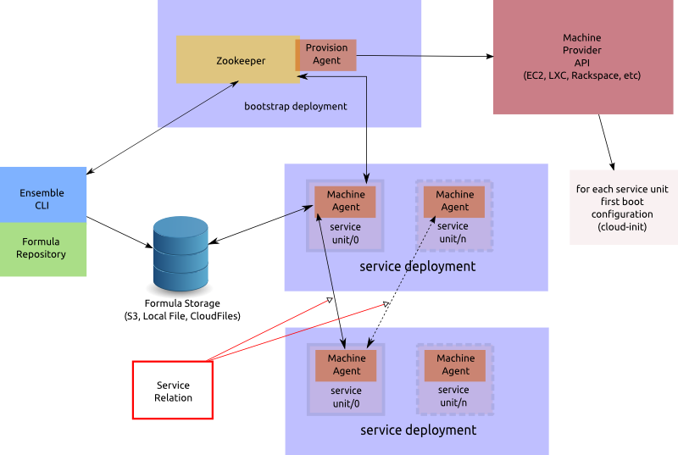
Juju under the hood.

Slide 35
Also ..
When this Project started
Juju was called Ensemble
Charms were called Formulas

Slide 36
More about Charms ..
Each charm defines dependencies and/or provides.
Juju treats individual services as atoms that are described as charms and can be instantiated one or many times.
Multiple charms can provide the same service and can be easily switched.

Slide 37
Little bit more ..
Juju maintains the relations between the services so that you don't need to care about the elasticity of your environment.
Relations are to formulas what bounds are to atoms.
Services are loosely coupled but highly cohesive.
Juju delivers service focused management through their life-cycle

Slide 38






Available Charms ..
Over 40 charms are availble …

Slide 39

You can help!!

Slide 40
Contribute
All development is public
Free and Open Source Software
Communication is open
Join Us
IRC: #juju on irc.freenode.net
Launchpad: https://launchpad.net/juju
Web: https://juju.ubuntu.com/

Slide 41
Credits
Photo : To there respctive owners, thanks for keeping it under CC, taken from flicker.
Docs/logo : Ubuntu Juju Project

Slide 42
Questions!!

Slide 43

About Me!!
Atul Jha
@koolhead17

Slide 44
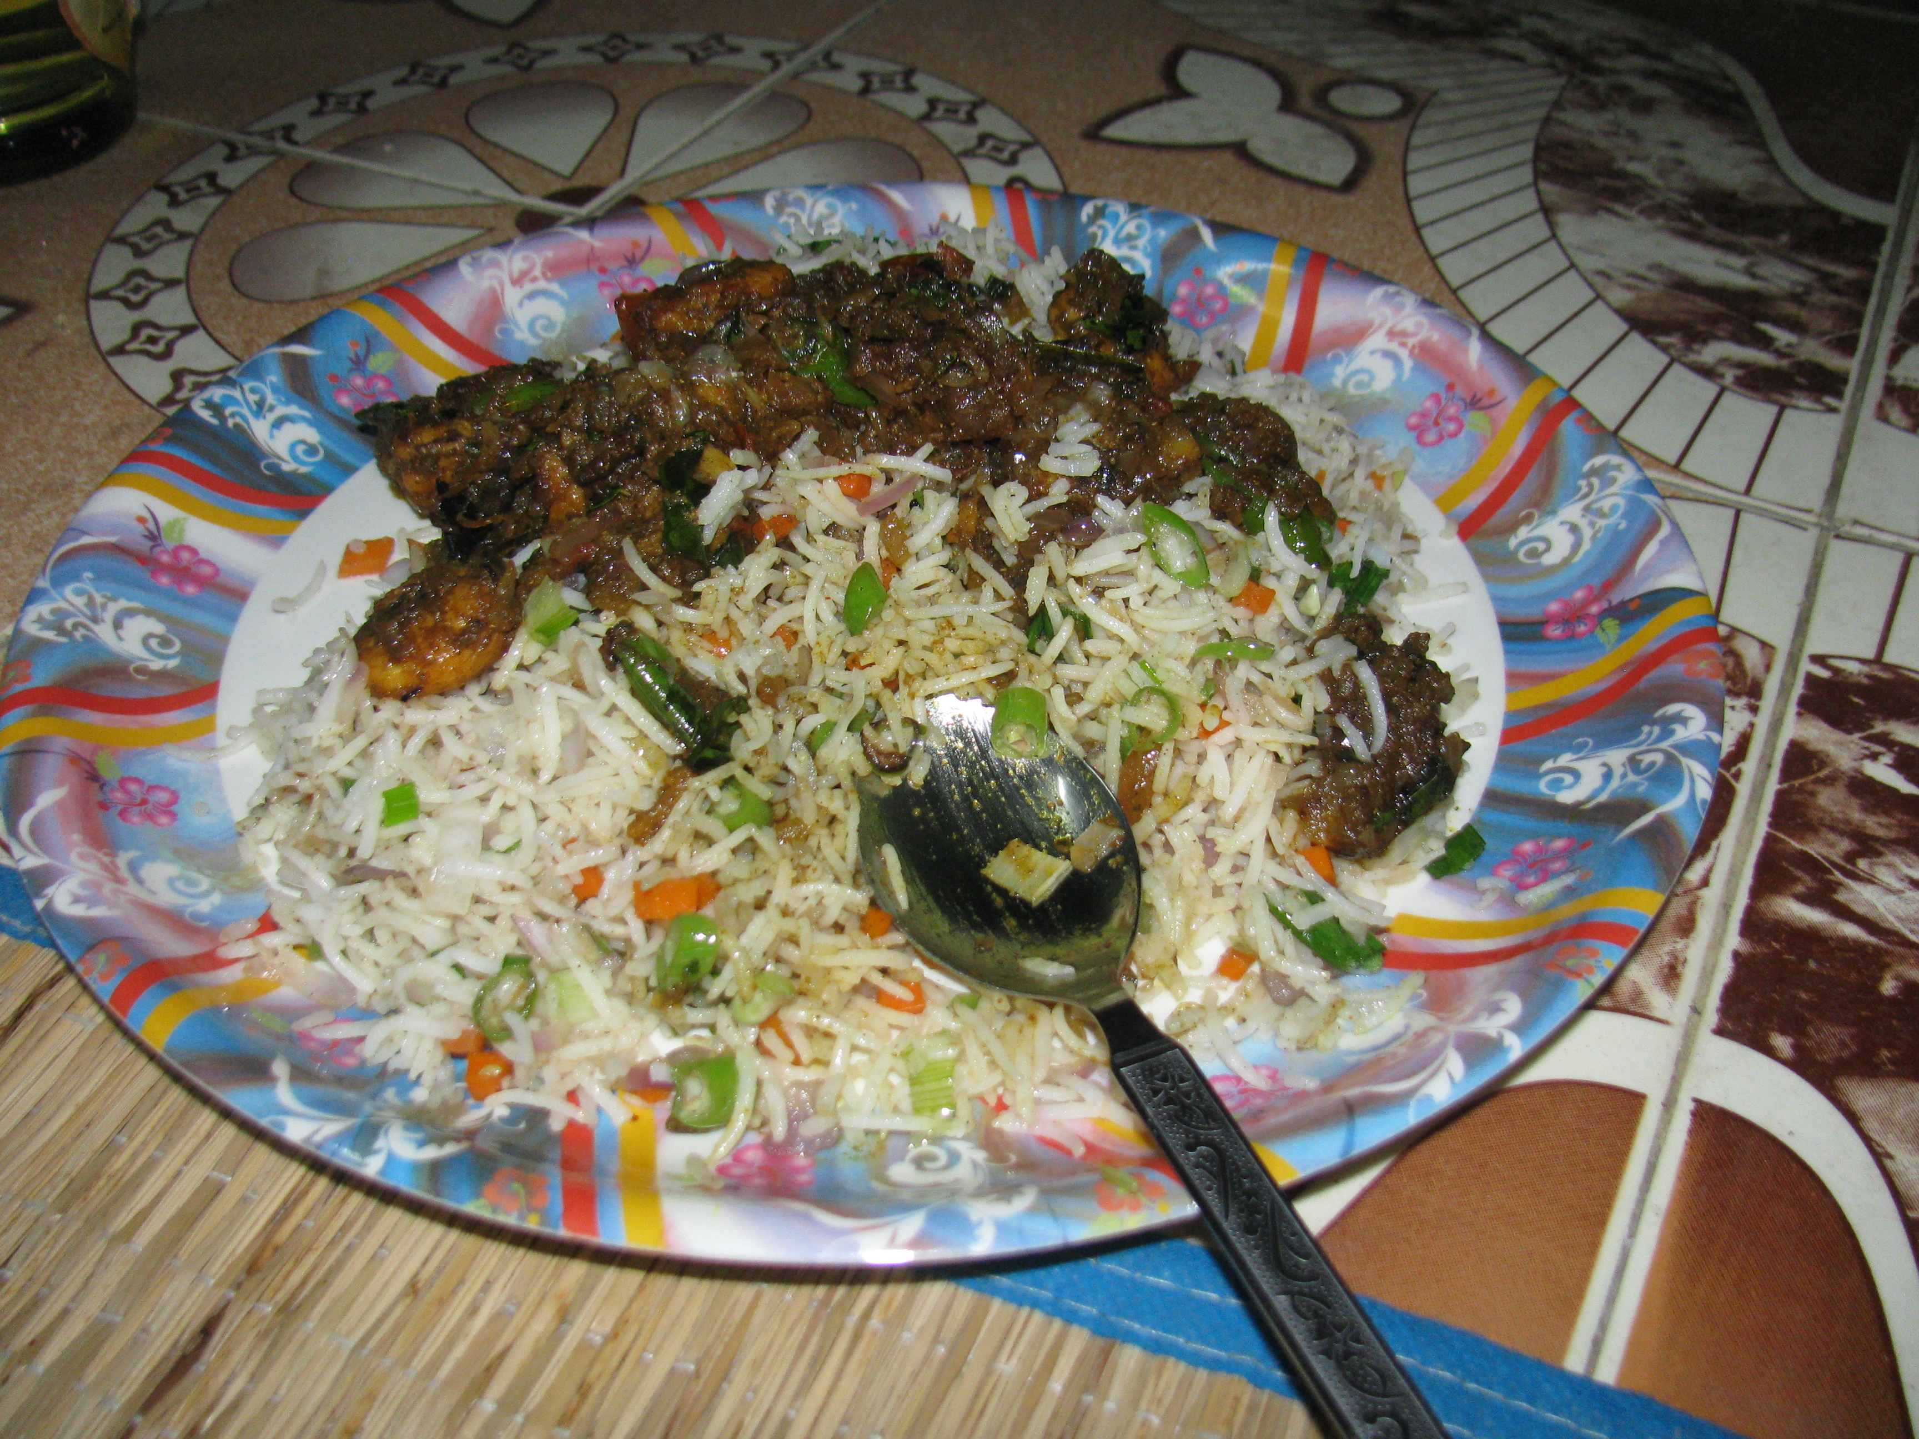
Thanks!!
I know most of you are thinking about Lunch now!!

