Slide 1
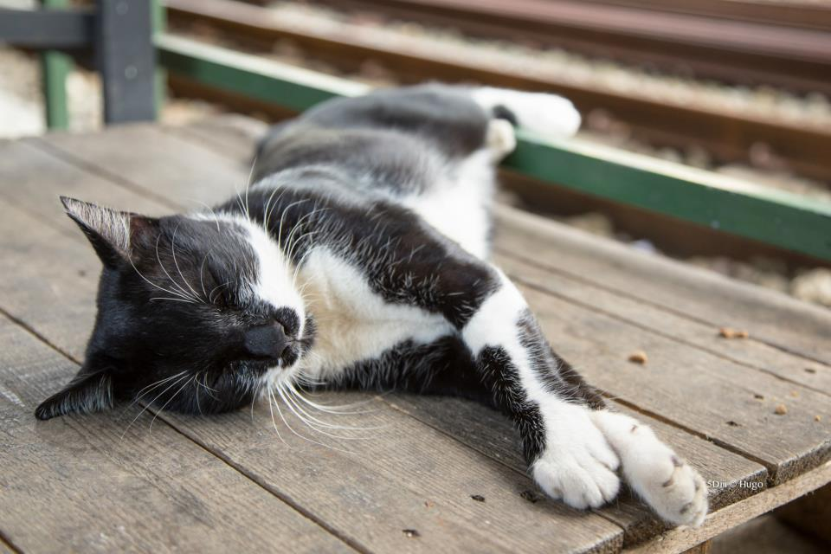

Slide 2
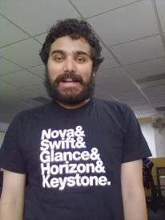

Slide 3
So lets begin
No bug is a minor bug & a patch is a patch.
Even if its one line FIX

Slide 4


Slide 5
Agenda
History
Components of OpenStack
Contributing to project as Developer
Q/A

Slide 6
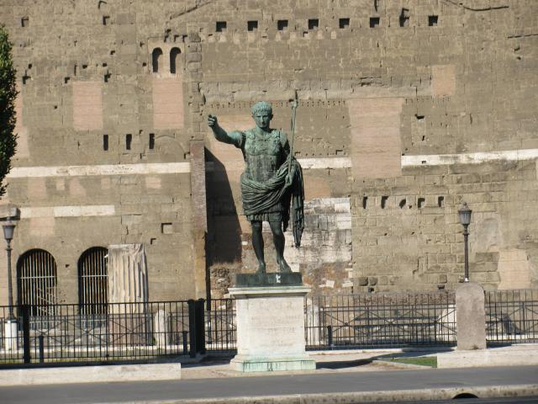

Slide 7
In the beginning...

Slide 8



http://www.openstack.org

Slide 9
Now ..

Slide 10










Slide 11
Over 100+ others
Whom I cannot accomodate in my previous slide

Slide 12
Also
VC have pumped in over > 80M USD
Startups & EcoSystem
Developed by more than 330 contributors who implemented 185 different features
In current stable release name “Folsom”

Slide 13
Release Cycle
June 2010 OpenStack Formed
Austin 21 October 2010
Bexar 3 February 2011
Cactus 15 April 2011
Diablo 22 September 2011
Essex 5 April 2012
Folsom 27 September 2012

Slide 14
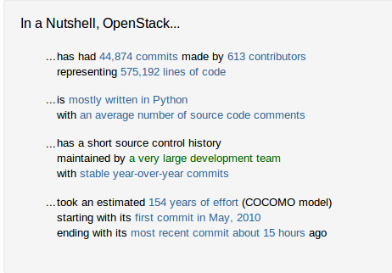
Some stats Ohloh ..

Slide 15
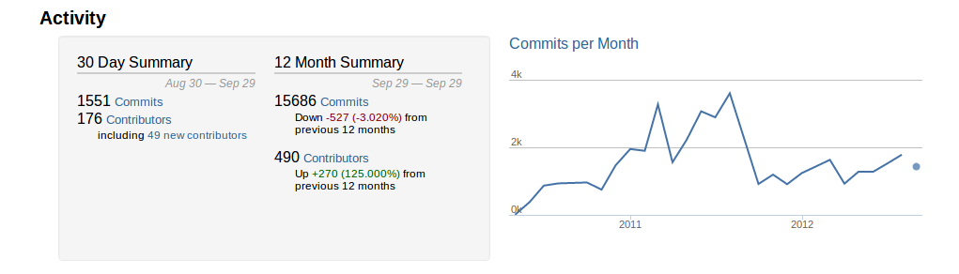
Some stats Ohloh..

Slide 16
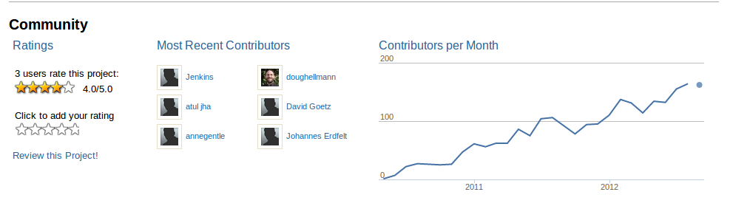
Some stats Ohloh..

Slide 17
And ..
On 4 April 2013

Slide 18
Grizzly is coming out.

Slide 19
Components
Compute (Nova)
provides virtual servers upon demand.
Object Store (Swift)
allows you to store or retrieve files
Image (Glance)
provides a catalog and repository for virtual disk images.

Slide 20
Components
Dashboard (Horizon)
provides a modular web­based user interface
for all the OpenStack services.
Identity (Keystone)
provides authentication and authorization for
all the OpenStack services.

Slide 21
Landed in Folsom
Network (Quantum)
provides "network connectivity as a service"
between interface devices managed by
other OpenStack services (most likely Nova).
Block Storage ( Cinder)
provides persistent block storage to guest VMs.

Slide 22
Incubated Projects
Ceilometer metering project. it provides
metering, it is not a billing project.
Heat provides a REST API to orchestrate
multiple cloud applications implementing
standards such as AWS CloudFormation.

Slide 23
Comparison Against AWS
Nova is conceptually similar to EC2.
Swift is conceptually similar to S3.
Glance provides many of the same features as Amazon's AMI catalog.
Cinder provides block services similar to EBS.

Slide 24
Components little deeper

Slide 25
Nova (OpenStack Compute)
ReST based API
Highly-modular framework
Horizontally and massively scalable
Hardware agnostic
Hypervisor agnostic

Slide 26

Nova components
Scheduler node
Compute node
RabbitMQ
API node
Object server
Datastore
Database

Slide 27
Swift (OpenStack Object Storage)
Object storage
ReSTful interface
Objects in containers in accounts
No object size limit
3+ replication factor in separate
Stable and deployed in production

Slide 28
Swift main components
Object server
Proxy server
Swift API
Container server
Account server

Slide 29
Glance (OpenStack Image service)
Disk images and associated metadata
Discover, register and retrieve
Multiple disk formats :
raw, VHD, vmdk, vdi, qcow2, aki, ari, ami
Multiple container formats :
ovf, bare, aki, ari, ami

Slide 30
Glance architecture
glance-api
Swift
glance
CLI tool
S3
Glance API
HTTP
glance.client
Python library
Local FS
Images
...
...
Registry API
glance-registry
...
SQL
Metadata

Slide 31
Keystone (OpenStack Identity)
Unified tenants / accounts for all services
Swift
Keystone
Glance
keystone-manage
Session API
Admin API
Nova
API servers
...
SQL
LDAP

Slide 32
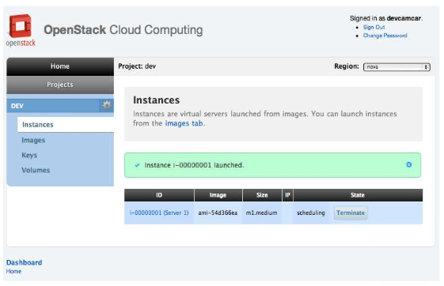
“Horizon” (OpenStack Web UI)
Django module to build web UIs
Quantum
Cinder
Swift
Glance
Nova
API servers

Slide 33
Did I Miss Something?

Slide 34
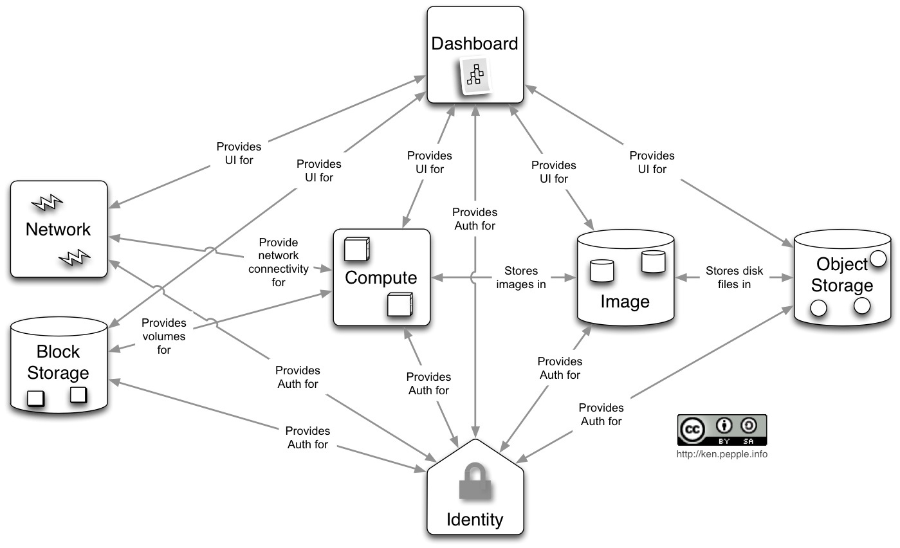

Slide 35
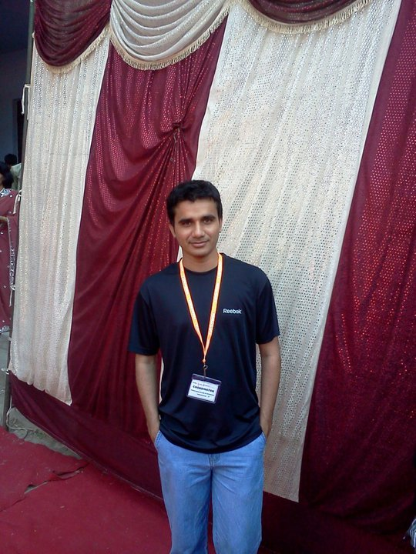
U See this boy!!

Slide 36
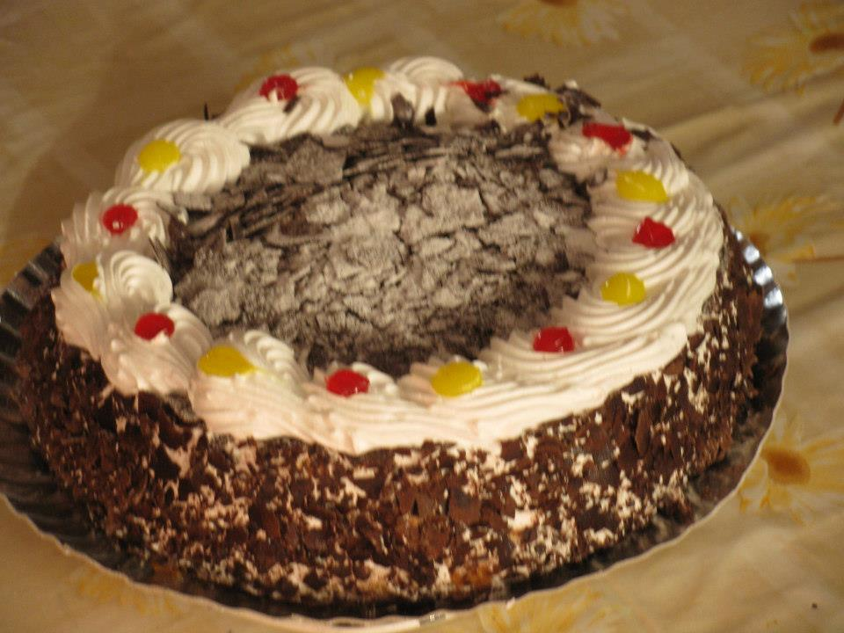
Bake bake bake ..

Slide 37
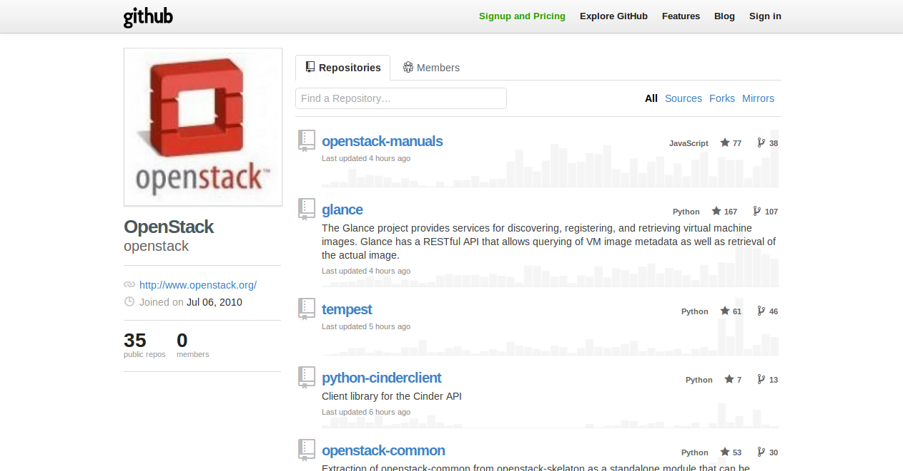

Slide 38
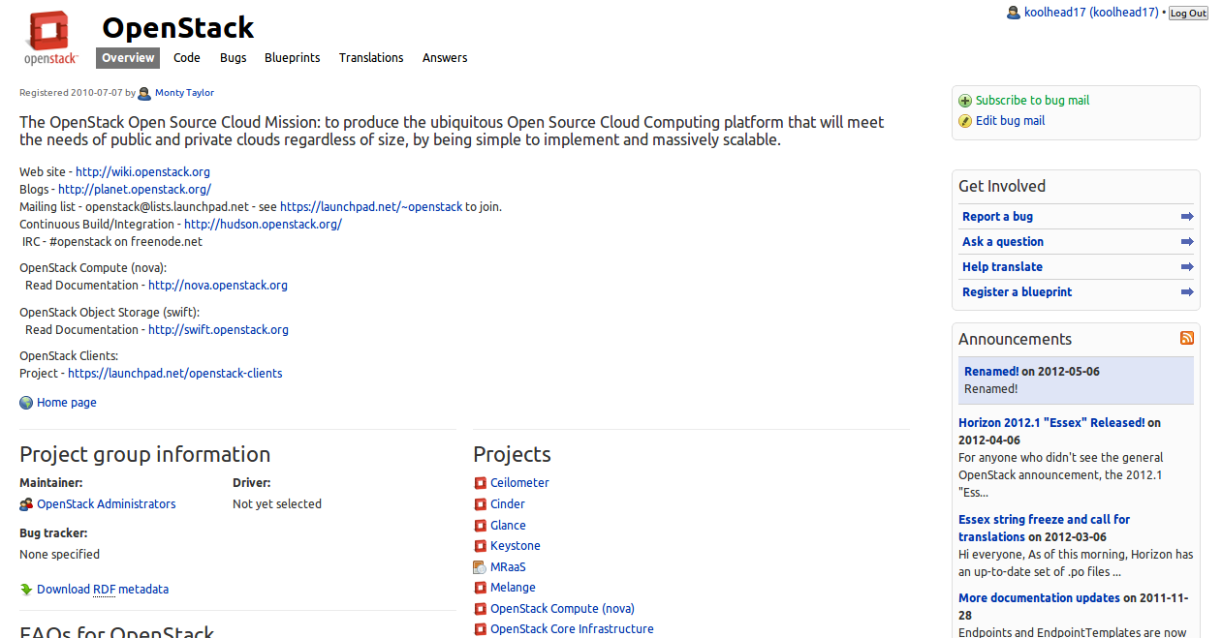

Slide 39
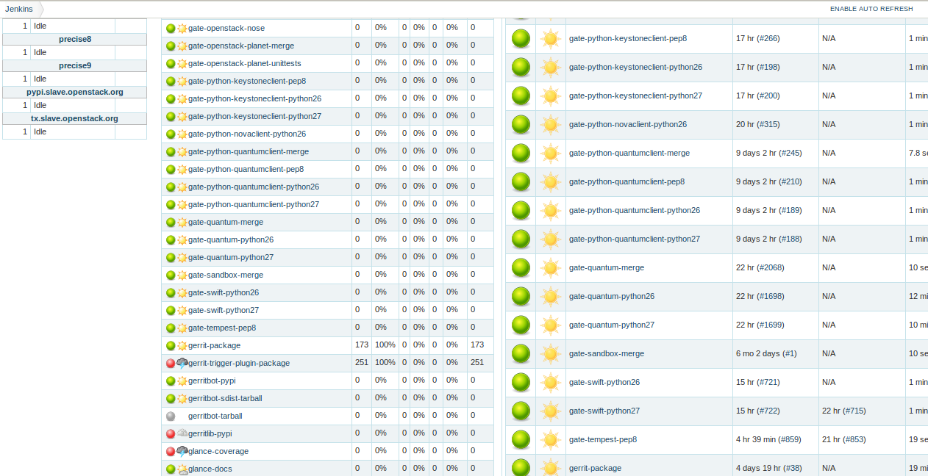

Slide 40
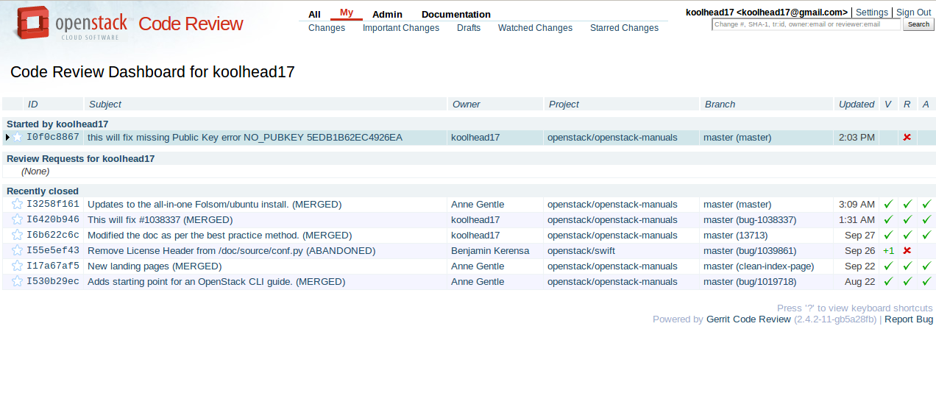

Slide 41
Development cycle
6 months
Design, blueprint creation
Design Summit, 3 days to discuss and brainstorm
PTLs define cycle targets
Feature milestones every 4 weeks
Last feature milestone, no more features allowed
Release branch is cut, next cycle starts
Final release

Slide 42
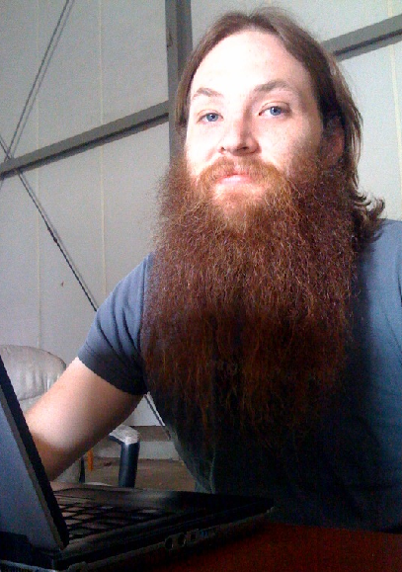


Journey of a feature
Design
Write
code
Code
review
Pre-merge
tests
Postmerge
tests
Milestone
Release
Final
Release
feature branch
trunk

Slide 43
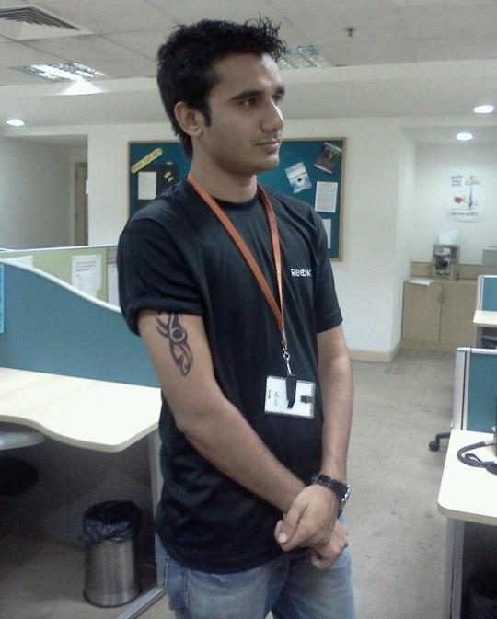
Lets bring back this boy.

Slide 44
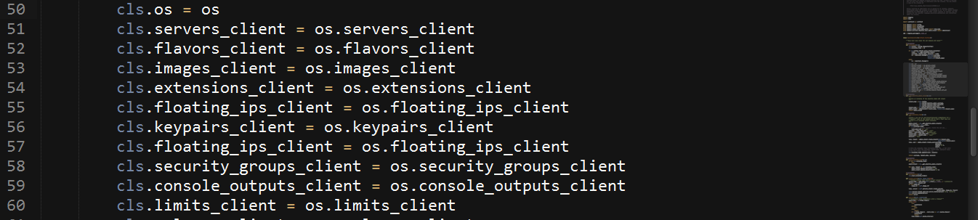
He saw a bug in the Code
Line 55 and 57 were duplicate lines.

Slide 45
STEP 1
(A). Sign the CLA, Every developer needs to sign the Individual Contributor License agreement.
(B) Create a Launchpad Account( https://launchpad.net/) if you don't have one. Its a must.
(C). Add yourself to the contributors wiki
(D). Request membership in the openstack-cla group on Launchpad. Membership in this group is required in order to submit code changes.

Slide 46
2. The Environment Setup
Bug was in Tempest
Get the source code of tempest project from the github repo.
Install git on your local machine. Ex: On ubuntu just type sudo apt-get install git-core
Configure Your user name and password:
git config --global user.name "Firstname Lastname"
git config --global user.email "your_email@youremail.com"
Install git-review tool
On ubuntu: sudo apt-get install git-review
On other unix like systems: pip install git-review

Slide 47
STEP 3: Getting the Code
git clone git://github.com/openstack/tempest.git

Slide 48
STEP 4: Fix the Bug
Enter in to tempest directory and let git-review tool to configure your project. Make sure your gerrit/launchpad user name is the same as the current running user.
$ cd tempest
$ git review -s
Get the latest upstream changes:
$ git remote update
$ git checkout master
$ git pull origin master
$ git checkout -b duplicate_line_in_base.py

Slide 49
Remove the duplicate line and save it.
Now commit your change with a commit message. You can read more about commit messages on http://wiki.openstack.org/GitCommitMessages.
$git commit -am “Removed the duplicate line from base.py.”
Finally send the code for review.
$ git review

Slide 50
After you submit a change
Any Openstack developer may propose or comment on a change (including voting +1/0/-1 on it). Openstack projects have a policy requiring two positive reviews from core reviewers.
When a review has two +2 reviews and one of the core team believes it is ready to be merged.
Jenkins will run tests on the change, and if they pass, it will be merged.

Slide 51
Few links
Gerrit Workflow
http://wiki.openstack.org/GerritWorkflow
Gerrit, Jenkins, and GitHub
http://wiki.openstack.org/GerritJenkinsGithub
How To Contribute
http://wiki.openstack.org/HowToContribute

Slide 52

http://devstack.org/

Slide 53


Slide 54

OpenStack is... you, us
http://launchpad.net/openstack
  http://wiki.openstack.org
  http://planet.openstack.org
Twitter
@OpenStack
@OpenStackIndia

Slide 55
Special Thanks...
Thierry Carrez, Syed Armani,Ken Pepple Tony Dk & Razique

Slide 56
