Slide 1
Introduction to free & open source software
SRM University,
Chennai, India

Slide 2
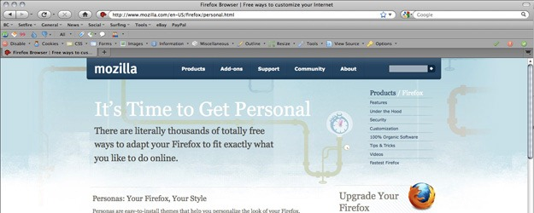
How many of you have used ..
Mozilla Firefox

Slide 3
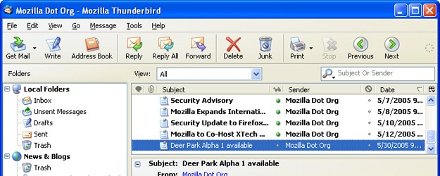
And
Thunderbird

Slide 4
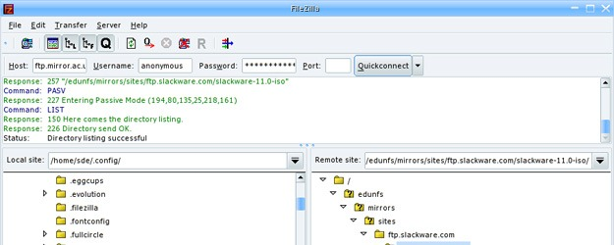
and
Filezilla

Slide 5
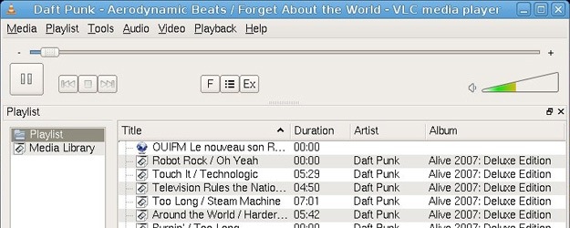
and
VLC media player

Slide 6
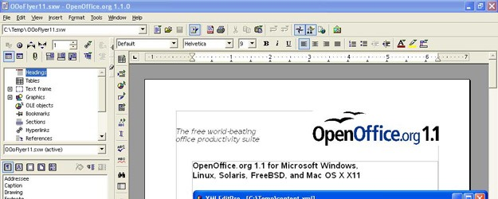
also
OpenOffice

Slide 7
What is common in all of them?
All the above are Free and Open Source Software.

Slide 8

Confused?

Slide 9
Lets go back ...
History

Slide 10
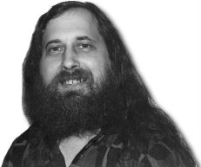
In 1985
Richard Stallman formed FSF

Slide 11
He along with a group of like minded programmers started work in developing the tools needed to make a complete OS - like an editor (Emacs), a C compiler (GCC), libraries and all associated generic Unix tools like cat,ls, chmod etc

Slide 12

In year 1990
A finnish student by name Linus Torvalds

Slide 13
Wrote kernel
And released it under GPL.
This kernel is now popularly known as Linux.

Slide 14
So
Gnu toolchains + kernel == Gnu/Linux

Slide 15



What are various distros ?

Slide 16
Also
After 1997, a programming model other than the GPLed model emerged which is now popularly known as the Open Source Initiative.

Slide 17
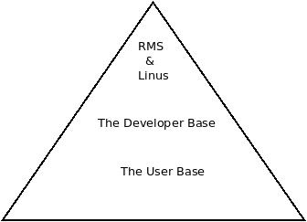
The Pyramid

Slide 18
So the question is ..
Why should i learn free & opensource software, Gnu/Linux?
How and where to look for help?

Slide 19
Why should i learn free & opensource software?
For your good.
Better knowledge about how things/technology works.
Better paid job?

Slide 20
How and where to look for help?
The Linux Documenatation Project (tldp.org)
Distribution/software specific websites

Slide 21
But am not a coder …..
You can still help and be part of the community
Localization
Documentation
Artwork
Bug Reporting
Mentoring

Slide 22

Questions?

Slide 23
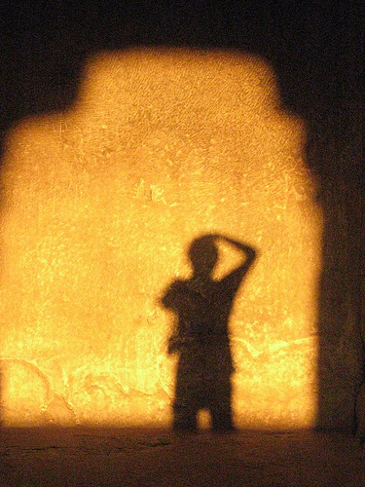
Thanks
Atul Jha
@koolhead17

