Slide 1


Meet Our AI Sales Team
Two AI agents — Robin and Marvin — running 24/7 to drive pipeline, automate intelligence, and scale execution for Rev.io's sales growth.
SHARED MANDATE
Both agents are focused on two things: accelerating revenue by giving the sales and channel teams better intelligence and tools — and improving efficiency by automating work that shouldn't require a human.
🦸🏻‍♂️ Robin
🤖 Marvin
AI Sales Assistant & Intelligence Engine
AI Channel & Community Intelligence Engine
Built for Ryan Koontz · SVP of Sales
Built for Usman Zahoor · VP Channel & Community
PIPELINE & FORECASTING
INTELLIGENCE & MONITORING
· Daily forecast dashboard — live SF data, scenarios, marketing attribution
· Daily Channel & MSP market brief — CRN, Channel Futures, Reddit r/MSP, industry newswires
· Automated weekly forecast report delivered to ELT every Monday
· Monitors Rev.io email, Gmail, and Teams — flags actionable messages, filters noise
· Per-product Q1 tracking vs quota
DATA & RESEARCH
SALES ACTIVITY
· Connected to Salesforce — partner data, pipeline context, account info on demand
· Daily activity scorecard — calls, emails, meetings, opps sourced
· Connected to Notion — Channel & Community workspace, KPI trackers, event calendars
· AE capacity dashboard — prospect meetings MTD vs projected
· Web research on demand — competitive intel, partner backgrounds, market trends
PROSPECTING & INTELLIGENCE
PUBLISHING & DASHBOARDS
· Daily MSP prospector — 5 net-new accounts every morning not in SF
· Builds and maintains the Channel KPI dashboard (live SF data, auto-refreshing)
· Real-time access on Discord — available to the entire sales team 24/7
· Publishes internal guides and reports to hosted web pipeline instantly
COACHING & ANALYTICS
AUTOMATION
· Discovery call grading — BEACON framework, 6 categories, 100 pts
· PSA Partner Sync — seeding Rev.io PSA with partner data from Salesforce
· Closed loss analysis — Feb vs March trends + coaching actions
· Event Intelligence — monitoring 30+ 2026 industry events for opportunities
RESEARCH & CONTENT
· Competitive Monitor — tracking competitors across news, jobs, product updates
· Competitive battle card dashboard · MSP PSA requirements deck
· Custom decks and analysis on demand
• rev.io
BUILT FOR TOMORROW.
READY FOR TODAY.

Slide 2



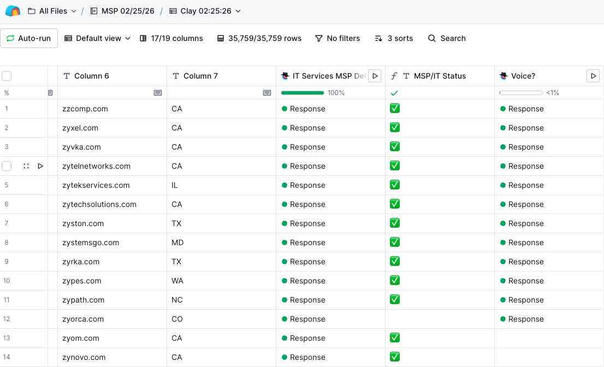
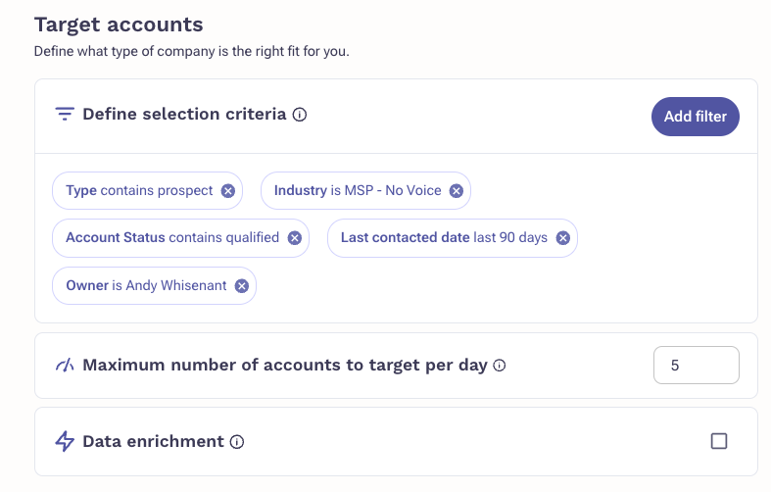
Robin's Tool Stack
Integrated with best-in-class tools to automate the full sales workflow end-to-end.
INTEGRATIONS
Robin connects into Rev.io's existing tool stack — using AI to turn raw data and workflows into automated action at scale.
AI Knowledge & Workflow Automation
Custom AI for Data Intelligence
Revenue Agent — Automated Sequencing
Personalization · Transcription · Follow-up
Enrichment · CRM hygiene · Verification
MSP Team · Persona-based · Always-on
• MSP EMAIL PERSONALIZATION AT SCALE
• INDUSTRY FIELD VERIFICATION
• DEDICATED REVENUE AGENTS PER PERSONA
Researches each prospect and writes personalized outreach automatically — no manual prep required.
Built a custom AI agent to verify and correct the industry field on Salesforce accounts at scale.
MSP team agents automatically add contacts into specific sequences daily — based on persona, industry, and time since last engagement.
• MEETING NOTE-TAKING & TRANSCRIPTION
↳ Result: Found 11,000+ accounts incorrectly marked as MSPs — cleaning the CRM foundation for better targeting and scoring.
• ELIMINATED MANUAL SEQUENCE MANAGEMENT
Captures full meeting notes, key takeaways, and action items from every prospect call.
Removed daily decision-making and time spent manually adding prospects to sequences. Reps focus on selling, not admin.
• POST-MEETING FOLLOW-UP EMAILS
Generates tailored follow-up emails and action item summaries immediately after each call.
• rev.io
BUILT FOR TOMORROW.
READY FOR TODAY.

Slide 3
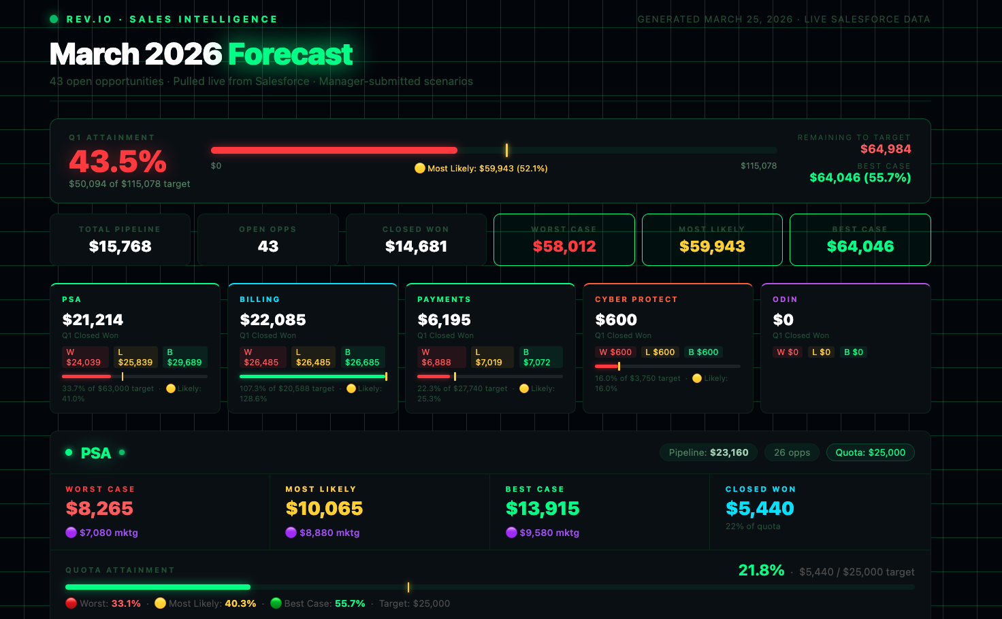
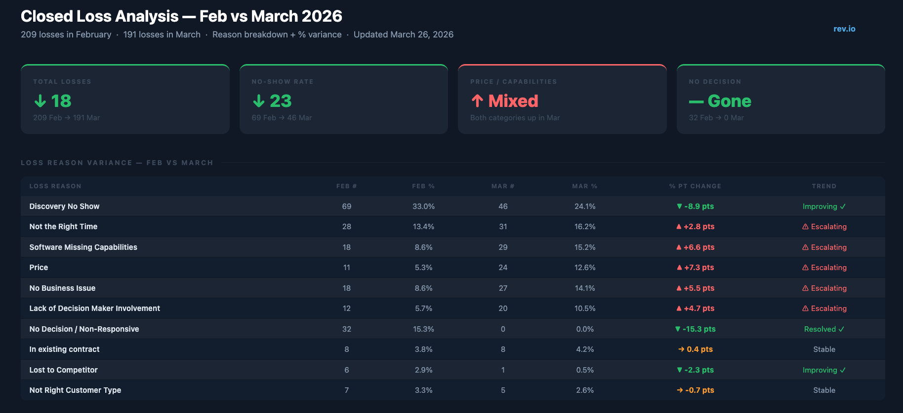
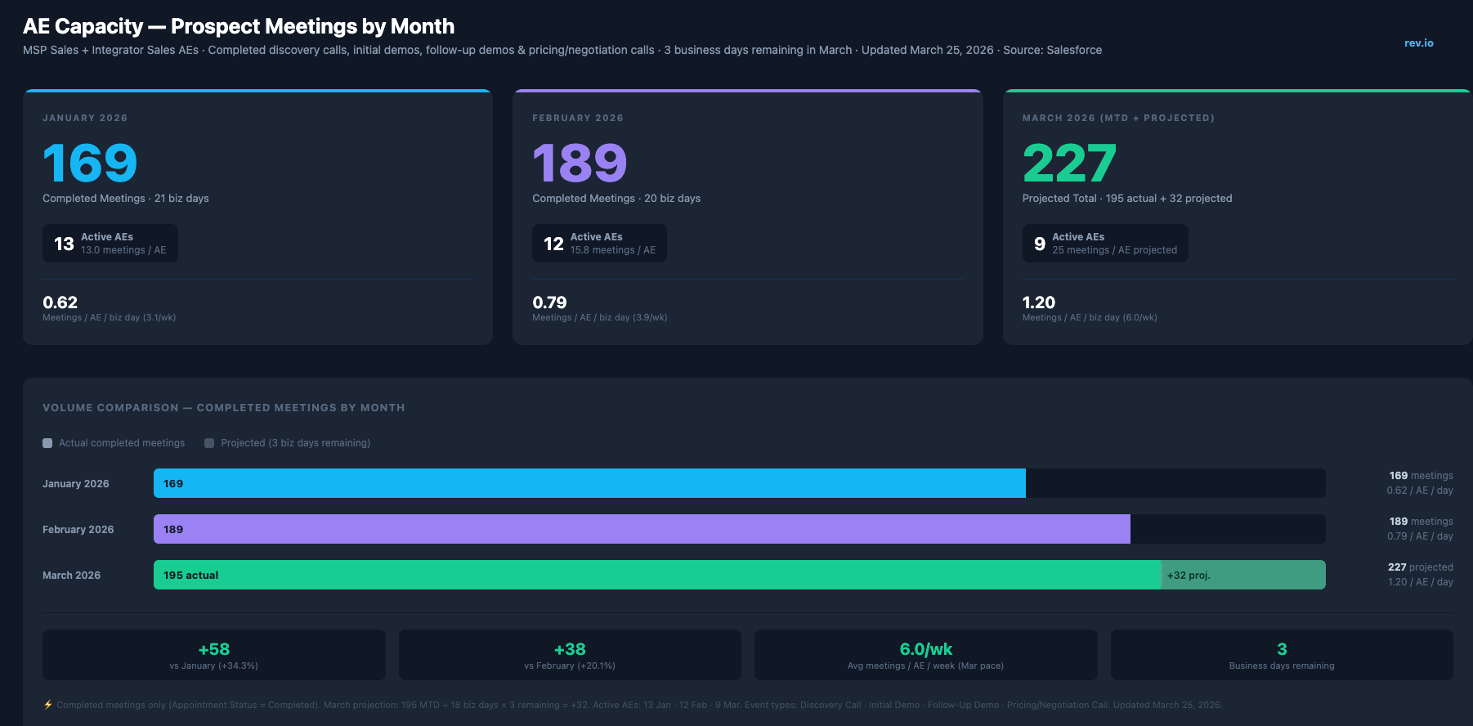
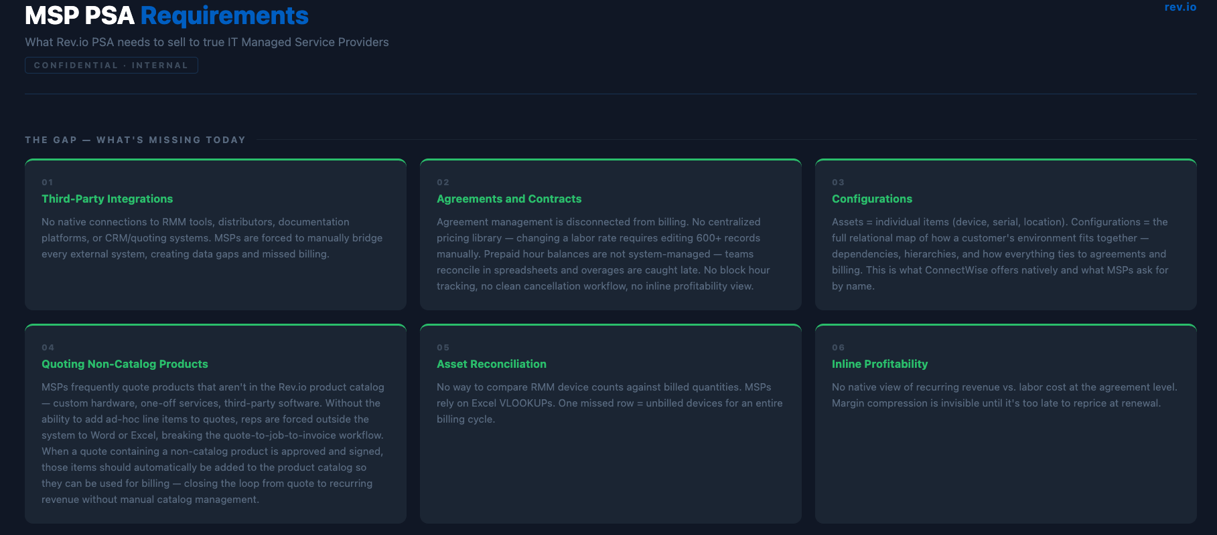
Data Intelligence — Built by Robin
Live dashboards powered by Salesforce — built, automated, and maintained by AI.
ALWAYS ON · ALWAYS CURRENT · ZERO MANUAL UPDATES
Every dashboard below pulls live from Salesforce — rebuilt and pushed automatically. No spreadsheets. No manual refresh. No stale data.
March 2026 Forecast
Closed Loss Analysis
AE Capacity — Prospect Meetings
MSP PSA Requirements
• rev.io
BUILT FOR TOMORROW.
READY FOR TODAY.

