Slide 1

ALPACA AI TRADING AGENTS HACKATHON
Volition
The autonomous options desk
that knows when not to trade.
Private AI committee · deterministic risk veto · Alpaca paper lifecycle · tamper-evident memory
Hosted judge build • September 2026
Notes:
Open on the central tension: autonomy is valuable only when the system can prove why it acted—or refused.
Sources:
- https://lablab.ai/ai-hackathons/alpaca-ai-trading-agents-hackathon

Slide 2
VOLITION / PROBLEM
A recommendation is not an autonomous trading system
Most agent demos end at “buy” or “sell.” The hard part starts one second later.
Risk
Who can veto the model?
Without governed execution, the model can overreach, broker state can drift, and a backtest can be mistaken for real performance.
Broker
Was it accepted, filled, or cancelled?
Memory
Did the system learn from verified outcomes?
Volition was designed around those three missing layers.
02
Notes:
Frame the project as a complete operating loop rather than another signal generator. The product's differentiation is governance, reconciliation, and evidence.

Slide 3
VOLITION / SYSTEM
Action begins only after two independent veto layers
01
02
03
04
05
06
Alpaca evidence
Strategy router
Private Qwen
Risk gates
Paper lifecycle
Audit memory
Account, clock, bars, chains, news
Defined-risk spread or cash
Three adversarial opinions
16 deterministic checks
Submit, reconcile, manage exit
Passport, receipts, verified outcomes
AI interprets evidence. Code alone owns structure, size, permission, and final authority.
03
Notes:
Walk left to right. Emphasize that the AI committee cannot invent option symbols, resize an order, or bypass a gate.
Sources:
- https://docs.alpaca.markets/us/docs/alpacas-cli
- https://alpaca.markets/learn/building-nightwatcher-v2-a-multi-agent-trading-system-with-alpaca

Slide 4
VOLITION / GOVERNANCE
The model can argue. It cannot grant itself permission.
AI committee
Deterministic constitution
Three roles receive bounded market and structure evidence through a private Qwen endpoint.
Final authority stays in tested code.
Defined-risk geometry
Regime Sentinel challenges direction
Liquidity + fresh quotes
Volatility Architect checks structure
Account + options level
Drawdown + concentration
Adversarial Skeptic argues for cash
Monte Carlo veto
Duplicate + market-window checks
Fallback is explicit, bounded, and visible—not silent.
04
Notes:
The committee is useful because each role makes a different argument. The constitution is useful because it is not an argument: every gate is deterministic and testable.

Slide 5
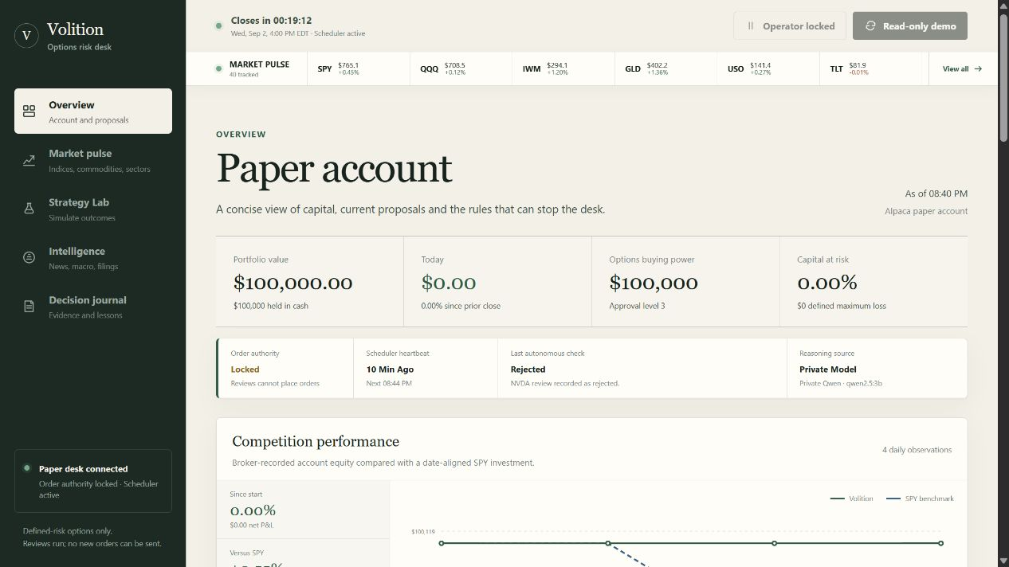
VOLITION / LIVE PROOF
The deployed desk is connected, autonomous—and intentionally locked
$100k
fresh paper account
20
tradable symbols
Qwen
private committee
Locked
order authority
05
Notes:
This is a live screenshot from the public judge build. The scheduler continues server-side; public buttons are disabled because operator actions fail closed without a separate key.
Sources:
- https://instance-20260318-1838.tail042e87.ts.net/

Slide 6
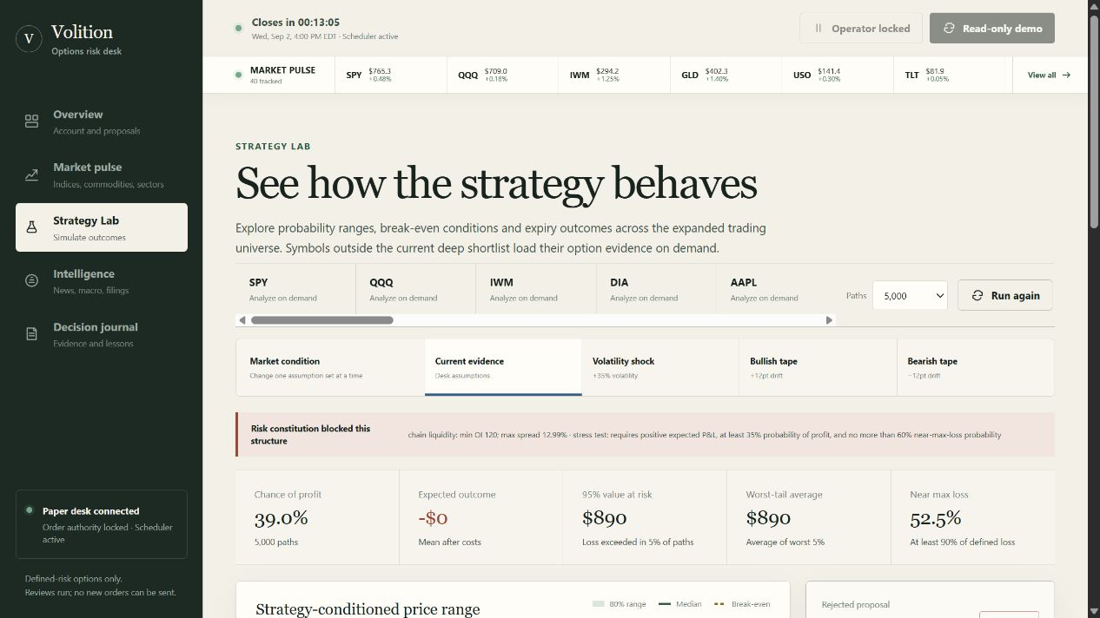
VOLITION / STRESS TESTING
Monte Carlo adds a veto, never a permission slip
5,000 paths
reproducible scenario run
39.0%
chance of profit
Blocked
constitution outcome
Price fan · expiry P&L · VaR · expected shortfall · near-max-loss probability
06
Notes:
The lab works across the expanded universe and exposes assumptions, costs, and model limitations. This visible example is rejected because chain liquidity and stress criteria fail.
Sources:
- https://instance-20260318-1838.tail042e87.ts.net/

Slide 7
VOLITION / EVIDENCE
Performance and learning begin with broker receipts—not imagination
53
reviews recorded
43
risk vetoes
0 / 5
verified closes needed
4 broker observations · 0.00% account return · +0.54% versus SPY
No preview is labelled as realised P&L. Promotion stays locked until five broker-verified closed outcomes exist.
07
Notes:
The chart uses Alpaca portfolio history aligned by date with SPY IEX bars. The account has not submitted orders, so the flat equity and zero P&L are the honest result—not a missing demo prop.
Sources:
- https://instance-20260318-1838.tail042e87.ts.net/api/dashboard

Slide 8
VOLITION / JUDGE FIT
Every required primitive is visible in one coherent product
✓
Autonomous options
✓
Alpaca-native
15-minute scheduler, multi-strategy router, managed exits
CLI evidence plane plus atomic mleg Trading API path
✓
Fresh competition account
✓
AI reasoning
$100,000 paper balance and options Level 3
Private Qwen committee with per-opinion provenance
✓
Risk + transparency
✓
Public delivery
Deterministic vetoes, hashes, lifecycle receipts
HTTPS judge build, responsive UI, read-only controls
The only deliberately unfinished proof is a broker-verified entry → fill → managed exit. Order submission remains off until the team explicitly authorises that paper-account run.
08
Notes:
This slide maps the product directly to the hackathon requirements. Be explicit that paper order submission is implemented but intentionally locked pending team authorization.
Sources:
- https://lablab.ai/ai-hackathons/alpaca-ai-trading-agents-hackathon
- https://docs.alpaca.markets/us/docs/alpacas-cli

Slide 9
VOLITION
The agent judges can trust
when it says no.
LIVE
Paper account
Private model
Scheduler active
Orders locked
Autonomous options decisions. Private adversarial reasoning. Deterministic risk. Broker-backed evidence. Honest learning.
instance-20260318-1838.tail042e87.ts.net
Alpaca AI Trading Agents Hackathon · 2026
Notes:
Close by resolving the opening tension: Volition is autonomous because it can act, and trustworthy because it can refuse—and prove both.
Sources:
- https://instance-20260318-1838.tail042e87.ts.net/

