Slide 1
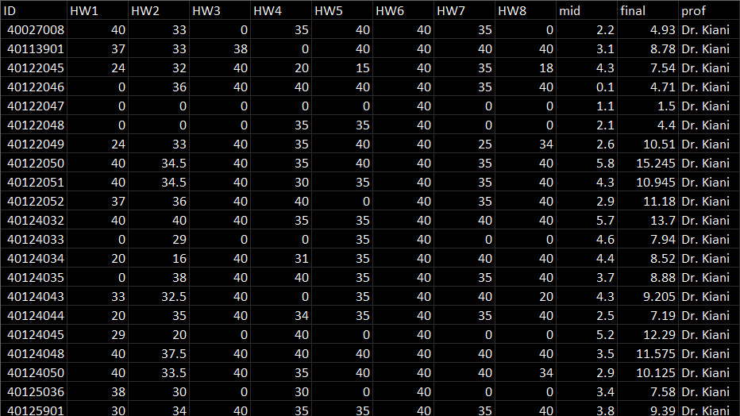

Exploring Academic Performance
in General Mathematics 1
A Case Study of Students
at AmirKabir University of Technology
by Koorosh Komeilizadeh

Slide 2
Project Introduction
In this project, our primary objective is to conduct a meticulous analysis of student and instructor performance during the grading process for General Mathematics 1 at AmirKabir University of Technology for the 1401 academic year. Leveraging a dataset generously provided by the esteemed Faculty of Mathematics and Computer Science, we will employ advanced data retrieval and cleaning techniques to ensure data accuracy and consistency. By scrutinizing the information meticulously, we aim to discern insightful trends and patterns that can shed light on the efficacy of the grading system and identify areas for potential improvement. Our findings will serve as a valuable resource for enhancing the overall educational experience and fostering an environment of academic excellence at the university.
Outlines
Preview Data Processing Data Visualization Correlation of Clusters Machine Learning Conclusion
with Grades Model

Slide 3
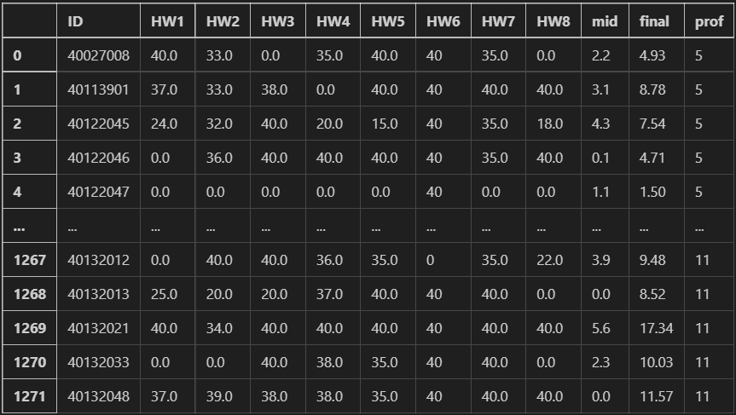




Preview
Dataset & Data Processing
Tools
Contributors
Koorosh Komeilizadeh - Author and Analyst
DSAI Undergraduate Student at Leiden University
Behzad Najafi Saghezchi - Reviewer
Professor at AmirKabir University of Technology
Farzad Didehvar - Reviewer
Professor at AmirKabir University of Technology

Slide 4
Data Visualization & Correlation of Clusters with Grades

Slide 5
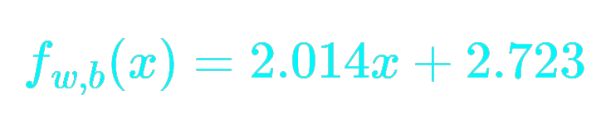
Machine Learning Model
SLRM
MLRM

Slide 6
C O N C L U S I O N
Project Goals and Outcomes
Understanding Grade Distribution of Students.
Grades in general math 1 at Amirkabir University vary widely from 0 to 19.4, with an average of 9.86 and a standard deviation of 4.9. This indicates differing levels of student performance and achievement.
Exploring the Correlation between Instructors and Average Grades.
Dr. Najafi and Shariati's classes facilitate passing and higher grades, unlike Dr. Broojerdian and Tavana's class which poses greater challenges.
Investigating the Relationship Between Students' Majors and Grade Status.
Research highlights field impact on grades. Math and engineering excel (especially Electrical and Mechanical), while Mining, Textile, and Marine lag.
Finding the relationships between international and native students' grades.
International students have lower grades than natives, but both perform similarly for scores above 5, emphasizing the importance of initial support and inclusivity for International student success.
Predicting Final Grades based on Midterm and Homework Scores.
Two machine learning models, SLRM and MLRM, accurately predict pre-exam grades, aiding timely course decisions.
Thanks for your attention! By Koorosh Komeilizadeh

