Slide 1
Devoxx 2017
Ronald Kooistra & Koos Drost
29-11-2017

Slide 2

Devoxx 2017
Jaarlijkse conferentie met +-3500 ontwikkelaars.
Antwerpen, België
Grote namen zoals:
- Brian Götz (Oracle)
- Mark Reinhold (Oracle)
- Juergen Hoeller (Spring / Pivotal)
- Venkat Subramaniam (writer / conference speaker)
- Martijn Verburg (jClarity)

Slide 3

Keynote CERN
European Organization for Nuclear Research, Genève, Zwitserland.
Bekend van deeltjesversneller LHC / Higgs boson.
Dataverwerking: 10,5 gigabyte per seconde.
Opslag: 240 petabytes capaciteit, 50 petabytes per jaar.
Herfst 2019: gratis open dagen, LHC geopend.

Slide 4
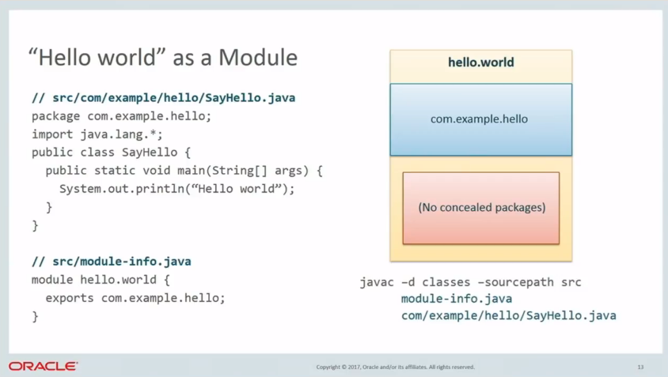
Modular development with JDK 9
jshell, HTTP 2.0 & process API upgrade.
Modular system (Project Jigsaw).
“A module is a set of packages designed for reuse.”
Diepgaande presentatie over implementatie en voordelen.

Slide 5
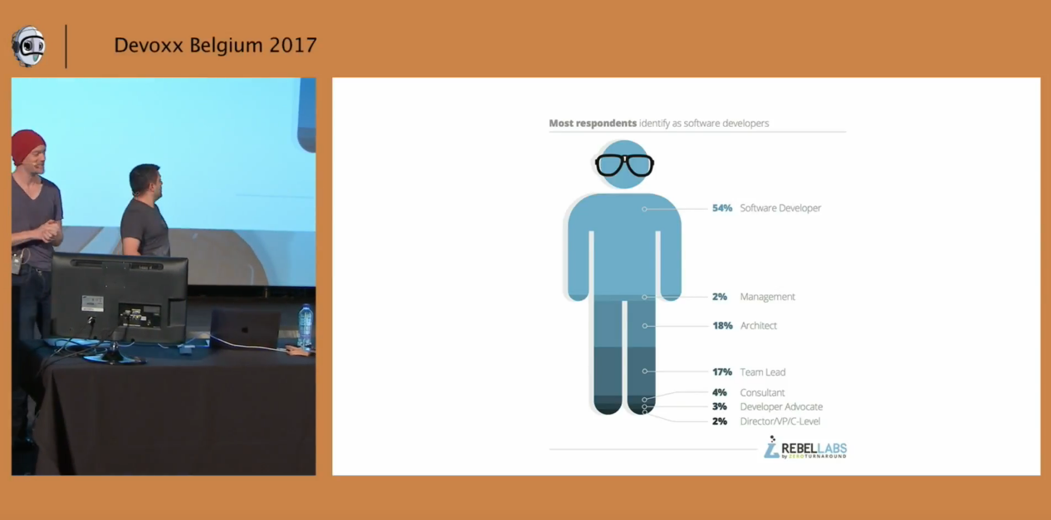
The Java Council
Simon Maple, Martijn Verburg, Oleg Šelajev and special guests.
Vermakelijke onderzoeken.
Improvisatie en gratis bier!

Slide 6

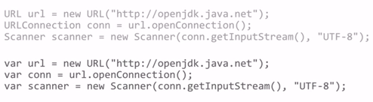
Java 10
Maart 2018
Half jaarlijkse releases, September 2018 Java 11
Elke 3 jaar LTS, waarvan september 2018 LTS
Geen 18.3, 18.9 maar 10, 11, etc.
Java 10 project amber

Slide 7
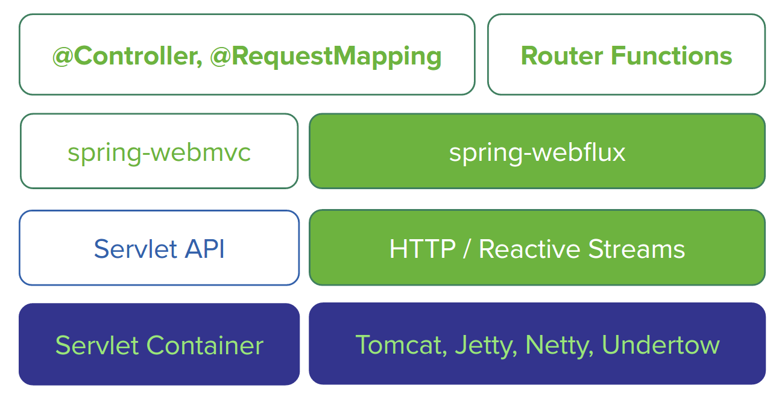
Going reactive with spring 5 & project reactor
What is Reactive Programming?
In plain terms reactive programming is about non-blocking applications that are asynchronous and event-driven and require a small number of threads to scale vertically
start.spring.io

Slide 8


Angular vs React Smackdown
Angular Google
React Facebook
Technical: Angular
Philosophical differences: Angular
Usability: React
Easyer to learn: Angular
Ecosystem: Angular

Slide 9
Top-5 presentaties
1. “CERN, from an IT Perspective”
by Derek Mathieson; 4.74 with 282 votes.
2. “(Deep) Learning to Fly”
by Krzysztof Kudrynski, Blazej Kubiak; 4.74 with 114 votes.
3. “Parallel and Asynchronous Programming with Streams and CompletableFuture”
by Venkat Subramaniam; 4.73 with 215 votes.
4. “Blue Team Security. Actual Security work for Actual Developers”
by Siren Hofvander; 4.71 with 86 votes.
5. “Next Generation Asynchronous Patterns in JavaScript”
by Jonathan Mills; 4.69 with 29 votes.

Slide 10
Online content
Youtube channel Devoxx 2017
bevat alle presentaties van 2017
Top-100 Devoxx 2017
top-100 op basis van de rating van het publiek (inclusief links)

Slide 11
