Slide 1
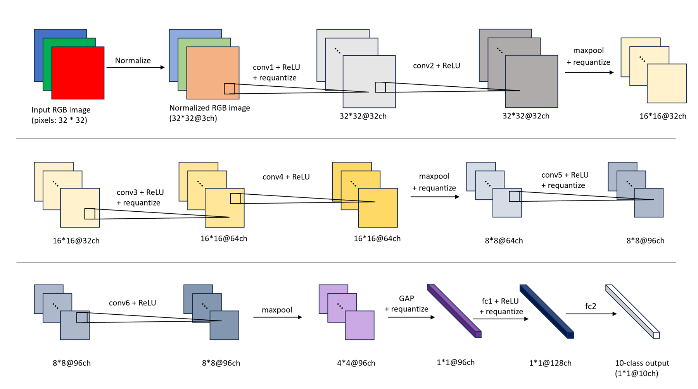

Slide 2
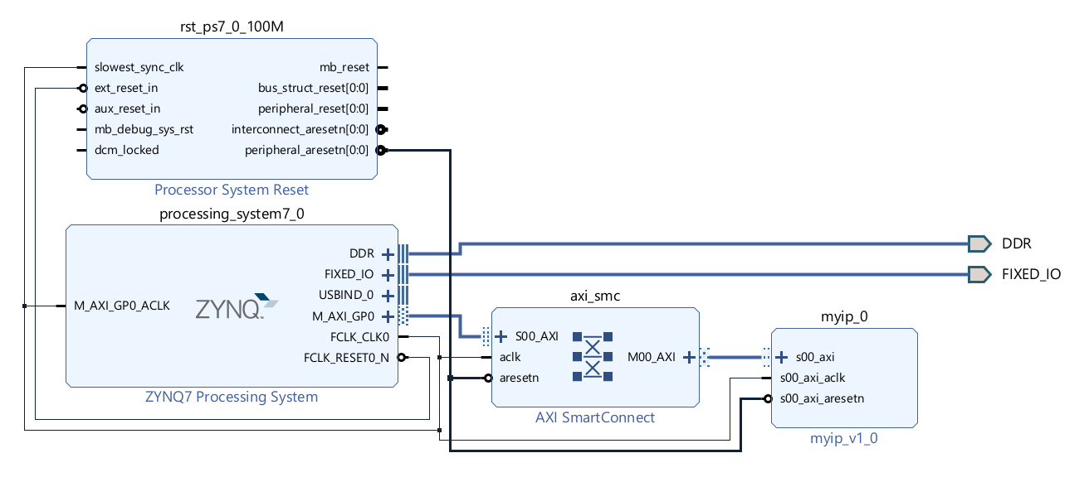

Slide 3
20
37
37
Activation
Matrix
Product
Matrix
Weight
Matrix
40
×
20
=
40

Slide 4
20
9
Activation
Matrix
1
2
3
40
40
1
2
3
bank #
Address

Slide 5
37
bank #
11
Weight
Matrix
21
20
31
12
22
16
16
5
32
11
12
13
13
9
Weight Tiling
21
22
23
23
9
2
31
32
33
33
Address

Slide 6
bank #
1
2
3
Address

Slide 7
1
3
#1
11
#7
31
1
3
31
#2
12
#8
32
1
3
32
#3
33
13
#9
33
33
2
#4
2
21
#5
2
22
#6
23
33

Slide 8
16
16
#1
#4
#7
1
#2
#5
#8
2
40
+
+
=
40
+
+
=
5
37
#3
#6
#9
3
1
2
3
Product
Matrix
40
+
+
=
=
40

Slide 9
Ctrl
Weight Buffer
ctrl_to_wb
ctrl_to_ab
ctrl_to_sa
wb_to_sa
Activ-ation
Buffer
Input
Loader
Weight-Stationary
Systolic Array
9 * 16
Product
Loader
sa_to_pb
bigger
Product Buffer
ctrl_to_pb

Slide 10
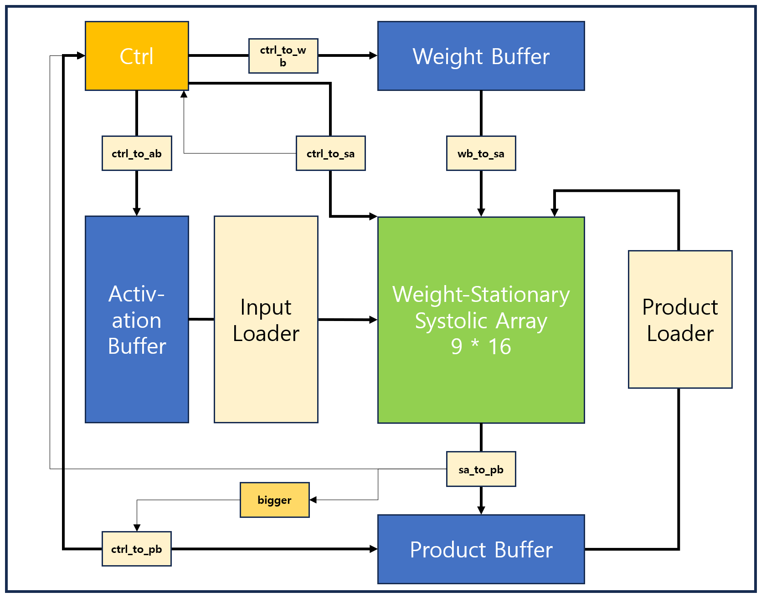
AXI_Master
AXI_Slave
MatMul
PS

Slide 11
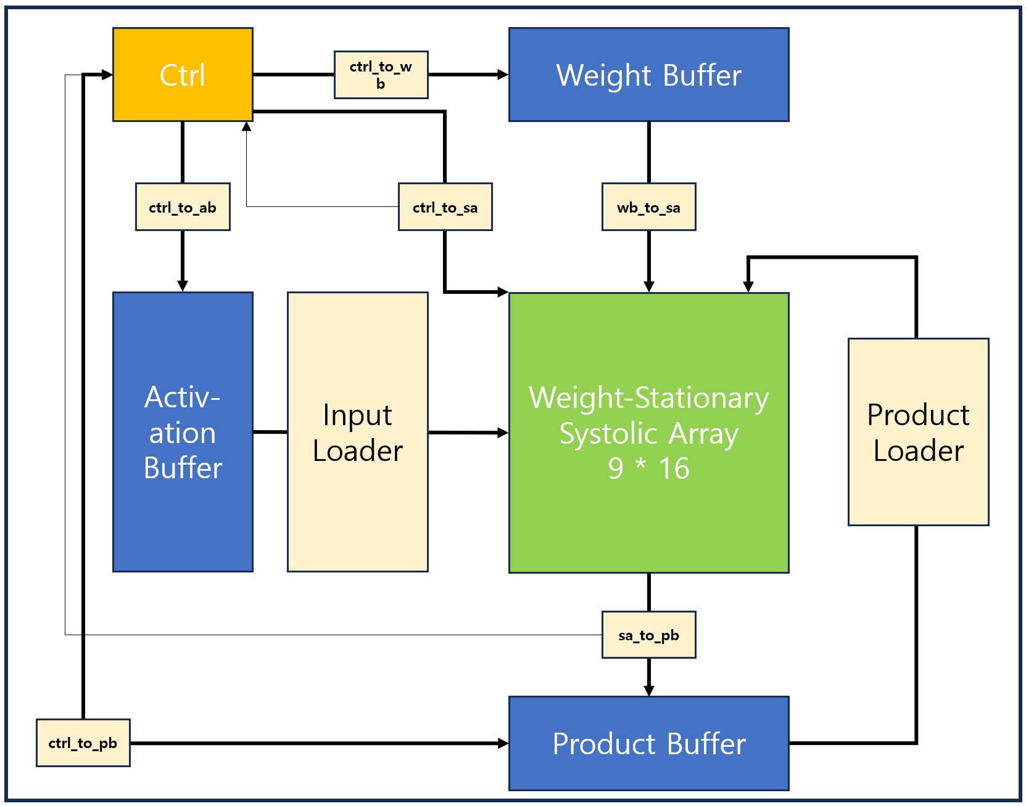
AXI_Master
AXI_Slave
MatMul
PS

Slide 12
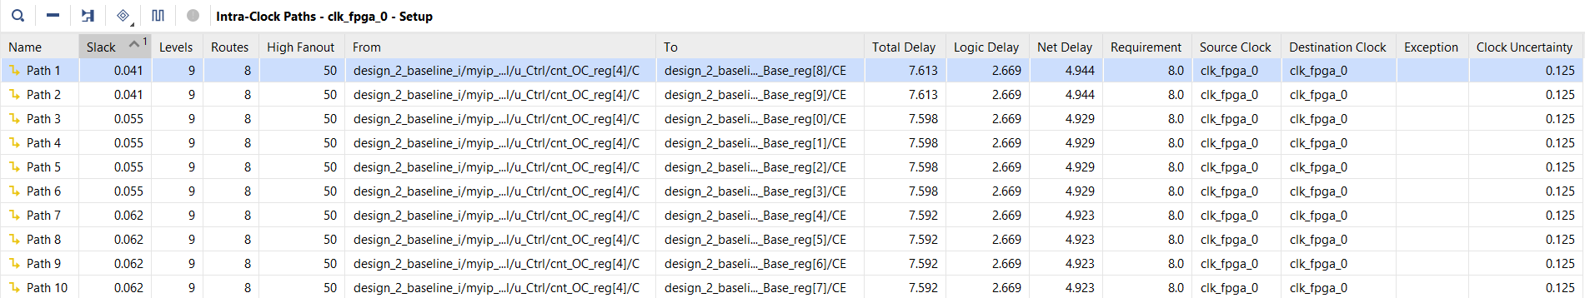
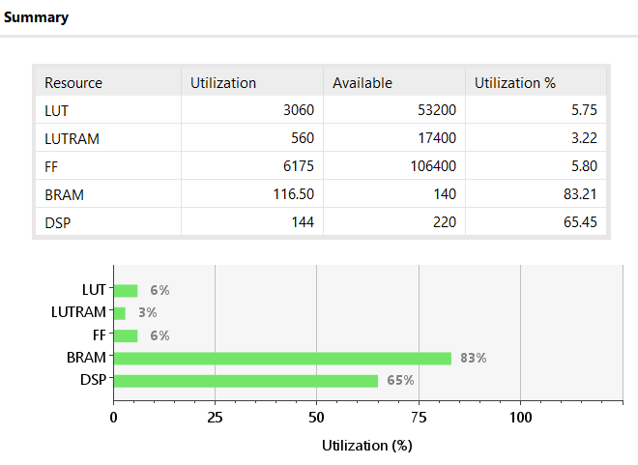
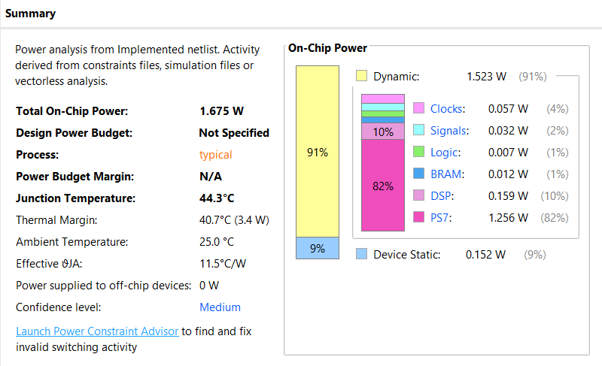
hw reports (125MHz)

Slide 13
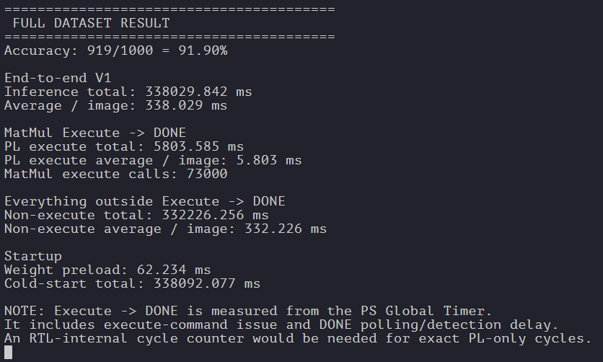
Baseline
PL Fmax = 125MHz

Slide 14
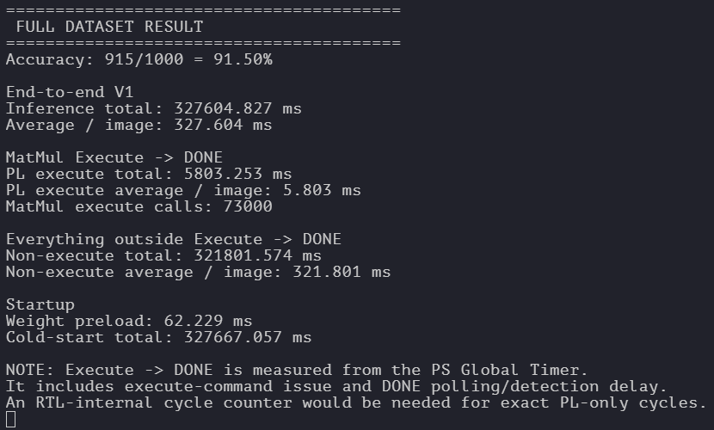
Requantization modified hw-friendly

Slide 15
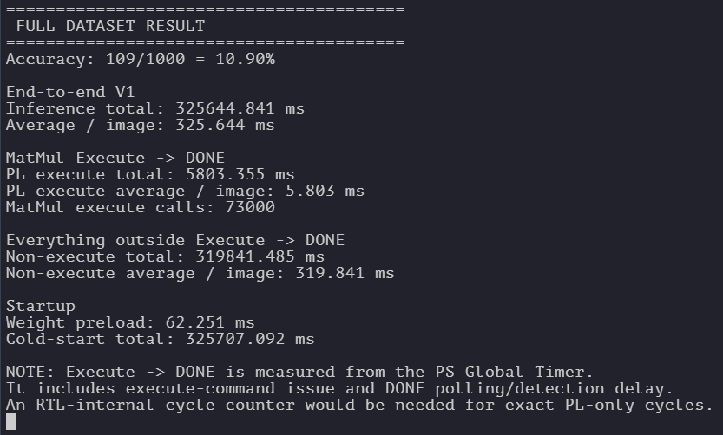
Requantization modified hw-friendly
+ preprocessing modified hw-friendly

Slide 16
PB
read
Data
re-
quant
max
pool
Valid+
address
En_requant
En_maxpool

Slide 17
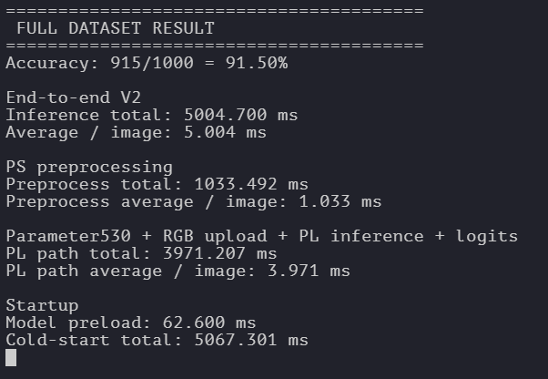
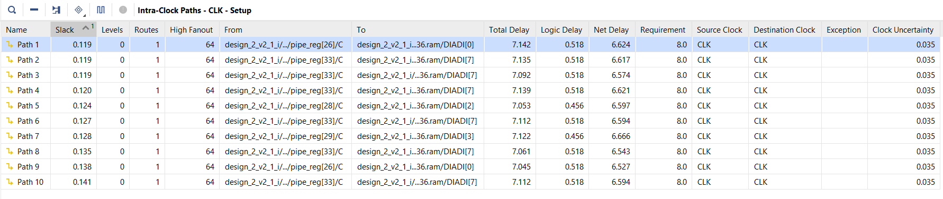
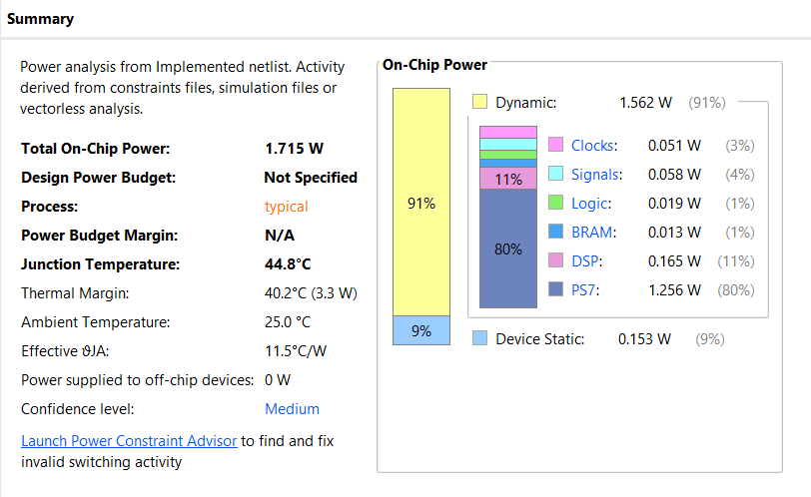
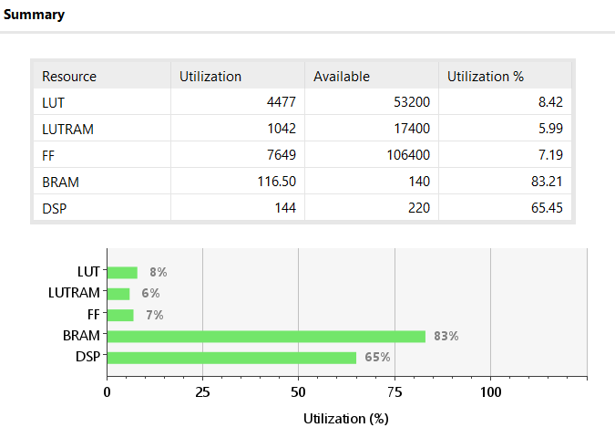
v2

Slide 18
v2

