Slide 1
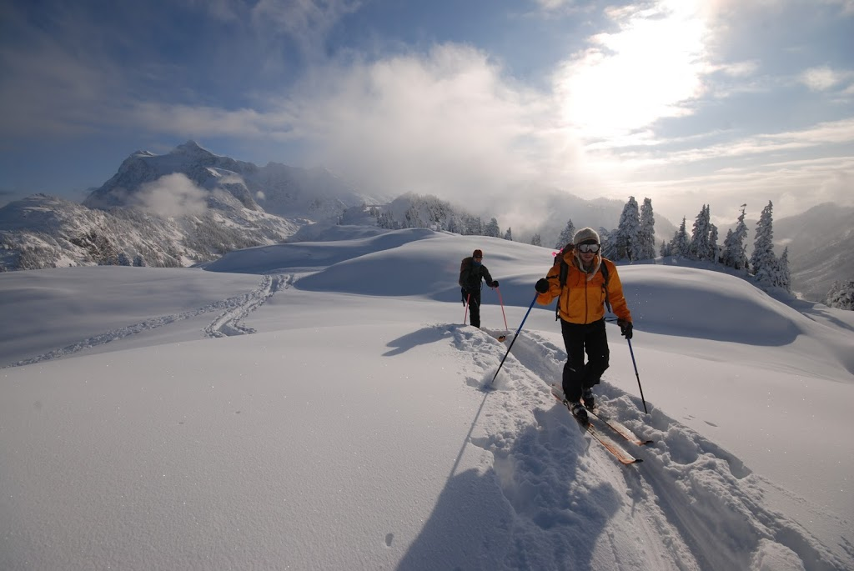

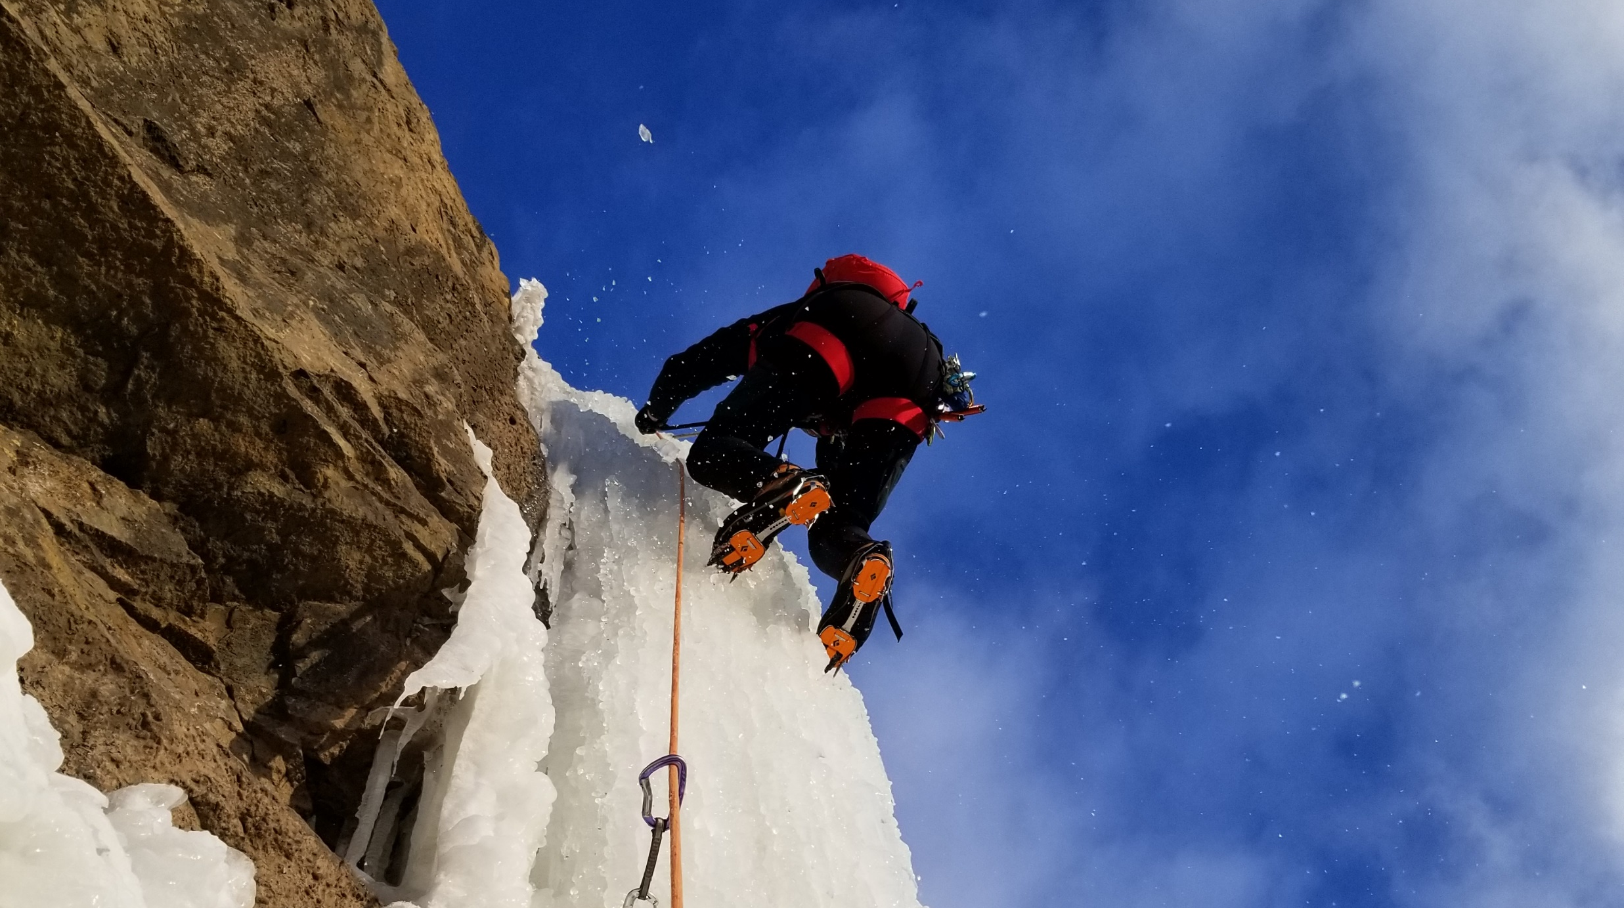
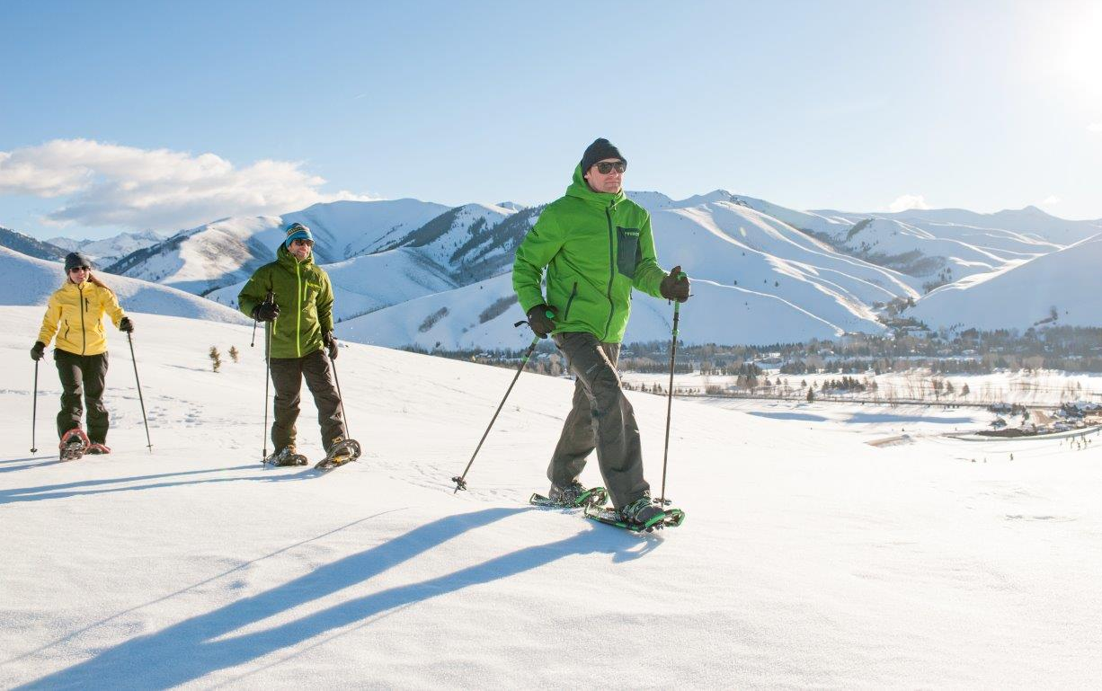


Help us to design avalanche bulletins that work better for you!

Slide 2
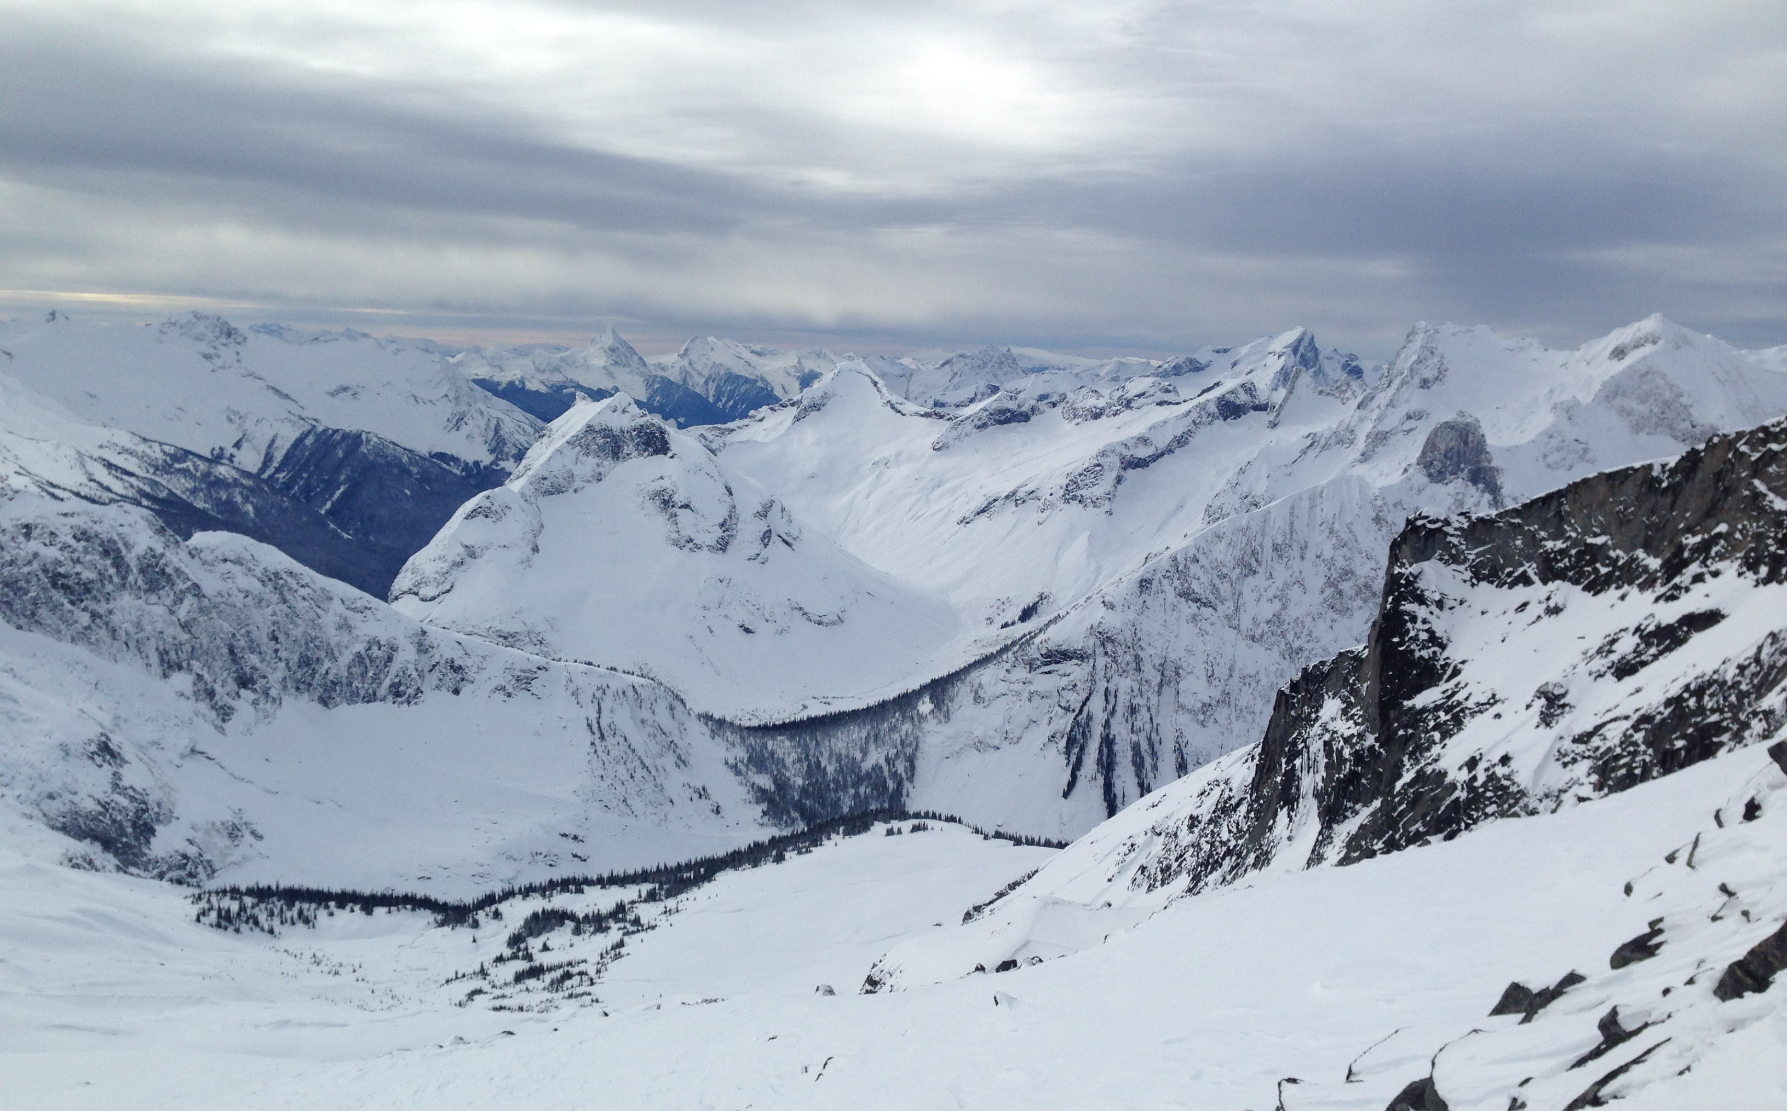
Please visit
avbulletin.avalancheresearch.ca
to sign up for our upcoming survey
We are interested in everybody’s perspective, even if you are just starting out, rarely go into the backcountry or do not use the avalanche bulletin much. We want to make the bulletin work for you!
Don’t be shy! Signing up just takes a minute!
Photo credits: Matt Gunn, Grant Statham & Ian Coble

