Slide 1

Prepared by Julia Kuznetsova
Analysis of Stephen King novels
May 2022

Slide 2
Scope of analysis
The analysis includes 63 novels written by Stephen Kings and published as of May 2022.
1974 Carrie 1975 'Salem's Lot 1977 The Shining 1977 Rage 1979 The Long Walk 1979 The Dead Zone 1980 Firestarter 1981 Roadwork 1981 Cujo 1982 The Running Man 1982 The Gunslinger 1983 Christine 1983 Pet Sematary 1983 Cycle of the Werewolf 1984 The Talisman 1984 The Eyes of the Dragon | 1984 Thinner 1986 It 1987 The Drawing of the Three 1987 Misery 1987 The Tommyknockers 1989 The Dark Half 1990 The Stand 1991 The Waste Lands 1991 Needful Things 1992 Gerald's Game 1992 Dolores Claiborne 1994 Insomnia 1995 Rose Madder 1996 The Green Mile 1996 Desperation 1996 The Regulators | 1997 Wizard and Glass 1998 Bag of Bones 1999 The Girl Who Loved Tom Gordon 2001 Dreamcatcher 2001 Black House 2002 From a Buick 8 2003 Wolves of the Calla 2004 Song of Susannah 2004 The Dark Tower 2005 The Colorado Kid 2006 Cell 2006 Lisey's Story 2007 Blaze 2008 Duma Key 2009 Under the Dome 2011 11/22/63 | 2012 The Wind Through the Keyhole 2013 Joyland 2013 Doctor Sleep 2014 Mr. Mercedes 2014 Revival 2015 Finders Keepers 2016 End of Watch 2017 Gwendy's Button Box 2017 Sleeping Beauties 2018 The Outsider 2018 Elevation 2019 The Institute 2021 Later 2021 Billy Summers 2022 Gwendy's Final Task

Slide 3
Method of comparison
63 novels were compared among themselves using TfidfVectorizer, a sklearn feature extraction tool that converts a collection of raw documents to a matrix of TF-IDF (term frequency — inverse document frequency) features.
TF-IDF is a measure of the originality (weight) of a word, in which the frequency of a word in a document is compared with the number of documents in which the word occurs. Only the frequency of words in a document is considered; while information about the relative position of words is ignored. For each pair of books, the result is a number from 0 (least similarity) to 1 (most similarity).

Slide 4
The most similar novels
All novels in pairs of very similar books (similarity ≥ 0.95) were written after 2009, except Bag of Bones.
 |  |  | Similarity
Pair 1 | End Of Watch (2016) | Finders Keepers (2015) | 0.966924
Pair 2 | Gwendy’s Button Box (2017) | Gwendy’s Final Task (2022) | 0.965771
Pair 3 | Joyland (2013) | Under The Dome (2009) | 0.964749
Pair 4 | Joyland (2013) | Revival (2014) | 0.956291
Pair 5 | Joyland (2013) | Bag Of Bones (1998) | 0.951275
Pair 6 | Joyland (2013) | The Outsider (2018) | 0.950588
Pair 7 | Revival (2014) | Under The Dome (2009) | 0.950219

Slide 5
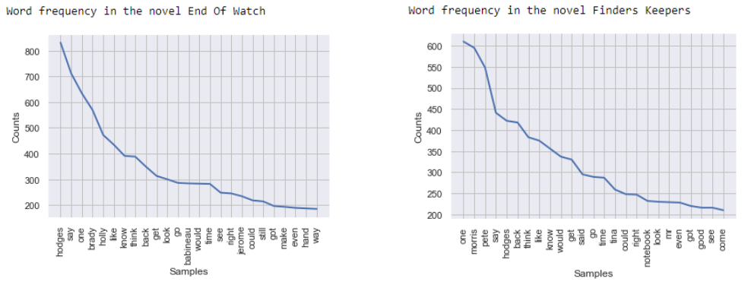
The most similar novels
End Of Watch and Finders Keepers are two parts of Bill Hodges trilogy. Thus, it should not come as a surprise that they are similar.

Slide 6
The most similar novels
Gwendy’s Final Task continues the Gwendy’s Button Box novel. It is also obvious that they can have similarity in terms of word frequency.
Joyland, however, is strongly similar to four novels, with which it is not in the same cycle: Bag Of Bones, Under The Dome, Revival, and Outsider. At the same time, the last three are also all similar to each other.

Slide 7
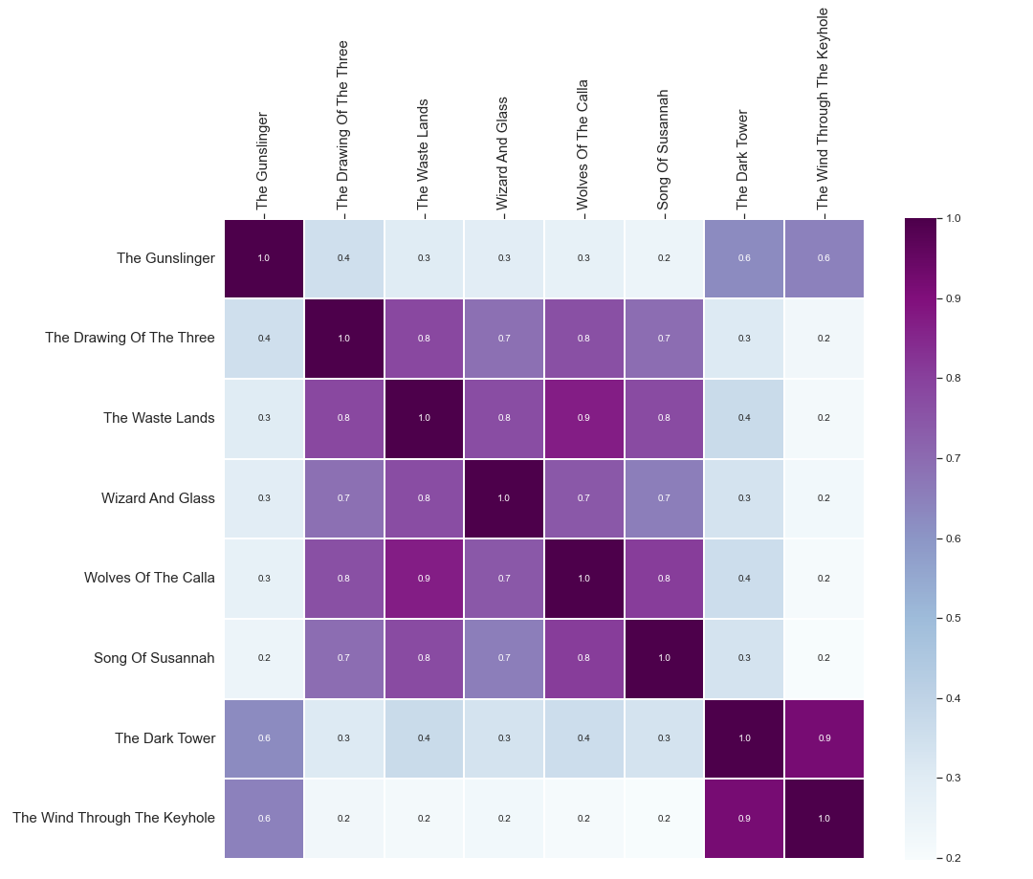
Similarity among The Dark Tower novels

Slide 8
Similarity among The Dark Tower novels
There are two groups of books:
The Drawing Of The Three, The Waste Lands, Wizard and Glass, Wolves Of The Calla, and Song of Susannah turned out to be quite similar to each other: their pairs have a degree of similarity of 0.7–0.9.
The Gunslinger, The Dark Tower, and The Wind Through The Keyhole stand apart: they are similar to each other, but are not like the rest of the books in the cycle. The Gunslinger is the very first novel in the cycle, The Dark Tower is the last, and The Wind Through the Keyhole was written after the completion of the main cycle, taking place between the end of the fourth and the beginning of the fifth books.

Slide 9
Novels written in co-authorship
Five novels were written in co-authorship:
The Talisman (1984, with Peter Straub)
Black House (2001, with Peter Straub)
Gwendy’s Button Box (2017, with Richard Chizmar)
Sleeping Beauties (2017, with Owen King)
Gwendy’s Final Task (2022, with Richard Chizmar)
Similarity analysis has shown that:
The Talisman and Black House are different from other Stephen King books (similarity < 0.5)
Both Gwendy novels are very similar between each other (similarity = 0.96)
Sleeping Beauties wording looks very similar (≥ 0.85) to a variety of Stephen King books

Slide 10
Novels similar to Sleeping Beauties
The following novels are similar to Sleeping Beauties (similarity ≥ 0.85):
Joyland (2013) | 0.949744 | The Wind Through The Keyhole (2012) | 0.914879
Under The Dome (2009) | 0.945271 | The Colorado Kid (2005) | 0.913519
Revival (2014) | 0.938211 | Cell (2006) | 0.913498
The Outsider (2018) | 0.935828 | Billy Summers (2021) | 0.911454
Bag Of Bones (1998) | 0.933672 | The Regulators (1996) | 0.910473
Needful Things (1991) | 0.928754 | The Dark Tower (2004) | 0.910413
Later (2021) | 0.928649 | Elevation (2018) | 0.907241
Duma Key (2008) | 0.928171 | Blaze (2007) | 0.895995
Doctor Sleep (2013) | 0.923030 | Mr Mercedes (2014) | 0.887420
The Institute (2019) | 0.916117 | Insomnia (1994) | 0.874596

Slide 11
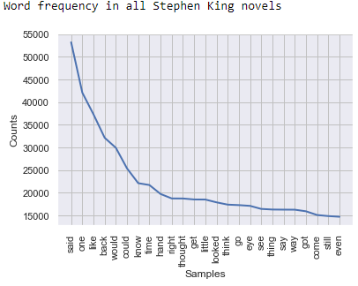
Word frequency in all Stephen King novels

Slide 12
Contacts
GITHUB: github.com/kooznitsa
EMAIL: jukuznetswork@gmail.com

