Slide 1

SPANISH RED WINE ANALYSIS
April 2022
Made by Julia Kuznetsova

Slide 2
ABOUT DATA
Scope of analysis: 2017 Spanish red wines, all prices, all ratings
Data source: Vivino.com
User IP: Netherlands
Period: April 2022

Slide 3
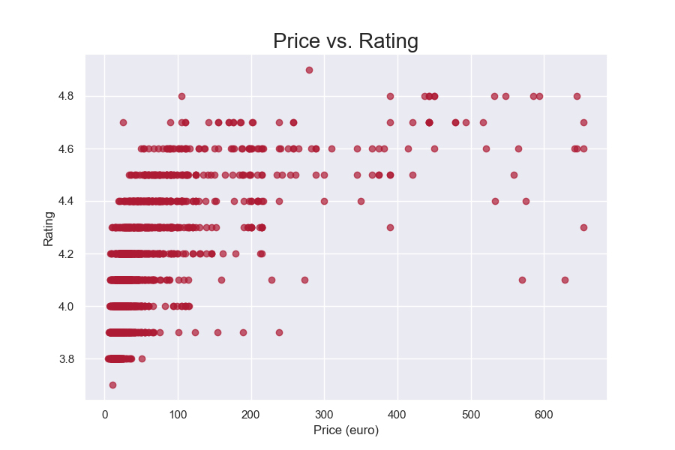
PRICE/RATING CORRELATION

Slide 4
PRICE/RATING CORRELATION
There is strong positive correlation (r = 0.76) between price and rating
Top-100 wines with the highest prices have a median rating of 4.6
Top-100 wines with the lowest prices have a median rating of 3.9
Top-100 wines with the highest ratings have a median price of € 440.14
Top-100 wines with the lowest ratings have a median price of € 14.30

Slide 5
PRICE/YEAR CORRELATION
The overall price/year correlation is weak (−0.49)
Top-100 oldest wines have a median price of € 197.44
Top-100 youngest wines have a median price of € 15.10
Top-100 wines with the highest prices are older: 2007 is the median year
Top-100 wines with the lowest prices are younger: 2018 is the median year

Slide 6
BEST-VALUE WINES: CRITERIA
Price: less than median* (under € 30)
Rating: more than median* (4.1)
Number of ratings*: more than median* (227)
Body: 4–5
Alcohol: 14.5 or less
* Based on the median values of all Spanish red wines (2017 entries)

Slide 7
ANNEXES
List of best-value wines: best_value_wines.html

Slide 8
CONTACTS
GITHUB: github.com/kooznitsa
EMAIL: jukuznetswork@gmail.com

