Slide 1
System Usability Scale (SUS)
Overview and Sample Instrument

Slide 2
What is the System Usability Scale (SUS)?
• A standardized 10-item questionnaire for assessing usability.
• Developed by John Brooke (1986) at Digital Equipment Corporation.
• Applicable to websites, apps, hardware, and digital systems.
• Produces a score from 0 to 100 (higher = better usability).

Slide 3
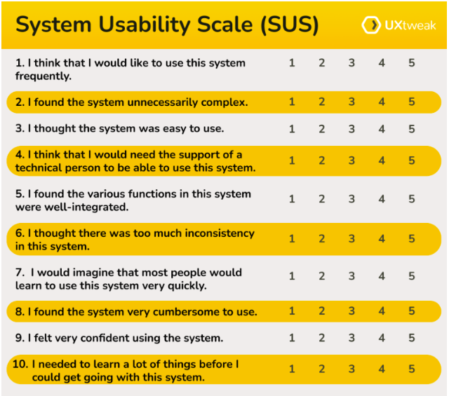
SUS Sample Questionnaire
Rate each statement from 1 (Strongly Disagree) to 5 (Strongly Agree):

Slide 4
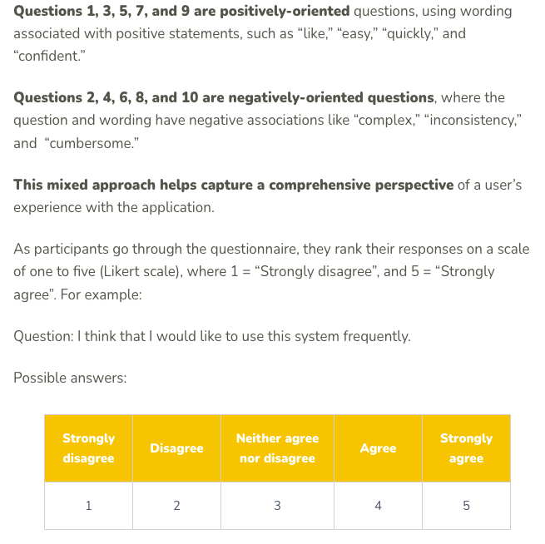

Slide 5
How to Score the SUS
For odd-numbered items: subtract 1 from the score.
For even-numbered items: subtract the score from 5.
Sum the adjusted scores for all 10 items (0–40 range).
Multiply the total by 2.5 to obtain a score between 0–100.
nterpretation: higher = better usability (68 is average).

Slide 6
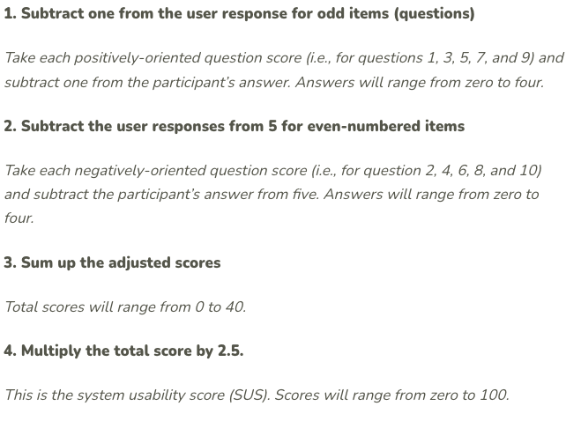
How to Score the SUS

Slide 7
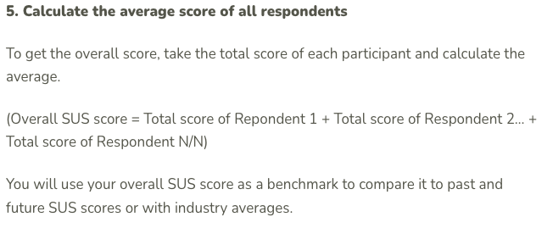

Slide 8
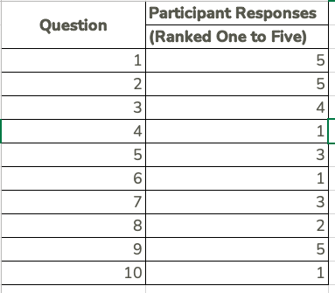

Slide 9
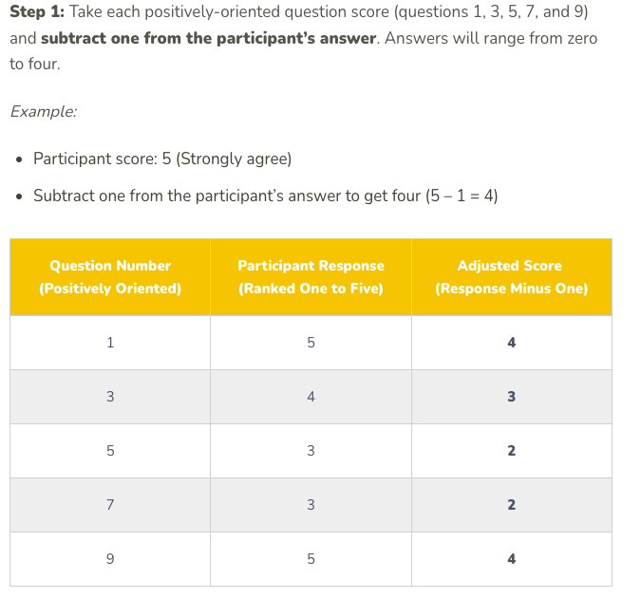

Slide 10
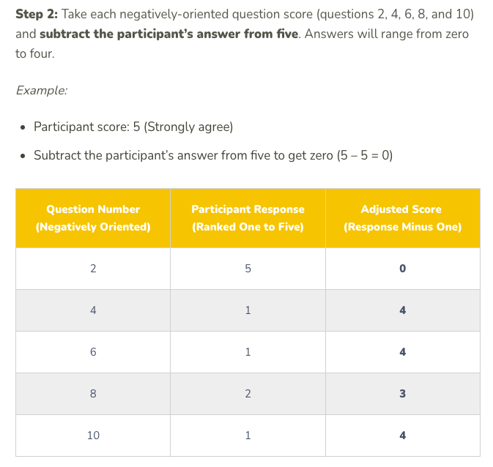

Slide 11
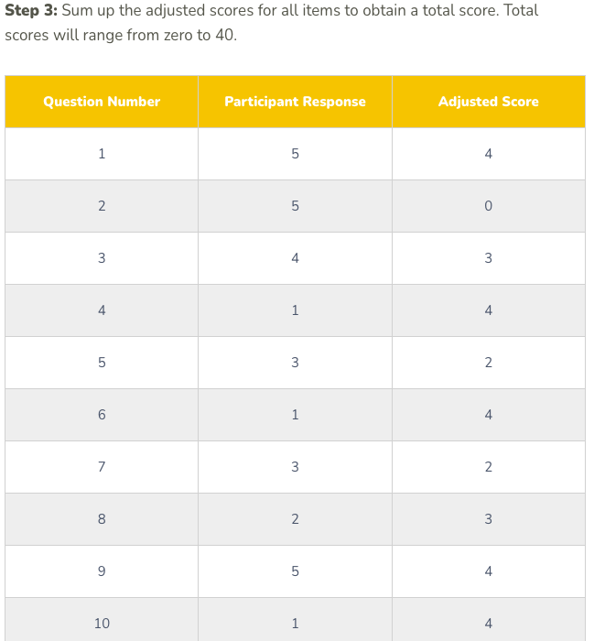

Slide 12
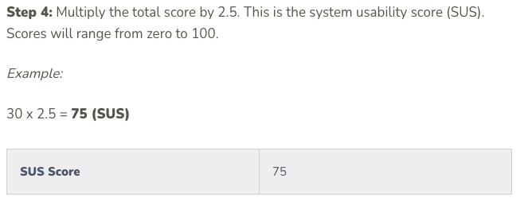

Slide 13
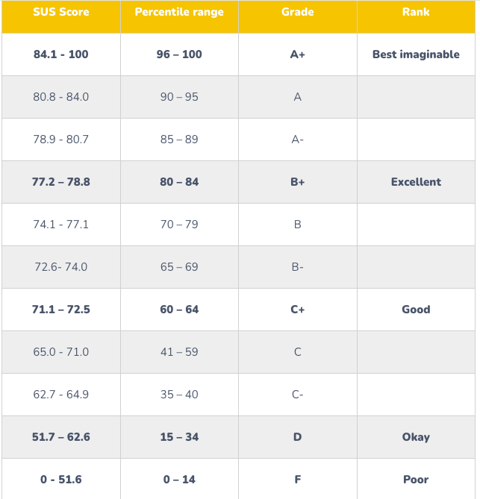
Interpreting SUS Scores

Slide 14
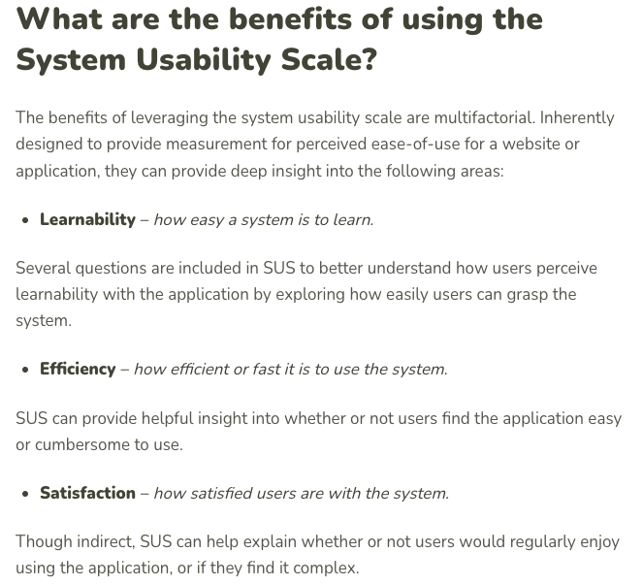

Slide 15
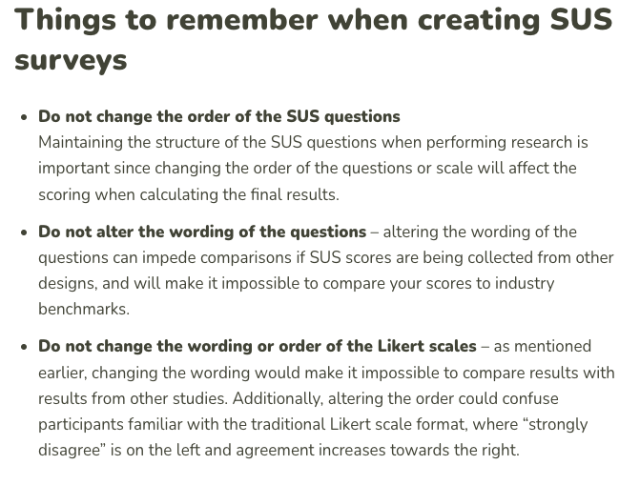

Slide 16
Tips for Using SUS
• Administer after users interact with the system.
• Maintain the original wording of questions for consistency.
• Combine with qualitative feedback for richer insights.

