Slide 1
기본 프로그래밍 04
자바에 삼 주만 빠져보자!
데이터융합SW과
김규석 교수
JAVA

Slide 2
Objective
Method
Calling a Method from the Same Class
Parameter
Declaring a static final variable
Returning a Value
Overloading
Recursive Function

Slide 3
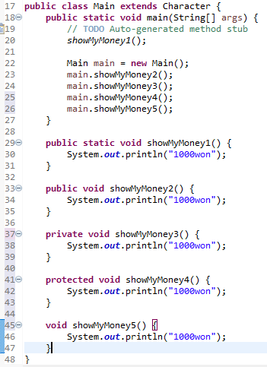
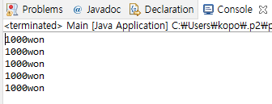
Method(Cont’d)
Calling a Method from the Same Class
A method is called in different ways as below
Keyword of Static and Access Modifiers

Slide 4
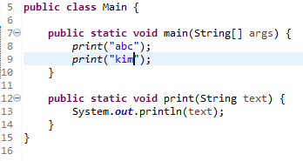
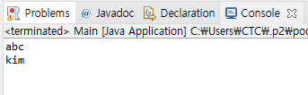
Method(Cont’d)
Method and Parameter
A method is a block code which runs when it is called.
Parameter
: Information can be passed to methods by this
Q1* : Explain the meaning of the 12nd line

Slide 5
P1
Printing a Name
User selects a number for a family member
Print the name of the family member
The program should include the following function
public void addition(int familyMember)
#Printing a Name
Father
Mother
Son
Daughter
-> 3
John

Slide 6
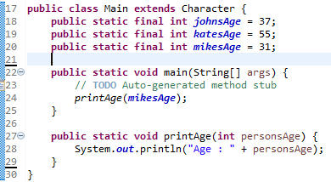

Method(Cont’d)
Declaring a static final Variable
A static final variable can’t be changed
P2 : Try changing the values for the static final variables in main function

Slide 7
P3
Printing a Name II
User selects a number for a family member
Print the name of the family member
The program should declare the static final variables for the names and include the function containing a parameter to print the name
#Printing a Name
Father
Mother
Son
Daughter
-> 3
John

Slide 8
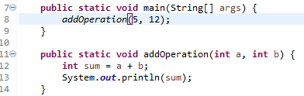

Method(Cont’d)
Multiple Parameters
Parameters can be separated by comma
Multiple Parameters

Slide 9
P4
Calculator
User inputs a formula including only one operator
The program calculates the formula by using the following 4 of functions
1) public static void addition(double num1, double num2)
2) public static void subtraction(double num1, double num2)
3) public static void multiplication(double num1, double num2)
4) public static void division(double num1, double num2)
3*7
21
6+9
15

Slide 10
P5
Multiplication Table
User inputs a number N
Print the N times table
(Use a separate method to print the N times table with a parameter)

Slide 11
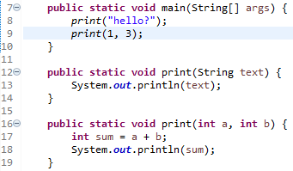

Method(Cont’d)
Overloading
A feature that allows a class to have many methods having the same name
The parameters are different from one another

Slide 12
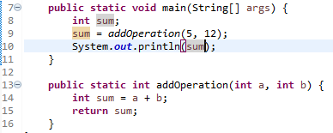
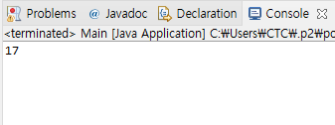
Method
Returning a Value
A method returns a value when reaching to a return statement, throwing an exception or completing all the statements in the method
Return Type
Return Value

Slide 13
P6
Calculator
User inputs a formula including only one operator
The program calculates the formula by using the following 5 of functions
1) public static double addition(double num1, double num2)
2) public static double subtraction(double num1, double num2)
3) public static double multiplication(double num1, double num2)
4) public static double division(double num1, double num2)
5) public static char getOperator(String formula)
3*7
21
6+9
15

Slide 14
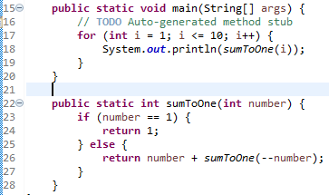
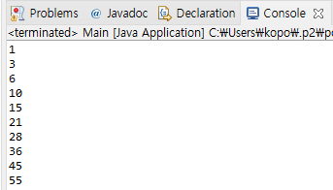
Recursive Function
Recursive Function
A function which calls itself

Slide 15
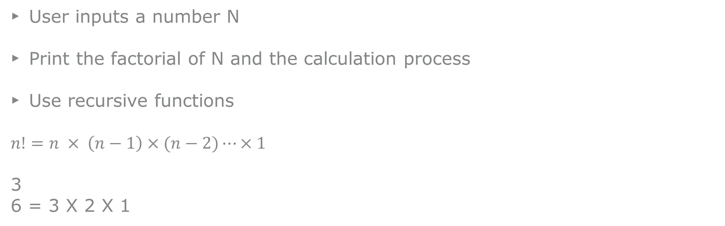
P7
Factorial
User inputs a number N
Print the factorial of N and the calculation process
Use recursive functions
$n!=n × \left(n−1\right)×(n−2)⋯×1$
3
6 = 3 X 2 X 1

Slide 16
A1
Program to Calculate the Probabilities
User inputs the numbers N and M
Print all the cases when the sum is M when throwing N of dice
2
6
(1, 5)
(2, 4)
(3, 3)
(4, 2)
(5, 1)

Slide 17
A2
Banking System
This program runs indefinitely until the user tries terminating it
#Menu
Deposit
Withdrawal
Balance : 0
-> 1
10000
#Menu
Deposit
Withdrawal
Balance : 10000
-> 2
2000
#Menu
Deposit
Withdrawal
Balance : 8000

Slide 18
A3
Program to Calculate the Sum of Multiples of N
User inputs the two numbers for the M and N respectively
Calculate the sum of multiples of N from 1 to M
20
5
SUM : 50(5, 10, 15, 20)

Slide 19
A4
Encryption and Decryption
Create your own encryption algorithm
e.g., a->b, b->c, c->d, d->e
#Menu
Encryption
Decryption
-> school
Result : tdippm
2. Encryption
3. Decryption
-> tdippm
Result : school

Slide 20
A5
Data Confirmation
Set up your conditions
The number of conditions should be at least 5
e.g.,
#1 : The string length should be over 10
#2 : The string should contains the character ‘k’
….
-> abdefewqqwer
FAIL
-> kdefkdie123
PASS

Slide 21
A6
Compose a program with the conditions below
Use your smartphone and compose the program on the web
Compose a program counting the number of consonants and vowels
This program should operate dynamically according to the user’s input string
This is an apple
Num. of Consonant : 8
Num. of Vowels : 5
I am fine
Num. of Consonant : 3
Num. of Vowels : 4

Slide 22
A7
Grade Calculator
User inputs a number(number of subjects)
User inputs the unit for each subject
User inputs the grade for each subject(A+, A0, B+, … ,F)
*Prints the average grade using Float data type
3
2
3
3
A+
B+
C0
3.1875

Slide 23
A8
Encoding and Decoding Program
Prints a menu
User chooses the menu
The encoder and decoder follow the rules below.
0123456789
abcdefghij
#Menu
Encoder
Decoder
Exit
1
01012345678
ababcdefghi
2
add
033

Slide 24
A9
Time Calculator
User inputs the two time information
Print the calculated time interval between them in seconds
163227
163558
211s

Slide 25
A10
Comparing the two strings
User inputs the two strings
Show the result if those two strings are the same after relocation
[Example]
abcdefg
fgdceba
Yes
Abbbccd
Bbbccda
No
Abc
cbA
Yes

Slide 26
A11
Comparing the velocities in different units
User inputs the three values
Each is m/s, km/h, m/ms in order
Comparing the values and print the quickest one
[Example]
190
780
0.19
780km/h

