Slide 1
Assignment 3/Mini-project
Deadline: March 20, GROUP SIZE - 1 or 2 or 3
Visual Recognition

Slide 2
Assignment 3a (7 marks)
Play with CNNs
CIFAR-10 dataset
AlexNet has 5 Conv and 3 FC layers
Play with a medium deep network with atleast 2 conv and 2 FC layers.
Metrics: training time and classification performance
Compare ReLU vs tanh vs sigmoid
With and without momentum, adaptive learning rates
Finally: what would be your recommended architecture..

Slide 3
Assignment 3b (3 marks)
CNN as a feature extracter
Pick your favourite object recognition dataset, other than CIFAR/MNIST
Use Alexnet/any deep NN as a feature extracter (extract last layer as features), use any model on top and report the classification accuracies
Report accuracies for Bike vs Horses dataset also

Slide 4
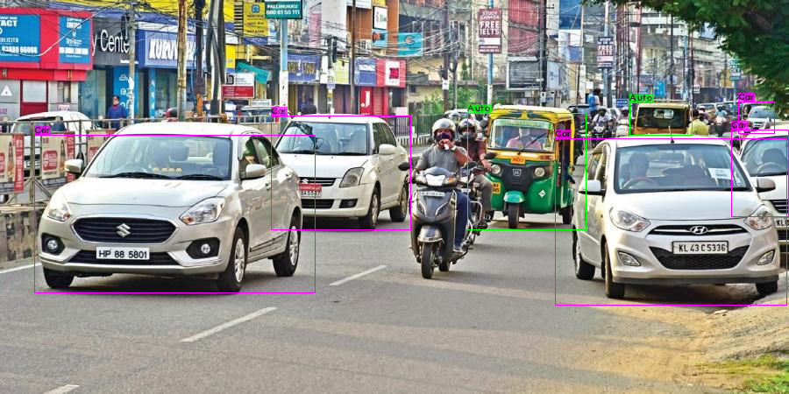
Assignment 3c (10 marks)
Auto detection
Build an “auto” detector using Faster RCNN/YOLO based methods (one of the above)
We will give you some auto image data as a starting point, feel free to add or use any other data, or annotate this data (notes folder)
Document where the method works well or fails
March 23, 4 PM: VIVA for randomly selected students, everyone should be ready for a call

