Slide 1
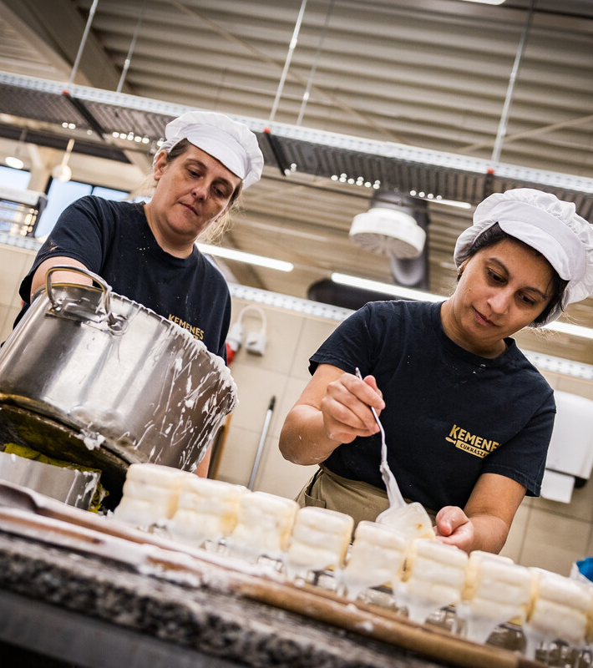
Lindström Group x Since AI Hacakthon
Angad Roy, 06.11.2026

Slide 2
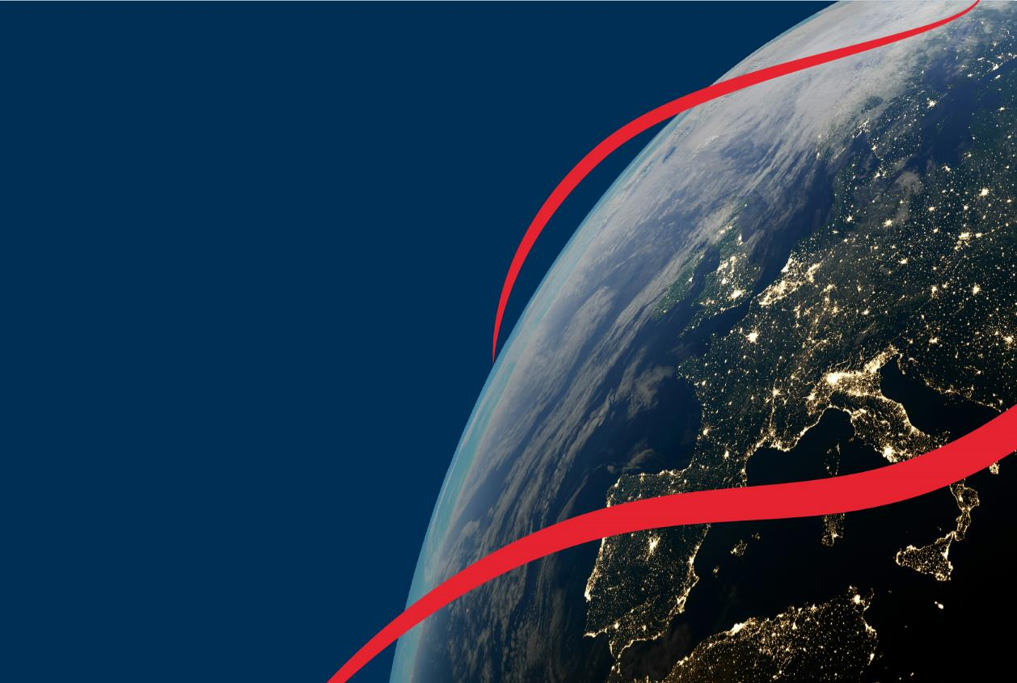

Established in
1848
Operations in
EUROPE:
Austria
Bulgaria
Croatia
Czech Republic Estonia
Finland
Germany
Hungary
Latvia
Lithuania
Poland
Romania
Serbia
Slovakia
Slovenia
Sweden
Türkiye
Ukraine
United Kingdom
ASIA:
China
India
Kazakhstan
South Korea
Vietnam
Lindström in a nutshell
87,000
customers
184,000
delivery points
5,100 employees
24
countries
We are a family-owned textile rental company with a business model based on circular economy principles.
Our purpose
We care for people and our planet by inspiring people to shine and businesses to grow in a sustainable way.
21.4M
pieces of textiles in circulation*
542 M€
Turnover
*figure does not include hotel and healthcare linen
Notes:
Lindström is a Finnish family-owned company founded in 1848.
We provide textile rental and maintenance services. Depending on the country, that can include workwear, entrance mats, professional cleaning textiles, cleanroom textiles, and other textile services.
The important word for today is not textile. It is service. We do not simply sell a garment and disappear. We manage textiles as part of an ongoing service.
Why does using textiles as a service matter for the circular economy? Let us compare two systems.

Slide 3




Design
and supply
2. Washing and maintenance
Carefree solution​
360º
turnkey
service
Businesses can focus on their core business as we take care of their textile needs from supply to washing, maintenance and recycling
We are a responsible local operator in every location we provide services.
4. Recycling and disposal
3. Delivery
and storage
Notes:
Think of this a little like a library. You have access to something useful, but an organisation manages the system around it.
In a textile rental service, Lindström supplies the textiles, collects them after use, washes and maintains them, delivers them again, repairs them when appropriate, and manages their end of life.
Different services work in different ways, but the central idea is that responsibility does not end after the product has been supplied. AND THE LONGER THE PRODUCTS LAST IN LIFECYCLE = MORE PROFIT; UNLIKE LINEAR MODEL WHERE YOU NEED TO SELL MORE AND MORE TO INCREASE PROFIT. OVERCONSUMPTION IS A BIG CHALLENGE FOR OUR PLANET TODAY
The service connects the product, the user, maintenance, logistics, and end-of-life decisions.

Slide 4
From linear to a circular use
Disposable
Towel
Disposable
Towel
Take
Make
Use
Waste
Reusable
Cotton Towel
Take
Make
Use
Reuse
Recycle
Notes:
A traditional linear economy is often described as take, make and waste. We take resources, manufacture a product, use it, and eventually discard it.
A circular economy asks different questions. Can the product be designed to last longer? Can it be maintained? Can it be repaired? Can it be used by another person? When it can no longer be used, can the material become a resource again?
Recycling is important, but it is not the entire circular economy. It is one of the later options. First, we try to avoid unnecessary production and keep existing products useful.
Ask: What is another product that could be offered as a service rather than something everyone has to own?
Disposable Towel
The raw material (e.g. wood) needs to be harvested and processed in large scale industrial process which consumes, chemicals, water and energy.
Wood as raw material is renewable, but it takes a long time (decades) to renew.
Disposable towels also need several steps of transportation until the raw material actually is produced as a towel (raw material to the mill, processed raw material to manufacturer, transportation for other needed compounds like chemicals)
Often the towels are first transported to local warehouse or to supplier’s warehouse for dispatching to the customer.
Produces waste which means that also trash bins and liners need to be bought.
Needs at least two separate transportation rounds – The delivery of the unused towels and the waste pickup
More about Disposable towels:
https://en.wikipedia.org/wiki/Tissue_paper#Paper_towels
Reusable Cotton Towel
The raw material (cotton) needs to be harvested and processed in industrial process which also consumes some chemicals and some water and energy.
Cotton as a raw material is also renewable, growing cotton takes approx. 5-7months/harvest.
Cotton farming consumes quite a lot of water. But as the cotton raw material is first used and reused some 100 times in a form of a cotton towel roll, and then at EOL stage, the cotton material is recycled -- As result of the circular life cycle model, the water used during the growing period of the cotton raw material is highly compensated as is stated on a Linear, reuse or recycling? An environmental comparison of different life cycle options for cotton roller towels- study conducted by SYKE. *1).
Cotton has a very high capability to absorb moisture, up to some 25% of its weight.
Cotton also has high resistance for mechanical wear and tear, and it also endures high washing temperatures which makes it a very good material for reusable roll towel.
Cotton towel roll is used and re-used some 100 times during its lifecycle, generating some 11 000 hand dryings. At the End-Of-Life the Cotton roll is then recycled to be reused as cotton raw material for textile industry or repurposing the towel to disposable industrial wipes. –No waste to landfills is generated and the cotton material is recycled to have at lest one more life.
88,7% of the EOL cotton towel rolls were recycled in 2023 and we aim to 100% by the year 2025.
Cotton towels rolls are delivered and picked-up with other Lindström products on optimized delivery routes.
*1): https://www.sciencedirect.com/science/article/pii/S095965262203548X
More about cotton:
https://en.wikipedia.org/wiki/Cotton
https://www.stjm.fi/tekstiilikuidut/puuvilla/

Slide 5
Circular business model
2. Less textile waste thanks to on-demand production
4. Washed with efficient use of water and energy
1. Designed for a maximum life
5. Delivered
with optimum
loads and routes
Less textiles
Saved resources
3. Repaired & reused for longer service life
6. Recycled to create new
Notes:
Here we can see the different parts of the circular business model together.
First, products should be designed for a long life. Production should respond to real needs to avoid unnecessary stock. During use, products are collected, washed, maintained, and returned. If something is damaged, the first question should be whether it can be repaired and safely reused. Deliveries and collections also need to be planned. Finally, when the product is no longer usable, recycling may allow some of the material to remain in circulation.
Notice how much must happen before recycling. Circularity begins with design and continues through the whole service.
Key line
The goal is not to move a product through the circle as quickly as possible. The goal is to keep it useful for as long as it remains suitable for use.

Slide 6
Designed for a maximum life
PRODUCT DURABILITY
MINIMAL WASTE DESIGNS
REUSABILITY
EASE OF
REPAIRING
EMOTIONAL DURABILITY
DESIGN FOR CIRCULARITY
DESIGNED OF MAXIMUM LIFE & MINIMAL WASTE
Notes:
Circular economy starts before the garment exists. A designer needs to understand how the garment will be used, where it is likely to wear out, whether it can be adjusted for different users, and whether it can be repaired.
For example, high-wear areas can be reinforced. A product can be constructed so that damaged parts are easier to repair. Adjustable features may make it suitable for more than one user. Pattern design can also help reduce cutting waste during manufacturing.
This shows that sustainability is also a design and engineering challenge.
Career connection
Circular products need many kinds of professionals. They need designers, textile specialists, engineers, buyers, data specialists, laundry teams, repair teams, logistics planners, recyclers, communicators, and sustainability specialists.

Slide 7
SINCE AI HACKATHON 2026
Customer Value
& Future Review
THE NORTH-STAR QUESTION
What value did the customer receive?
What matters most now?
What should we improve or explore together next?
Build trust with evidence of value created, then plan the next chapter together.
LINDSTRÖM GROUP
Notes:
[Sources]
Visual Roadmap for 2026 Initiatives.page.
[/Sources]
[Speaker notes]
Open by framing the challenge as a customer conversation tool, not simply a sustainability dashboard.

Slide 8
SINCE AI HACKATHON 2026
THE BUSINESS BEHIND THE DATA
Lindström’s circular service model
Each service stage creates data that could demonstrate customer value.
1
2
3
4
5
›
›
›
›
Textiles in use
Collection & laundry
Repair & continued use
Delivery & service
End-of-life
Wearers, sites, products and garments in circulation
Scans, washed kilograms, water, energy and service cycles
Repairs, continued use and postponed replacement
Turnaround, delivery and service performance
Reuse, recycling, recovery and waste treatment
Hackathon question: How can we turn this operational data into a meaningful Customer Value & Future Review?
LINDSTRÖM GROUP
Notes:
[Sources]
Visual Roadmap for 2026 Initiatives.page.
[/Sources]
[Speaker notes]
Explain Lindström as a managed circular textile service. Builders need this context to understand why the data sources belong together.

Slide 9
SINCE AI HACKATHON 2026
THE CUSTOMER MOMENT
One experience for three strategic conversations
Annual review, steering committee and future workshop.
BEFORE THE MEETING
DURING THE MEETING
MOVING FORWARD
The KAM selects the customer and enters the meeting agenda, account context and priorities.
The customer sees consolidated evidence of service, operational, financial and sustainability value.
AI highlights opportunities, industry-relevant themes and questions for joint planning.
LINDSTRÖM GROUP
Notes:
[Sources]
Visual Roadmap for 2026 Initiatives.page.
Organizational Change Management tools and templates.pptx.
[/Sources]
[Speaker notes]
The meeting type changes the emphasis, but the trusted data foundation remains common.

Slide 10
SINCE AI HACKATHON 2026
BALANCED BY DESIGN
65% evidence and value | 35% future planning
The future conversation comes after proving value and building trust.
1
2
3
4
5
LOOK BACK
SHOW VALUE
BUILD TRUST
LOOK FORWARD
AGREE ACTIONS
›
›
›
›
Service, usage and performance
Operational, financial and sustainability value
Customer-specific evidence and transparent assumptions
Industry trends, opportunities and future questions
Priorities, owners and next steps
LINDSTRÖM GROUP
Notes:
[Sources]
Visual Roadmap for 2026 Initiatives.page.
1014 Lindström Project Management Handbook.pptx.
[/Sources]
[Speaker notes]
Stress that the purpose is to strengthen the relationship through evidence before moving into future planning.

Slide 11
SINCE AI HACKATHON 2026
PERSONALIZATION MODEL
80% common structure. 20% intelligent personalization.
Same trusted data foundation, different customer story.
COMMON FOUNDATION
PERSONALIZED EMPHASIS
• Active users and delivery sites
• Garments in circulation and utilization
• Service cycles and repair activity
• Footprint and circularity handprint
• Customer roll-up and site/product drill-down
• KAM-entered agenda and account context
• Customer priorities: cost, water, emissions, circularity or service
• Industry-aware themes
• User prompts and follow-up questions
• AI observations and future-workshop prompts
The KAM can override industry defaults.
LINDSTRÖM GROUP
Notes:
[Sources]
Visual Roadmap for 2026 Initiatives.page.
Organizational Change Management tools and templates.pptx.
[/Sources]
[Speaker notes]
Give examples: Food may prioritize water, hygiene and continuity; Manufacturing may prioritize utilization, repair and cost.

Slide 12
SINCE AI HACKATHON 2026
THREE-DAY BUILD
What the team should prototype
A convincing end-to-end experience, not a full production platform.
1
2
3
4
INPUT
CONSOLIDATE
GENERATE
EXPORT
Customer, agenda, priorities and comparison baseline
Multi-site data with customer roll-up and site/product drill-down
Value review, AI observations and recommended actions
Interactive dashboard plus customer-ready PowerPoint/PDF
SUCCESS = the prototype communicates customer value and creates a better strategic discussion.
LINDSTRÖM GROUP
Notes:
[Sources]
1014 Lindström Project Management Handbook.pptx.
Visual Roadmap for 2026 Initiatives.page.
[/Sources]
[Speaker notes]
Keep scope disciplined. The prototype should prove user value and identify future data needs.

Slide 13
SINCE AI HACKATHON 2026
DATA READINESS
The synthetic pack is sufficient for the hackathon
Use the available data to prove the concept; expose missing production data as an output.
AVAILABLE TO BUILD
BOUNDARIES TO KEEP VISIBLE
• Fictional multi-site customers and industries
• Sites, laundries, products and join keys
• Wearers, garment allocation, washing and service cycles
• Repairs, laundry resources and waste treatment
• Footprint/handprint baselines and assumptions
• Prompts, data-quality flags and sample outputs
• Customer hierarchy is synthetic
• Cost/time savings need stronger evidence
• Industry trends and regulation need curated sources
• Service-request detail may need another synthetic table
• All claims remain synthetic, allocated or estimated
LINDSTRÖM GROUP
Notes:
[Sources]
1014 Lindström Project Management Handbook.pptx.
Synthetic pack derived from Lindström report structures supplied by Roy Angad.
[/Sources]
[Speaker notes]
The data is sufficient for three days. Missing production data should become a data-readiness finding, not a blocker.

